Slide 1
Cookbook.com
Revature Group 1 - Project 2

Slide 2
Project Overview: Description
A website that users can look up recipes for meals on, and if they create an account can save recipes for later. They can look up specific recipes by keyword, or they can click a button that presents them a random recipe. Recipe information includes the name of the recipe, ingredients required, steps required and a small picture accompanying it. Users that are logged on may also like other recipes, add recipes to their cookbooks and follow other users or cookbooks. Users may also create their own recipes.

Slide 3
Project Overview: User Stories
As an anonymous user, I want to be able to…
  Search for recipes (optionally by ingredient, type, area, prep time)
  Look up random recipes
As a logged in user, I want to be able to...
  Save meals to my account
  Create my own recipe
  Follow other users
  Leave a review on other recipes

Slide 4
Project Overview: MVP
Searching recipes with optional filters
Creating and storing users
  Register yourself as a new user
  Login
  Usernames should be hashed
  Passwords should be salted and hashed
Random meal button

Slide 5
Project Overview: MVP Cont.
When showing recipes
  Show thumbnail of meal
  Show ingredients included
  Show steps in recipe
Ability for users to create different “cookbooks”
Ability for users to add recipes to their “cookbooks”

Slide 6
Project Overview: Stretch Goals
Users can like recipes
Ability for users to follow other users
Ability for users to follow different “cookbooks”
Users can leave a review for recipes
Ability for users to download recipes
Ability for users to create new recipes

Slide 7
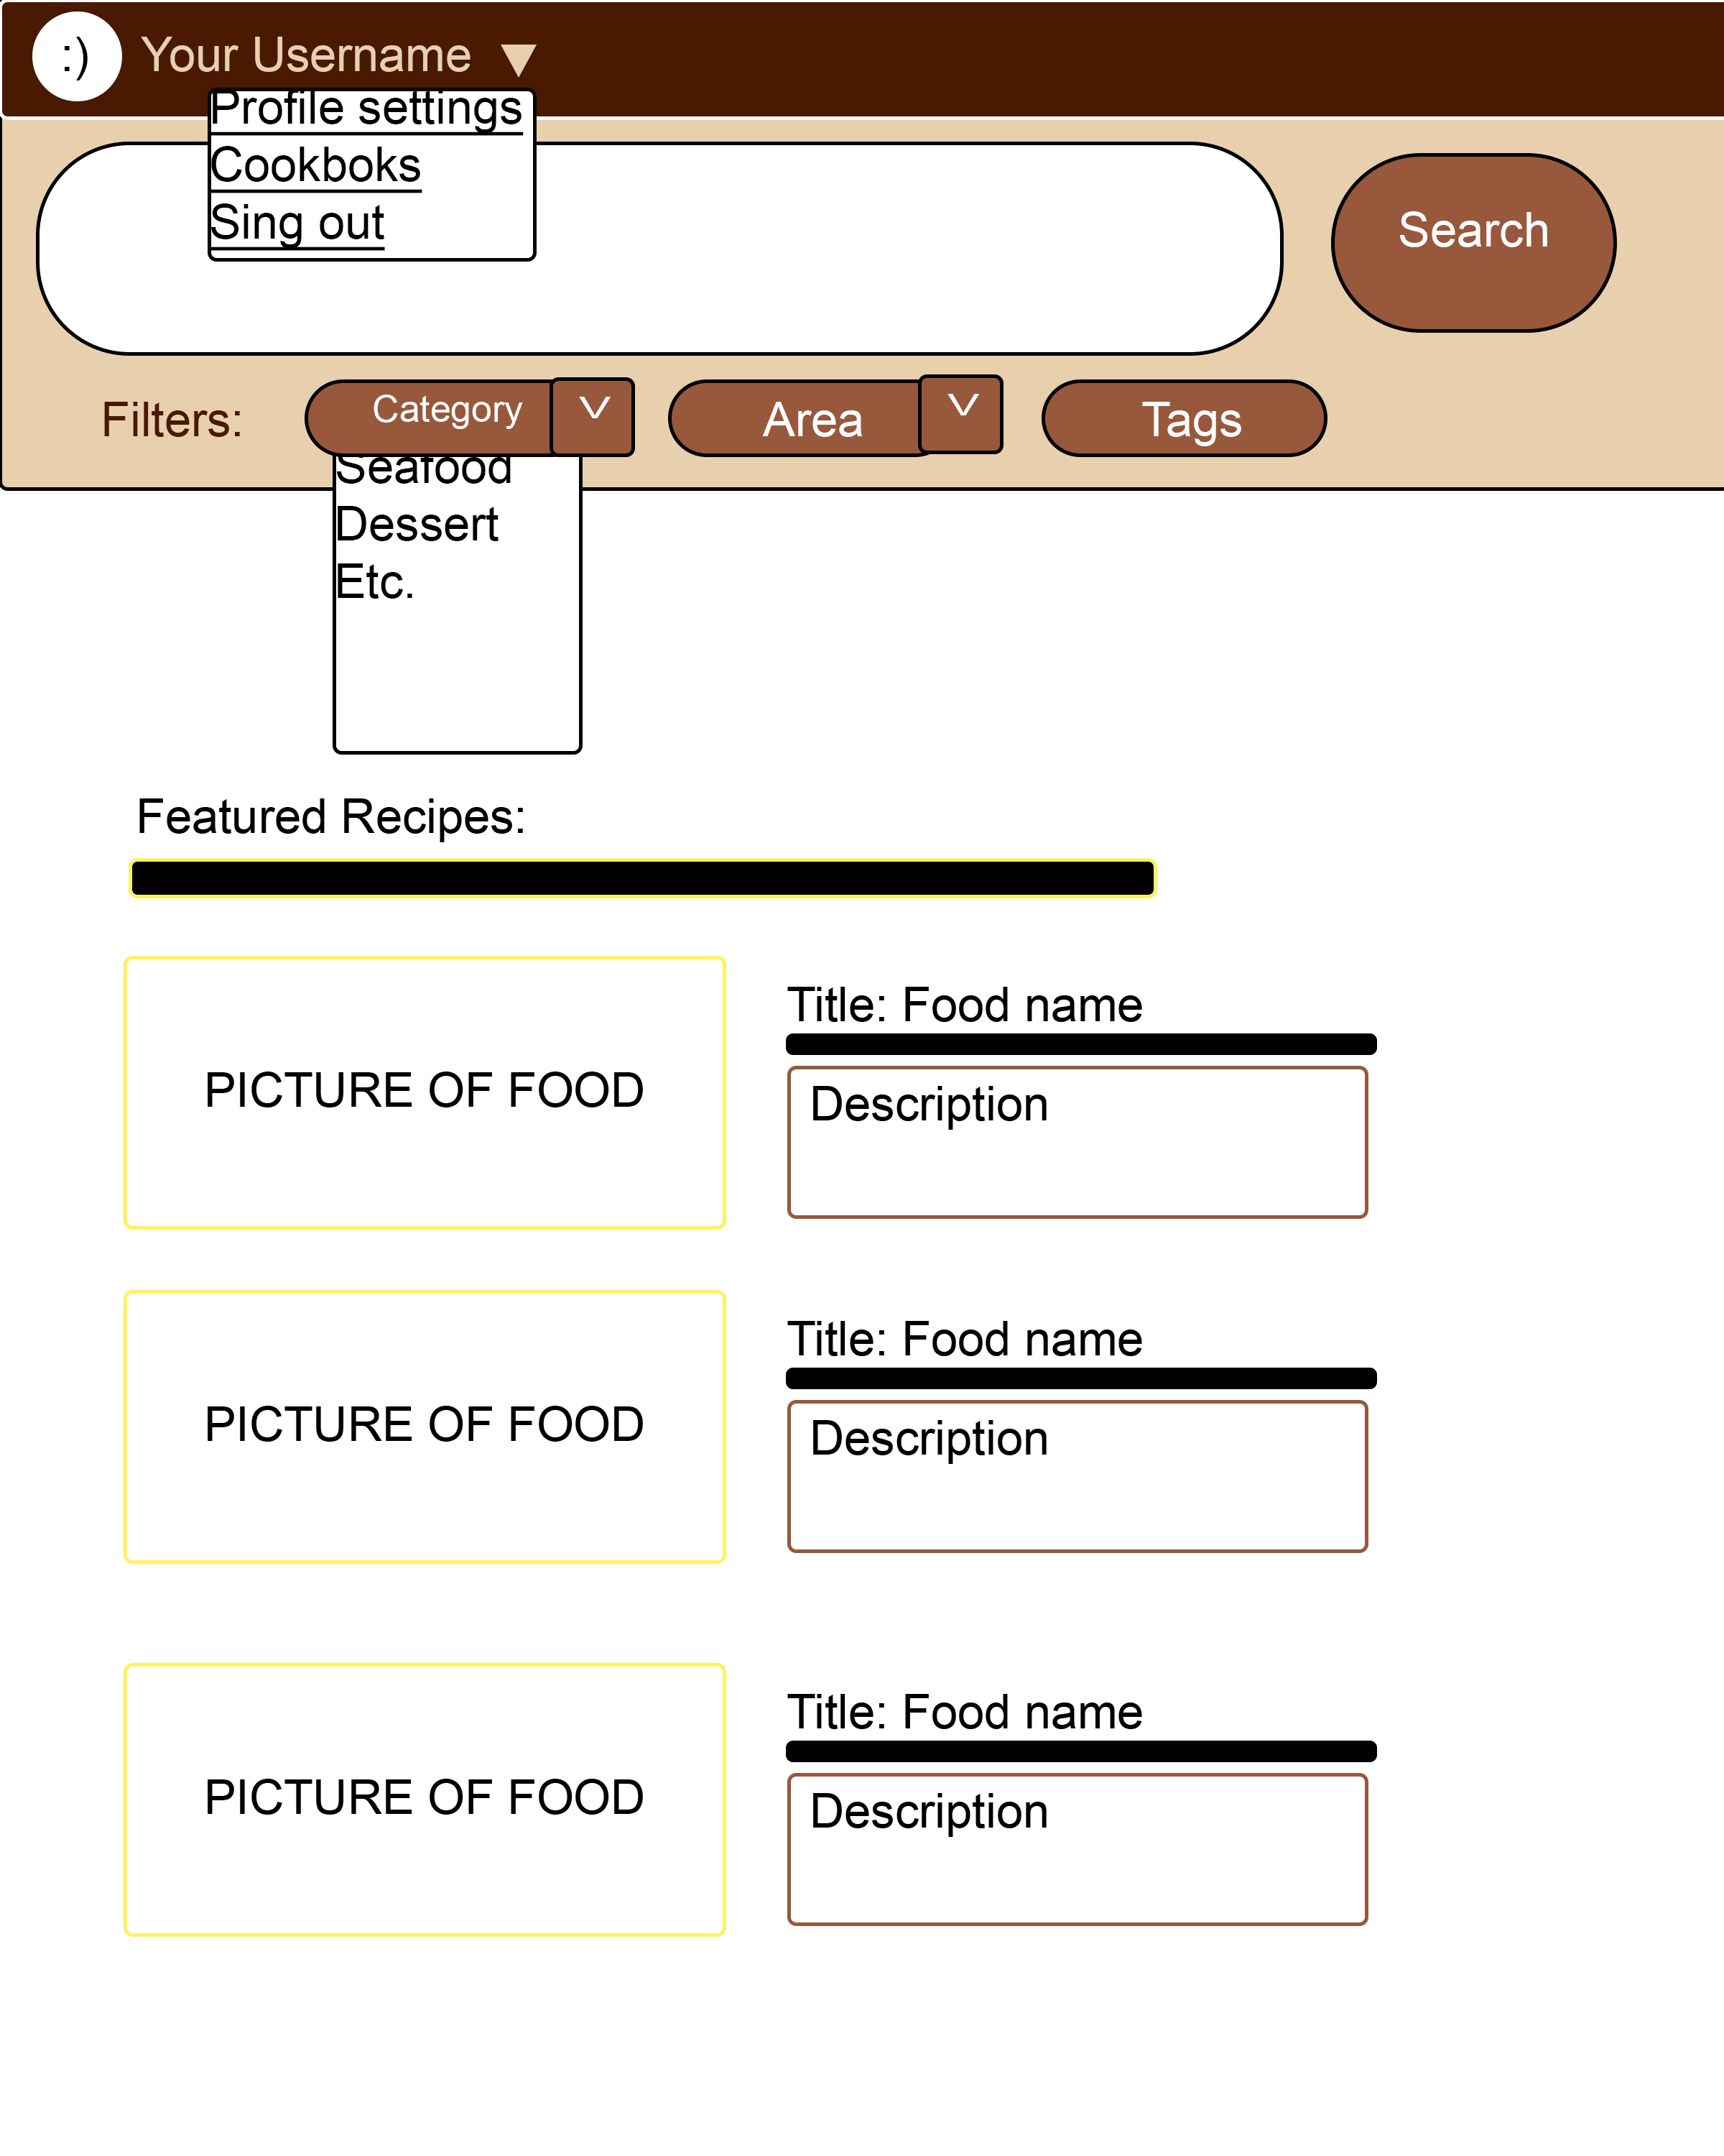
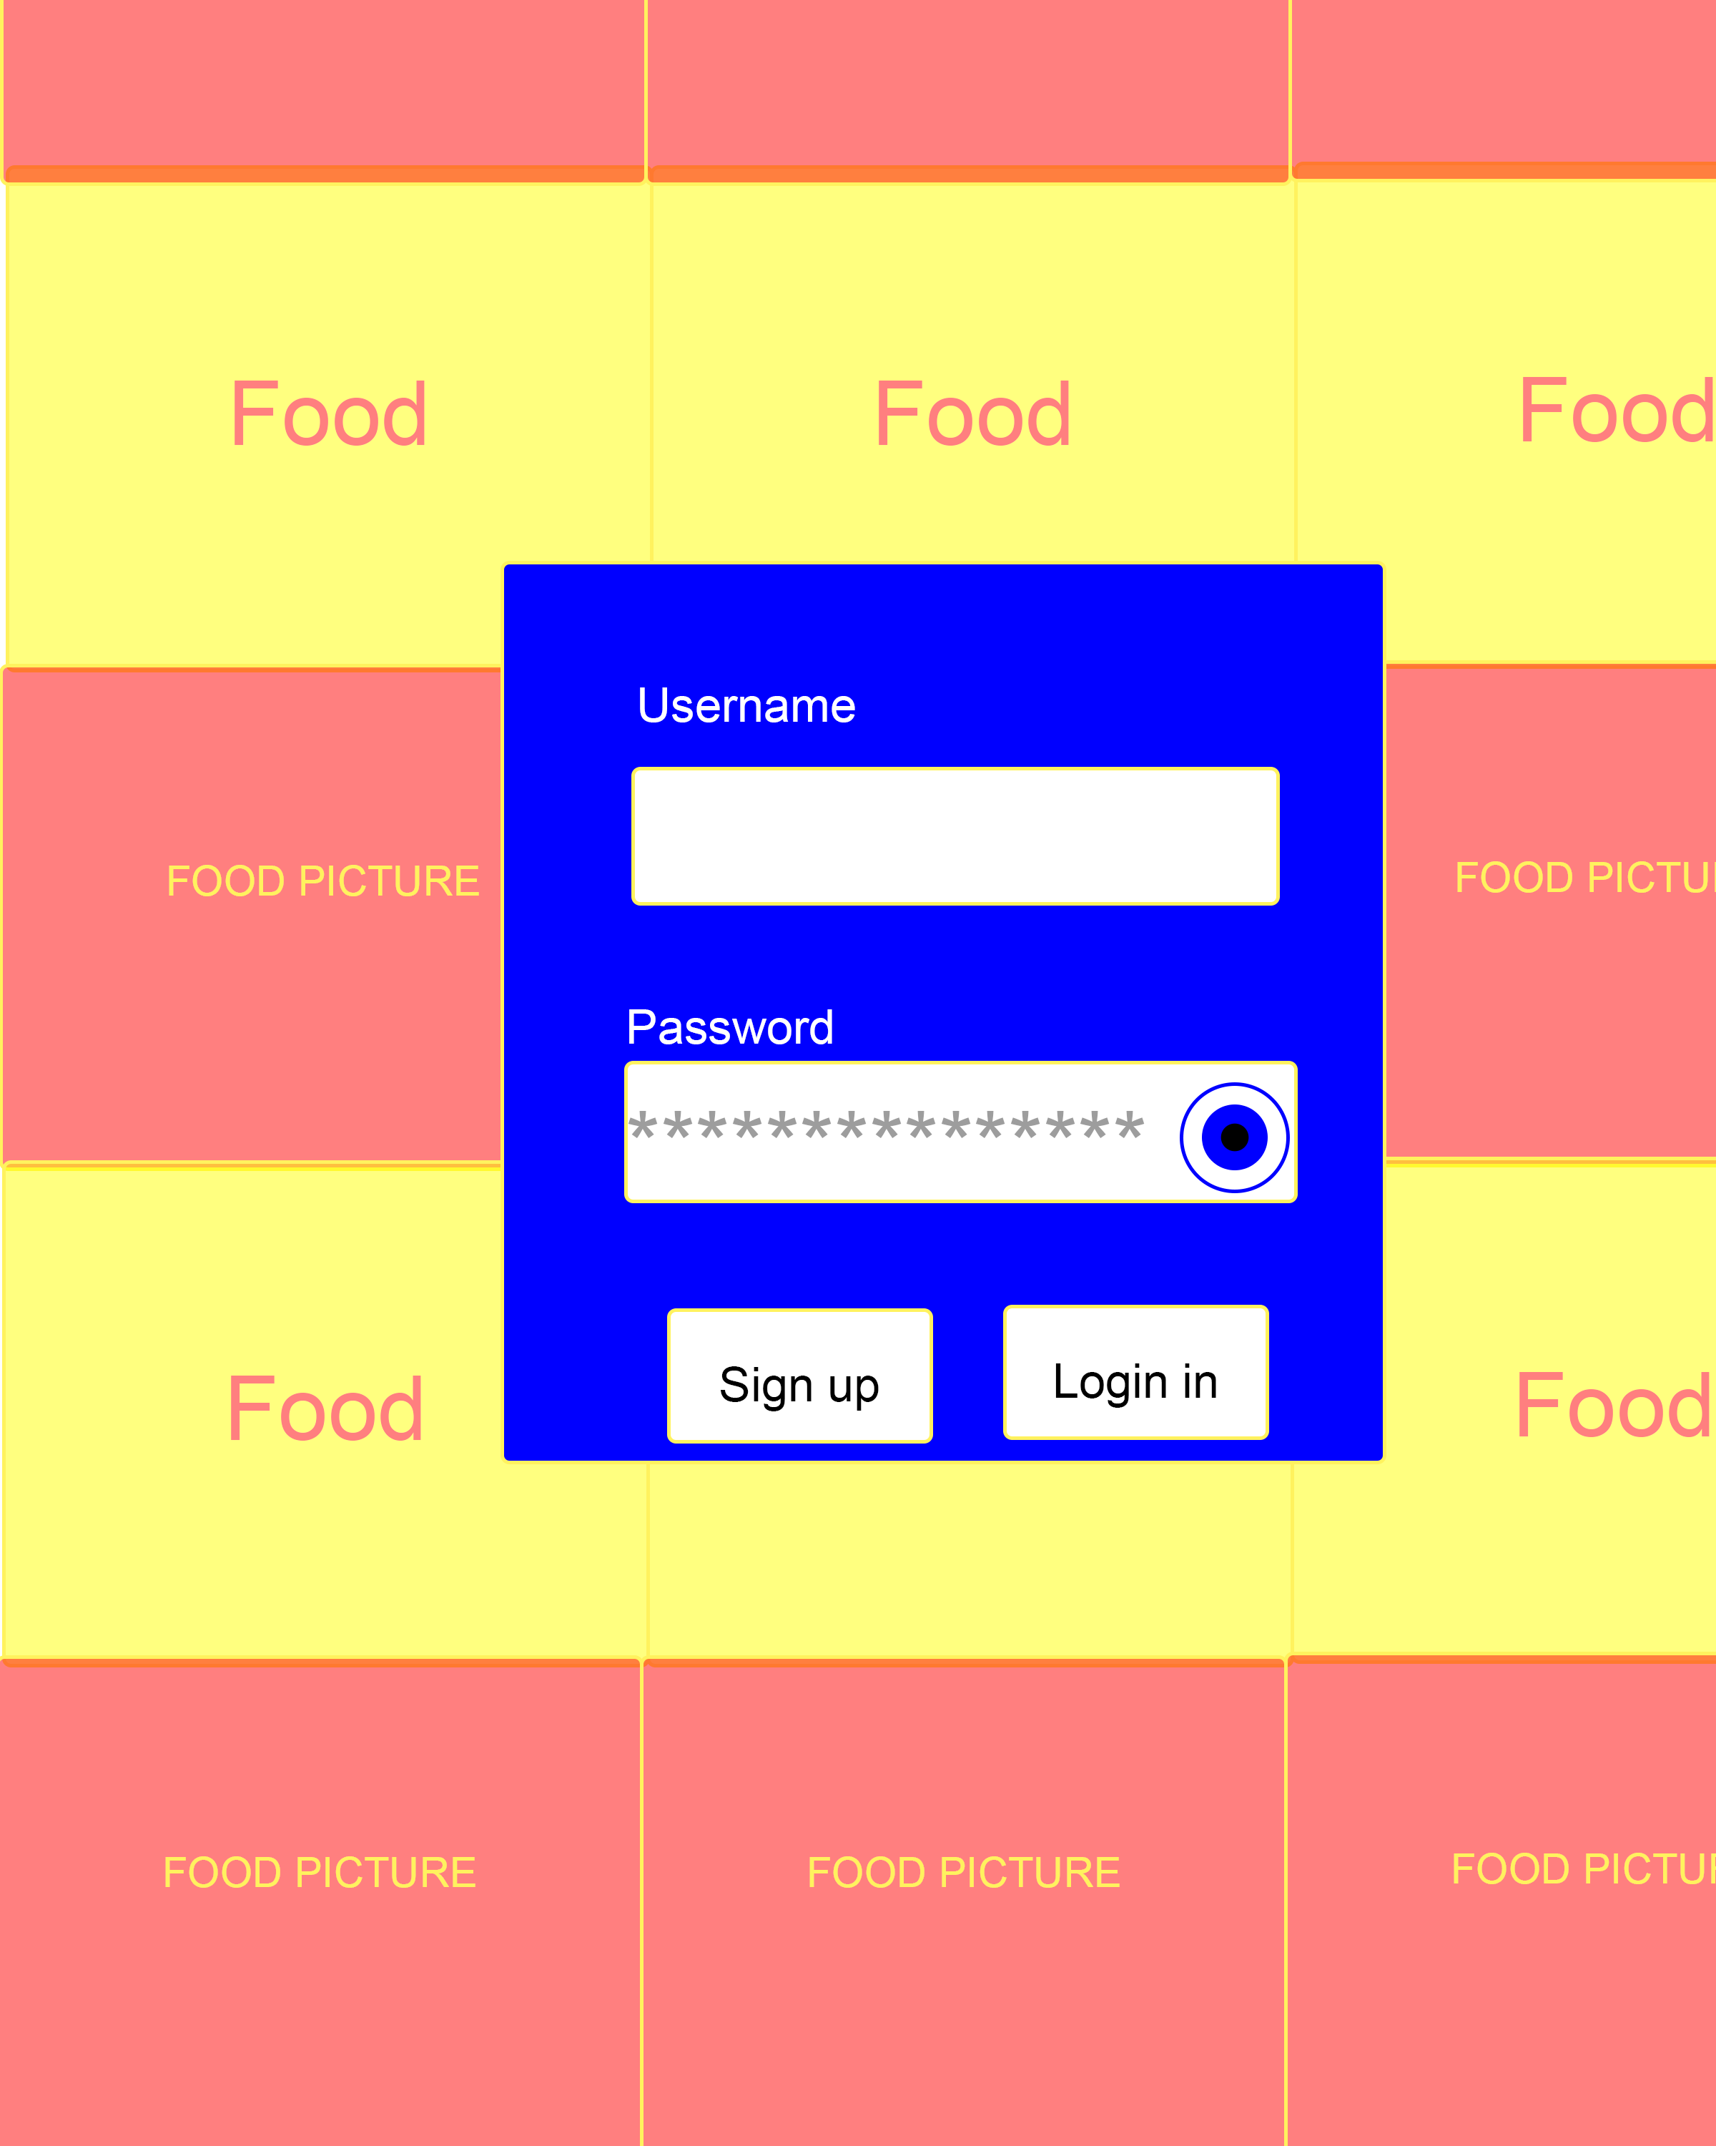
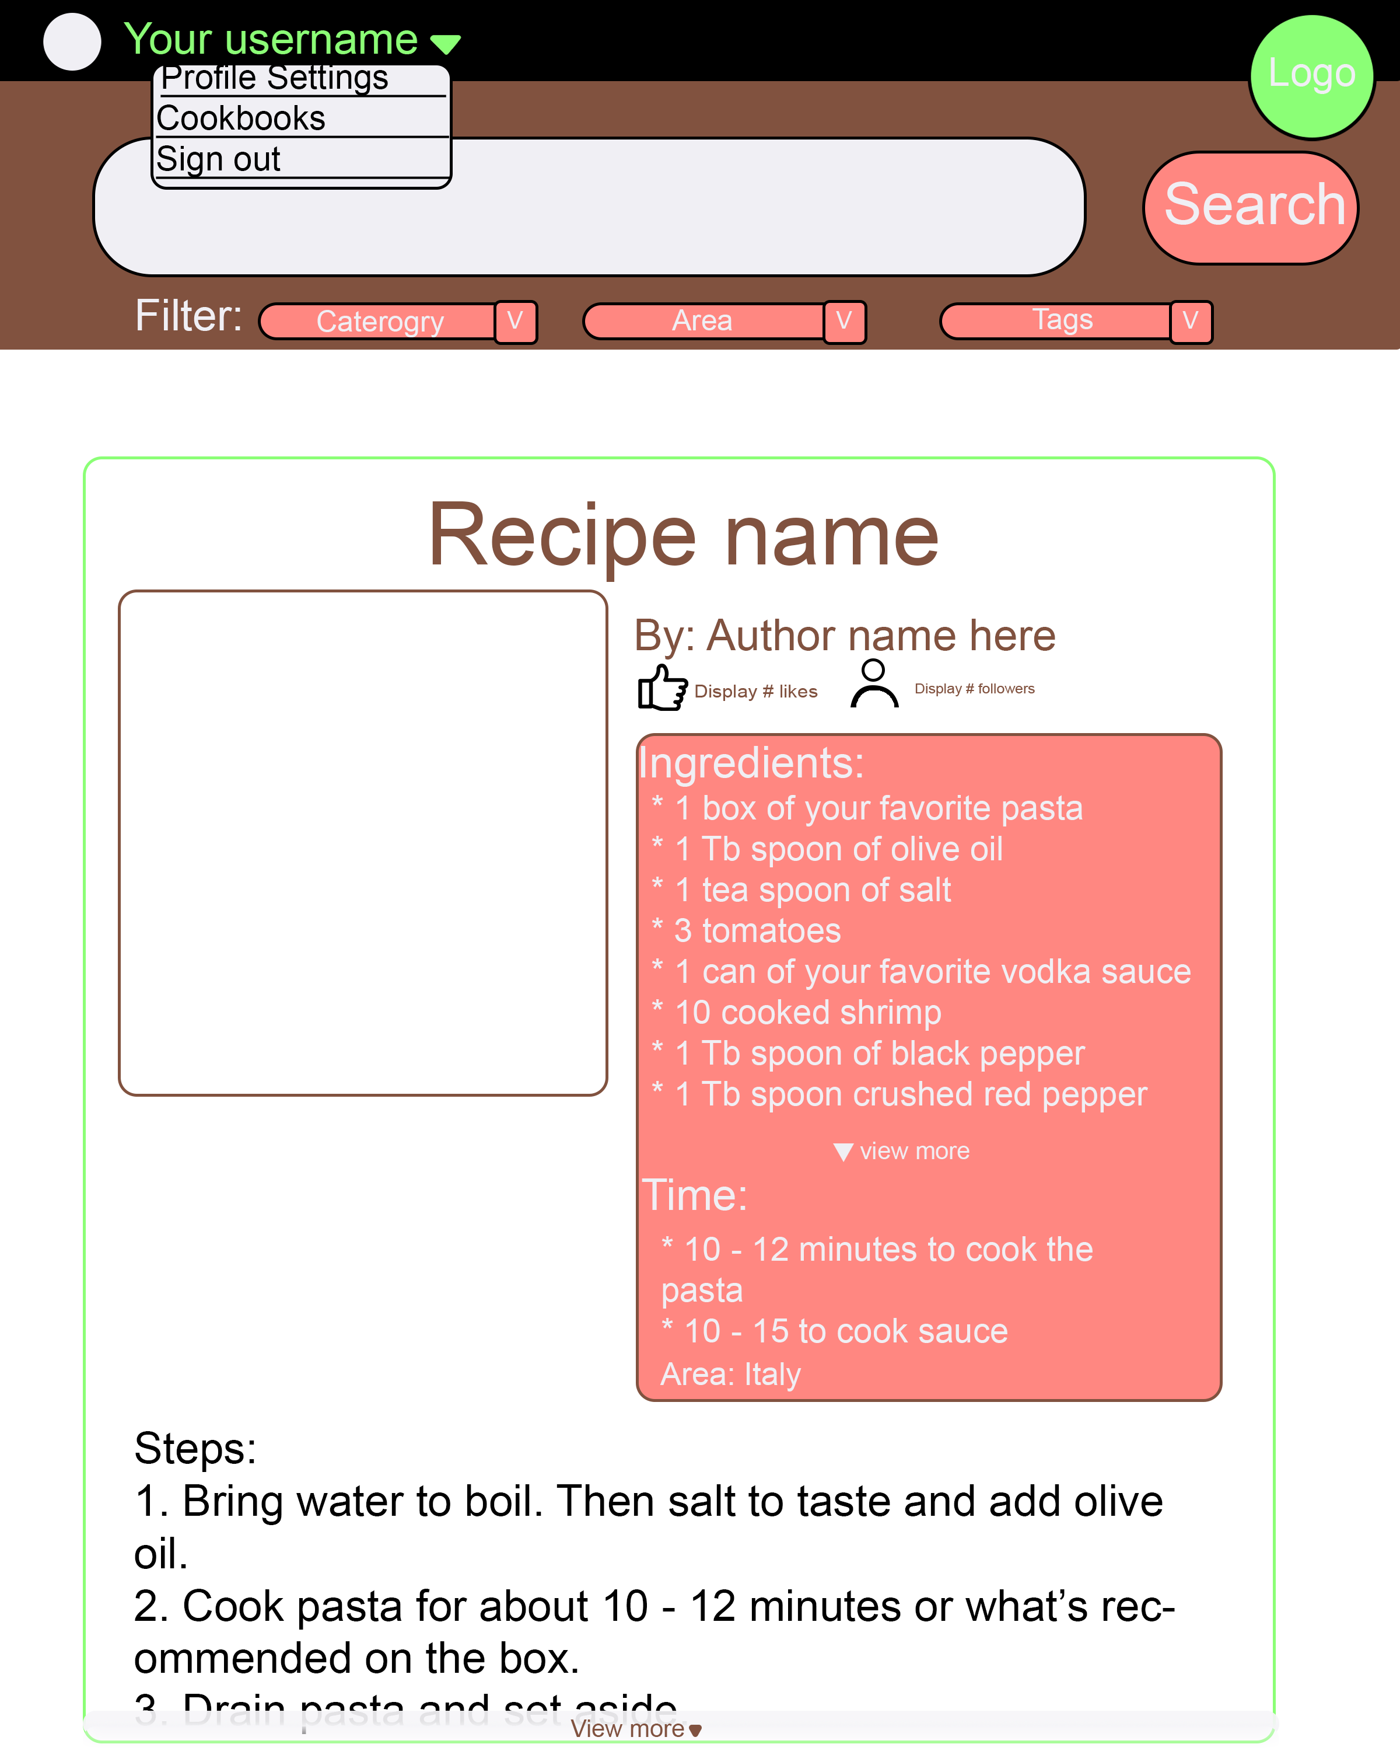
Project Overview: Concept Pages
Main/Welcome Page
Login Page
Recipe Page

Slide 8
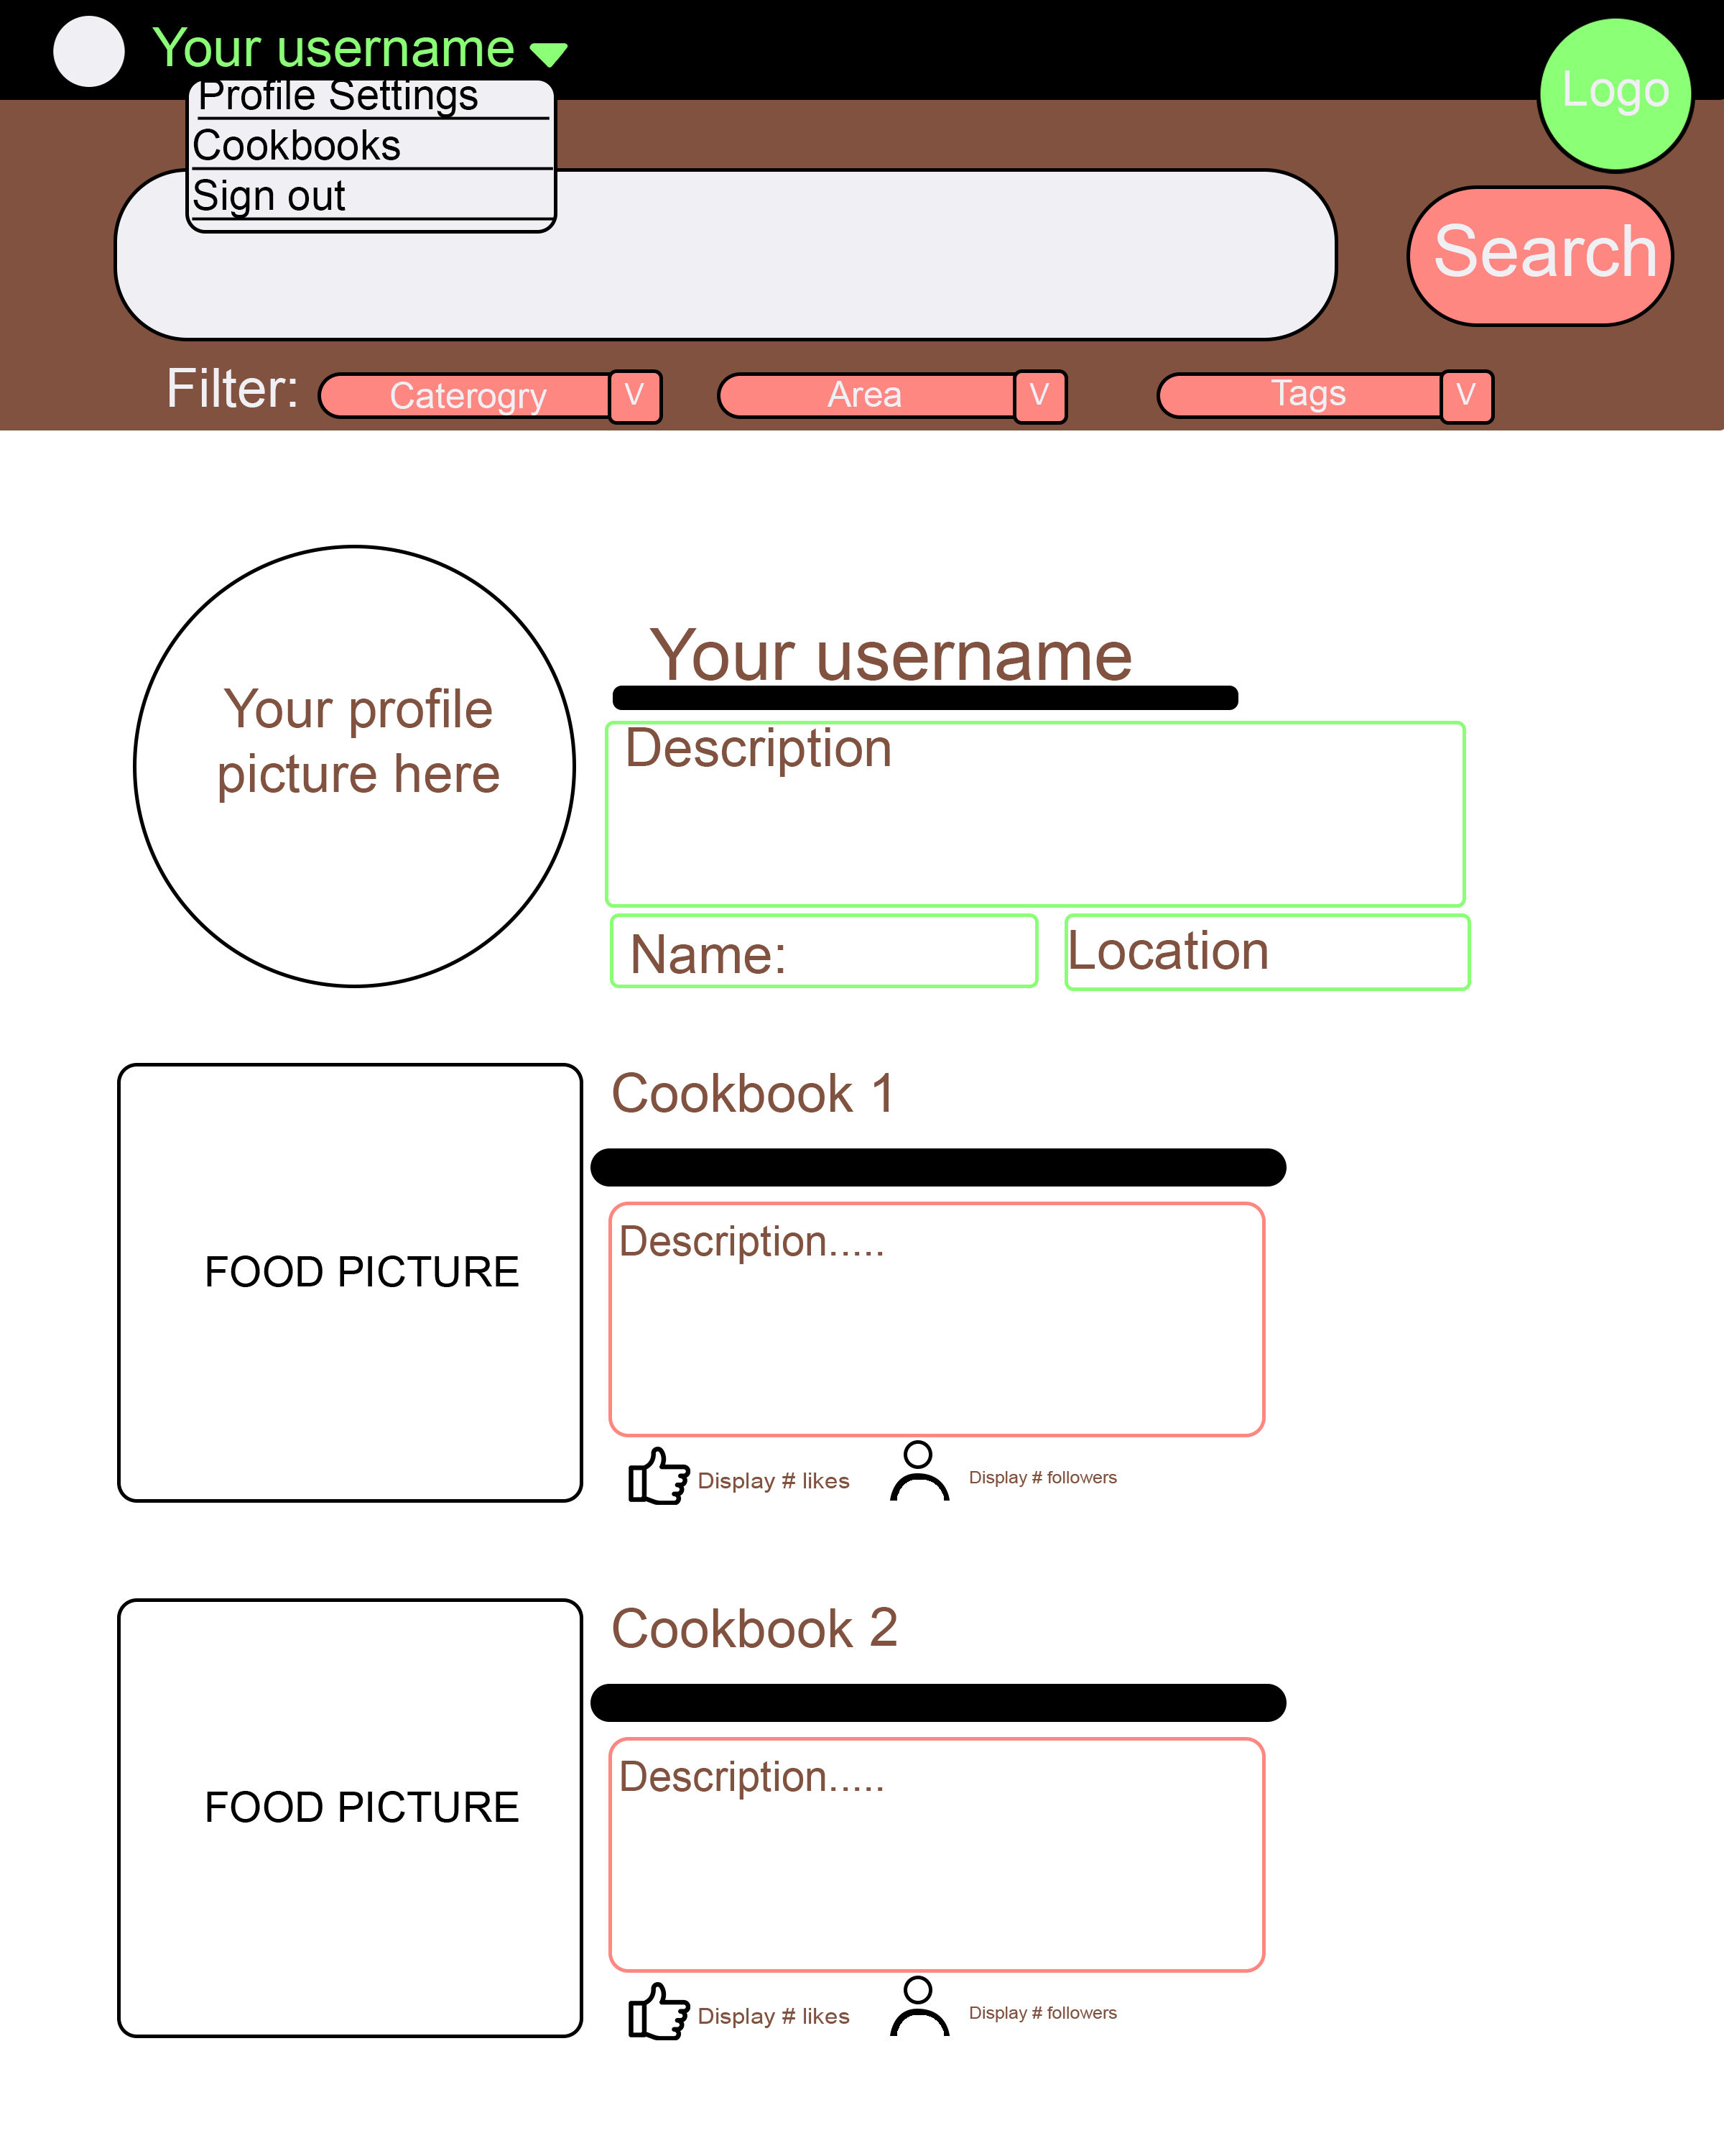
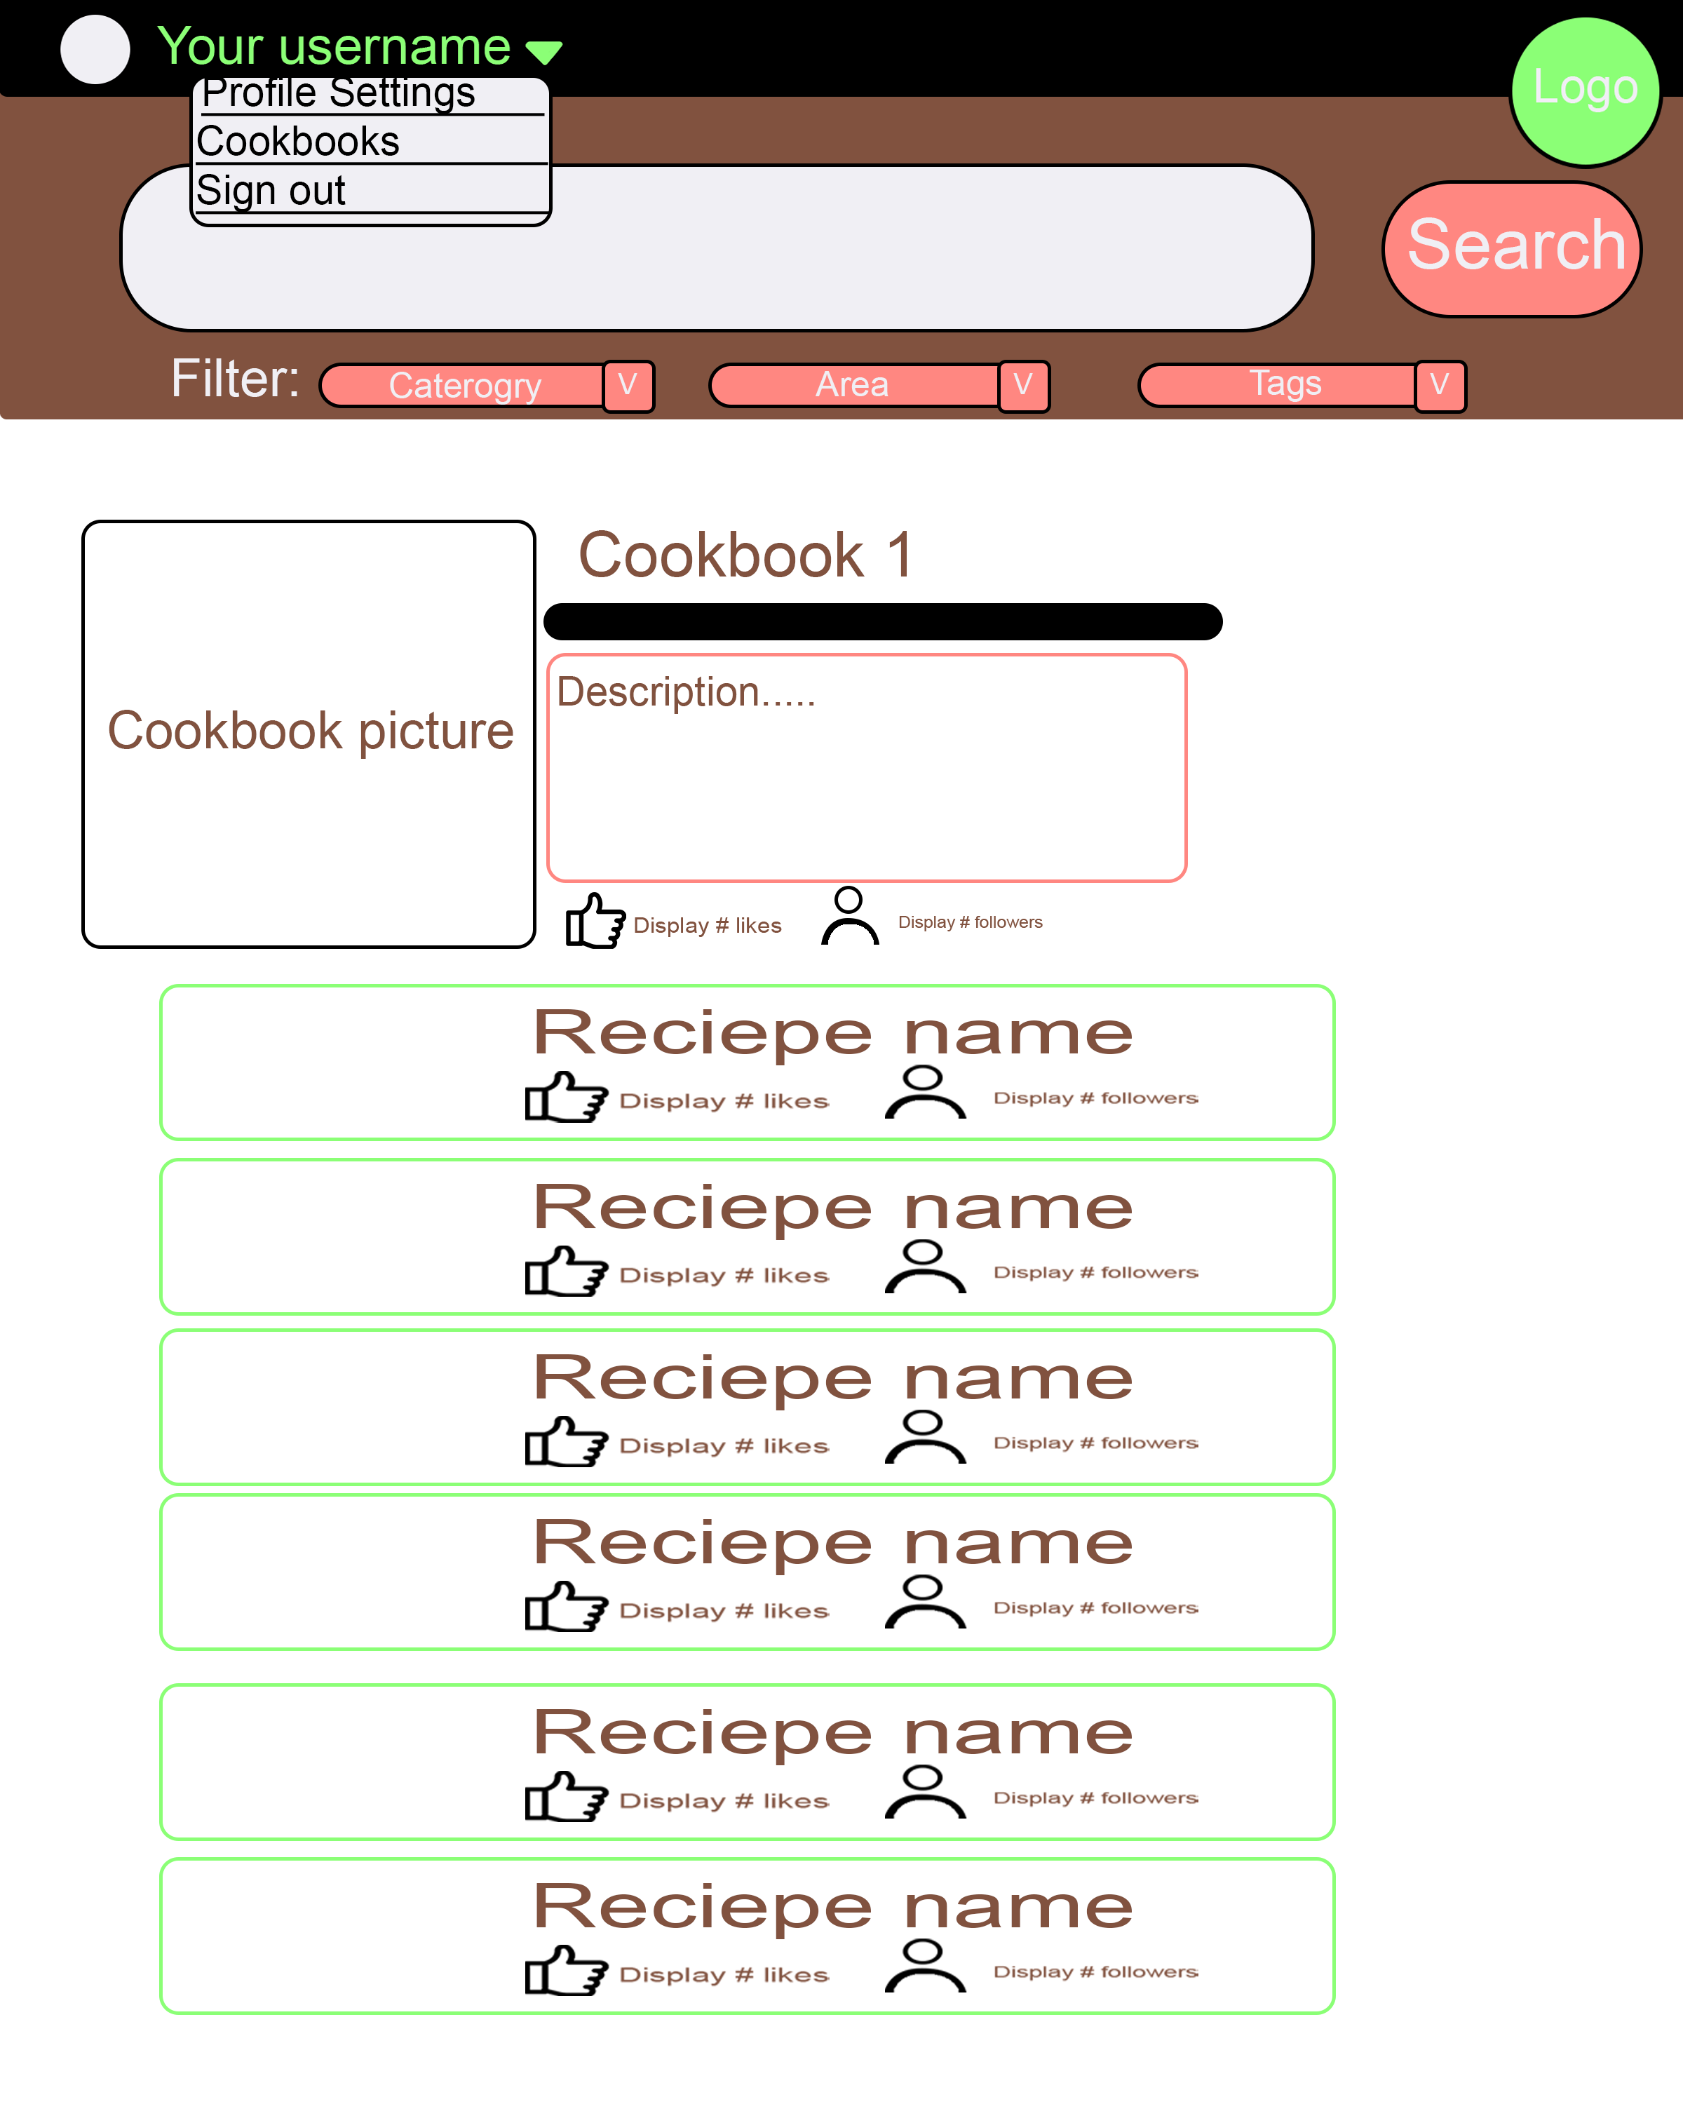
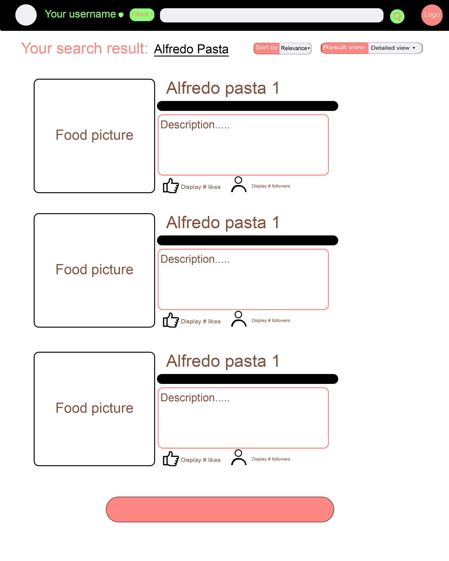
Project Overview: Concept Pages Cont.
Profile Page
Cookbook Page
Search Results Page

Slide 9
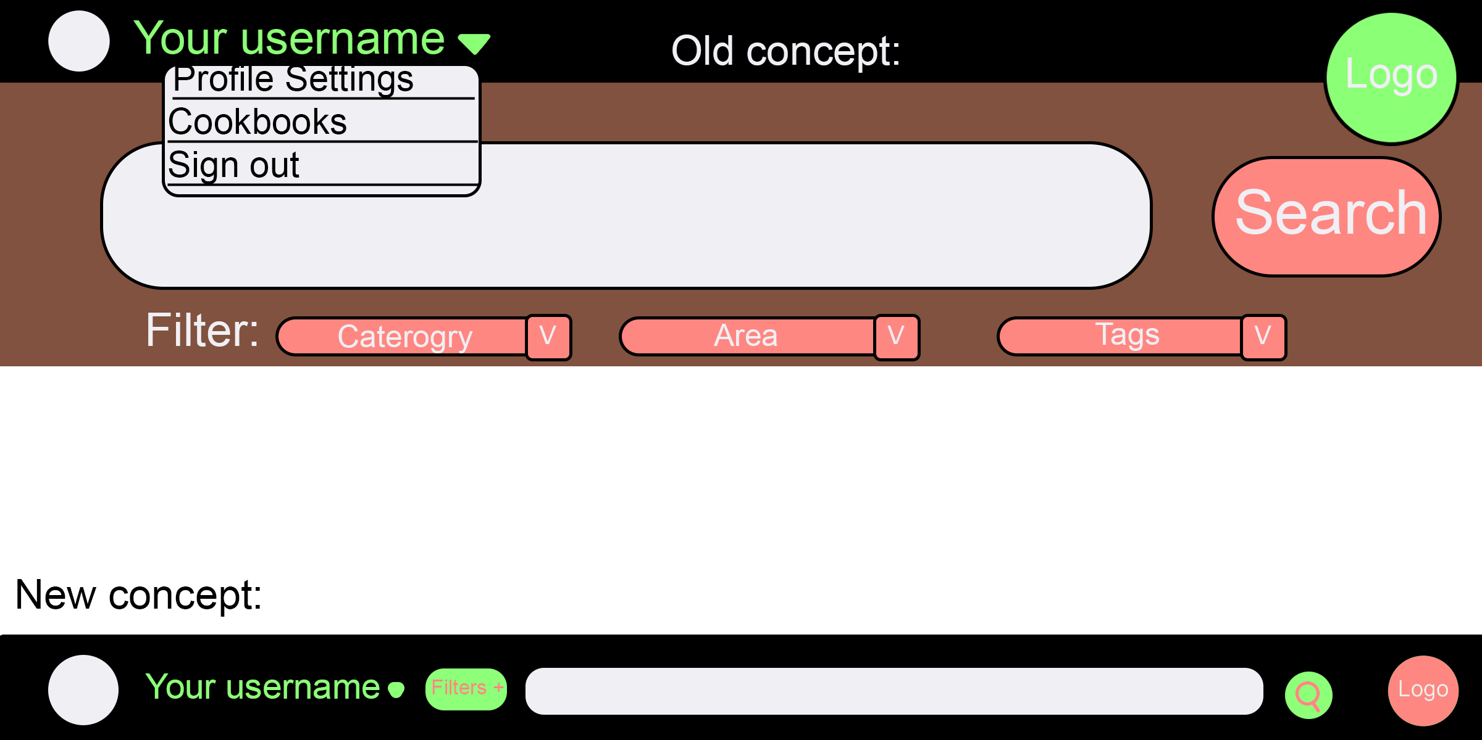
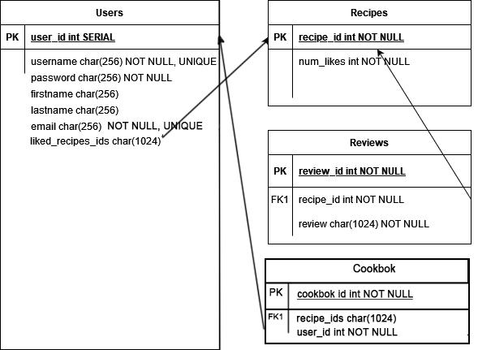
Project Overview: Concept Pages Cont.
Database Tables
Navbar Alternative

