Slide 1
HomeValue
Matthew Brown
Mandy Wong 014558570
Kuang Sheng 008422128
Yanlin Song 014535313

Slide 2
Agenda
Introduction & Background
Data Preprocessing
Backend Implementation
Web Application Design
Demo

Slide 3
Introduction & Background
When you go to Zillow or Redfin, you have to punch in the city or zip code of where you want to live and then the website shows you homes in that area.
This way of doing things puts all of the responsibility on the user to research which neighborhood they want to live in. This is a lot of work which we believe could be shifted away from the user to the application.
We have envisioned a new way of shopping for homes, where the user answers a short questionnaire about what kind of values are important to them, and we give them a list of houses which complement those values.
For this POC those values are organic diet, low carbon footprint, and outdoor activities, but this application could be expanded to include much more.

Slide 4
Data Preprocessing
Find names or addresses of all public parks, whole foods, and public transportation hubs in the cities where our houses are.
Use google maps API to geocode the addresses into lat/long coordinates.
Calculate the distance from each home to the nearest location in each category.

Slide 5
Backend Implementation
REST API using Python and Flask.
Deployed on AWS Lambda.
Fetches real estate data from a MYSQL database.
Constructs an ideal home for the user based on their criteria.
Sorts homes based on Euclidean Distance from the ideal home.

Slide 6
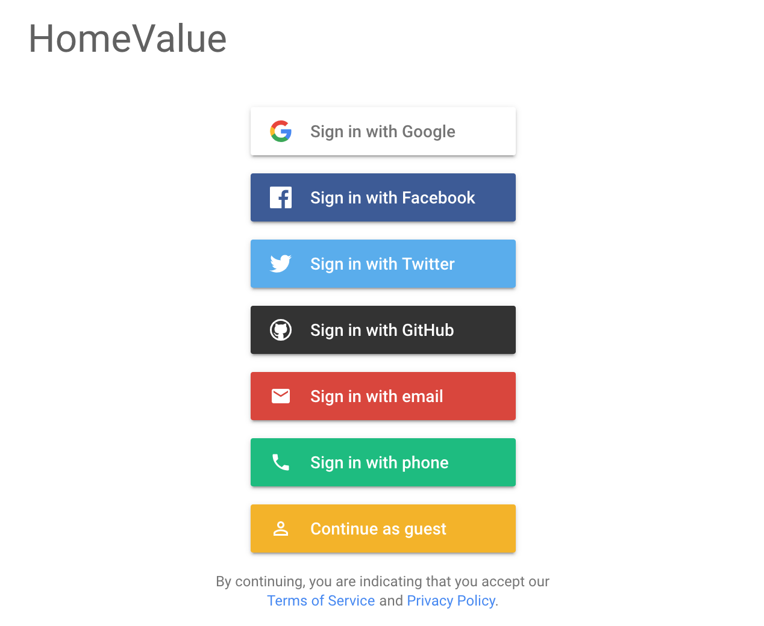
Web Application Design
Login Page

Slide 7
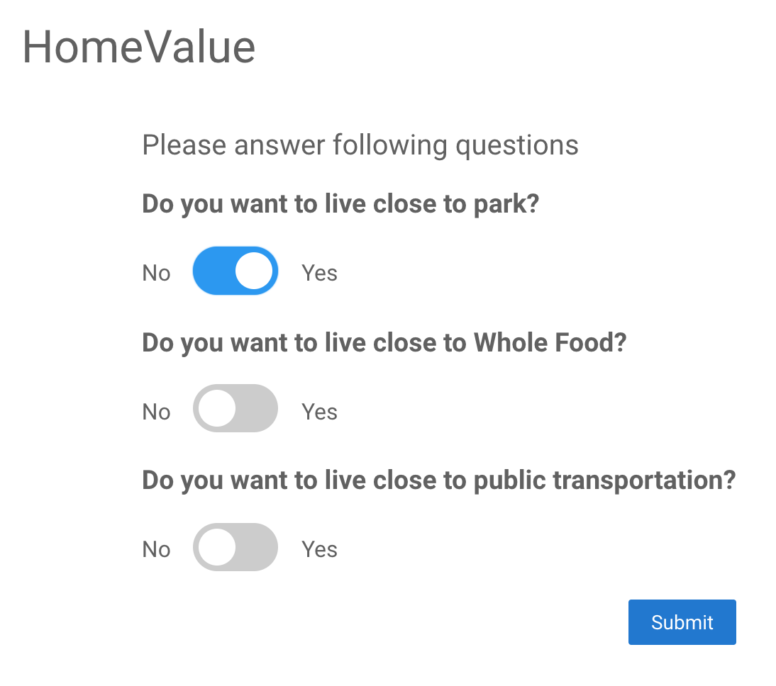
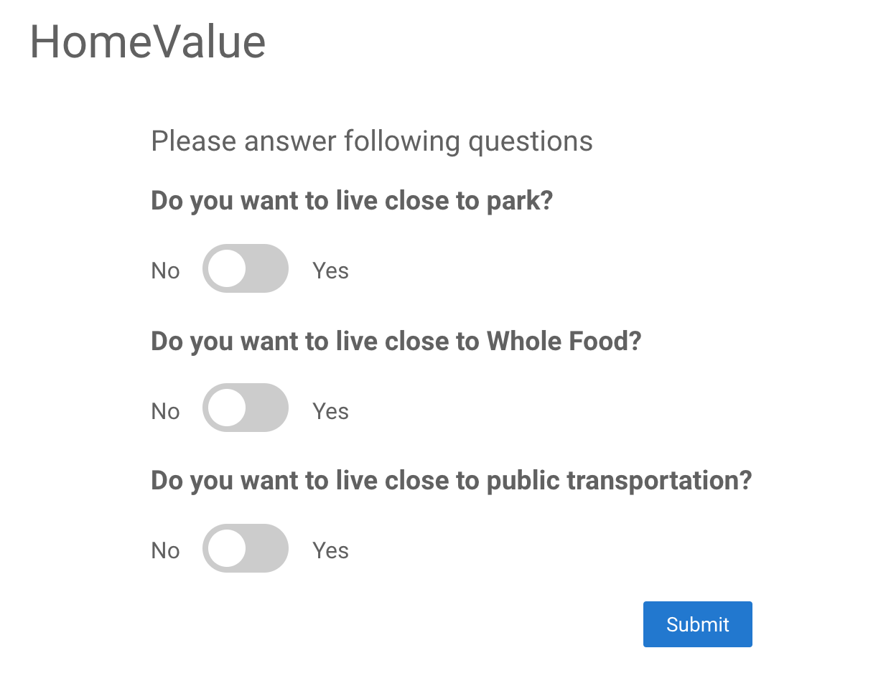
Web Application Design
Questionnaire Page

Slide 8
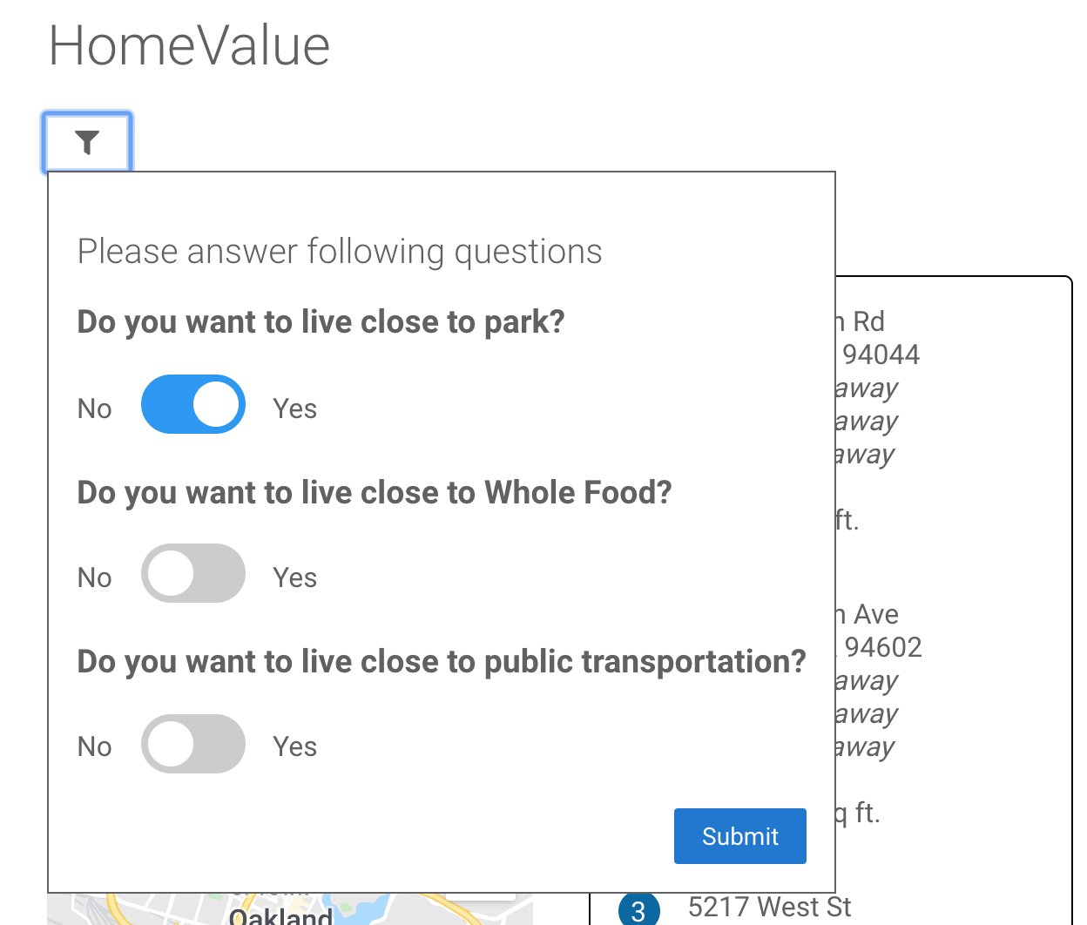
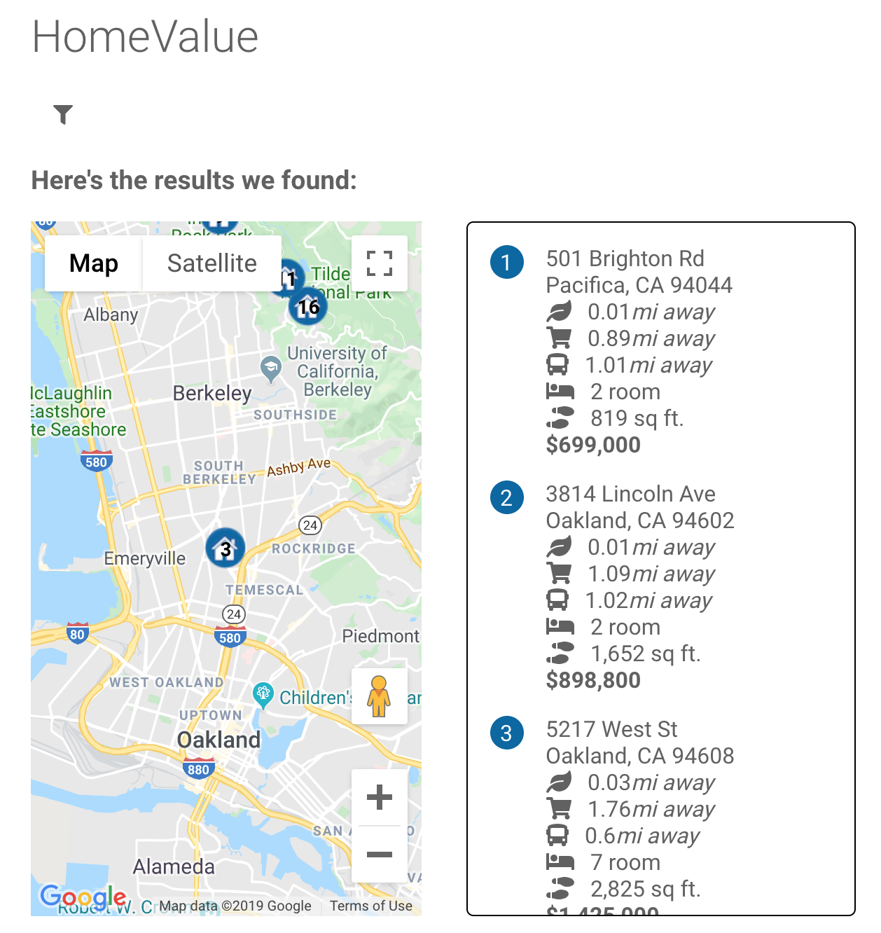
Web Application Design
Dashboard

Slide 9
Demo
http://cmpe272classdemobucket.s3-website-us-west-1.amazonaws.com/

Slide 10
Thank You!

