Slide 1
Software design patterns: reusable Tools
Object-Oriented Analysis and design
Thelma Looms
16 November 2017

Slide 2
Overview
What is a Design Pattern?
History and Innovators
Using Design Patterns in Refactoring

Slide 3
Challenges in OO Design and development
How do we:
Solve problems efficiently and quickly
Make designs reusable
Minimize re-design
Provide flexibility
Communicate relationships
Notes:
Classes, interfaces, hierarches, relationships that define a problem,

Slide 4
What is a Design Pattern?
“In software engineering, a software design pattern is a general reusable solution
to a commonly occurring problem within a given context in software design. ”
“Each pattern describes a problem which occurs over and over again in our environment, and then describes the core of the solution to the problem in such away that you can use this solution a million times over.”
“A pattern language guides a designer by providing workable solutions to all of the problems known to arise in the course of design. … written in a style and arranged in an order which leads a designer to ask (and answer) the right questions at the right time.”
Notes:
General description, Christopher Alexander, Wade Cunningham and Beck
Ask students: Problem, solution and reusable – not re-inventing the wheel when start a new implementation and theses address the challenges that we face as designers.
Design patterns = code level,
Architecture patterns = component level = MVC

Slide 5
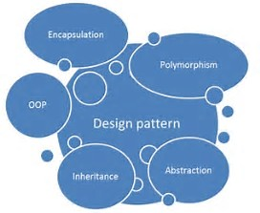
What is a Design Pattern?
Solution – time-tested solutions for recurring problems
Design Vocabulary – shared language to support design
Choose Alternatives – when it should be used and tradeoffs
Reusable – over and over again
Toolbox – application independent
“A Design pattern is a way of understanding OOP with scenarios.”
Notes:
This diagram is itself a design pattern - it represents the concepts and vocabulary we use in object-oriented programming language
Generally, the ability to appear in many forms. In object-oriented programming, polymorphism refers to a programming language's ability to process objects differently depending on their data type or class. More specifically, it is the ability to redefine methods for derived classes. For example, given a base class shape, polymorphism enables the programmer to define different area methods for any number of derived classes, such as circles, rectangles and triangles. No matter what shape an object is, applying the area method to it will return the correct results. Polymorphism is considered to be a requirement of any true object-oriented programming language (OOPL).

Slide 6
Why Use Design Patterns?
Best Practices – found after decades of experience
Design – from success not failure
Cost – designing from scratch is expensive
Accelerate – not designing concepts from scratch
Standardized communication and documentation – by providing a design vocabulary
Notes:
This diagram is itself a design pattern - it represents the concepts and vocabulary we use in object-oriented programming language
Generally, the ability to appear in many forms. In object-oriented programming, polymorphism refers to a programming language's ability to process objects differently depending on their data type or class. More specifically, it is the ability to redefine methods for derived classes. For example, given a base class shape, polymorphism enables the programmer to define different area methods for any number of derived classes, such as circles, rectangles and triangles. No matter what shape an object is, applying the area method to it will return the correct results. Polymorphism is considered to be a requirement of any true object-oriented programming language (OOPL).

Slide 7








Timeline and innovators
1977
Christopher W. Alexander (Architecture)
1980
1987
Ward Cunningham and Kent Beck (Coding Patterns)
1995
Gang of Four: Gamma, Helm, Johnson, Vlissides
(23 Patterns)
1996
Party of Five: Buschman, Meunier, Rohnert, Sommerlad, Stal
1997
Three Amigos: Booch, Jacobson, Rumbaugh (UML)
1997
Craig Larman (GRASP)
Trygve M. H. Reenskaug (MVC)
1994
Portland Pattern Repository (PPR)
Notes:
Peter Coad – color coding to understand model - He is notable for his role in defining what have come to be known as the UML colors,^{[3]} a color-coded notation chiefly useful for simplifying one's understanding of a design or model.
UML – OMG – Object Management Group
Pattern-Oriented Software Architecture: A System Of Patterns - Party of Five
Gary Booch – Unified Modeling Language
Gary Booch, Ivan Jacobson, James Rumbaugh (UML)
Craig Larman – General responsibility assignment software patterns - consist of guidelines for assigning responsibility to classes and objects in object-oriented design
Cunningham (textronix) and Beck (Apple) – applying patterns to programming languages
Need a way to patterns that we encounter need to be captured and documented - visualize - use UML

Slide 8

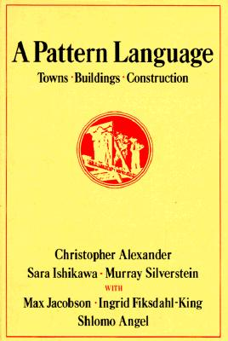


History and innovators
1977: Christopher Alexander, A Pattern Language, Oxford University Press, 1977
Introduces architectural patterns in architecture for urban design, buildings and towns
253 patterns each consisting of a design problem, discussion, illustration, and solution
“These tools allow anyone, and any group of people, to create beautiful,
functional, meaningful places.”
Notes:
It was authored by Christopher Alexander, Sara Ishikawa and Murray Silverstein of the Center for Environmental Structure of Berkeley, California, with writing credits also to Max Jacobson, Ingrid Fiksdahl-King and Shlomo Angel. Decades after its publication, it is still one of the best-selling books on architecture
Patterns describe a problem and then offer a solution. In doing so the authors intend to give ordinary people, not only professionals, a way to work with their neighbors to improve a town or neighborhood, design a house for themselves or work with colleagues to design an office, workshop or public building such as a school.
The Timeless Way of Building, The Oregon Experience
Center for Environment Structure at Berkley - These tools allow anyone, and any group of people, to create beautiful, functional, meaningful places.

Slide 9
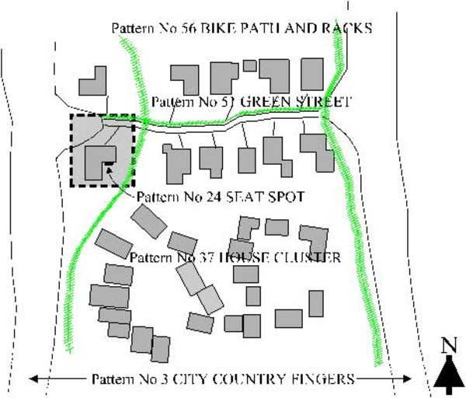


Pattern Language : Architecture
Patterns 21 – 27 “Local Environment”
Patterns 35 – 40 “Housing Clusters”
Patterns 49 – 56 “Local Networks”
Patterns 87 – 94 “Gathering Places and Shops”
http://www.jacana.plus.com/pattern/P0.htm.
Notes:
It was authored by Christopher Alexander, Sara Ishikawa and Murray Silverstein of the Center for Environmental Structure of Berkeley, California, with writing credits also to Max Jacobson, Ingrid Fiksdahl-King and Shlomo Angel. Decades after its publication, it is still one of the best-selling books on architecture
Patterns describe a problem and then offer a solution. In doing so the authors intend to give ordinary people, not only professionals, a way to work with their neighbors to improve a town or neighborhood, design a house for themselves or work with colleagues to design an office, workshop or public building such as a school.
The Timeless Way of Building, The Oregon Experience
Patt 24 – Seat Spots
Pat 49 – 56 – Bike paths , road crossings, green streets
Center for Environment Structure at Berkley - These tools allow anyone, and any group of people, to create beautiful, functional, meaningful places.

Slide 10




History and innovators
1987: Wade Cunningham and Kent Beck, Using Pattern Languages for Object-Oriented Programs, OOPSLA-87
Used concepts from Christopher Alexander
Pattern language for describing graphical user interface design
Beck: Coding Patterns
Class-Responsibility-Collaborator brainstorming tool to describe:
class of objects
behaviors
interactions
“Our initial success using a pattern language for user interface design has left us quite enthusiastic about the possibilities for computer users designing and programming
their own applications.”
http://c2.com/doc/oopsla87.html
Notes:
Cunningham (textronix) and Beck (Apple) – applying patterns to programming languages
Object-Oriented Programming, Systems, Languages & Applications – ACM conference

Slide 11


Kent Beck: Coding Patterns, 1995.
Problem: How do you provide access to an instance variable? How can we change the value?
Solution: Provide a method that returns or sets the value of the variable.
Pattern: “Getting and Setting Method”
Example: C# property implementation
private int _x;
public int x {
get { return _x; }
set { _x = value; }
}
someObject.x = 50;
Domain: 89 Coding Patterns for Smalltalk Language
Recipe of Programming Solutions
Goal: Able to develop code faster and with less risk that is easier to maintain and reuse
Smalltalk Best Practice Patterns Volume 1: Coding,
Kent Beck, 1995, 1996.
Notes:
Smalltalk is an object-oriented, dynamically typed, reflective programming language. Smalltalk was created as the language to underpin the "new world" of computing exemplified by "human–computer symbiosis."^{[2]} It was designed and created in part for educational use, more so for constructionist learning, at the Learning Research Group (LRG) of Xerox PARC by Alan Kay, Dan Ingalls, Adele Goldberg, Ted Kaehler, Scott Wallace, and others during the 1970s – Alan Kay, Dan Ingalls, Adele Goldberg
OO languages, such as Objective-C, Python, Ruby, CLOS, PHP 5, Perl 6, Erlang, Groovy, Scala, Dart, Swift, and so on.

Slide 12
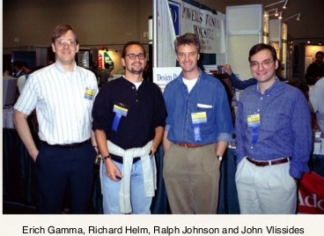
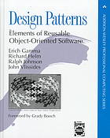


Gang of Four (Gof)
1995: Erich Gamma, Richard Helm, Ralph Johnson, John Vlissides.
Birds of a feather (BoF) session at OOPSLA ‘90.
Design Patterns: Elements of Resuable Object-Oriented Software, Addison-Wesley, 1995.
“The design patterns in this book are description of communicating objects and classes that are customized to solve a general design problem.”
Notes:
(passed away November 24th, 2005)

Slide 13
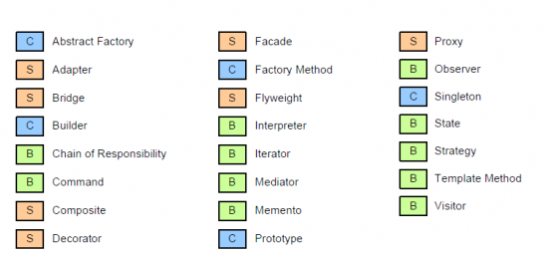
GOF Pattern Classification
Creational Patterns: “object creation”
Structural Patterns “composition to form larger and new structures”
Behavior Patterns “interaction” “communication”
Notes:
Structural - Façade - How objects create an entire system - Flyweight for sharing objects
Behavior – inheritance and composition
Communication – Chain of Responsibility – set of
Creation pattern – singleton (print spooler) – factory abstract factory

Slide 14
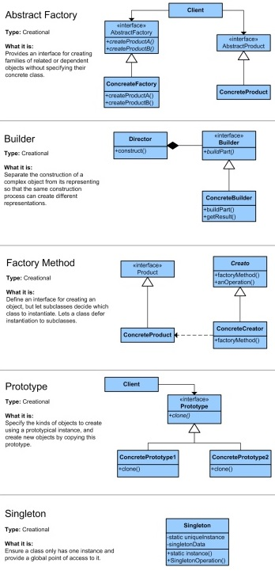
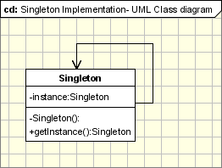
UML: Singleton Method Pattern
One instance for class, for example a window manager, file system, print spooler
Provide a global access point to the object
Notes:
Public (+)
Private (-)
Protected (#)
Package (~)
Derived (/)
Static (underlined)

Slide 15
Theory into practice
Using Patterns in Refactoring
Case Study
Notes:
Peter Coad – color coding to understand model - He is notable for his role in defining what have come to be known as the UML colors,^{[3]} a color-coded notation chiefly useful for simplifying one's understanding of a design or model.
Gary Booch – Unified Modeling Language
Gary Booch, Ivan Jacobson, James Rumbaugh (UML)
Craig Larman – General responsibility assignment software patterns - consist of guidelines for assigning responsibility to classes and objects in object-oriented design
Cunningham (textronix) and Beck (Apple) – applying patterns to programming languages
Need a way to patterns that we encounter need to be captured and documented - visualize - use UML

Slide 16
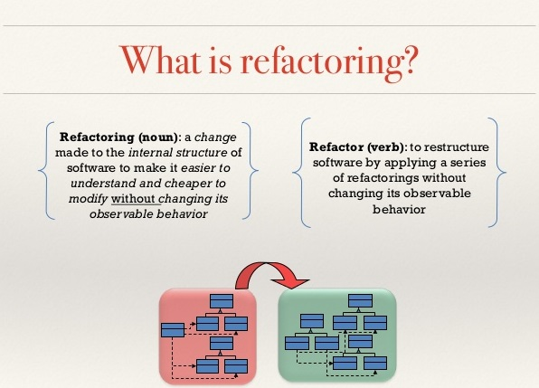
Refactoring with design Patterns

Slide 17
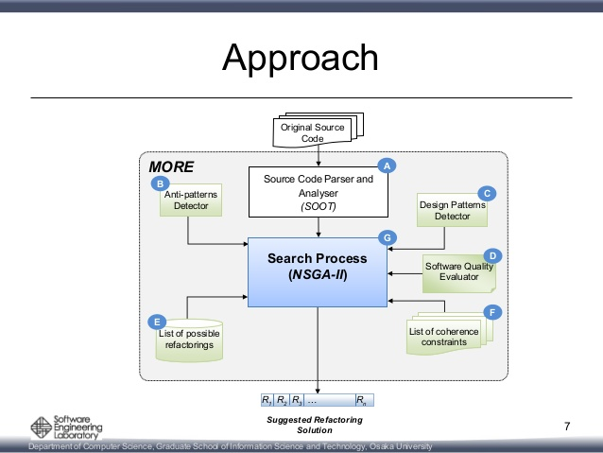


Refactoring with design Patterns
“A Multi-Objective Refactoring Approach to
Introduce Design Patterns and Fix Anti-Patterns,” Ouni et al.
“Automatic Design Pattern Detection,”
Heuzeroth et al.
MORE (Multi-Objective Refactoring REcommendation)
Notes:
Search Based Software Engineering - SBSE - North American Search Based Software Engineering Symposium (2015).
List of refactorings (label E). The MORE approach currently supports the following refactoring types: Move method, Move field, Pull up field, Pull up method, Push down field, Push down method, Inline class, Extract method, Extract class, Move class, Extract superclass, Extract subclass, and Extract interface [2]. We selected these refactoring because they are the most frequently used and they are implemented in modern IDEs such as Eclipse and Netbeans. We
List of Constraints: For instance, a refactoring solution might move a method calculateSalary() from the class Employee to the class Car. This refactoring could improve program structure by reducing the complexity and coupling of the class Employee while preserving program behavior. However, having a method calculateSalary() in the class Car does not make sense from the domain semantics standpoint. To avoid this kind of problem, we use a set of semantic coherence constraints that must be satisfied before applying a refactoring in order to prevent incoherent changes to code elements
Graduate School of Information Science and Technology,
Osaka University, Japan b
University of Michigan, USA c DIRO,
Université de Montréal, Montréal, Canada d
University College Dublin, Ireland e
Michigan State University, USA
University of Karlsruhe,Germany IPD, Program Structures Group
University of Växjö, Sweden MSI, Software Technology Group {heuzer|holl}@ipd.info.uni-karlsruhe.de Welf.Lowe@msi.vxu.se

Slide 18
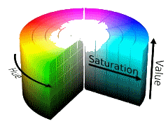
Case Study:
You’ve just started a new job and your team lead says: “Here’s some code in our graphic system that handles different color schemes. Could you come up with a better design?”
enum ColorScheme { RGB, HSB, HLS };
public class Color
{
private float red, green, blue; // RGB scheme
private float hue1, sat1, bright1; // HSB scheme
private float hue2, light2, sat2; // HLS scheme
public Color(float arg1, float arg2, float arg3, ColorScheme cs)
{
switch (cs)
{
// init arg1, arg2, and arg3 based on ColorScheme
}
}
}

Slide 19
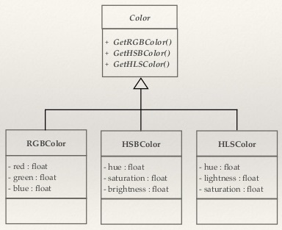
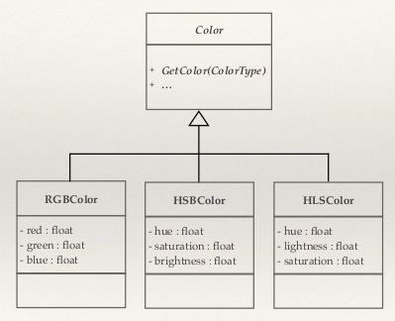
Case Study:
Define an interface for creating an object, but let subclasses decide which class to instantiate

Slide 20
Refactoring with the Factory Pattern
Define an interface for creating an object, but let subclasses decide which class to instantiate. Factory Method lets a class defer instantiation to subclasses.
Factory method pattern is a Creational Pattern.
There is a base factory interface/base class which defines common methods for creating objects of subclasses.
The logic for creating different types is contained in the subclass.
Uses polymorphism in that what is returned is an object of type base class at run time.

Slide 21
Class Diagram: Factory Method PAttern
Base Product Interface
ColorScheme
Factory
Creates the
required
implementation
Uses
+Create(String TypeScheme)
Extends
Extends
Extends
Uses
Concrete Implementations
RGB
HSB
HLS
Client

Slide 22
Re-Implementation Using Factory Pattern
public class ColorScheme {
// base class
}
public class RBGScheme : ColorScheme {
// code for overriding ColorScheme methods
}
public class HSBScheme : ColorScheme {
// code for overriding ColorScheme methods
}
public class HLSScheme : ColorScheme {
// code for overriding ColorScheme methods
}
ColorScheme
Extends
Extends
Extends
RGB
HSB
HLS

Slide 23
RE-Implementation using Factory Pattern
public static class Factory
{
public static Dictionary<string, ColorScheme> scheme =
new Dictionary <string, ColorScheme>();
static Factory()
{
scheme.Add( "RGB", new RGBScheme());
scheme.Add( "HSB", new HSBScheme());
scheme.Add( "HLS", new HLSScheme());
}
public static ColorScheme Create(string TypeScheme)
{
return scheme[TypeScheme];
}
}
Factory
+Create(String TypeScheme)
Factory has a Create method with an input string that identifies the color scheme type.
Returns an object of type ColorScheme

Slide 24
RE-Implementation using Factory Pattern
public class Client
{
private ColorScheme selection = null;
// create a new scheme based on selection
selection = Factory.Create ( “RGB” );
}
Factory
+Create(String TypeScheme)
Uses
Color Scheme
RGB
HSL
HSB
Client

Slide 25

Case Study
You’ve just started a new job and your team lead says: “Here’s some code in our graphic system that handles different color schemes. Could you come up with a better design?”
New Implementation
Old Implementation
Uses Base and Concrete Classes
Factory Pattern to create objects
RIP (Replace IF with Polymorphism)
Modular and easily modified
Use Enums and variables
Constructor with multiple arguments
switch and if statements
Non-modular

Slide 26

Summary
Patterns are the recurring solutions to the problems of design.
People learn patterns by seeing them and recall them when need be without a lot of effort.
Patterns link together in the mind so that one pattern leads to another and another until familiar problems are solved.
http://c2.com/ppr/
Portland Pattern Repository
Repository of solutions to recurring problems found in computer programming
Pattern Language Catalogue
People, Projects & Patterns

Slide 27
Thank you

Slide 28


Lesson Acroynm
Acronym | Definition
CRC | Class-Responsibility-Collaboration
GRASP | General Responsibility Assignment Software
OOAD | Object Oriented Analysis and Design
OOP | Object Oriented Programming
OOPSLA | Object oriented Programming, Systems, Language and Architecture
MVC | Model-View-Controller
NSGA-II | Non-dominated Sorting Genetic Algorithm II
UML | Unified Modeling Language
Notes:
GRASP – assigning responsibilities to objects – creater – who is responsible for creating an instance of a class, controller – who is responsible for handling an input event
CRC – paper-based method for assigning

Slide 29
Works cited
A Multi-Objective Refactoring Approach to Introduce Design Patterns and Fix Anti-Patterns: http://csserver.ucd.ie/~meloc/papers/nasbase_2015b_final.pdf
Design Patterns Through Refactoring, Ganesh Samarthyam, 2015.
OODesign.com : http://www.oodesign.com/
Table Summary for A Pattern Language: http://www.jacana.plus.com/pattern/P0.htm.
.NET Interview Preparation videos

