Slide 1
Quiz Bee
Python game
Jericho Ferrer

Slide 2
The game is all about philippine history it consist with 8 question it will test you about your knowledge in our history . It will show your score and your average, It’s a simple game but you will learn about our history and its fun .

Slide 3
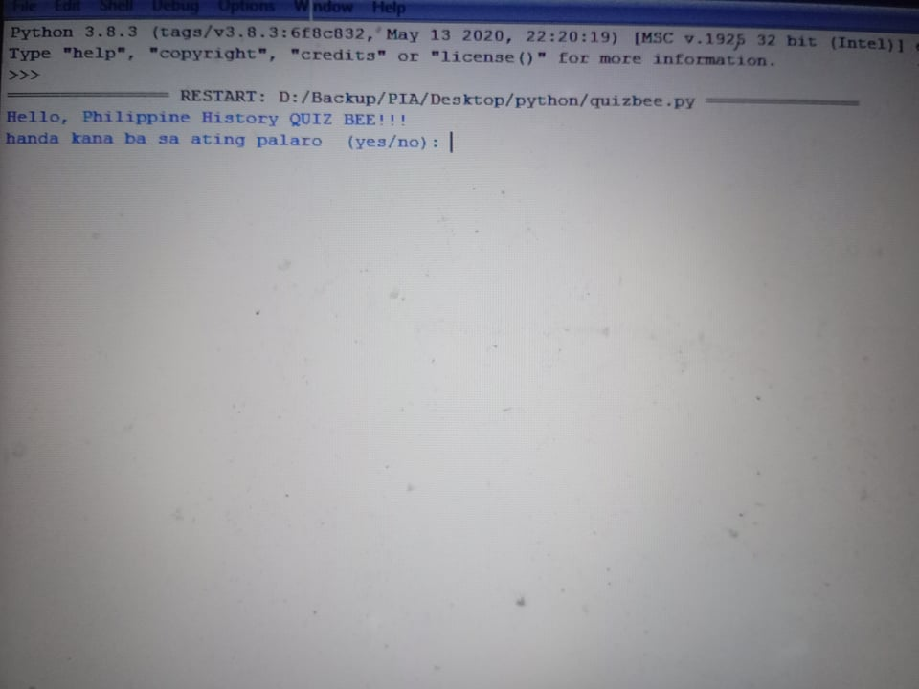
Sample picture

Slide 4
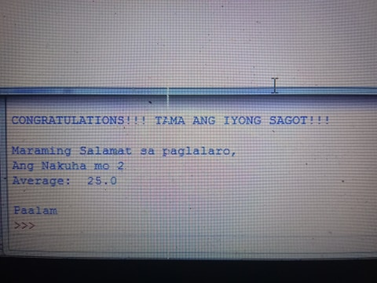
Sample Picture

