Slide 1
REDESIGNING THE RECIPE
Reducing the cognitive load of cooking
Miriam Cha, Michelle Deng, and Melih Elibol
CS279 Final Presentation

Slide 2
Outline
Background: Motivation, theory, and goals
Procedure: Iterative design and observations
Synthesis

Slide 3
BACKGROUND
Motivation, theory, and goals

Slide 4
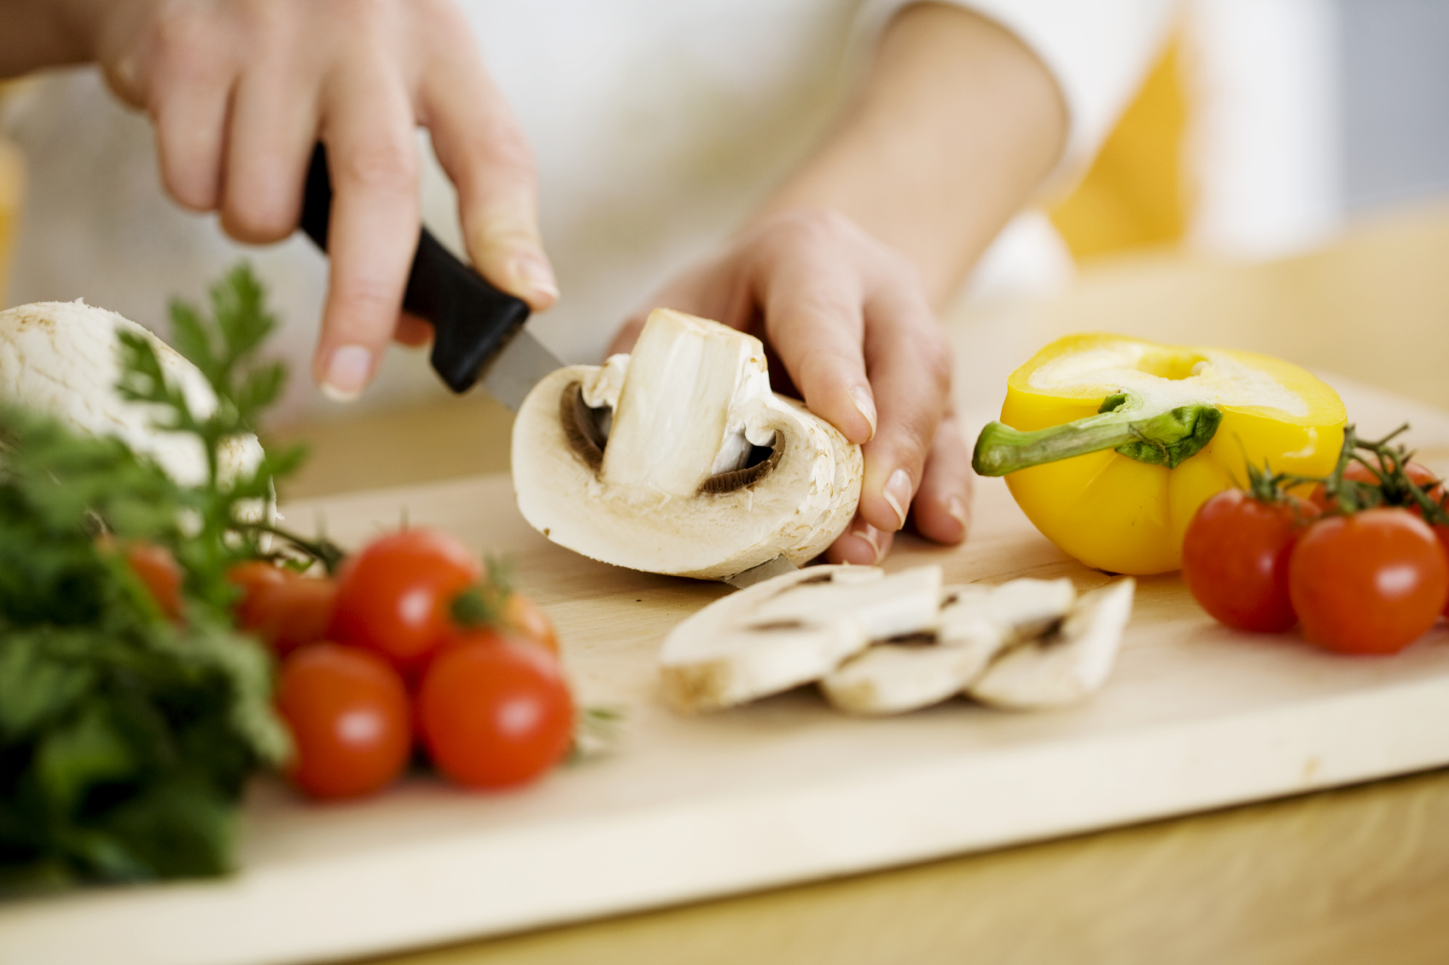
Once upon a time…

Slide 5
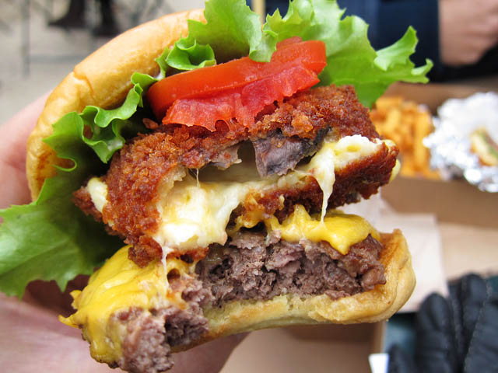
But now…
Notes:
- This is despite the many benefits of home cooking, e.g. nutrition and fun
We wanted to help bring back home cooking, so we decided to examine cooking instruction material: i.e., the recipe. Specifically, in the mind of a novice.
Healthy eating, dietary restrictions due to allergies, religious reasons, personal beliefs, etc.
Our research targets people who:
Are interested in controlling what they eat
Are unable to achieve their dietary needs through take out / pre-packaged food
Do not know how to cook

Slide 6
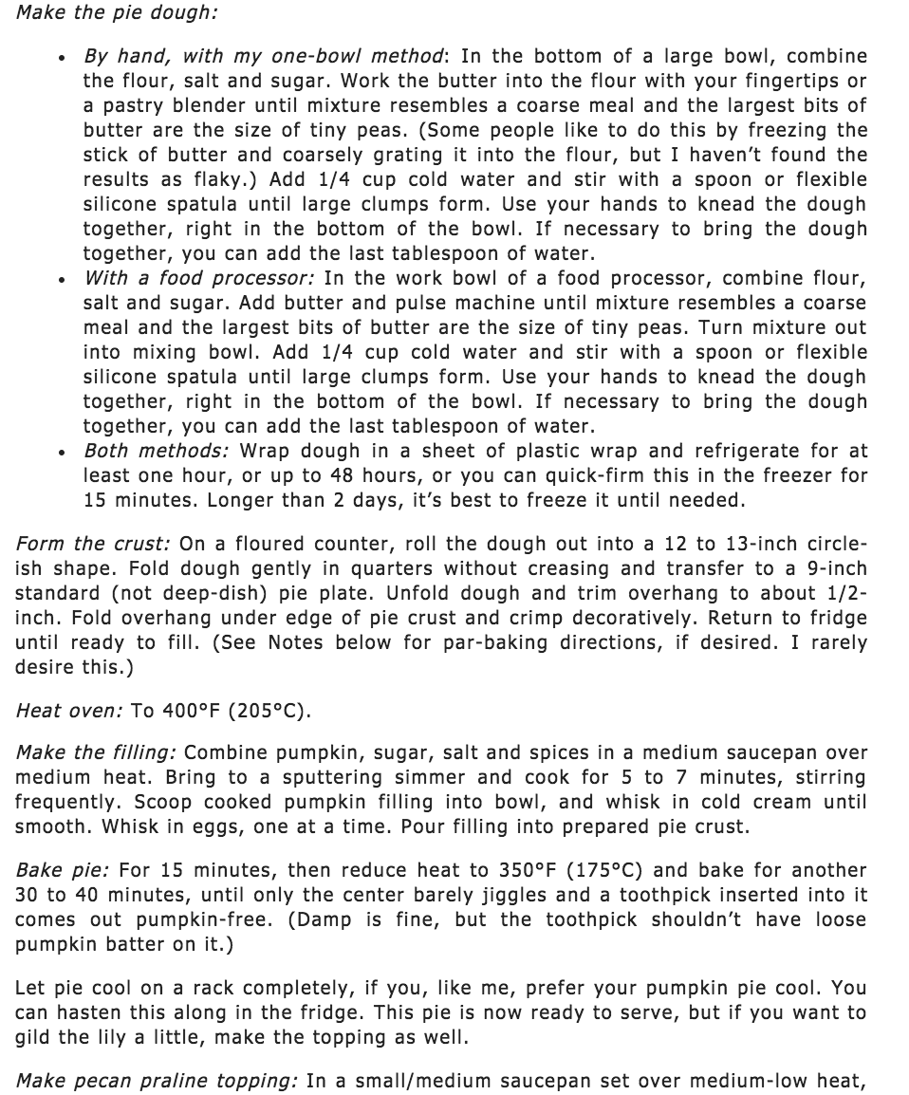
Typical recipe

Slide 7
Typical recipe
???
Notes:
Large blobs of text describing sequences of actions
Time pressure, accuracy pressure
So much to process, particularly to the novice cook. Learning is hard.
In technical terms: this may be cognitive overload.

Slide 8
Cognitive load + learning recap
Definitions
Working memory: limited buffer of actively processed events
Long-term memory: vast repository of learned schemas
Learning: working memory → LTM
Cognitive load: load on working memory
Good instructional design increases germane load and reduces extraneous cognitive load
Notes:
Let’s step back and review these concepts.
Working memory: auditory, visual buffers. Stores 7 units. Element interactivity increases load. Actively process 2-3 units at a time.
Long-term memory: not as bad
Learning: save in LTM, but need to go through working memory to do that. To facilitate learning need to ease load. How?
1) Promote useful connections that encode richer concepts – known as germane load
2) Reduce unnecessary effort, e.g. flipping back and forth to remember different parts of one idea – extraneous load
We’re going to use this to inform our design.
John Sweller “Cognitive Architecture and Instructional Design”

Slide 9
Design principles
Use interactivity to limit displayed information
Emphasize relevant information based on user interaction
Retain existing design choices that work well
Notes:
We are “chunking” information to reduce cognitive load.
Reduce visual search time to allow more working memory to be allocated toward germane cognitive load.
Don’t change what already works well; see how interactivity can improve antiquated designs.

Slide 10
Research questions:
What is important information to a cook?
What information is extraneous?
What adds confusion?
How do these change over time?
What format makes important information most salient?
If we make important information salient and remove extraneous information, will perceived difficulty of cooking decrease?
Notes:
First 4 questions are background information needed to inform a recipe design.
5th is what we will measure in controlled experiments.
Hypothesis is that the answer to the last one is yes.

Slide 11
PROCEDURE
Iterative designs and observations

Slide 12
Sequence
User observations for preliminary answers to Q1-Q4
Design 2 experimental interfaces based on observations
Test these interfaces and a control
Use results to refine interfaces and answers to Q’s
Notes:
1. What information is important to a cook?
2. What information is extraneous?
3. What adds confusion?
4. How do these change over time?

Slide 13
Preliminary observations
At beginning, all ingredients and overview of step sequence seem important
Later, only subset of ingredients and steps are relevant
Keeping track of current step and ingredients in relation to previous steps adds stress
People tend to like to plan current actions in light of what’s coming next
Notes:
Presented this last time – recall that it’s 3 subjects of differing skill level, each doing an unfamiliar recipe
Note the design we had before Study 1 (we should use Michelle's original mocks for this).
Note the design we had after Study 1 (we can just show the live site)
Note the changes and reasoning (in cognitive-load-theoretic terms) we made to final design based results of study 1.

Slide 14
Translating to design…
We should definitely:
Emphasize instructions for current step
Highlight ingredients for current step
Uncertain how much context about other steps is needed in addition
Notes:
Obviously, when working on a current step, every detail needs to be shown, and to reduce effort searching for current step, should make these visually salient.
Secondly people like to plan, and that needs context about other steps. But what do they really need in view? Other ingredients? Overarching summary of what happened / will happen? How many steps remain? Or do they need anything at all?

Slide 15
Interface demo!
https://github.com/frankbaffle/omnomnom/tree/master/client
Notes:
To test this, 2 experimental interfaces. Arrived on these via parallel paper prototyping -> digital prototypes -> final implementations on web.
First show SBS: “this is the one we call step-by-step”. Sidebyside arrow nav as well. Bold ingredients. Multi-step ingredients – list twice. Based on idea that all that’s important is current position / index in sequence. Hide all the details of other steps to eliminate load of search.
Then show responsive (“we called this responsive.”). Same ingredients, also highlight current stpe. Features notion of semantic zoom – amount of info shown changes with different levels of interaction. Based on idea that people may want to see summary goal of all steps at any given time to better understand recipe structure and make mental calculations about relative time, ingredients, and cookware necessary at each step. Still eliminate nitty gritty details of every step.

Slide 16
Experimental design
3 interfaces, 3 recipes, 3 subjects
Each subject tried each interface and recipe once
Latin squares counterbalanced both interface and recipe sequences
Measurements:
Qualitative: Direct observations, in-depth interviews, NASA survey
Quantitative: temporal logging, step-scanning frequency, and raw count
Notes:
Same 3 subjects as before
Tried to make recipes things nobody had done quite exactly before (obviously hard, esp given different skill levels), and somewhat consistent in difficulty across recipes

Slide 17
Results: Subject 1
Control (Eggs)
“Seemed like an essay”
Step-by-step (Lasagna)
Paragraph format “didn’t have as daunting of a feel since SBS only showed one”
Each step was still “a heap of information and wasn’t easy to figure out intermediate steps”
Responsive (Risotto)
“With ingredient highlighting, I didn’t have to concern myself with extraneous things on table”
“I could see all the steps in one place rather than having to click back and forth multiple times”
“I like the little blurbs of what was being achieved in that step”
Notes:
Showing in the order that subjects has conducted the experiment.
SBS:
Clear separation of steps made for easier digestion and awareness of what I needed to do without worrying too much of overall picture.
I like the clear delineation of each step and the ingredients involved respectively.
It would b e nice to make the paragraphs even smaller with more steps. If the same time that would make it more challenging to go back and forth when doing simultaneous procedures.
Ours:
the highlighting of ingredients list as I went through the steps was wonderful because I could just focus on the few on table that I needed at the moment
I liked that each step was clearly spaced out just like in interface 2. But what made interface 3 even better was I could see all the steps in one place rather than having to click back and forth multiple times to go from say step 2 to step 5 with interface 3. I could look at step 5 and then go back to step 2 with just one click. And because each step had a header, it sort of offered a little blurb/summary of what was being achieved in that step.

Slide 18
Results: Subject 2
Responsive (Lasagna)
“I was going up and down a lot because trying to parallelize process”
Each chunk was still too large: “Didn't know what to do first. What ingredient in what.”
“Didn’t notice” the summary text
Control (Risotto)
“Information overload”
Step-by-step (Eggs)
Recipe was easy: “once I looked at the recipe, actually didn't go back to it because it was so straightforward”
Liked visual previous/next labels and horizontal transitions: more “digestible” and “rewarding”
Notes:
This user prioritized speed and focused on parallelizing process across several pots. Everything is about what ingredients and pots can be done simul.
Difficulty rankings…
Recipe difficulty: "the more work I put into it, more difficult I think it is. scared I am that it'll fail.""
- first: borderline medium-hard. required 3 pots and the oven, and anything that requires oven for long periods of time makes me nervous.
- second: medium. only 2 pans.
third: low. "very easy. closed eyes could do it."
- Information content:
- control was "definitely the worst. spent so much time trying to figure out where I am, what ingredient to use, " "pretty terrible experience, really difficult to use."
- responsive vs. sbs:
- "Couldn't tell difference in how much information was presented; couldn't tell if you were changing it up."
- Didn't notice the summary text for responsive.
- "EXCEPT I really liked next and previous arrows. Somehow, that just made it more digestible.”
Evident that large blob text was the first thing missed. Ingredient panel used often for easy reference – very crucial to be accurate here.
control was "definitely the worst. spent so Lack of detail in ingredients panel contributed to chopping mistake:
- ingredients panel said need half cup broccoli, half cup cauliflower, so assumed they want you to just cut into florets - but they actually wanted dice. could not fix mistake for cauliflower because no time to fix (onions and carrots were cooking already). ingredients only say 1/2 cup, but the detailed instructions say dice.
- He must have skimmed the step for ingredients and then only referred to the ingredients panel for quantities after that, because ingredients panel is simpler and less overloady. This holds even for control, which lacks ingredient bolding.
- Takeaways:
(1) blob text really does get lost, especially when there is time pressure
(2) we should ensure that simple terms like "chopped" or "diced"
responsive vs. sbs:
- "Couldn't tell difference in how much information was presented; couldn't tell if you were changing it up."
- Didn't notice the summary text for responsive.
- "EXCEPT I really liked next and previous arrows. Somehow, that just made it more digestible."

Slide 19
Results: Subject 3
Step-by-step (Risotto)
“Actually, it's (ingredient highlighting) so helpful I didn't even notice it was happening!”
“Well, I wish I would have known that I should have prepared a little extra broth.” (reaction while reading last step)
Responsive (Eggs)
“I guess I’m baking.” (referring to an unselected step summary)
“I don't have a scale so I can't weigh out exactly one pound.”
(prolonged silence) Q: “How is everything going?” A: “Good.“
Control (Lasagna)
“Ughh it's not highlighted!”
“I'm going to assume this means pan.”
“I am now simultaneously doing steps 1, 2, and 3, but I can't start step 3 until I have the pan from step 1, so now I am also starting step 4.”
Notes:
What worked?
Ingredient highlighting was very successful (stayed out of users' way while helping them keep track of ingredients involved in a given step).
Post interview with subject suggests that benefits of SBS is that it chunks information, instead of having "everything written out in a giant blob."
Subject likes responsive interface.
Subject dislikes control interface. Says this may have been influenced by the difficulty of lasagna recipe.
What didn't work?
Expected responsive to be more performant than sbs, but this was not evident from data/observations. The drawbacks of SBS were clear (missed important future steps that slowed user down), but it was not clear whether responsive interface helped alleviate this. This may be due to eggs and risotto recipes being well written and not containing any steps that needed to be performed at the same time. Post questioning of subject seemed to indicate that subject would prefer Responsive interface over SBS for lasagna recipe.
Subject reports that adding materials list would be super helpful, but highlighting materials may be unnecessary.
NASA data seemed to reflect reactions to recipe, not interface.
Recipes were not equal in difficulty, creating biases in NASA and reactions to interfaces.

Slide 20
Results: What Worked?
Most subjects preferred Responsive Interface over Step-by-step and Controlled
Ingredient highlighting helped subjects keep track of ingredients per step while staying out of their way
Responsive interface reduced load of extraneous information presented at any given step

Slide 21
Results: What Didn’t Work?
SBS chunked information, but missed important future steps that slowed subject down
For a given recipe, we expected responsive to take less total cooking time than Step-by-step and Control, but this was not evident from data/observations
NASA data seemed to reflect reactions to recipe, not interface
Recipes were not equal in difficulty, creating biases in NASA and reactions to interfaces

Slide 22
Results: Quantitative
Number of times user has switched between steps
 | Risotto | Eggs | Lasagna
Control | - | - | -
Responsive | 6 | 10 | 34
Step-by-step | 14 | 25 | 37
For each recipe, Responsive interface led to smaller number of step changes than Step-by-step interface.
For each recipe, the number of times a step has changed indicates the amount of cognitive load the recipe demands.
Notes:
For each recipe, the # of times a step has changed indicates the amount of cognitive load the recipe demands.
SBS vs. Responsive: For a given recipe, we may compare the # of times a step has changed. We claim a smaller number in step change indicates the ability of that interface to reduce cognitive load due to the capacity of working memory.
Control vs. SBS: For a given recipe, we may compare the total duration it took to make that recipe. We claim this indicates an overall reduction in cognitive load due to chunking.
Control vs. Responsive: For a given recipe, we may compare the total duration it took to make that recipe. We claim this indicates an overall reduction in cognitive load due to chunking.

Slide 23
Proposed design refinements
Enforce constraints on text length of recipe steps
Use summaries that enable multi-tasking
Include (possibly highlight) cookware
Salient clickable navigation
Include ‘next’ and ‘previous’ buttons
Visual feedback for clickability
Notes:
Subjects expressed need for materials to be given upfront
Constraining the length of recipe steps will force more bite-sized steps (expressed as an issue in recipe design).
For responsive, write step summaries that provide information that enables parallelization. This may help counter the drawbacks of SBS, and make the difference in SBS and Responsive interface more prominent. (Although Subject 3 indicated this would be unhelpful; she liked the summary).
A map between materials and steps should be established.
Based on success of ingredient highlighting in study 2, highlight materials used per step (similar to ingredients used per step). (Subject 3 indicated this would be excessive/unnecessary).

Slide 24
Future Work
Crowdsource users to curate recipes
Crowdsourcing to find errors in recipes
More number of subjects to get statistically meaningful results
Examine possibilities to curate a recipe that can guide users to complete multiple tasks at the same time
Incorporate multimedia (e.g., images, videos) information
Notes:
Another round of testing: if time, let each subject follow one more (new) recipe with the new design; if not, at least let them play with the implementation and give feedback

