Slide 1
Neighborhood recommend for a new Chinese restaurant
XU Shuai
2020/7/29

Slide 2
1. INTRODUCTION
1.1 Background
Find the preliminary siting for a new Chinese restaurant in New York City by grouping the information of the restaurant existent and the rate of crime
1.2 Problem
A high level of the restaurant;
A low level of the Chinese restaurant;
A low level of the crime.
1.3 Interest
new chines restaurant

Slide 3
2. DATA
2.1 data source
Restaurant:
FourSquare API,
geo info of the neighborhood (https://geo.nyu.edu/catalog/nyu_2451_34572)
Crimes:
New York City Police Department (NYPD)
(https://data.cityofnewyork.us/Public-Safety/NYPD-Complaint-Data-Current-Year-To-Date-/5uac-w243 )

Slide 4
2.2 data choosing
restaurant data
Neighborhood
Latitude
Longitude
venues
crime data
LAW_CAT_CD:
Latitude
Longitude

Slide 5
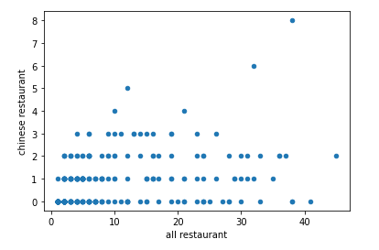
3. Methodology
Choose the neighborhood base on the number of the restaurant
Neighborhoods chosen
All restaurants >20
Chinese restaurant <1

Slide 6
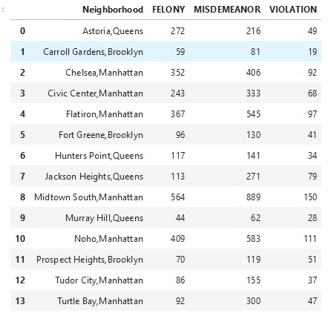
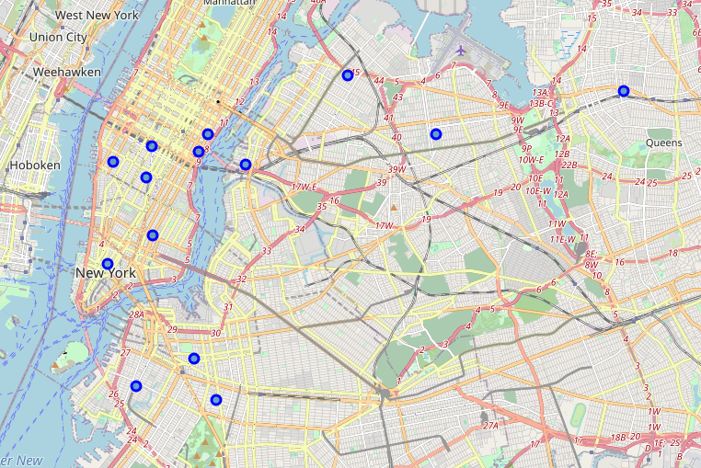
Count the number of crimes in a certain distance

Slide 7
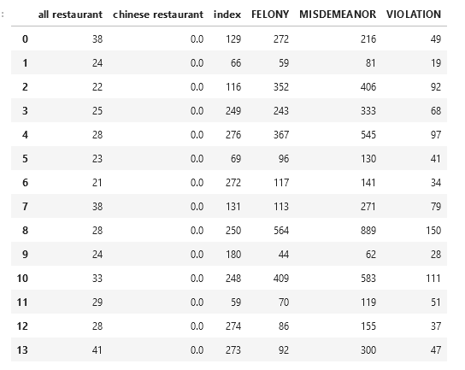
Merge the data and cluster
All restaurant
Chinese restaurant
Felony
Misdemeanor
Violation
Model
Kmeans
K=4

Slide 8
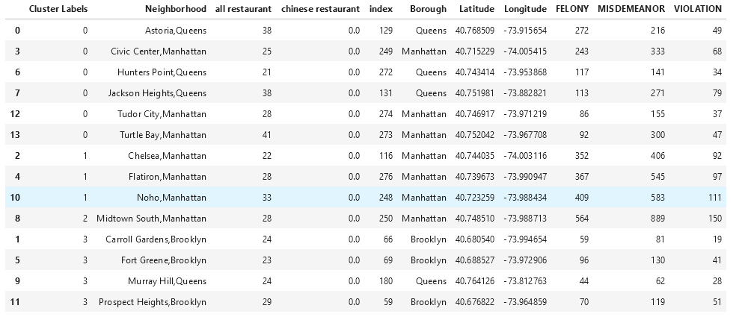
4. Result
Cluster 0: 6 red points
Cluster 1: 3 purple points
Cluster 2: 1 blue point
Cluster 3: 4 green points

Slide 9
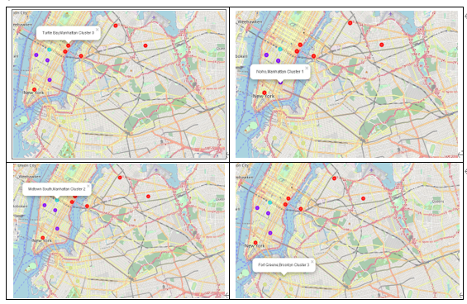

Slide 10
5. Discussion
Cluster 0: high-level restaurant low crime
recommend
Cluster 1: low-level restaurant high serious crime
Don’t suggestif
Cluster 2: low-level restaurant very high serious crime
Don’t suggestif
Cluster 3: low-level restaurant low crime
Choice alternance

Slide 11
6. Conclusion
recommend
Astoria, Queens
Civic Center, Manhattan
Hunters Point, Queens
Jackson Heights, Queens
Tudor City, Manhattan
Turtle Bay, Manhattan
Choice alternance
Chelsea, Manhattan
Flatiron, Manhattan
Noho, Manhattan

Slide 12
7. To improve
The list of the restaurant:
A list more exact for the restaurants
The research of the crimes:
A better way to find the crimes nearby
The algorithm of the clustering:
Try the others models or coefficients

