Slide 1
An Interim Futility Approach for Clinical Trials with Multiple Experimental Groups
Zhishen Ye & Neby Bekele

Slide 2
Outline
Background
Study design
Challenge
Simple approach
The “issues”
Examples
New approach
A concept
A tool
Discussion

Slide 3
Study Design
W8
W52
N=220
placebo
placebo
N=220
exp. q2w
exp. q2w
N=220
exp. qw
exp. qw
N=150
(Part A)
N=510
(Part B)
FDA would like a Phase II study & an EOP2 meeting
Initial
enrollment
~50/group
Continue
enrollment
~170/group
Interim futility
of W8 response
Primary analysis
of W8 response
Select one optimal regimen &
Enroll Cohort 2 based on the optimal regimen

Slide 4
Calculation of Predictive Power
The test statistic to select an experimental group over placebo group at the end of the study is
Predictive power: the predictive probability of rejecting this test statistic given the interim data
Assuming a beta prior, takes form of a beta-binomial
Beta(0.05,0.05) is selected to limit its impact

Slide 5
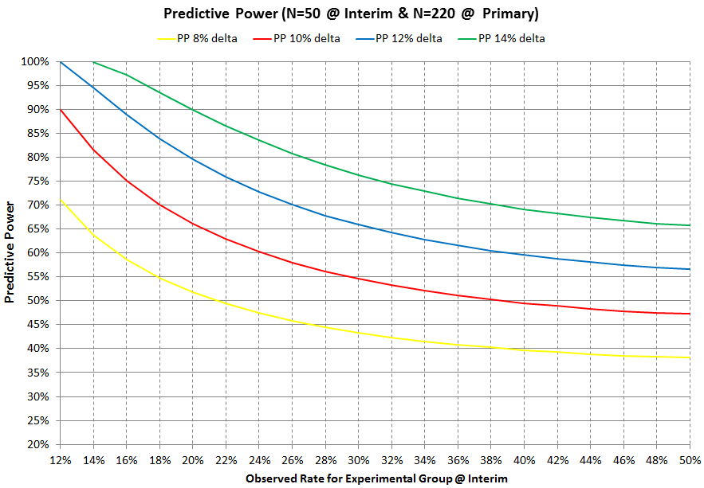
Predictive Power Curves

Slide 6
Simple Futility Approach
Predictive power futility guideline
Stop none if both PP ≥ 45%
Otherwise stop each group with PP < 45%
What if
Example 1 | Treatments
 | Placebo | Exp. qw | Exp. q2w
Number (%) of Responders @ IA | 10 (20%) | 14 (28%) | 14 (28%)
Predictive Power |  | 44.47% | 44.47%
Example 2 | Treatments
 | Placebo | Exp. qw | Exp. q2w
Number (%) of Responders @ IA | 10 (20%) | 15 (30%) | 13 (26%)
Predictive Power |  | 54.59% | 34.46%

Slide 7
New Concept: Nominal Predictive Gain
Nominal Predictive Gain, NPG=1-(1-PP₁)*(1-PP₂)
Equal to the joint predictive power if PP₁ and PP₂ are independent
Easy to calculate
Example 1 | Treatments
 | Placebo | Exp. qw | Exp. q2w | NPG
Number (%) of Responders @ IA | 10 (20%) | 14 (28%) | 14 (28%)
Predictive Power |  | 44.47% | 44.47% | 69.16%
Example 2 | Treatments
 | Placebo | Exp. qw | Exp. q2w | NPG
Number (%) of Responders @ IA | 10 (20%) | 15 (30%) | 13 (26%)
Predictive Power |  | 54.59% | 34.46% | 70.24%

Slide 8
NPG Futility Approach
NPG futility guideline
Stop none if both PP ≥ 45%
Otherwise calculate NPG=1-(1-PP₁)*(1-PP₂)
If NPG ≥ 65%, then stop none
Otherwise stop each group with PP < 45%
What if
Example 3 | Treatments
 | Placebo | Exp. qw | Exp. q2w | NPG
Number (%) of Responders @ IA | 9 (18%) | 13 (26%) | 11 (22%)
Predictive Power |  | 45.81% | 25.82% | 59.80%
Example 4 | Treatments
 | Placebo | Exp. qw | Exp. q2w | NPG
Number (%) of Responders @ IA | 10 (20%) | 17 (36%) | 13 (26%)
Predictive Power |  | 80.17% | 34.46% | 87.01%
NPG=1-(1-PP₁)+(1-PP₁)*PP₂=PP₁+(1-PP₁)*PP₂

Slide 9
NPG Futility Approach
NPG futility guideline
Stop none if both PP ≥ 45%
Otherwise calculate NPG=1-(1-PP₁)*(1-PP₂)
If NPG ≥ 65% and ≥10% higher than both PP, then stop none
Otherwise stop each group with PP < 45%
Example 1 | Treatments
 | Placebo | Exp. qw | Exp. q2w | NPG
Number (%) of Responders @ IA | 10 (20%) | 14 (28%) | 14 (28%)
Predictive Power |  | 44.47% | 44.47% | 69.16%
PP₂ | PP₁
 | High (≥45%) | Low (<45%)
High (≥45%) | Stop None
Low (<45%)
Stop qw if Fail:
NPG≥65% AND
NPG≥10%+max(PP₁,PP₂)
Stop q2w if Fail:
Stop Both if Fail:
Example 2 | Treatments
 | Placebo | Exp. qw | Exp. q2w | NPG
Number (%) of Responders @ IA | 10 (20%) | 15 (30%) | 13 (26%)
Predictive Power |  | 54.59% | 34.46% | 70.24%
NPG≥65% AND
NPG≥10%+max(PP₁,PP₂)
NPG≥65% AND NPG≥10%+max(PP₁,PP₂)

Slide 10
Futility Rules Including Clinical Criteria
Yes
PP ≥ 45% in
both experimental groups?
No
PP ≥ 45% in
one experimental group?
No
Yes
NPG ≥ 65% and
NPG ≥ 10% + max(PP₁,PP₂)?
NPG ≥ 65% and
NPG ≥ 10% + max(PP₁,PP₂)?
No
No
Stop both groups
Yes
Yes
Only the group with PP ≥ 45% is eligible for continued enrollment
Both groups are eligible for continued enrollment
Clinical criteria
No
For each group: is the observed rate < 20% and < 10% higher than the rate in placebo?
Yes
Enroll additional subjects for the group
Consider stopping the group based on totality of the data

Slide 11
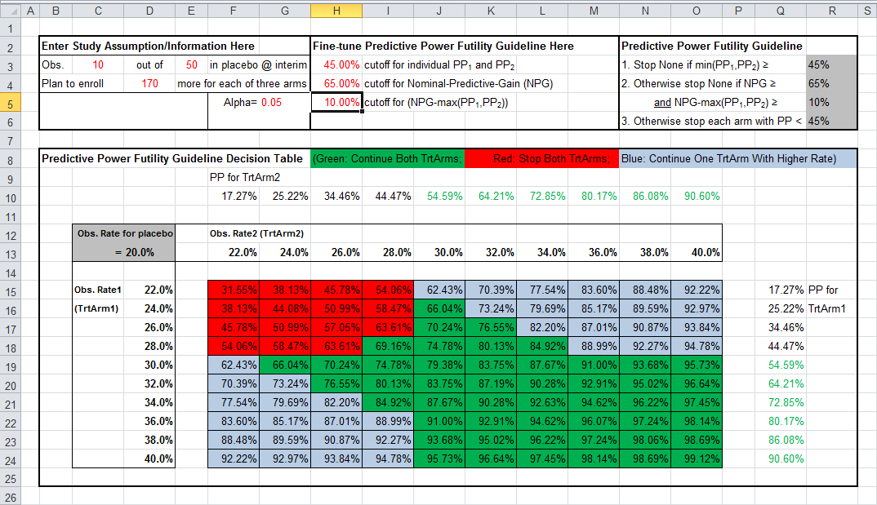
Excel Tool for NPG Futility Approach

Slide 12
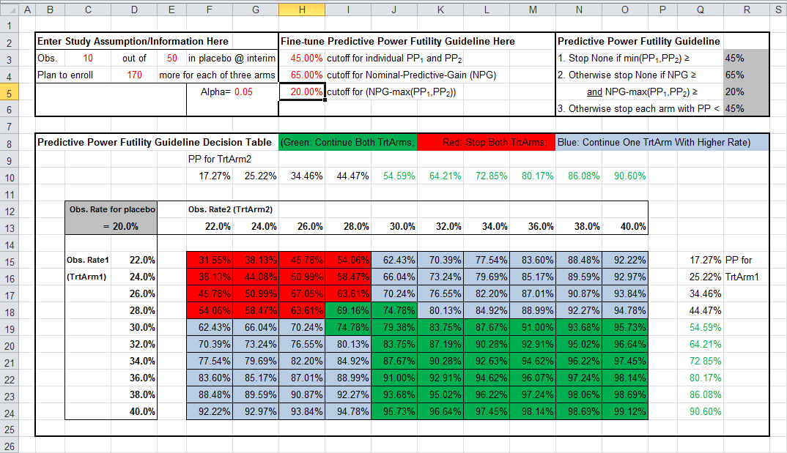
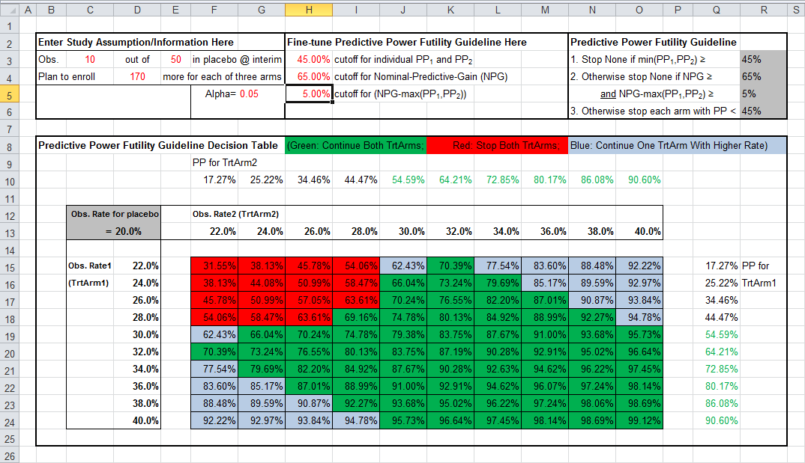
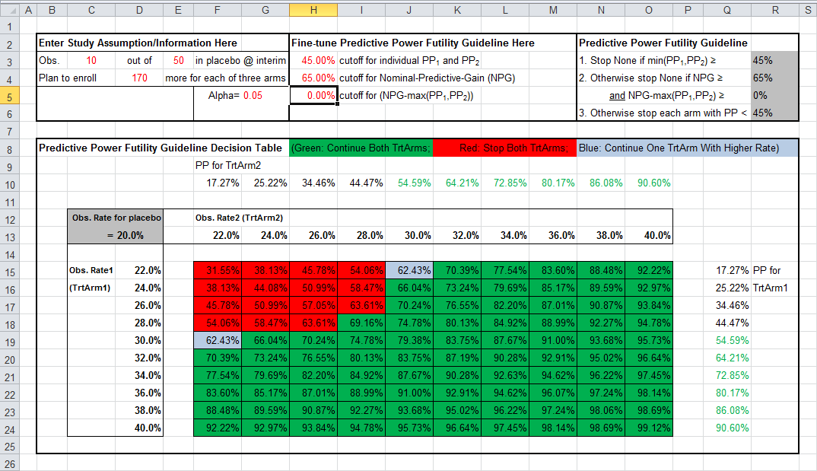
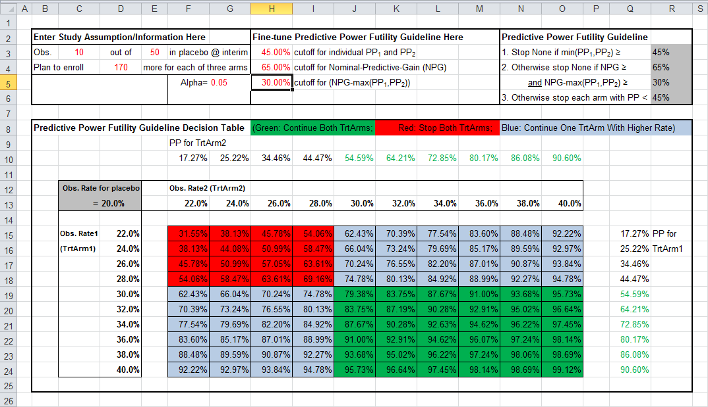
Fine-tune Cutoff for NPG-Max(PP₁,PP₂)

Slide 13
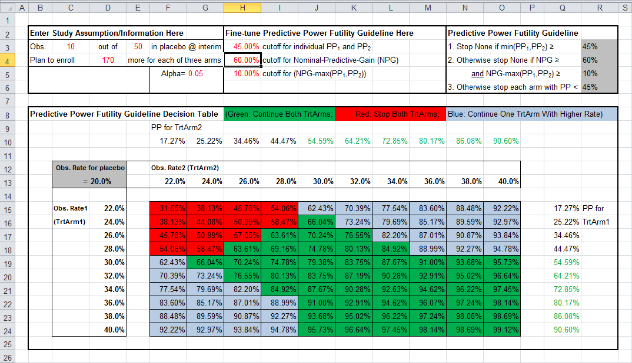



Fine-tune Cutoff for NPG

Slide 14


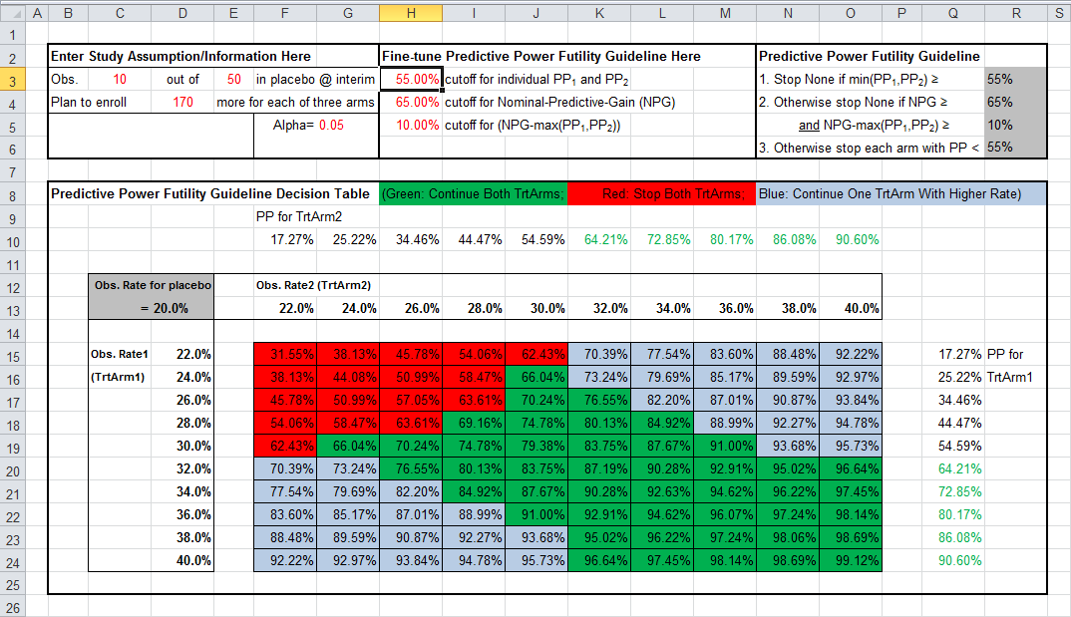
Fine-tune Cutoff for Individual PP

Slide 15
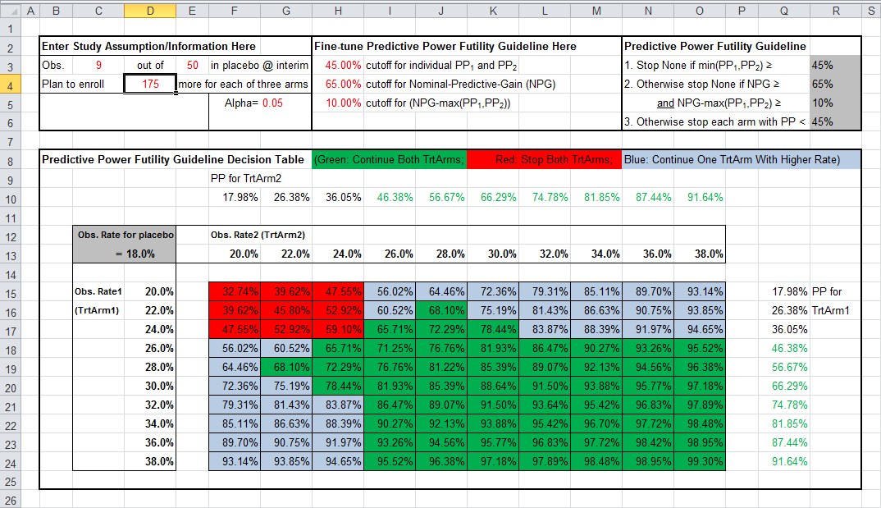


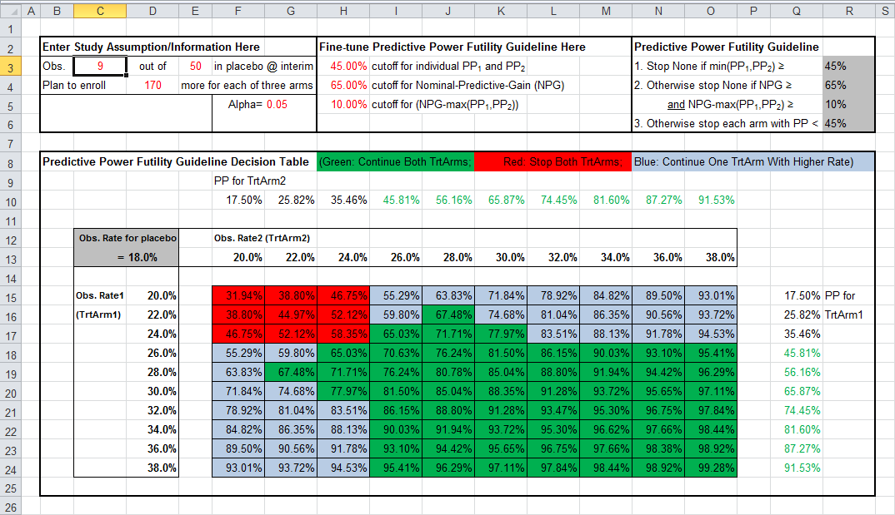
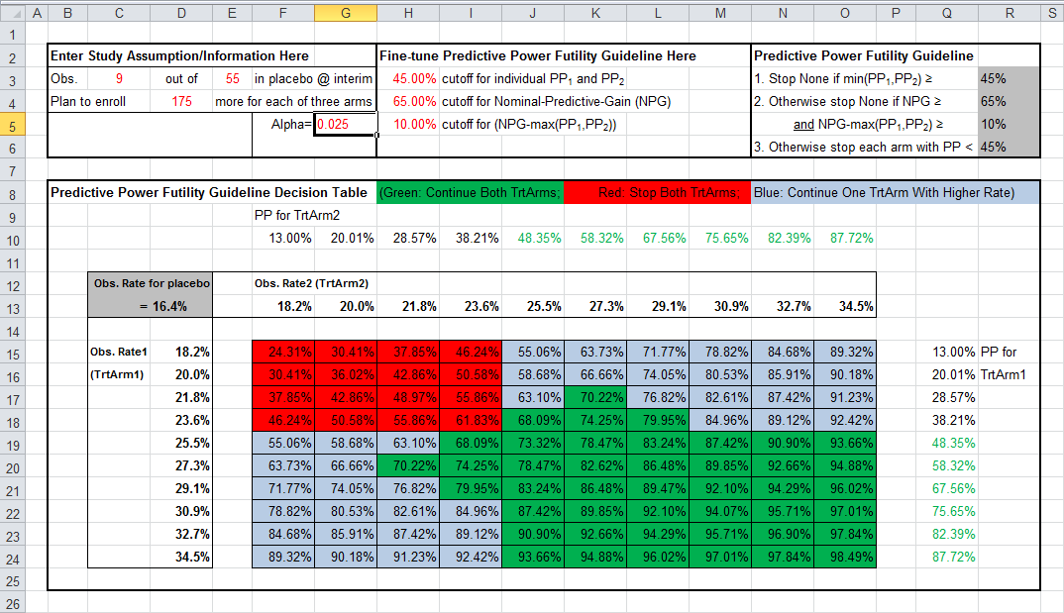
Other Parameters

Slide 16
Generalize NPG Futility Guideline
Example NPG guideline for studies with three experimental groups
Stop none if all three PP ≥ 45%
Otherwise sort three PP so that PP₁ ≥ PP₂ ≥ PP₃, then calculate NPG₃=1-(1-PP₁)*(1-PP₂)*(1-PP₃) and NPG₂=1-(1-PP₁)*(1-PP₂)
If NPG₃ ≥ 75% and ≥ 5% + NPG₂, then stop none
Otherwise stop the group with PP₃, treat the rest of two groups as a two-group-problem:
Stop neither if PP₁ ≥ PP₂ ≥ 45%
Otherwise,
If NPG₂ ≥ 65% and ≥ 10% + PP₁, then stop neither
Otherwise stop each group with PP < 45%
Continue the worst group?
If yes, then continue the worst, and therefore all three groups
If no, then stop the worst group, and reduce it to a two-group-problem

Slide 17
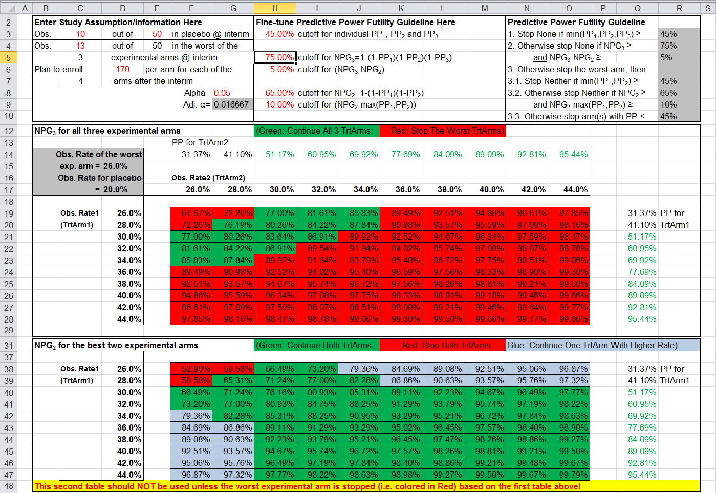
Excel Tool for Studies with 3 Experimental Groups

Slide 18
Discussion
Can not cover all scenarios once we specify the cutoffs
Focus on those most likely to happen
Impact on alpha & power
Binding or non-binding
Generalization
Studies with more than two experimental groups
Different type of endpoints
Nominal conditional (power) gain
Alternatives to nominal predictive gain?
Computational cost?
Necessary?

