Slide 1
Parallel Computing with OpenMP & GPU
Yanci Zhang

Slide 2
Contents
Overview of parallel computing
Introduction to OpenMP
Introduction to GPU
Applications in image processing and computer graphics

Slide 3
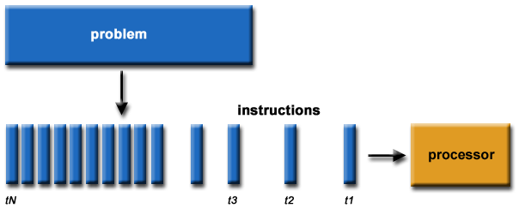
Serial Computing
Traditionally, software has been written for serial computation:
A problem is broken into a discrete series of instructions
Instructions are executed sequentially one after another
Executed on a single processor
Only one instruction may execute at any moment in time

Slide 4
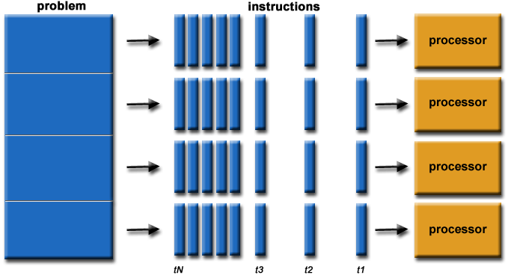
Parallel Computing
Parallel computing is the simultaneous use of multiple compute resources to solve a computational problem:
A problem is broken into discrete parts that can be solved concurrently
Each part is further broken down to a series of instructions
Instructions from each part execute simultaneously on different processors
An overall control/coordination mechanism is employed

Slide 5
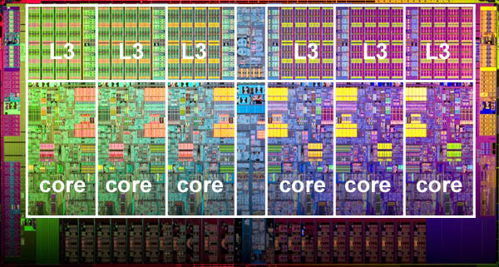
Parallel Computers 1/2
Virtually all stand-alone computers today are parallel from a hardware perspective:
Multiple functional units
Multiple execution units/cores
Multiple hardware threads

Slide 6
Parallel Computers 2/2
Networks connect multiple stand-alone computers (nodes) to make larger parallel computer clusters
Majority of world's large parallel computers are clusters of hardware produced by a handful of well known vendors

Slide 7

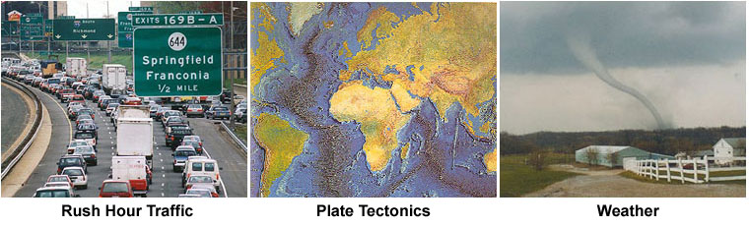
Why Use Parallel Computing 1/5
The real world is massively parallel

Slide 8

Why Use Parallel Computing 2/5
Save time and/or money
Throwing more resources at a task will shorten its time to completion, with potential cost savings

Slide 9

Why Use Parallel Computing 3/5
Solve larger problems
Many problems are so large and/or complex that it is impractical or impossible to solve them on a single computer, especially given limited computer memory

Slide 10

Why Use Parallel Computing 4/5
Provide concurrency
A single compute resource can only do one thing at a time. Multiple computing resources can be doing many things simultaneously

Slide 11

Why Use Parallel Computing 5/5
Use of non-local resources
Using compute resources on a wide area network, or even the Internet when local compute resources are scarce

Slide 12
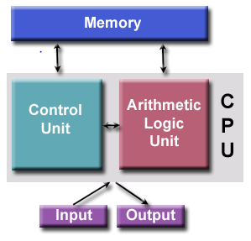
von Neumann Architecture 1/2
All computers have followed this basic design
Comprised of four main components:
Memory
Control Unit
Arithmetic Logic Unit
Input/Output

Slide 13
von Neumann Architecture 2/2
Read/write, random access memory is used to store both program instructions and data
Instructions: coded data which tell the computer to do something
Data: information to be used by the program
Control unit fetches instructions/data from memory, decodes the instructions and then sequentially coordinates operations to accomplish the programmed task
Aritmetic Unit performs basic arithmetic operations
Input/Output is the interface to the human operator

Slide 14
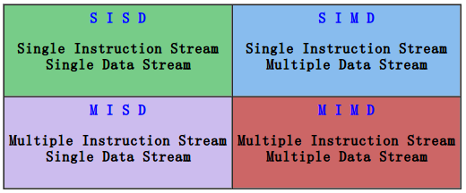
Flynn's Classical Taxonomy
Most widely used classifications for parallel computers
Distinguishes multi-processor computer architectures along the two independent dimensions of Instruction Stream and Data Stream
Each of these dimensions can have only one of two possible states: Single or Multiple

Slide 15
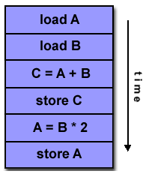
SISD
A serial (non-parallel) computer, oldest type of computer
Single Instruction: Only one instruction stream is being acted on by the CPU during any one clock cycle
Single Data: Only one data stream is being used as input during any one clock cycle
Deterministic execution

Slide 16
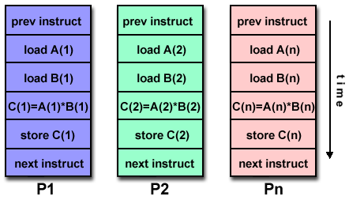
SIMD
Single Instruction: All processing units execute the same instruction at any given clock cycle
Multiple Data: Each processing unit can operate on a different data element
Best suited for specialized problems characterized by a high degree of regularity, such as graphics/image processing
Synchronous (lockstep) and deterministic execution

Slide 17
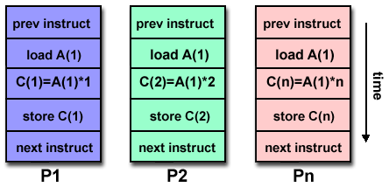
MISD
Multiple Instruction: Each processing unit operates on the data independently via separate instruction streams
Single Data: A single data stream is fed into multiple processing units
Few actual examples of this class of parallel computer have ever existed

Slide 18
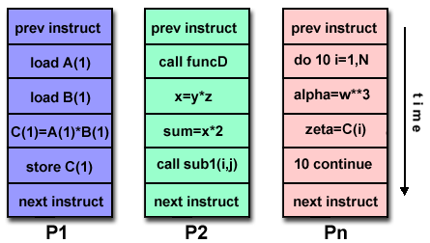
MIMD
Multiple Instruction: Every processor may be executing a different instruction stream
Multiple Data: Every processor may be working with a different data stream
Execution can be synchronous or asynchronous, deterministic or non-deterministic
Most modern supercomputers fall into this category

Slide 19
Amdahl's Law 1/3
States potential program speedup defined by the fraction of code (P) that can be parallelized
Example: If 50% of the code can be parallelized, maximum speedup = 2, meaning the code will run twice as fast ideally

Slide 20
Amdahl's Law 2/3
Introducing the number of processors N performing the parallel fraction of work, the relationship can be modeled by:

Slide 21
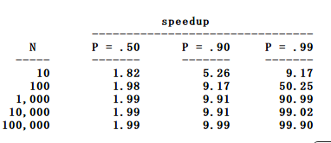
Amdahl's Law 3/3
There are limits to the scalability of parallelism
Problems that increase the percentage of parallel time with their size are more scalable than problems with a fixed percentage of parallel time

Slide 22
Shared Memory 1/2
All processors to access all memory as global address space
Changes in a memory location effected by one processor are visible to all other processors
Classified as UMA and NUMA, based upon memory access times

Slide 23
Shared Memory 2/2
Advantages
User-friendly programming perspective to memory
Data sharing between tasks is both fast and uniform
Disadvantages
Lack of scalability between memory and CPUs
Programmer responsibility to ensure "correct" access of global memory

Slide 24
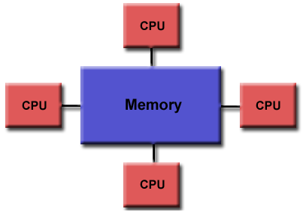
Uniform Memory Access
Commonly represented by Symmetric Multiprocessor (SMP) machines
Identical processors
Equal access and access times to memory

Slide 25
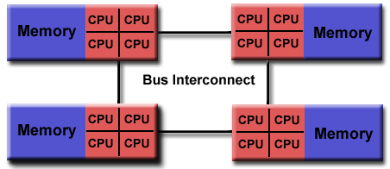
Non-Uniform Memory Access
Often made by physically linking two or more SMPs
One SMP can directly access memory of another SMP
Not all processors have equal access time to all memories
Memory access across link is slower

Slide 26
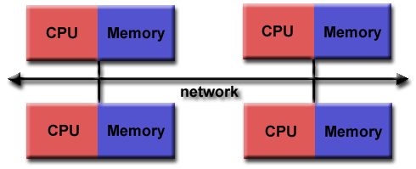
Distributed Memory 1/2
Processors have their own local memory. No global address space!
Processor operates its memory independently
Programmer’s responsibility for data communication and synchronization

Slide 27
Distributed Memory 2/2
Advantages
Memory is scalable with the number of processors
Each processor rapidly access its own memory without interference and without the overhead to maintain global cache coherency
Cost effectiveness
Disadvantages
The programmer is responsible for data communication
Difficult to map existing data structures, based on global memory, to distributed memory
Data residing on a remote node takes longer to access than local data

Slide 28
Designing Parallel Programs
First steps in designing a parallel program is to break the problem into discrete "chunks" of work that can be distributed to multiple tasks
Two basic ways to partition work: domain and functional decomposition

Slide 29
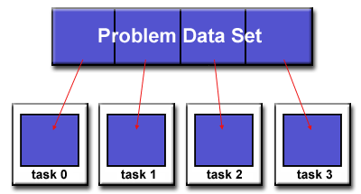
Domain Decomposition
Data associated with a problem is decomposed. Each parallel task then works on a portion of the data

Slide 30
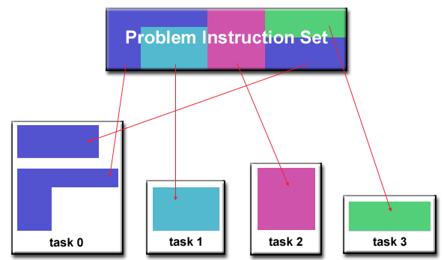
Functional Decomposition
Focus on the computation performed rather than on the data manipulated by the computation
Problem is decomposed according to the work to be done. Each task performs a portion of overall work

Slide 31
What is OpenMP?
High-level API for multi-threaded shared memory programs
Comprised of three primary API components:
Compiler Directives
Runtime Library Routines
Environment Variables

Slide 32
OpenMP Programming Model 1/3
Thread Based Parallelism
Accomplish parallelism through threads
Number of threads match number of machine cores. However, actual use of threads is up to application
Explicit Parallelism
Offer programmer full control over parallelization
Parallelization can be as simple as taking a serial program and inserting compiler directives
Or as complex as inserting subroutines to set multiple levels of parallelism, locks and even nested locks

Slide 33
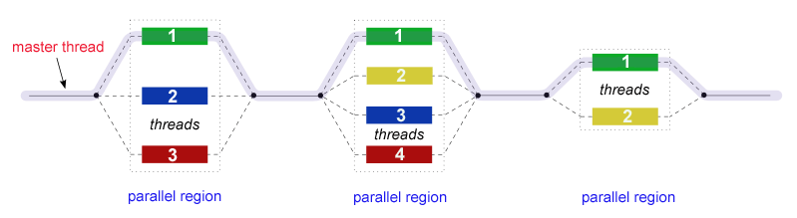
OpenMP Programming Model 2/3
Fork - Join Model
Begin as a single process executing sequentially until the first parallel region construct is encountered
FORK: master thread creates a team of parallel threads automatically
Statements enclosed by the parallel region construct are executed in parallel among various team threads
JOIN: When team threads complete, they synchronize and terminate, leaving only the master thread

Slide 34
OpenMP Programming Model 3/3
Compiler Directive Based
Most OpenMP parallelism is specified through compiler directives
Nested Parallelism
Dynamic Threads
Ability to dynamically alter number of threads executing parallel regions
I/O
Specifies nothing about parallel I/O
Up to programmer to ensure correctness of I/O operations within context of multi-threaded program

Slide 35
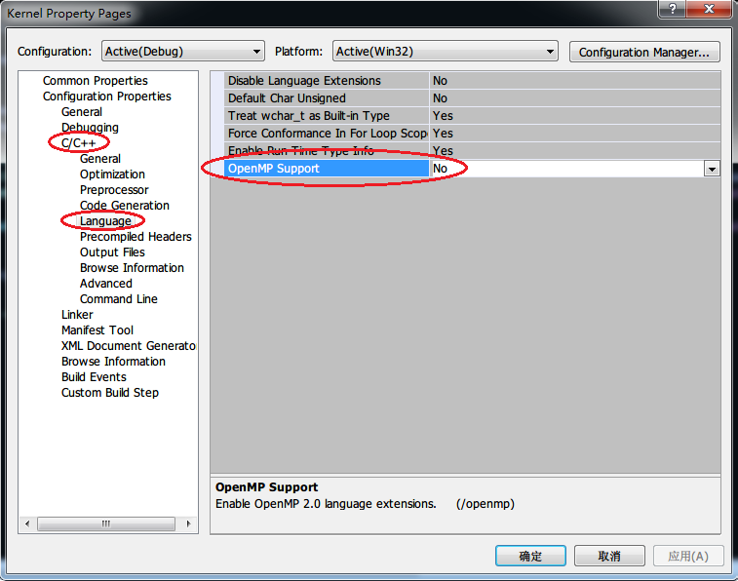
Configure OpenMP
#include <omp.h>
Configure compile options

Slide 36
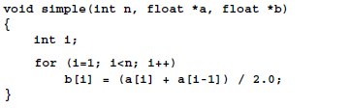
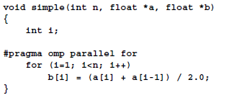
First Example 1/2
Serial program
OpenMP program

Slide 37
First Example 2/2
Key line
OpenMP automatically handles threads creation and deletion
OpenMP automatically conducts data decomposition

Slide 38
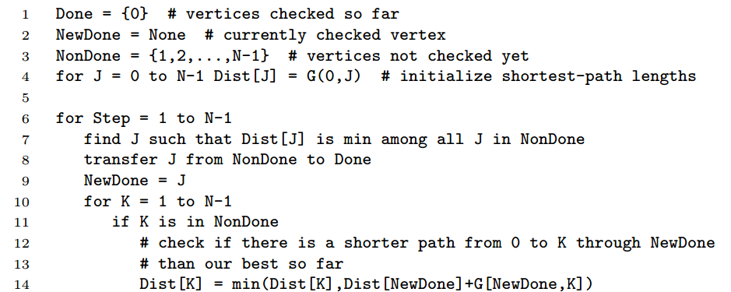
Dijkstra Shortest Path Algorithm
Find the shortest paths from vertex 0 to the other vertices in an N-vertex undirected graph

