Slide 1

The Open Standard for Parallel Programming of Heterogeneous systems
James Xu

Slide 2
Introduction
Parallel Applications Becoming common place
GPGPU
MATLAB
Quad Cores

Slide 3
Challenges
Vendor specific APIs
CPU – GPGPU Programming gap

Slide 4
OpenCL
Open Computing Langauage
Introduces uniformity
“Close-to-silicon”
Parallel Computing using all possible resources on end system
Initially by Apple
Khronos group, OpenGL, OpenAL
Major Vendor support

Slide 5
OpenCL Overview
All computational resources on an end system seen as peers
CPU, GPU, ARM, DSPs etc
Strict IEEE 754 Floating Point specification. Fixed rounding, error
Defines architecture models and software stack

Slide 6
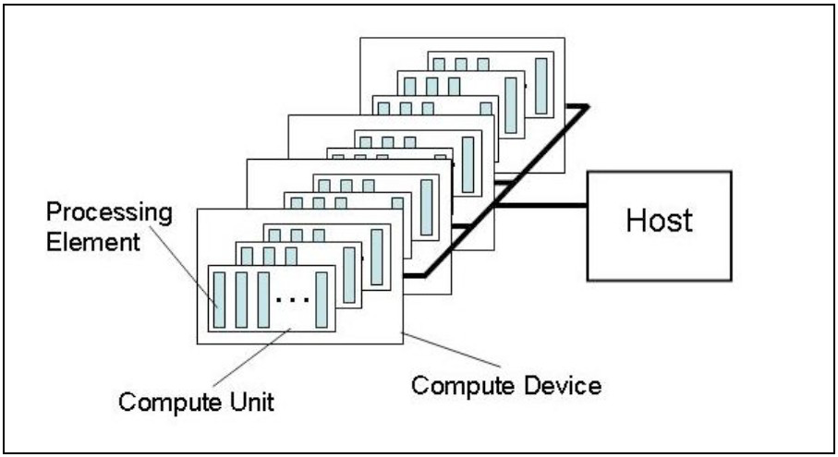
Architecture Model – Platform

Slide 7
Architecture – Execution Model
Kernel – Smallest unit of execution, like a C function
Host program – A collection of kernels
Work item, an instance of kernel at run time
Work group, a collection of work items

Slide 8
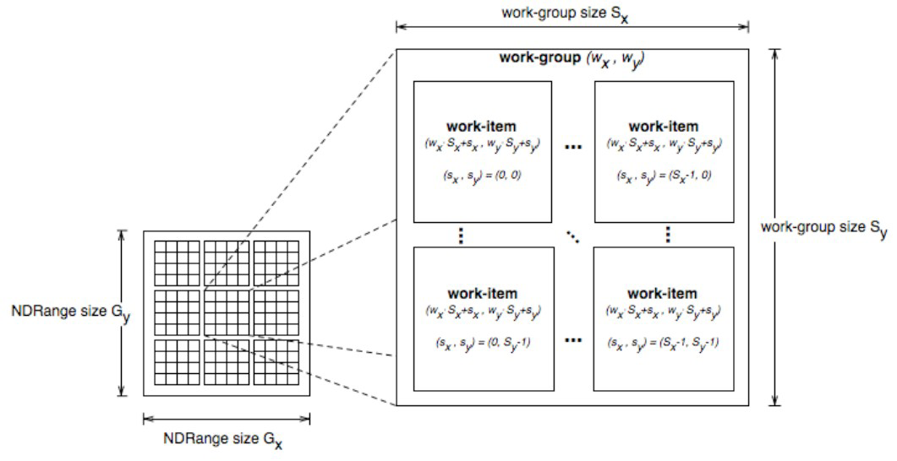
Architecture – Execution Model

Slide 9
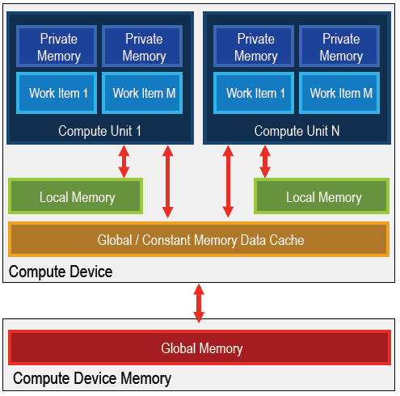
Architecture – Memory Model

Slide 10
Architecture – Programming Model
Data Parallel, work group consist of instances of same kernel (work items)
Different data elements are fed into the work items in the group
Task Parallel, work group consist of a single work item (instance of kernel)
Work group can run independently
Each compute device sees a number of work groups in parallel, thus task parallel

Slide 11
Architecture – Programming Model
Only CPUs are expected to have task parallel mechanisms
Data parallel model must be present on all OpenCL compatible devices

Slide 12
OpenCL Runtime
Language derived from ISO C99 (C Language)
Restrictions:
  No recursion
  no function points
All standard data types, including vectors
OpenGL extension

Slide 13
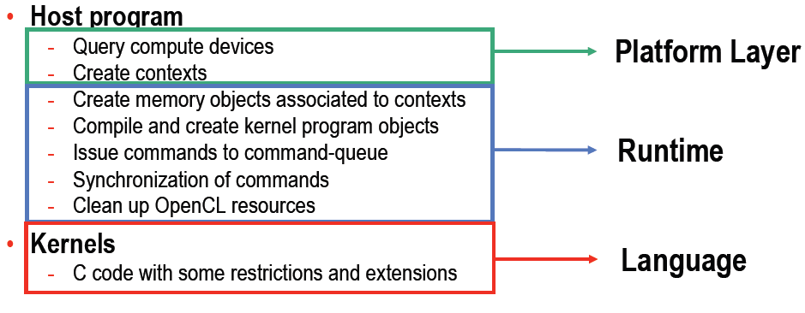
OpenCL Software Stack
Shows the steps to develop an OpenCL program

Slide 14
OpenCL Example in C
FFT Example using GPU
__kernel void fft1D_1024 (__global float2 *in, __global float2 *out,
__local float *sMemx, __local float *sMemy) {
int blockIdx = get_group_id(0) * 1024 + tid;
float2 data[16];
in = in + blockIdx; out = out + blockIdx;
globalLoads(data, in, 64);

Slide 15
OpenCL Example in C
fftRadix16Pass(data);
twiddleFactorMul(data, tid, 1024, 0);
localShuffle(data, sMemx, sMemy, tid,(((tid&15)*65) + (tid >> 4)));
fftRadix16Pass(data);
twiddleFactorMul(data, tid, 64, 4);
localShuffle(data, sMemx, sMemy, tid,(((tid>>4)*64) + (tid & 15)));
fftRadix4Pass(data);
fftRadix4Pass(data + 4);
fftRadix4Pass(data + 8);
fftRadix4Pass(data + 12);
globalStores(data, out, 64);
}

Slide 16
OpenCL Example in C
context = clCreateContextFromType(0, CL_DEVICE_TYPE_GPU, NULL, NULL, NULL);
queue = clCreateWorkQueue(context, NULL, NULL, 0);
memobjs[0] = clCreateBuffer(context, CL_MEM_READ_ONLY |
CL_MEM_COPY_HOST_PTR, sizeof(float)*2*num_entries, srcA);
memobjs[1] = clCreateBuffer(context, CL_MEM_READ_WRITE,
sizeof(float)*2*num_entries, NULL);
program = clCreateProgramFromSource(context, 1, &fft1D_1024_kernel_src, NULL);
clBuildProgramExecutable(program, false, NULL, NULL);
kernel = clCreateKernel(program, "fft1D_1024");
global_work_size[0] = n;
local_work_size[0] = 64;
range = clCreateNDRangeContainer(context, 0, 1, global_work_size,
local_work_size);

Slide 17
OpenCL Example in C
clSetKernelArg(kernel, 0, (void *)&memobjs[0], sizeof(cl_mem), NULL);
clSetKernelArg(kernel, 1, (void *)&memobjs[1], sizeof(cl_mem), NULL);
clSetKernelArg(kernel, 2, NULL, sizeof(float)*(local_work_size[0]+1)*16, NULL);
clSetKernelArg(kernel, 3, NULL, sizeof(float)*(local_work_size[0]+1)*16, NULL);
clExecuteKernel(queue, kernel, NULL, range, NULL, 0, NULL);

