Slide 1
OpenCL
Joseph Kider
University of Pennsylvania
CIS 565 - Fall 2011

Slide 2
Sources
Patrick Cozzi Spring 2011
NVIDIA CUDA Programming Guide
CUDA by Example
Programming Massively Parallel Processors
Notes:
1 to 8. Maybe 1 if all threads are in the same warp and issued at the same time.

Slide 3
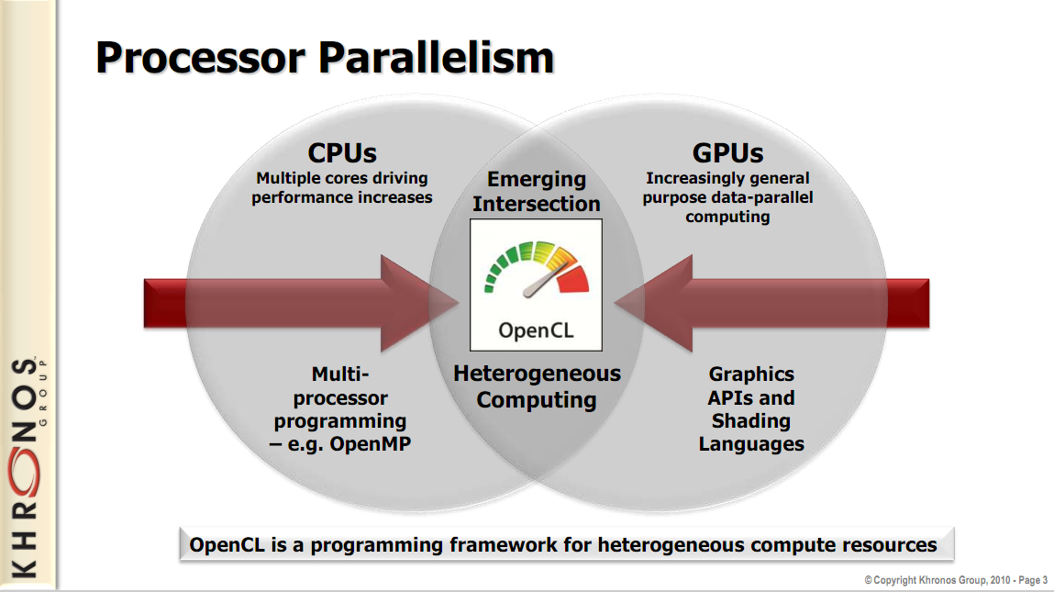
Image from: http://www.khronos.org/developers/library/overview/opencl_overview.pdf

Slide 4

OpenCL
Open Compute Language
For heterogeneous parallel-computing systems
Cross-platform
  Implementations for
    ATI GPUs
    NVIDIA GPUs
    x86 CPUs
  Is cross-platform really one size fits all?
Image from: http://developer.apple.com/softwarelicensing/agreements/opencl.html
Notes:
A high performance OpenCL application that is cross-platform will need runtime checks to fully take advantage of the system. Likewise, the workloads for GPU and CPU parallel algorithms are quite different.

Slide 5
OpenCL
Standardized
Initiated by Apple
Developed by the Khronos Group

Slide 6
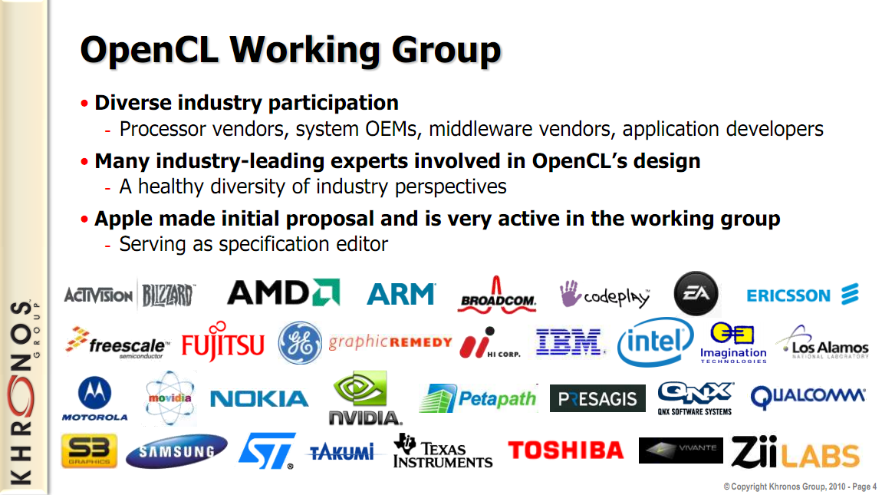
Image from: http://www.khronos.org/developers/library/overview/opencl_overview.pdf

Slide 7
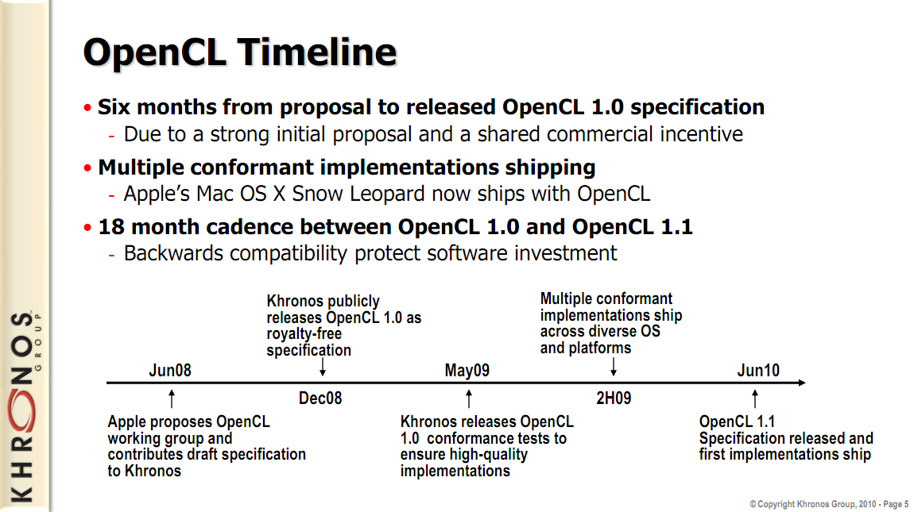
Image from: http://www.khronos.org/developers/library/overview/opencl_overview.pdf

Slide 8
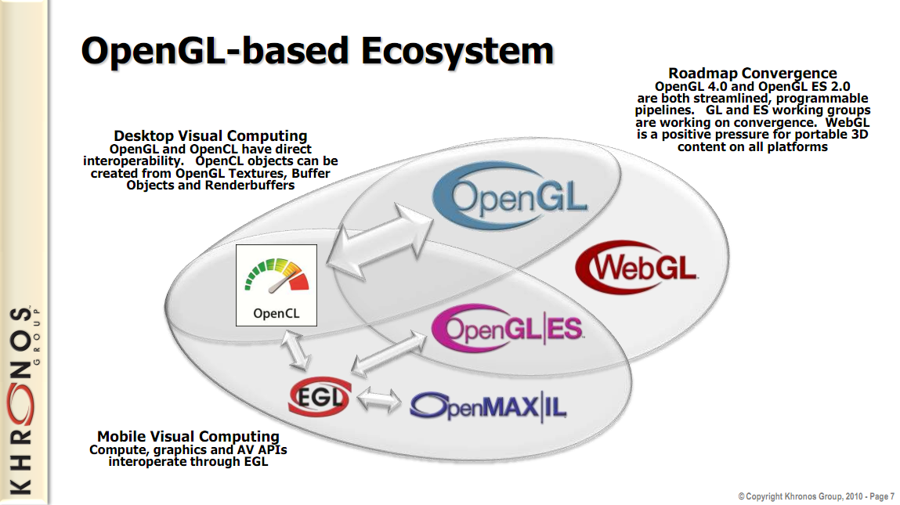
Image from: http://www.khronos.org/developers/library/overview/opencl_overview.pdf

Slide 9
OpenCL
API similar to OpenGL
Based on the C language
Easy transition form CUDA to OpenCL

Slide 10
OpenCL and CUDA
Many OpenCL features have a one to one mapping to CUDA features
OpenCL
  More complex platform and device management
  More complex kernel launch
Notes:
OpenCL has more complexity due to its support for multiplatform and multivendor portability

Slide 11

OpenCL and CUDA
Compute Unit (CU) correspond to
  CUDA streaming multiprocessors (SMs)
  CPU core
  etc.
Processing Element correspond to
  CUDA streaming processor (SP)
  CPU ALU

Slide 12
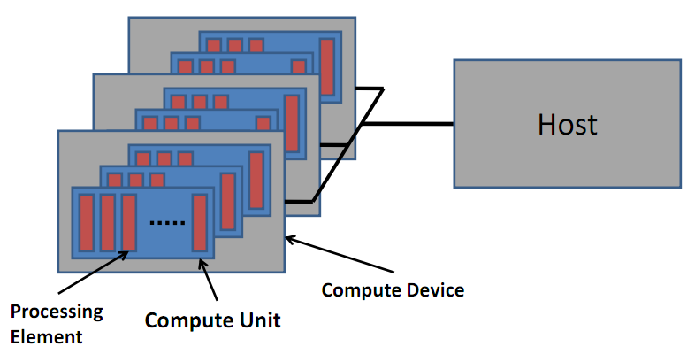
OpenCL and CUDA
Image from: http://developer.amd.com/zones/OpenCLZone/courses/pages/Introductory-OpenCL-SAAHPC10.aspx

Slide 13
OpenCL and CUDA
CUDA | OpenCL
Kernel | Kernel
Host program | Host program
Thread | Work item
Block | Work group
Grid | NDRange (index space)

Slide 14
OpenCL and CUDA
Work Item (CUDA thread) – executes kernel code
Index Space (CUDA grid) – defines work items and how data is mapped to them
Work Group (CUDA block) – work items in a work group can synchronize

Slide 15
OpenCL and CUDA
CUDA: threadIdx and blockIdx
  Combine to create a global thread ID
  Example
    blockIdx.x * blockDim.x + threadIdx.x

Slide 16
OpenCL and CUDA
OpenCL: each thread has a unique global index
  Retrieve with get_global_id()
CUDA | OpenCL
threadIdx.x | get_local_id(0)
blockIdx.x * blockDim.x + threadIdx.x | get_global_id(0)

Slide 17
OpenCL and CUDA
CUDA | OpenCL
gridDim.x | get_num_groups(0)
blockIdx.x | get_group_id(0)
blockDim.x | get_local_size(0)
gridDim.x * blockDim.x | get_global_size(0)

Slide 18
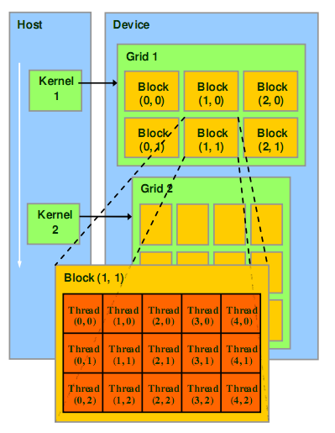
OpenCL and CUDA
Recall CUDA:
Image from: http://courses.engr.illinois.edu/ece498/al/textbook/Chapter2-CudaProgrammingModel.pdf

Slide 19
OpenCL and CUDA
In OpenCL:
get_global_size(0)
Index Space
get_local_size(0)
Work Group
(0, 0)
Work Group
(1, 0)
Work Group
(2, 0)
Work Group (0,0)
get_
global_
size(1)
Work
Item
(0, 0)
Work
Item
(1, 0)
Work
Item
(2, 0)
Work
Item
(3, 0)
Work
Item
(4, 0)
Work Group
(0, 1)
Work Group
(1, 1)
Work Group
(2, 1)
get_
local_
size(1)
Work
Item
(0, 1)
Work
Item
(1, 1)
Work
Item
(2, 1)
Work
Item
(3, 1)
Work
Item
(4, 1)
Work
Item
(0, 2)
Work
Item
(1, 2)
Work
Item
(2, 2)
Work
Item
(3, 2)
Work
Item
(4, 2)

Slide 20
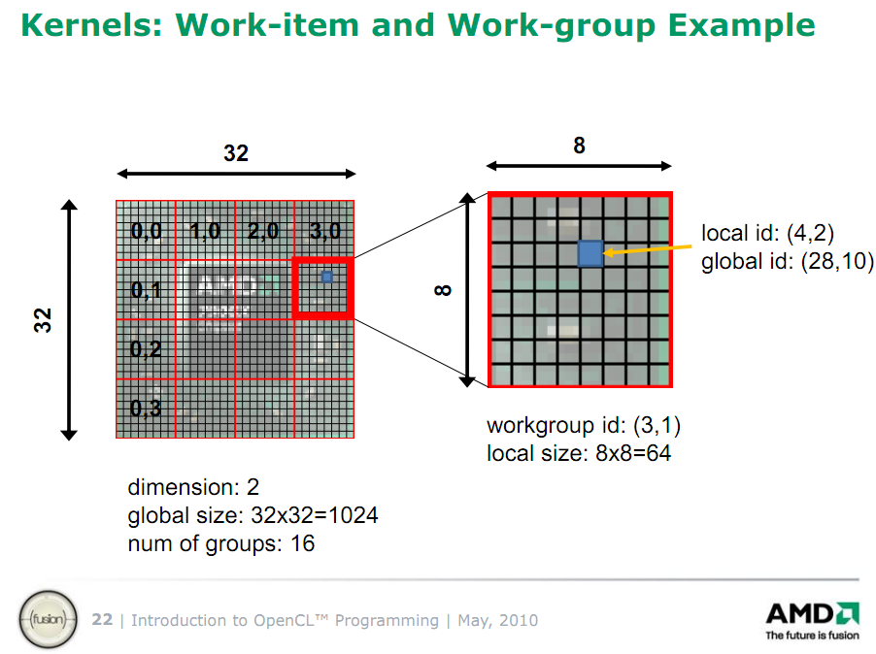
Image from http://developer.amd.com/zones/OpenCLZone/courses/pages/Introductory-OpenCL-SAAHPC10.aspx

Slide 21
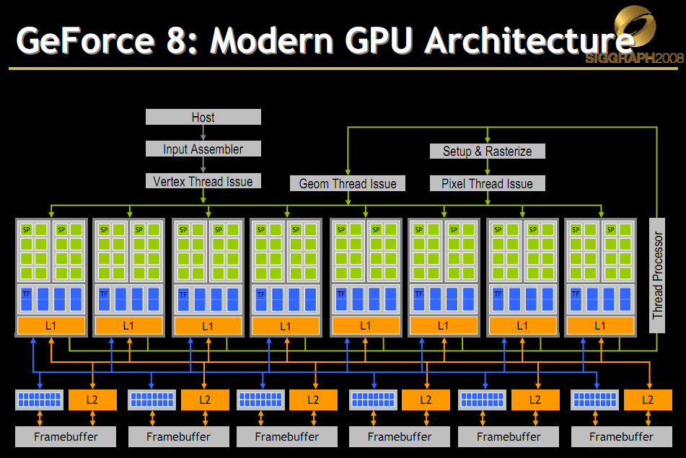
OpenCL and CUDA
Mapping to NVIDIA hardware:
Image from http://s08.idav.ucdavis.edu/luebke-nvidia-gpu-architecture.pdf

Slide 22
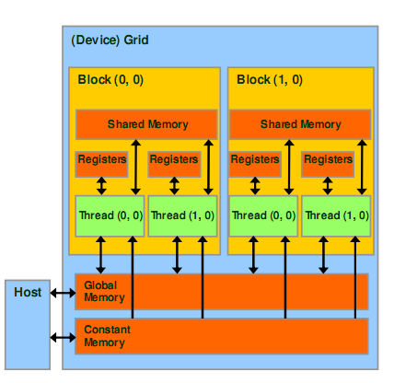
OpenCL and CUDA
Recall the CUDA memory model:
Image from: http://courses.engr.illinois.edu/ece498/al/textbook/Chapter2-CudaProgrammingModel.pdf

Slide 23
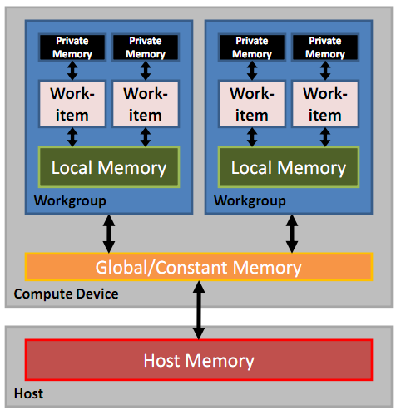
OpenCL and CUDA
In OpenCL:
Image from http://developer.amd.com/zones/OpenCLZone/courses/pages/Introductory-OpenCL-SAAHPC10.aspx

Slide 24
OpenCL and CUDA
CUDA | OpenCL
Global memory | Global memory
Constant memory | Constant memory
Shared memory | Local memory
Local memory | Private memory

Slide 25
OpenCL and CUDA
CUDA | OpenCL
__syncthreads() | __barrier()
Both also have Fences
  In CL
    mem_fence()
    read_mem_fence()
    write_mem_fence()
Notes:
Compiler may reorder memory reads/writes to better exploit local (shared) and global memory

Slide 26
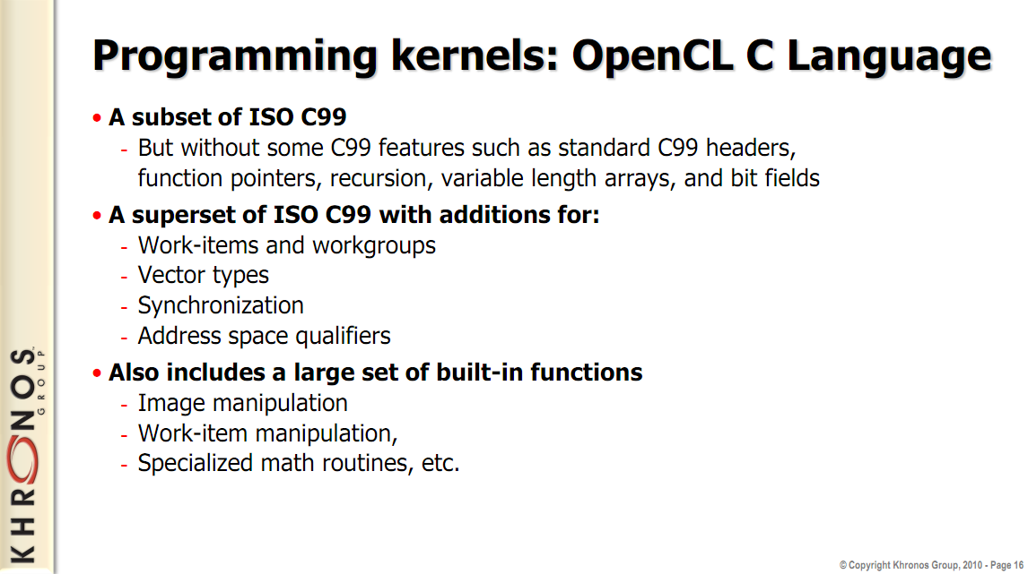
Image from: http://www.khronos.org/developers/library/overview/opencl_overview.pdf

Slide 27
OpenCL and CUDA
Kernel functions. Recall CUDA:
__global__ void vecAdd(float *a, float *b, float *c)
{
int i = threadIdx.x;
c[i] = a[i] + b[i];
}

Slide 28
OpenCL and CUDA
In OpenCL:
__kernel void vecAdd(__global const float *a, __global const float *b, __global float *c)
{
int i = get_global_id(0);
c[i] = a[i] + b[i];
}

Slide 29
OpenCL and CUDA
In OpenCL:
__kernel void vecAdd(__global const float *a, __global const float *b, __global float *c)
{
int i = get_global_id(0);
c[i] = a[i] + b[i];
}

Slide 30
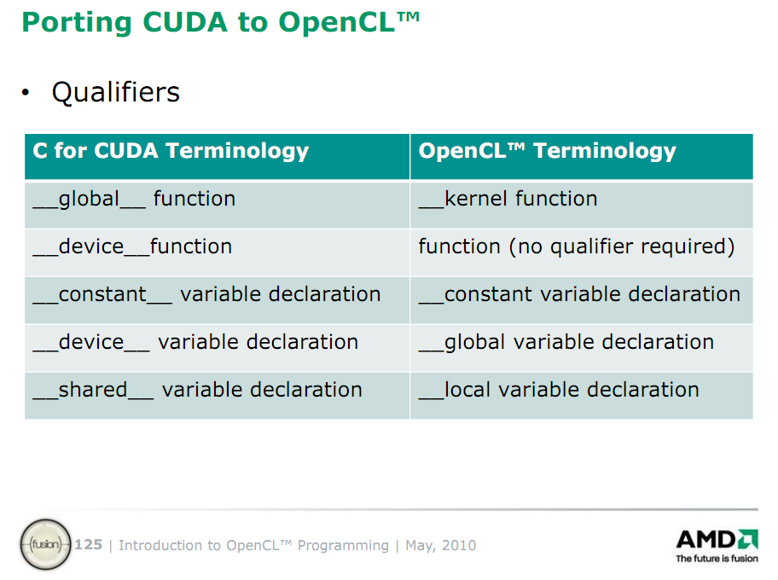
Slide from: http://developer.amd.com/zones/OpenCLZone/courses/pages/Introductory-OpenCL-SAAHPC10.aspx

Slide 31
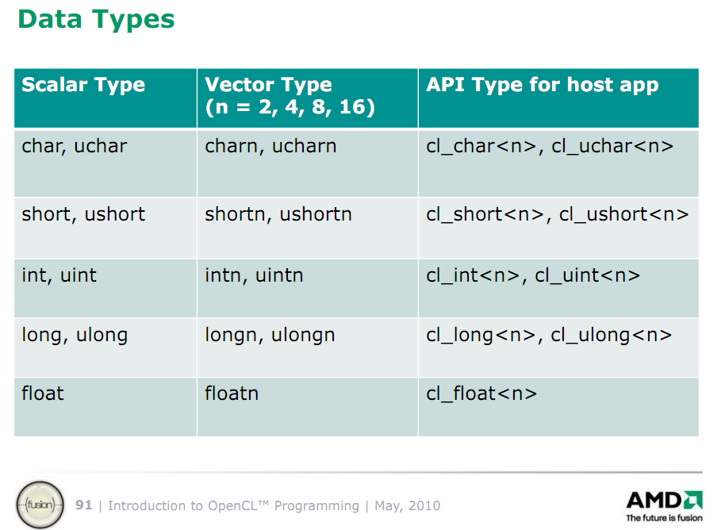
Slide from: http://developer.amd.com/zones/OpenCLZone/courses/pages/Introductory-OpenCL-SAAHPC10.aspx

Slide 32
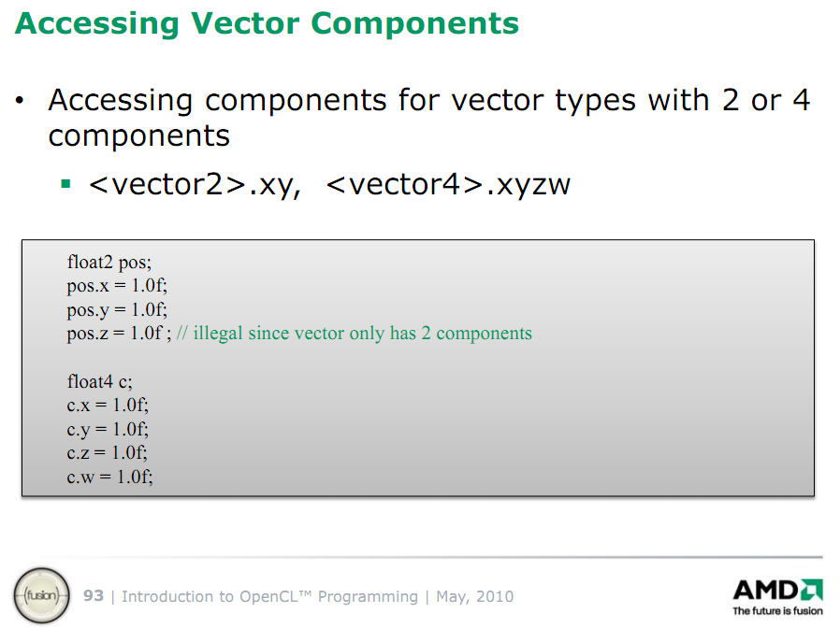
Slide from: http://developer.amd.com/zones/OpenCLZone/courses/pages/Introductory-OpenCL-SAAHPC10.aspx

Slide 33
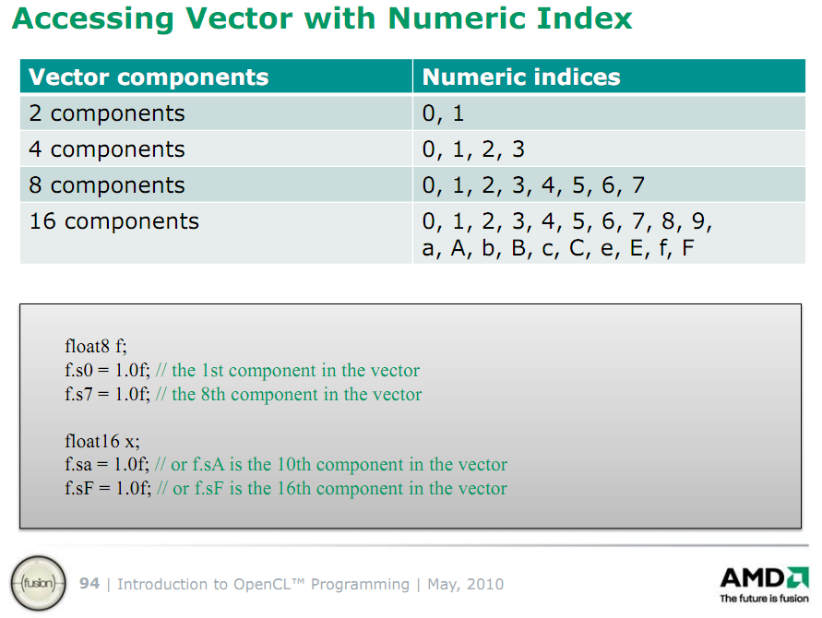
Slide from: http://developer.amd.com/zones/OpenCLZone/courses/pages/Introductory-OpenCL-SAAHPC10.aspx

Slide 34
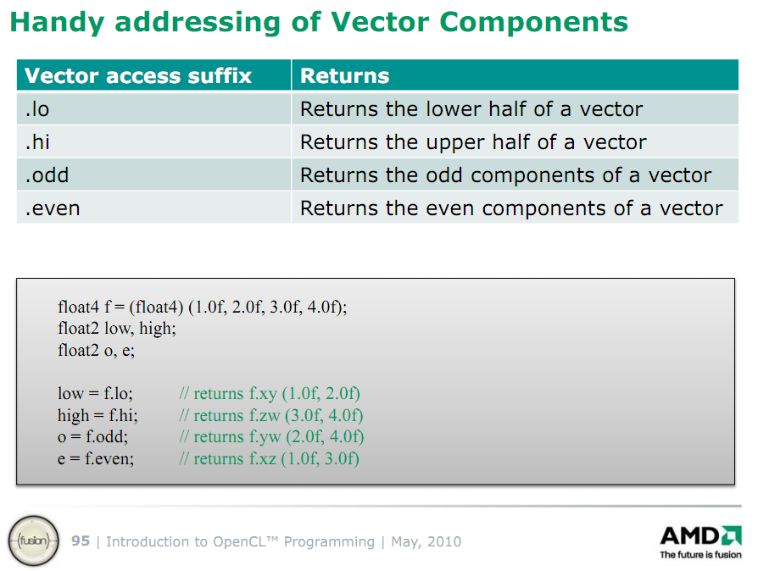
Slide from: http://developer.amd.com/zones/OpenCLZone/courses/pages/Introductory-OpenCL-SAAHPC10.aspx

Slide 35
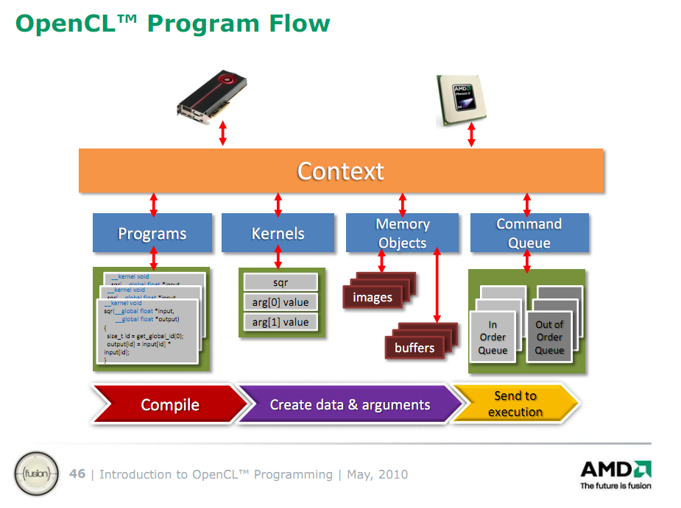
Slide from: http://developer.amd.com/zones/OpenCLZone/courses/pages/Introductory-OpenCL-SAAHPC10.aspx

Slide 36
OpenGL
Shader Programs
OpenGL
Buffers
CUDA
Streams
Slide from: http://developer.amd.com/zones/OpenCLZone/courses/pages/Introductory-OpenCL-SAAHPC10.aspx

Slide 37
OpenCL API
Walkthrough OpenCL host code for running our vecAdd kernel:
__kernel void vecAdd(__global const float *a, __global const float *b, __global float *c)
{
int i = get_global_id(0);
c[i] = a[i] + b[i];
}
See NVIDIA OpenCL JumpStart Guide for full code example: http://developer.download.nvidia.com/OpenCL/NVIDIA_OpenCL_JumpStart_Guide.pdf

Slide 38
OpenCL API
// create OpenCL device & context
cl_context hContext;
hContext = clCreateContextFromType(0, CL_DEVICE_TYPE_GPU, 0, 0, 0);

Slide 39
OpenCL API
// create OpenCL device & context
cl_context hContext;
hContext = clCreateContextFromType(0, CL_DEVICE_TYPE_GPU, 0, 0, 0);
Create a context for a GPU

Slide 40
OpenCL API
// query all devices available to the context
size_t nContextDescriptorSize;
clGetContextInfo(hContext, CL_CONTEXT_DEVICES, 0, 0, &nContextDescriptorSize);
cl_device_id aDevices = malloc(nContextDescriptorSize);
clGetContextInfo(hContext, CL_CONTEXT_DEVICES,
nContextDescriptorSize, aDevices, 0);

Slide 41
OpenCL API
// query all devices available to the context
size_t nContextDescriptorSize;
clGetContextInfo(hContext, CL_CONTEXT_DEVICES, 0, 0, &nContextDescriptorSize);
cl_device_id aDevices = malloc(nContextDescriptorSize);
clGetContextInfo(hContext, CL_CONTEXT_DEVICES,
nContextDescriptorSize, aDevices, 0);
Retrieve an array of each GPU

Slide 42
OpenCL API
// create a command queue for first
// device the context reported
cl_command_queue hCmdQueue;
hCmdQueue = clCreateCommandQueue(hContext,
aDevices[0], 0, 0);

Slide 43
OpenCL API
// create a command queue for first
// device the context reported
cl_command_queue hCmdQueue;
hCmdQueue = clCreateCommandQueue(hContext,
aDevices[0], 0, 0);
Create a command queue (CUDA stream) for the first GPU

Slide 44
OpenCL API
// create & compile program
cl_program hProgram;
hProgram = clCreateProgramWithSource(hContext,
1, source, 0, 0);
clBuildProgram(hProgram, 0, 0, 0, 0, 0);

Slide 45
OpenCL API
// create & compile program
cl_program hProgram;
hProgram = clCreateProgramWithSource(hContext,
1, source, 0, 0);
clBuildProgram(hProgram, 0, 0, 0, 0, 0);
A program contains one or more kernels. Think dll.
Provide kernel source as a string
Can also compile offline

Slide 46
OpenCL API
// create kernel
cl_kernel hKernel;
hKernel = clCreateKernel(hProgram, “vecAdd”, 0);

Slide 47
OpenCL API
// create kernel
cl_kernel hKernel;
hKernel = clCreateKernel(hProgram, “vecAdd”, 0);
Create kernel from program

Slide 48
OpenCL API
// allocate host vectors
float* pA = new float[cnDimension];
float* pB = new float[cnDimension];
float* pC = new float[cnDimension];
// initialize host memory
randomInit(pA, cnDimension);
randomInit(pB, cnDimension);

Slide 49
OpenCL API
cl_mem hDeviceMemA = clCreateBuffer(
hContext,
CL_MEM_READ_ONLY | CL_MEM_COPY_HOST_PTR,
cnDimension * sizeof(cl_float),
pA, 0);
cl_mem hDeviceMemB = /* ... */

Slide 50
OpenCL API
cl_mem hDeviceMemA = clCreateBuffer(
hContext,
CL_MEM_READ_ONLY | CL_MEM_COPY_HOST_PTR,
cnDimension * sizeof(cl_float),
pA, 0);
cl_mem hDeviceMemB = /* ... */
Create buffers for kernel input. Read only in the kernel. Written by the host.

Slide 51
OpenCL API
hDeviceMemC = clCreateBuffer(hContext, CL_MEM_WRITE_ONLY,
cnDimension * sizeof(cl_float),
0, 0);

Slide 52
OpenCL API
hDeviceMemC = clCreateBuffer(hContext, CL_MEM_WRITE_ONLY,
cnDimension * sizeof(cl_float),
0, 0);
Create buffer for kernel output.

Slide 53
OpenCL API
// setup parameter values
clSetKernelArg(hKernel, 0, sizeof(cl_mem), (void *)&hDeviceMemA);
clSetKernelArg(hKernel, 1, sizeof(cl_mem), (void *)&hDeviceMemB);
clSetKernelArg(hKernel, 2, sizeof(cl_mem), (void *)&hDeviceMemC);

Slide 54
OpenCL API
// setup parameter values
clSetKernelArg(hKernel, 0, sizeof(cl_mem), (void *)&hDeviceMemA);
clSetKernelArg(hKernel, 1, sizeof(cl_mem), (void *)&hDeviceMemB);
clSetKernelArg(hKernel, 2, sizeof(cl_mem), (void *)&hDeviceMemC);
Kernel arguments
set by index

Slide 55
OpenCL API
// execute kernel
clEnqueueNDRangeKernel(hCmdQueue, hKernel, 1, 0, &cnDimension, 0, 0, 0, 0);
// copy results from device back to host
clEnqueueReadBuffer(hContext, hDeviceMemC, CL_TRUE, 0,
cnDimension * sizeof(cl_float),
pC, 0, 0, 0);

Slide 56
OpenCL API
Let OpenCL pick
work group size
// execute kernel
clEnqueueNDRangeKernel(hCmdQueue, hKernel, 1, 0, &cnDimension, 0, 0, 0, 0);
// copy results from device back to host
clEnqueueReadBuffer(hContext, hDeviceMemC, CL_TRUE, 0,
cnDimension * sizeof(cl_float),
pC, 0, 0, 0);
Blocking read

Slide 57
OpenCL API
delete [] pA;
delete [] pB;
delete [] pC;
clReleaseMemObj(hDeviceMemA);
clReleaseMemObj(hDeviceMemB);
clReleaseMemObj(hDeviceMemC);

