Slide 1
Heterogeneous Computing with OpenCL

Slide 2

Outline
Heterogeneous Computing
OpenCL
  Introduction
  Architecture
  Uses
  A simple programming guide
  Interoperate with OpenGL
  Compare with CUDA

Slide 3
Heterogeneous Computing
OpenCL
  Introduction
  Architecture
  Uses
  A simple programming guide
  Interoperate with OpenGL
  Compare with CUDA

Slide 4
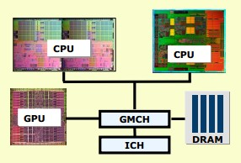
Why heterogeneous Computing
It’s a heterogeneous world
  A model platform
  includes:
    One or more CPUs
    One or more GPUs
    DSP processors
    ... other?
Notes:
Nowadays, a model computer of platform has more than only one computing processors ,such as CPU and GPU, actually , most of pcs have one cpu and one independent gpu. So play all processors’performance together is a desire way to accelerate the computing ability.

Slide 5
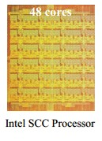
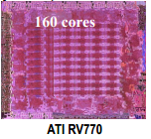
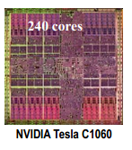

Microprocessor Trends
Individual processors are many core (and often heterogeneous ) processors
Notes:
Not only platforms have many processors , but also processor has many cores. Please look at the four figures form left to right, we can see that cores of processors are increasing , especially for the GPU. However, when we have a multiple-core processer, how can we accelerate the performance?

Slide 6
Parallel Computing
Parallel computing
  calculations are carried out simultaneously
  large problems can often be divided into smaller ones
  the small problems can be solved concurrently in parallel
Two forms of parallel computing
  data parallelism
  task parallelism
Notes:
Yes , parallel computing!
Parallel computing is a form of computation in which many calculations are carried out simultaneously, operating on the principle that large problems can often be divided into smaller ones, which are then solved concurrently ("in parallel").

Slide 7
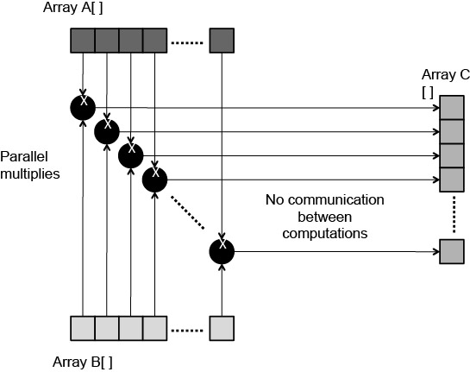
Data Parallelism
Data parallelism
  the simultaneous execution on multiple cores of the same function across the elements of a dataset.
Notes:
Data parallelism is parallelism inherent in program loops, which focuses on distributing the data across different computing nodes to be processed in parallel. A typical example is vectors’ addition.

Slide 8
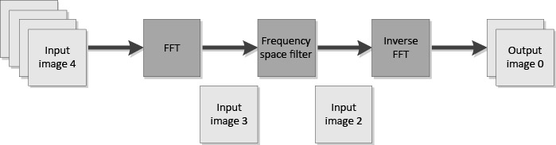
Task Parallelism
Task parallelism
  is the simultaneous execution on multiple cores of many different functions across the same or different datasets
Notes:
Task parallelism is the characteristic of a parallel program that "entirely different calculations can be performed on either the same or different sets of data".
pipeline

Slide 9
Heterogeneous Computing
Combine
  the parallelism of traditional multi-core CPUs
  accelerator cores (e.g. programmable GPUs)
Get
  unprecedented levels of performance
Need
  a programming interface that allows users to take advantage of all of the system’s resources
Notes:
so after the parallel computing , I will now introduce the heterogeneous computing . In fact , there is no a accurate definition of common view, so here I only list the most typical characters of heterogeneous computing.

Slide 10
Heterogeneous computing
OpenCL
  Introduction
  Architecture
  Uses
  A simple programming guide
  Interoperate with OpenGL
  Compare with CUDA

Slide 11
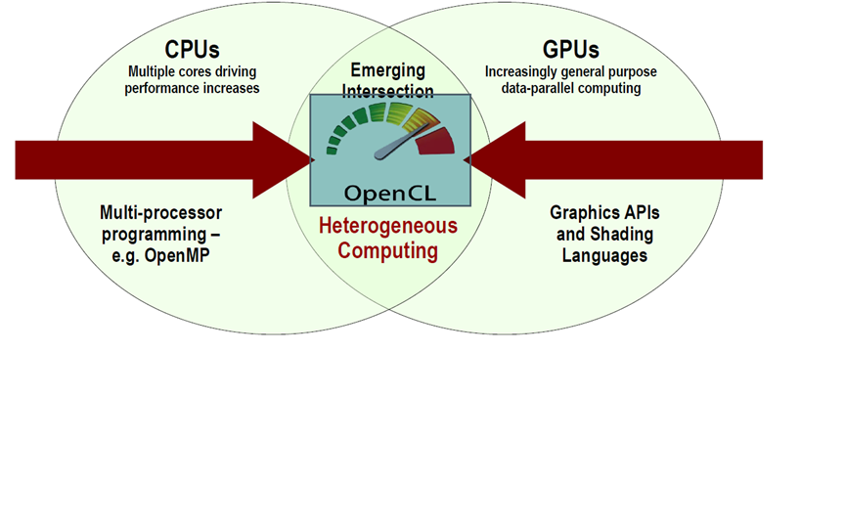
What is OpenCL1/3
OpenCL – Open Computing Language
  An open industry standard framework for heterogeneous programming
Notes:
OpenCL stands for open computing language. It is an industry standard framework for programming computers composed of a combination of CPUs, GPUs, and other processors.

Slide 12

What is OpenCL2/3
  Proposed by apple
  Specification developed by a number of companies
  Specification is maintained by the Khronos Group
Notes:
It firstly proposed by apple, while now involved many big companies ,such as AMD , IBM,INTERL,NVIDIA. And now it draw more companies’ attention.

Slide 13
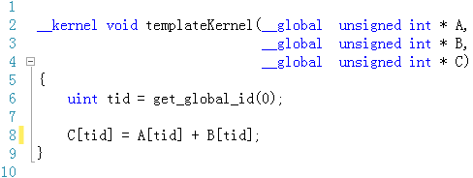
What is OpenCL3/3
Cross-platform parallel computing API and C-like language for heterogeneous computing devices
Code is portable across various target devices
Notes:
It most noticeable character is cross-platform.

Slide 14
Heterogeneous computing
OpenCL
  Introduction
  Architecture
  Uses
  A simple programming guide
  Interoperate with OpenGL
  Compare with CUDA

Slide 15
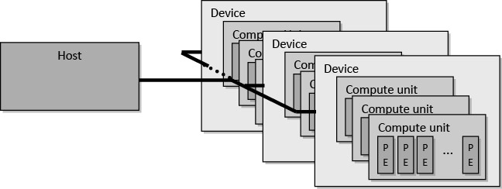
OpenCL Platform Model
One Host + one or more Compute Devices
  Each Compute Device is composed of one or more Compute Units
Notes:
The OpenCL platform model is defined as a host connected to one or more OpenCL devieces. This figure shows that the platform model comprising one host plus multiple compute devices, each having multiple compute units, each of which have multiple processing elements.
The host is any computer with a cpu running a standard operating systems, while the compute devices maybe GPU, DSP, or a multi-core cpu.

Slide 16
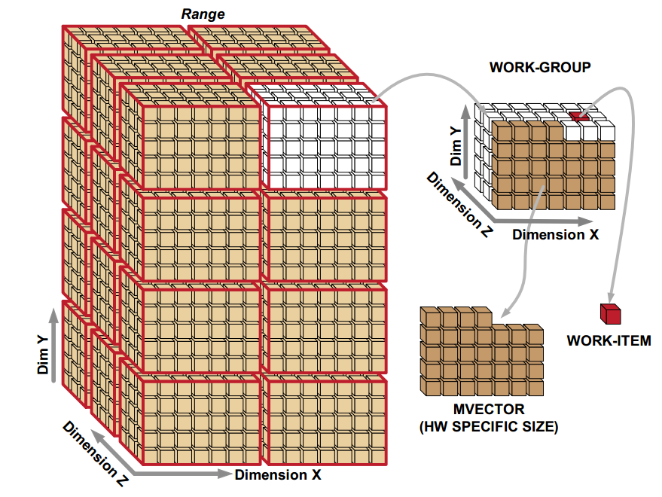
OpenCL Execution Model1/3
Define N-dimensional computation domain
Execute a kernel at each point in computation domain
Notes:
Opencl can manage 1 2 or 3 Dimensional data for its hardware architecture.

Slide 17
OpenCL Execution Model2/3
Host programs
  C or C++ code
Kernels
  C-like code that actually executes on target devices
  Kernel body is instantiated once for each work item
  Each OpenCL work item gets a unique index
Notes:
Similar to the OpenGL shading language , we need host programs to initialize many arguments and the actual code is written in a kernel file.
One kernel is like on thread.

Slide 18
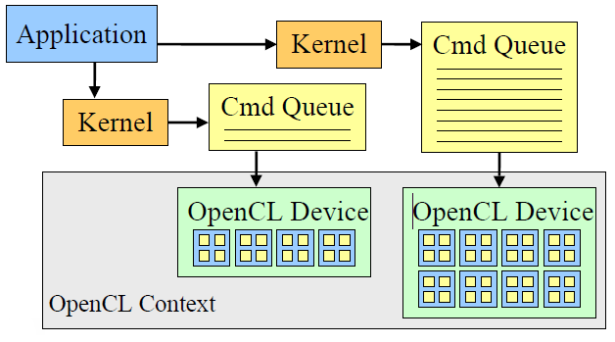
OpenCL Execution Model3/3
Notes:
This figure shows the opencl execution model. Fist initialize some factors and deliver them to kernel and it will be implemented in a OpenCL device.

Slide 19
Heterogeneous computing
OpenCL
  Introduction
  Architecture
  Uses
  A simple programming guide
  Interoperate with OpenGL
  Compare with CUDA

Slide 20
Uses of OpenCL
Where OpenCL can be used
  Image, video and audio processing
  Simulations and scientific calculations
  Medical imaging
  Financial models
Data-parallel algorithm that are computationally significant
Notes:
So where can use OpenCL, while OpenCL can be used in lots of applications in many places. It is not peculiar for image or for video, it can be applied in financial problems and medical imaging .so opencl can be used in a cross various of things, but really it is designed and can be used any kinds of data parallel algorithm where the computational part is a significant meaning to sth that really takes a lot of time and lots of computation.

Slide 21
Heterogeneous computing
OpenCL
  Introduction
  Architecture
  Uses
  A simple programming guide
  Interoperate with OpenGL
  Compare with CUDA
Notes:
This part maybe a little difficulty.

Slide 22
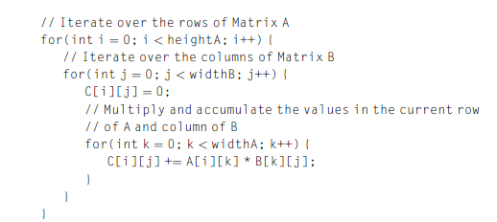
Matrix Multiplication example1/
A simple serial C implementation of matrix multiplication is shown here

Slide 23
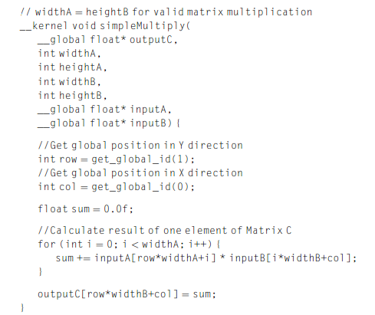
Matrix Multiplication example2/
Notes:
It is straightforward to map the serial implementation to OpenCL , as the two outer for-loops work independently of each other.

Slide 24
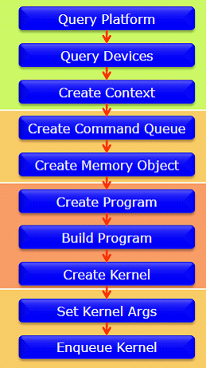
Programming Guide
OpenCL calculation
  Initialization
  Allocate resources
  Creating programs
  and kernels
  Execution
  Tear down
Notes:
To run an opencl program, 5 steps must be taken. And each step may be devided into more substeps which will be explained later.

Slide 25
Initialization
Selecting a device and creating a context in which to run the calculation

Slide 26
Context
Context
  environment
    the kernels execute
    the domain in which synchronization and memory management is defined.
contains
    Kernel execution commands
    Memory commands - transfer or mapping of memory object data
    Synchronization commands - constrains the order of commands
Notes:
The context includes a set of devices, the memory accessible to those devices, the corresponding memory properties and one or more command-queues used to schedule execution of a kernel(s) or operations on memory objects.

Slide 27
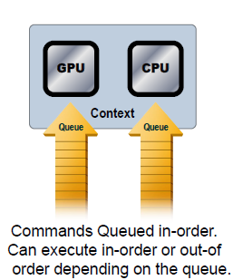
Command-Queues
All commands to a device
are submitted through a
command-queue.
Execution of the it is
guaranteed to be
completed at sync points
Notes:
All commands to a device are submitted through a command-queue.
Execution of the command-queue is guaranteed to be completed at sync points
Each Command-queue points to a single device within a context.

Slide 28
Allocation
Allocation of memory/storage that will be used on the device and push it to the device.

Slide 29
Memory Data Structures
Buffer
  One-dimensional arrays of bytes
  The data stored in a buffer is sequential
Image
  Two or three dimensional data structured arrays
  The data is stored in a range of compressed formats, may be not sequential.
Notes:
OpenCL applications often work with large arrays or multidimensional matrices. This data needs to be physically present on a devicebefore execution can begin. In order for data to be transferred to a device, it must first be encapsulated as a memory object. OpenCL defines two types of memory objects : buffers and images .Buffers are equivalent to arrays in C, created using malloc() , where data elements are stored contiguously in memory . Images , on the other hand, are designed as opaque objects, allowing for data padding and other optimizations that may improve performance on devices.

Slide 30
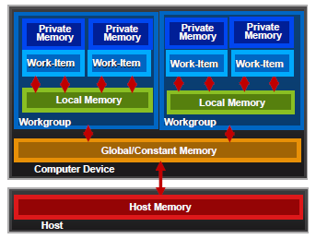
Memory Domain
Private Memory
  Per work-item
Local Memory
  Shared within a workgroup
Constant Memory
  Visible to all workgroups
Host Memory
  On the CPU
Notes:
OpenCL has four memory domains: private, local, global, and constant;
private memory - specific to a work-item; it is not visible to other work-items. local memory - specific to a work-gro up; accessible only by work-items belonging to that work-group.global memory - accessible to all work-items executing in a context, as well as to the host (read, write, and map commands).constant memory - read-only region for host-allocated and -initialized objects that are not changed during kernel execution. host (CPU) memory - host-accessible region for an application’s data structures and program data.PCIe memory - part of host (CPU) memory accessible from, and modifiable by, the host program and the GPU compute device. Modifying this memory requires synchronization between the GPU compute device and the CPU.

Slide 31
Program/Kernel Creation
Programs and kernels are read in from source and compiled or loaded as binary
Notes:
OpenCL C code (written to run on an OpenCL device) is called a program.

Slide 32
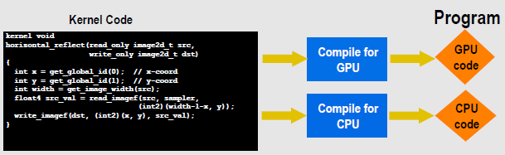
Program objects
The program object encapsulates:
  A context
  The program source/binary
  List of target devices and build options
Notes:
A program is a collection of functions called kernels, where kernels are units of execution that can be scheduled to run on a device, OpenCL programs are compiled at runtime through a series of API calls

Slide 33
Compute Kernels
Code that actually executes on target devices
Kernel body is instantiated once for each work item
Each OpenCL work item gets a unique index
Notes:
he fin al stage to obtain a cl_kernel object that can be used to execute kernels on a device is to extract the kernel from the cl_program. Extracting a kernel from a pro-gram is similar to obtaining an exported function from a dynamic library.

Slide 34
Execution
Arguments to the kernel are set and the kernel is executed on all data
Notes:
As we know that opengl glsl, uniform values should deliver from host to glsl files. And so as the opencl, memory objects should be delivered by the function .

Slide 35
Tear Down
As part of the process we read back the results to the host and clean up memory
Notes:
To release the resources, we must liberate the resources manually. Just like when you use new operator to allocate memory for a variable and then you should use delete operator to release .

Slide 36
Heterogeneous computing
OpenCL
  Introduction
  Architecture
  Uses
  A simple programming guide
  Interoperate with OpenGL
  Compare with CUDA

Slide 37
Interoperate with OpenGL1/4
OpenGL applications package data using three data structures:
  vertex buffer objects (VBOs)
  texture objects
  render buffer objects
OpenCL
  buffer
  image
Notes:
OpenCL applications access data using two structures as above: buffer objects and image objects. Similarly, OpenGL applications package data using three data structures: vertex buffer objects (VBOs), texture objects, and render buffer objects. The central concept behind OpenCL-OpenGL interoperability is that OpenCL memory objects can be created from data inside OpenGL data structures. This allows kernels to process OpenGL structures as though they were regular buffer objects and image objects.

Slide 38
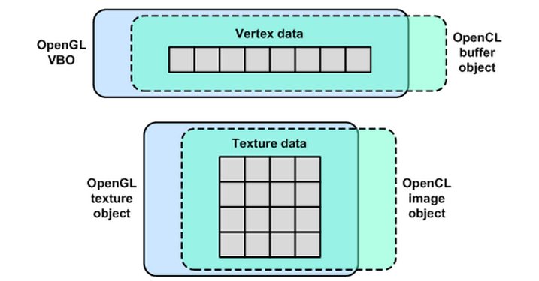
Interoperate with OpenGL2/4
OpenCL memory objects can be created from data inside OpenGL data structures
Notes:
As shown, the data doesn't move between OpenCL and OpenGL. Kernels and shaders access the same data using different types of data structures. After the OpenCL kernel processes the data, the OpenGL rendering process can continue normally.

Slide 39
Interoperate with OpenGL3/4
To configure OpenGL-OpenCL interoperability
  Create an OpenCL context that references the current OpenGL context or share group
  Construct OpenCL memory objects from OpenGL data objects
  Acquire exclusive access to the shared data for the kernel
Notes:
To configure OpenGL-OpenCL interoperability in code, three steps must be performed in sequence

Slide 40
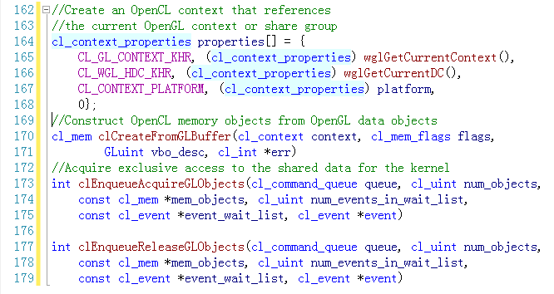
Interoperate with OpenGL4/4
Notes:
Synchronization between OpenGL-OpenCL is made possible through two OpenCL functions. The first is clEnqueueAcquireGLObjects, which ensures that the kernel will have exclusive access to the data. The second is clEnqueueReleaseGLObjects, which allows other processes, such as the OpenGL renderer, to access the data. These functions have similar signatures and they are given as follows:
When clEnqueueAcquireGLObjects is called, the kernel will have exclusive access to them. When clEnqueueReleaseGLObjects is called, the kernel will give up this exclusive access.

Slide 41
Heterogeneous computing
OpenCL
  Introduction
  Architecture
  Uses
  A simple programming guide
  Interoperate with OpenGL
  Compare with CUDA

Slide 42
Compared with CUDA
CUDA
  An extremely powerful, advanced GPGPU programming interface
  Integrate well with existing code(C/C++)
However, CUDA is not device agnostic
  Only work on NVIDIA hardware
  Only targets the graphics card
  Vendor controlled
Notes:
Most GPGPU-enthusiasts have heard of both OpenCL and CUDA.
I still think OpenCL will win eventually on consumer-markets (desktop and mobile) because of support for more devices, but CUDA will stay a big player in professional and scientific markets because of the
legacy software they are currently building up and the more friendly development-support.

