Slide 1

A Standard for
Shared Memory
Parallel Programming

Slide 2
Definition of OpenMP
  Application Program Interface (API) for Shared Memory Parallel Programming
  Directive based approach with library support
  Targets existing applications and widely used languages:
    Fortran API released October `97
    C, C++ API released October `98
  Multi-vendor/platform support

Slide 3
OpenMP Specification
Application Program Interface (API) for Shared Memory Parallel Programming
  non-profit organization: www.openmp.org
    full reference manual http://www.openmp.org/specs
  SGI implements C/C++ and Fortran specification version 1.0 (1997 Fortran and 1998 C]
  OpenMP Fortran 2.0 specification is out for public comment (November 2000)

Slide 4
Why OpenMP
  Parallel programming landscape before OpenMP
    Standard way to program distributed memory computers (MPI and PVM)
    No standard API for shared memory programming
  Several vendors had directive based API for shared memory programming
    Silicon Graphics, Cray Research, Kuck & Associates, DEC
    All different, vendor proprietary, similar but different spellings
    Most were targeted at loop level parallelism
  Commercial users, high end software vendors have big investment in existing code
  End result: users who want portability forced to program shared memory machines using MPI
    Library based, good performance and scalability
    sacrifice the built in shared memory advantages of hardware
    Requires major effort
      Entire program needs to be rewritten
      New features needs to be curtailed during conversion

Slide 5
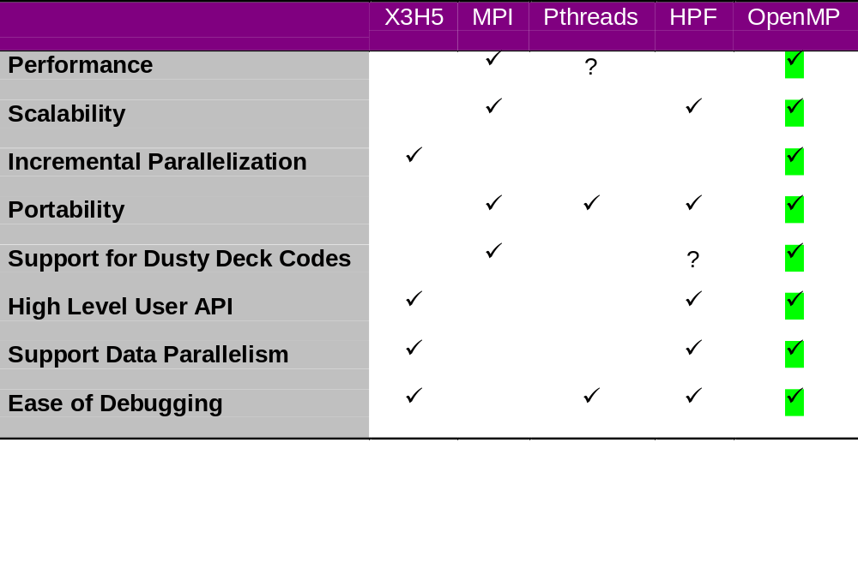
OpenMP Compared
Scientific and technical applications issues:

Slide 6
OpenMP Today
Organization:
  Architecture Review Board
  Web site: www.OpenMP.org
U.S. Department of Energy ASCI program
Hardware Vendors
Compaq/Digital (DEC)
Hewlett-Packard (HP)
IBM
Intel
SGI
Sun Microsystems
3rd Party Software Vendors
Absoft
Edinburgh Portable Compilers (EPC)
Kuck & Associates (KAI)
Myrias
Numerical Algorithms Group
Portland Group (PGI)

Slide 7
OpenMP Interface Model
Directives
and
pragmas
Runtime library
routines
Environment
Variables
Control structures
Work sharing
synchronization
Data scope attributes:
  private
  firstprivate
  lastprivate
  shared
  reduction
Orphaning
Control and query routines:
  number of threads
  throughput mode
  nested parallelism
Lock API
Runtime environment:
  schedule type
  max #threads
  nested parallelism
  throughput mode

Slide 8
OpenMP Interface Model...
Vendor
extensions
Address needs of CC-NUMA architecture
previous talk...
Data Distribution
access to threadprivate data
additional environment variables
Support for better scalability
man (3F/3C) mp
Address needs of IRIX operating system
man pe_environ

Slide 9
OpenMP Execution Model
OpenMP Program starts like any sequential program:
single threaded
To create additional threads user starts a parallel region
  Additional slave threads are launched to create a team
  Master thread is part of the team
  Threads “go away” at the end of the parallel region: usually sleep or spin
Repeat parallel regions as necessary
  Fork-join model
Master
thread
Parallel
region 1:
4 threads
Parallel
region 2:
6 threads
Parallel region 3:
2 threads

Slide 10
OpenMP Directive Format
sentinel directive_name [clause[,clause]…]
  the sentinels can be in fixed or free source format:
    fixed: !$OMP C$OMP *$OMP (starting from the first column)
    free: !$OMP
    continuation line: !$OMP& (a character in 6th column)
    C/C++: #pragma omp
  in Fortran the directives are not case sensitive
  in C/C++ the directives are case sensitive
  the clauses may appear in any order
  comments cannot appear on the same line as a directive
  conditional compilation:
    Fortran: C$ is replaced by two spaces with -mp flag
    C/C++: #ifdef _OPENMP is defined by OpenMP compliant compiler

Slide 11
Creating Parallel Regions
  Only one way to create threads in OpenMP API:
  Fortran:
  C/C++:
  Replicate execution:
C$OMP PARALLEL [clause[,clause]…]
code to run in parallel
C$OMP END PARALLEL
Block of code:
It is illegal to jump in
or out of that block
Data association rules(shared,private, etc.) have to be specified at start of parallel region (default shared)
#pragma omp parallel [clause[,clause]…]
{
code to run in parallel
}
Number of threads specified by user:
library: call omp_set_num_threads(128)
Environment: setenv OMP_NUM_THREADS 128
I=0
C$OMP PARALLEL
call foo(I, a, b, c)
C$OMP END PARALLEL
print*, I
I=0
call foo
call foo
call foo
call foo
print *, I

Slide 12
Semantics of Parallel Region
C$OMP PARALLEL [DEFAULT(PRIVATE|SHARED|NONE)]
[PRIVATE(list)] [SHARED(list)]
[FIRSTPRIVATE(list)]
[COPYIN(list)]
[REDUCTION({op|intrinsic}:list)]
[IF(scalar_logical_expression)]
block
C$OMP END PARALLEL
#pragma omp parallel [default(private|shared|none)]
[private(list)] [shared(list)]
[firstprivate(list)]
[copyin(list)]
[reduction({op|intrinsic}:list)]
[if(scalar_logical_expression)]
{
block
}

Slide 13
Work Sharing Constructs
Work sharing constructs is automatic way to distribute computation to parallel threads
C$OMP DO [PRIVATE(list)]
[FIRSTPRIVATE(list)] [LASTPRIVATE(list)]
[ORDERED] [SCHEDULE(kind[,chunk])]
[REDUCTION({op|intrinsic}:list)]
DO I=i1,i2,i3
block
ENDDO
[C$OMP END DO [NOWAIT]] {#pragma omp for}
Do loop iterations will be subdivided
according to SCHEDULE and each
chunk executed in a separate thread
C$OMP SECTIONS [PRIVATE(list)]
[FIRSTPRIVATE(list)] [LASTPRIVATE(list)]
[REDUCTION({op|intrinsic}:list)]
[C$OMP SECTION
block]
[C$OMP SECTION
block]
C$OMP END SECTIONS [NOWAIT] {#pragma omp sections}
Each section’s block of code will be
run in a separate thread in parallel
C$OMP SINGLE [PRIVATE(list)] [FIRSTPRIVATE(list)]
block
C$OMP END SINGLE [NOWAIT]
First thread that reaches SINGLE will
execute block, others will skip it and
wait for synchronization at END SINGLE

Slide 14
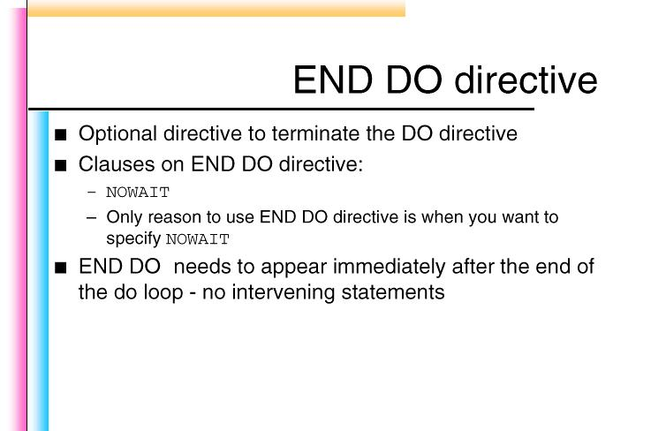
Work Sharing Constructs

Slide 15
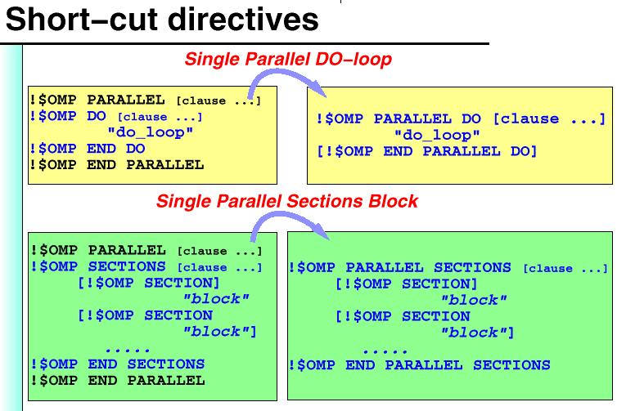
Work Sharing Constructs
#pragma omp parallel for
#pragma omp parallel sections

Slide 16
Why Serialize?
Race condition for shared data
  Cache Coherency protocol serializes a single store
  Atomic serializes operations
  example: x++
ld r1,x
add r1,1
st r1,x
p0 memory p1
r1:0 x=0
add
r1:1 x=1 r1:1
add
x=2 r1:2
“good timing”
p0 memory p1
r1:0 x=0 r1:0
add add
r1:1 x=1 r1:1
x=1
“bad timing”
ld
ld
ld
st
ld
st
st
Delay st for CC
st

Slide 17
Synchronization Constructs
C$OMP MASTER
block
C$OMP END MASTER
The master thread will execute the block. Other processors will
skip to the code after END MASTER and continue execution.
Block of code: It is illegal to jump in or out of that block
C$OMP CRITICAL [(name)]
block
C$OMP END CRITICAL [(name)]
C$OMP BARRIER
As soon as all threads arrive at BARRIER, they are free to leave
C$OMP ATOMIC
optimization of CRITICAL for one statement
C$OMP FLUSH (list)
shared variables in the list are written back to memory
C$OMP ORDERED
block
C$OMP END ORDERED

Slide 18
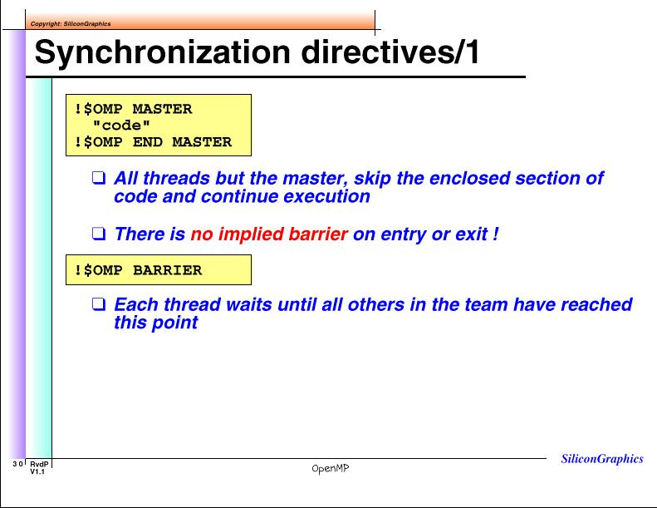
Synchronization Constructs
#pragma omp master
#pragma omp barrier

Slide 19
Example: Critical Section
Critical section is the way to order execution:
one processor will enter the critical section at a time
  in OpenMP, critical section can be named
    these names are global entities and should not conflict with other global entities like subroutine names of common blocks
    threads can execute critical sections with different names at the same time
  examples
C$OMP PARALLEL
……
C$OMP CRITICAL(left)
A(i) = A(i) + Alocal
C$OMP END CRITICAL(left)
……
C$OMP END PARALLEL
#pragma omp parallel
{
……
#pragma omp critical(left)
A(i) += Alocal
……
}

Slide 20
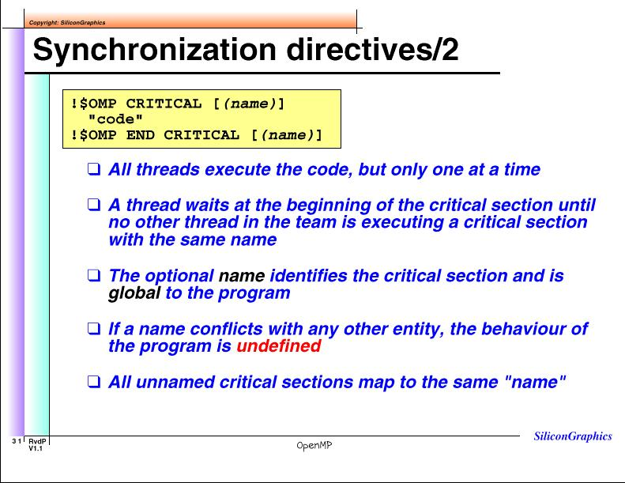
Synchronization Constructs

Slide 21
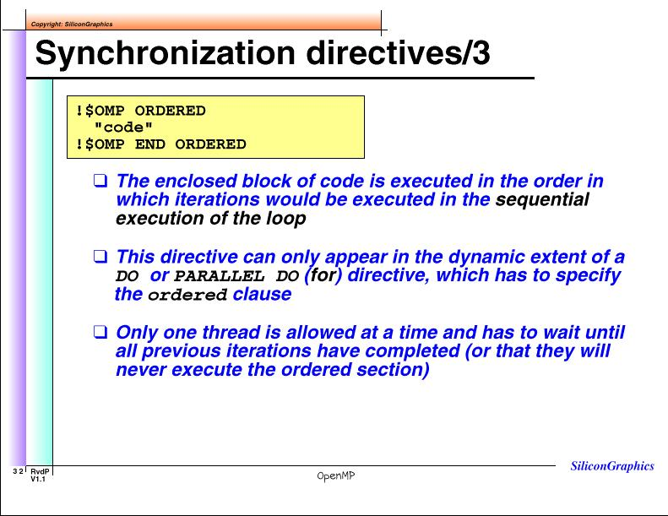
Synchronization Constructs
#pragma omp ordered

Slide 22
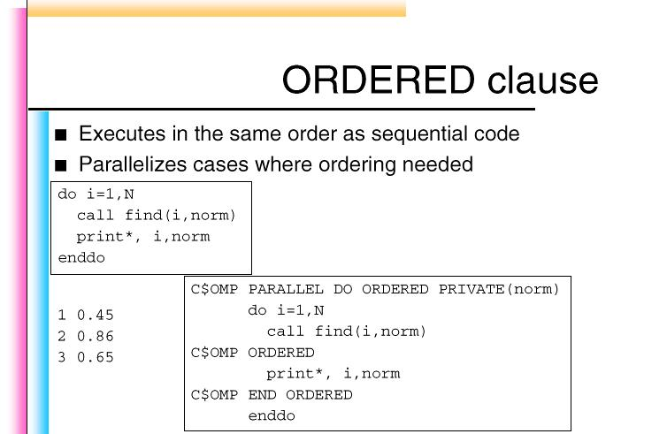
OpenMP Clauses

Slide 23
Example: Atomic Directive
optimization of mutual exclusion for certain cases:
  the directives applies to the statement immediately following it
  the statement must not be a structured block:
      x = x op expr
      x = intrinsic(x,expr)
      x binop = expr;
      x++; x--; ++x; --x
  All references to storage x must be of the same type
  enables fast implementation on some hardware, others will use the critical section construct
!$OMP ATOMIC
Y(INDEX(I)) = Y(INDEX(I)) + Z
C$OMP PARALLEL
……
C$OMP ATOMIC
A(i) = A(i) + Alocal
……
C$OMP END PARALLEL
#pragma omp parallel {
……
#pragma omp atomic
A[i] += Alocal
}

Slide 24
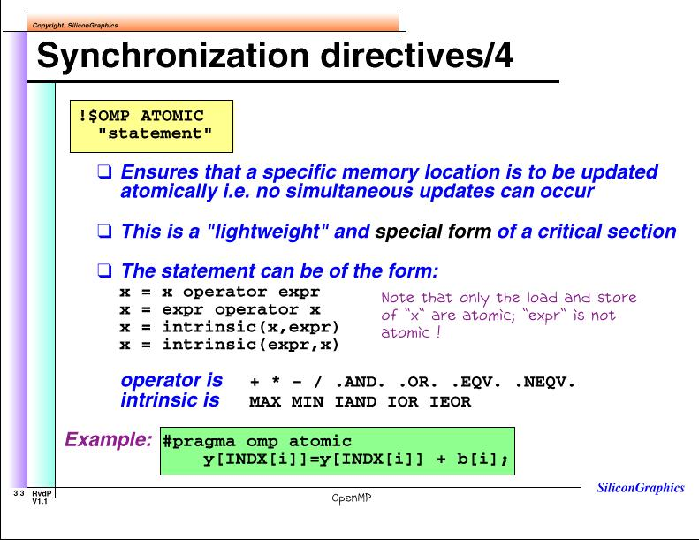
Synchronization Constructs

Slide 25
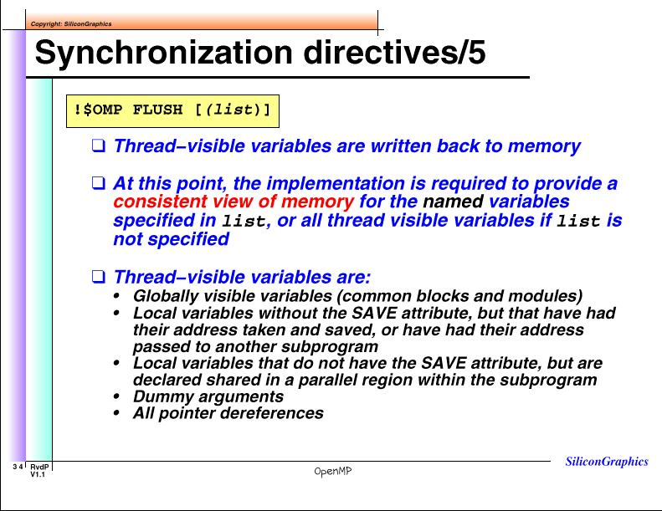
Synchronization Constructs
#pragma omp flush [(list)]

Slide 26
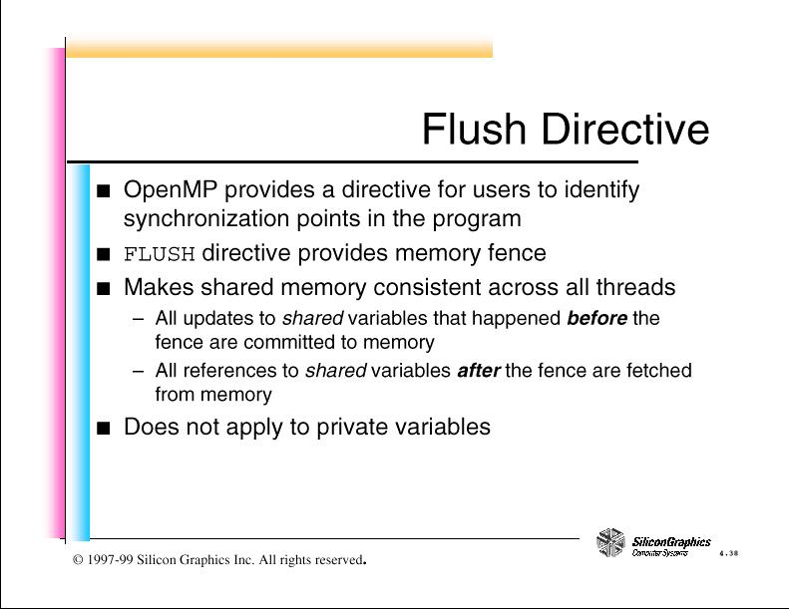
OpenMP Directive

Slide 27
Clauses in OpenMP/1
Clauses for the “parallel” directive specify data association rules and conditional computation:
default(private|shared|none)
    default association for variables that are not mentioned in other clauses
shared(list)
    data in this list is accessible by all the threads and reference the same storage
private(list)
    data in this list are private to each thread.
    A new storage location is created with that name and the contents of that storage are not available outside of the parallel region.
    The data in this list are undefined at the entry to the parallel region
firstprivate(list)
    as for the private(list) clause with the addition that the contents are initialized from the variable with that name from outside of the parallel region
lastprivate(list)
    this is available only for work sharing constructs
    a shared variable with that name is set to the last computed value of a thread private variable in the work sharing construct

Slide 28
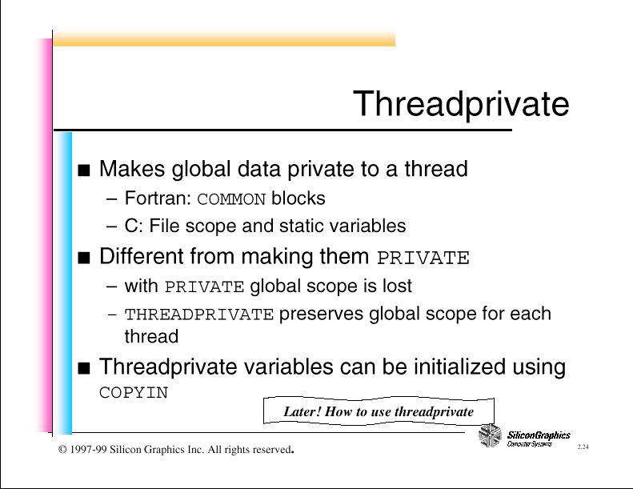
Thread Private

Slide 29
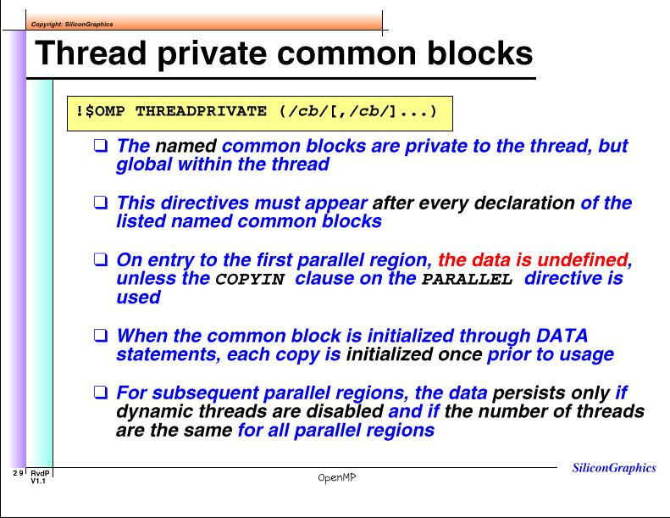
Thread Private

Slide 30
Data
No synchronization is needed when:
  data is private to each thread
  each thread works on a different part of shared data
When synchronizing for shared data:
  processors wait for each other to complete work
  processors arbitrate for access to data
A key to efficient OpenMP program
is independent data

Slide 31
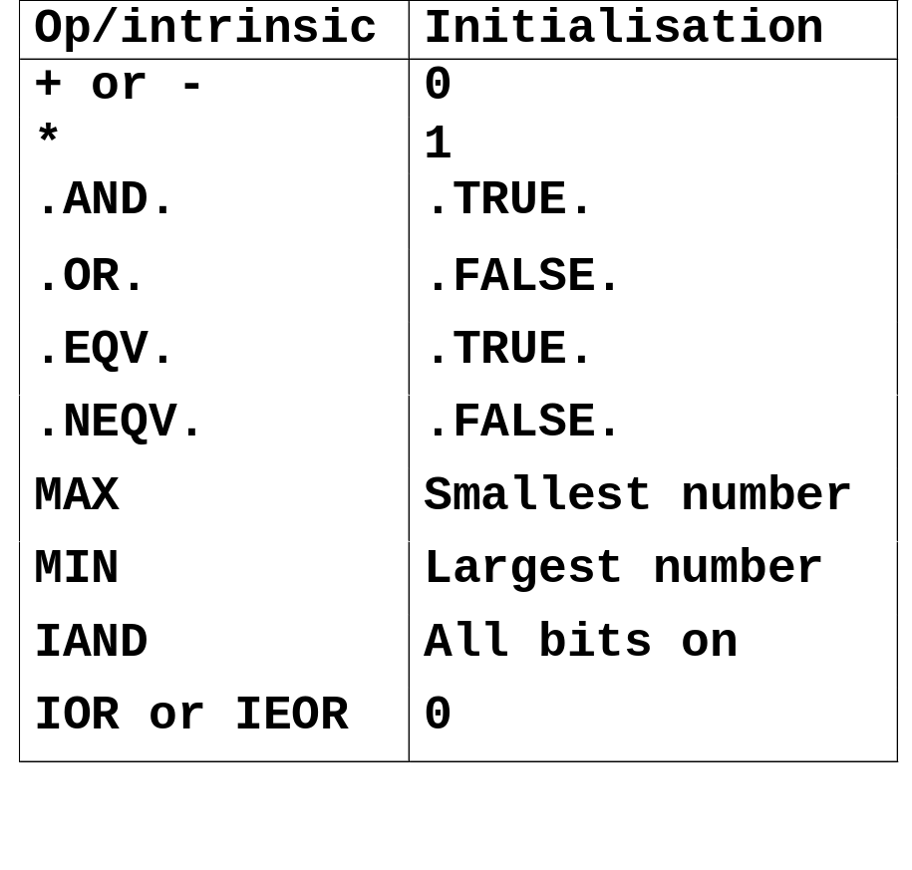
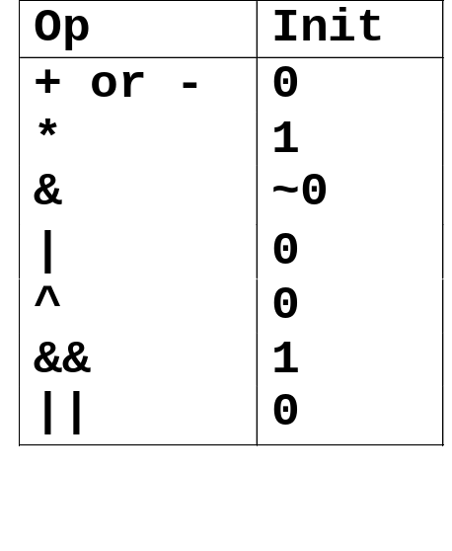
Clauses in OpenMP/2
reduction({op|intrinsic}:list)
    variables in the list are named scalars of intrinsic type
    a private copy of each variable in the list will be constructed and initialized according to the intended operation. At the end of the parallel region or other synchronization point all private copies will be combined with the operation
    the operation must be in the form
        x = x op expr
        x = intrinsic(x,expr)
        if (x .LT. expr ) x = expr
        x++; x--; ++x; --x;
    where expr does not contain x
    example:
!$OMP PARALLEL DO REDUCTION(+: A,Y) REDUCTION(.OR.: S)

Slide 32
Clauses in OpenMP/3
copyin(list)
    the list must contain common block (or global) names that have been declared threadprivate
    data in the master thread in that common block will be copied to the thread private storage at the beginning of the parallel region
    note that there is no “copyout” clause; data in private common block is not available outside of that thread
if(scalar_logical_expression)
    if an “if” clause is present, the enclosed code block is executed in parallel only if the scalar_logical_expression evaluates to .TRUE.
ordered
    only for DO/for work sharing constructs. The code enclosed within the ORDERED block will be executed in the same sequence as sequential execution
schedule(kind[,chunk])
    only for DO/for work sharing constructs. Specifies the scheduling discipline for the loop iterations
nowait
    end of work sharing construct and SINGLE directive implies a synchronization point unless nowait is specified

Slide 33
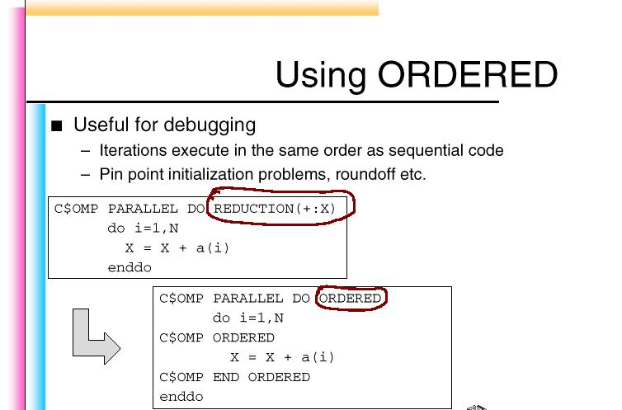
OpenMP Clause

Slide 34
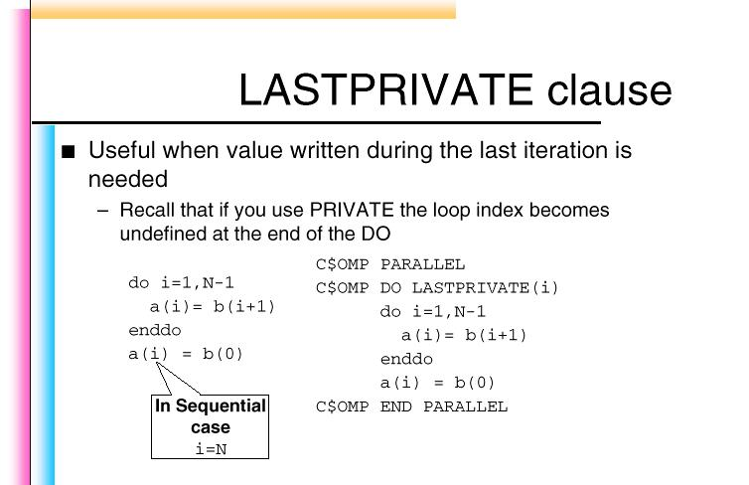
OpenMP Clause

Slide 35
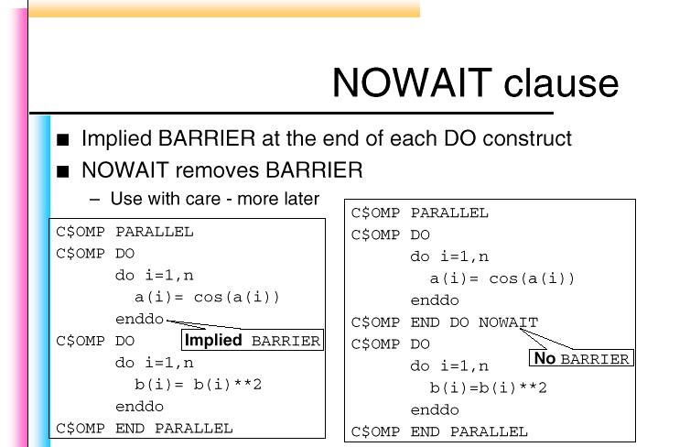
OpenMP Clause

Slide 36
Workload Scheduling
  In OpenMP, compiler accepts directives for work distribution:
    C$OMP DO SCHEDULE(type[,chunk]) where type is
      STATIC iterations are divided into pieces at compile time (default)
      DYNAMIC iterations assigned to processors as they finish, dynamically. This requires synchronization after each chunk iterations.
      GUIDED pieces reduce exponentially in size with each dispatched piece
      RUNTIME schedule determined by an environment variable OMP_SCHEDULE With RUNTIME it is illegal to specify chunk. Example: setenv OMP_SCHEDULE “dynamic, 4”
  If a directive does not mention the scheduling type, compiler switch -mp_schedtype=type can be used to set the scheduling type
SCHEDULE(STATIC,6)
26 iter on 4 processors
SCHEDULE(GUIDED,4)
26 iter on 4 processors

Slide 37
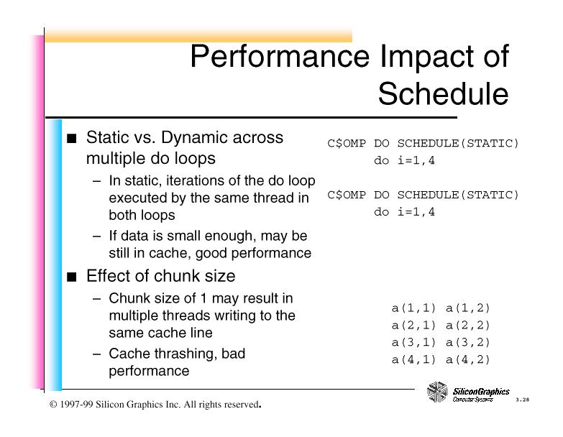
Workload Scheduling

Slide 38
Custom Work Distribution
C$OMP PARALLEL shared(A,n)
call ddomain1(n,is,ie)
A(:,is:ie) = …
…
C$OMP END PARALLEL
Subroutine ddomain1(N,is,ie)
integer N ! Assume arrays are (1:N)
integer is,ie ! Lower/upper range
nth=omp_get_num_threads()
mid=omp_get_thread_num()
is=(1+floor((mid*N+0.5)/nth))
ie=MIN(n,floor((mid+1)*N+0.5)/nth))
end

Slide 39
Scope Definitions
  Static Extent is the code in the same lexical scope
  Dynamic Extent is the code in Static Extent + all the code that can be reached from the Static Extent during program execution (dynamically)
  directives in dynamic extent are called Orphaned directives
    I.e. there can be OpenMP directives outside of the lexical scope
C$OMP PARALLEL
call whoami
C$OMP END PARALLEL
call whoami
subroutine whoami
external omp_get_thread_num
integer iam, omp_get_thread_num
iam = omp_get_thread_num()
C$OMP CRITICAL
print*,’Hello from ‘, iam
C$OMP END CRITICAL
return
end
+
Static
extent of
parallel
region
Dynamic
extent
includes
static
extent
Orphan
directive
One compilation unit
Different compilation unit

Slide 40
Scope Definitions
I=0
C$OMP PARALLEL
call foo(I, a, b, c)
C$OMP END PARALLEL
print*, I
I=0
call foo
call foo
call foo
call foo
print *, I
Dynamic Extent:
code reached during
program execution
Static Extent:
code in same lexical scope
subroutine foo(…)
C$OMP PARALLEL
call bar(I, a, b, c)
C$OMP END PARALLEL
print*, J
Orphan Directive
subroutine bar(…)
C$OMP ATOMIC
X = X + 1
Binding

Slide 41
Nested Parallelism
Nested parallelism is the ability to have parallel regions within parallel regions
  OpenMP specification allows nested parallel regions
  currently all implementation serialize nested parallel regions
    i.e. effectively there is no nested parallelism
  a PARALLEL directive in dynamic extent of another parallel region logically establishes a new team consisting only of the current thread
  DO, SECTIONS, SINGLE directives that bind to the same PARALLEL directive are not allowed to be nested
  DO, SECTIONS, SINGLE directives are not allowed in the dynamic extent of CRITICAL and MASTER directives
  BARRIER directives are not allowed in the dynamic extend of DO, SECTIONS, SINGLE, MASTER and CRITICAL directives
  MASTER directives are not permitted in the dynamic extent of any work sharing constructs (DO, SECTIONS, SINGLE)
Nested
Parallel
Regions

Slide 42
Nested Parallelism
The NEST clause on the !$OMP PARALLEL DO directive allows you to exploit nested concurrency in a limited manner.
The following directive specifies that the entire set of iterations across both loops can be executed concurrently:
!$OMP PARALLEL DO
!$SGI+NEST(I, J)
DO I =1, N
DO J =1, M
A(I,J) = 0
END DO
END DO
It is restricted, however, in that loops I and J must be perfectly nested. No
code is allowed between either the DO I ... and DO J ... statements or
between the END DO statements.

Slide 43
Compiler Support for OpenMP
  Native compiler support for OpenMP directives:
    compiler flag -mp
    Fortran
    C/C++
  Automatic parallelization option in addition to OpenMP
    compiler flag -apo (enables also -mp)
    mostly useful in Fortran
  mixing automatic parallelization with OpenMP directives

Slide 44
Run Time Library
subroutine omp_set_num_threads(scalar)
  sets the number of threads to use for subsequent parallel region
integer function omp_get_num_threads()
  should be called from parallel segment. Returns number of threads currently executing
integer function omp_get_max_threads()
  can be called anywhere in the program. Returns max number of threads that can be returned by omp_get_num_threads()
integer function omp_get_thread_num()
  returns id of the thread executing the function. The thread id lies in between 0 and omp_get_num_threads()-1
integer function omp_get_num_procs()
  maximum number of processors that could be assigned to the program
logical function omp_in_parallel()
  returns .TRUE. (non-zero) if it is called within dynamic extent of a parallel region executing in parallel; otherwise it returns .FALSE. (0).
subroutine omp_set_dynamic(logical)
logical function omp_get_dynamic()
  query and setting of dynamic thread adjustment; should be called only from serial portion of the program

Slide 45
OpenMP Lock Functions/1
#include <omp.h>
void omp_init_lock(omp_lock_t *lock);
void omp_init_nest_lock(omp_nest_lock_t *lock);
  initializes lock; the initial state is unlocked, for the nestable lock the initial count is zero. These functions should be called from serial portion.
void omp_destroy_lock(omp_lock_t *lock);
void omp_destroy_nest_lock(omp_nest_lock_t *lock);
  the argument should point to initialized lock variable that is unlocked
void omp_set_lock(omp_lock_t *lock);
void omp_set_nest_lock(omp_nest_lock_t *lock);
  ownership of the lock is granted to the thread executing the function; with nestable lock the nesting count is incremented
  if the (simple) lock is set when the function is executed the requesting thread is blocked until the lock can be obtained
void omp_unset_lock(omp_lock_t *lock);
void omp_unset_nest_lock(omp_nest_lock_t *lock);
  the argument should point to initialized lock in possession of the invoking thread, otherwise the results are undefined.
  For the nested lock the function decrements the nesting count and releases the ownership when the count reaches 0

Slide 46
OpenMP Lock Functions/2
#include <omp.h>
int omp_test_lock(omp_lock_t *lock);
int omp_test_nest_lock(omp_nest_lock_t *lock);
  these functions attempt to get the lock in the same way as omp_set_(nest)_lock, except these functions are non-blocking
  for a simple lock, the function returns non-zero if the lock is successfully set, otherwise it returns 0
  for a nestable lock, the function returns the new nesting count if the lock is successfully set, otherwise it returns 0
#include <omp.h>
omp_lock_t *lck;
omp_init_lock(lck);
…
/* spin until the lock is granted */
while( !omp_test_lock(lck));

Slide 47
OpenMP Correctness Rules
A correct OpenMP program...
  should not depend on the number of threads
  should not depend on a particular schedule
    should not have BARRIER in serialization or work sharing construct (critical, omp do/for, section, single)
    should not have work sharing constructs inside serialization or other work sharing constructs
  all threads should reach same work sharing constructs

Slide 48
OpenMP Efficiency Rules
Optimization for
scalability and performance:
  maximize independent data
  minimize synchronization

Slide 49
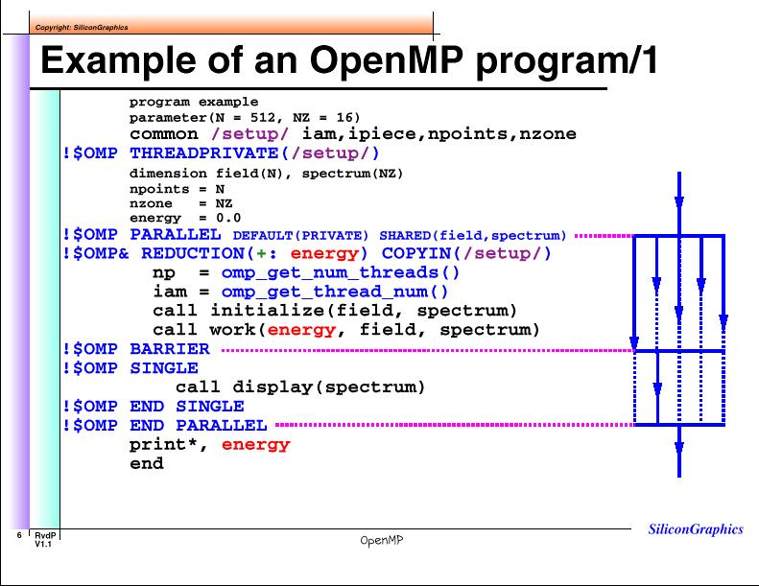
FORTRAN Example

Slide 50
Example of an OpenMP Program/3
  subroutine initialize ( field, spectrum )
  common /setup/ iam, ipiece, npoints, nzone
  !$OMP THREADPRIVATE ( / setup / )
  dimension field( npoints ), spectrum( nzone )
  !$OMP DO
  do i = 1, nzone
  spectrum(i) = “initial data”
  end do
  np = omp_get_num_threads()
  nleft = mod( npoints, np)
  ipiece = npoints / np
  if( iam .lt. nleft ) ipiece = ipiece + 1
  do i = istart, iend
  field(i) = “initial data”
  end do
  return
  end

Slide 51
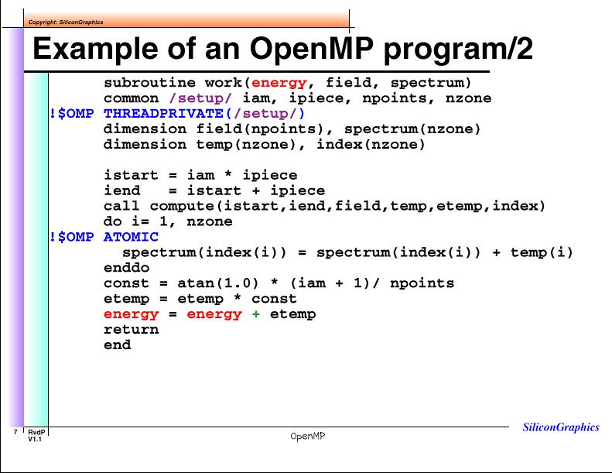
FORTRAN Example

Slide 52
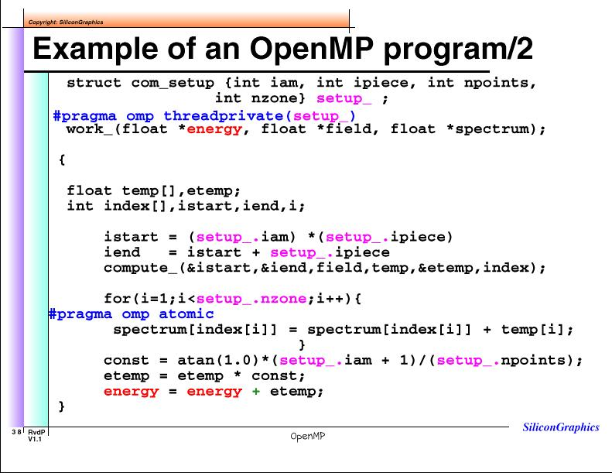
FORTRAN / C Example

Slide 53
Example: Parallel Region in C
int x,y, z[1000];
#pragma omp threadprivate (x)
void fun(int a)
{
const int c = 1;
int i = 0;
#pragma omp parallel default(none)
private(a) shared(z)
{
int j = omp_get_thread_num();
a = z[j];
x = c;
z[i] = y;
#pragma omp for firstprivate(y)
for(int i=0;i<10;i++)z[i] = y;
z[i] = y;
} /* end pragma parallel */
printf(“%d\n”,a);
}
x will be made local to each thread
and will keep the value assigned by
each thread in a second parallel reg
Constant c will be propagated inside
the parallel region
j is defined as automatic local var
and assigned to the current #threads
a is defined in void fun(int a)
-> private(a), therefore fresh copy of
int “a” is created in each parallel thread
z[i] = y is illegal because
y and i are unknown:
there is no default scope
int y is global; firstprivate(y)
will create a fresh copy of int “y” and
initialize it to the global value;
i is a local private variable in block
a here is the original int a passed to fun.
There is no access to private variables outside parallel region

Slide 54
Measuring OpenMP Performance
OpenMP constructs need time to execute:
  parallel region - transfer control to user code
  barrier - control synchronization of threads
    covers do/for parallel loops, parallel sections
  critical section - serialization of threads
    covers locks
  reduction operation - update of a shared variable
    covers atomic
Compiler versions 7.3.1.1m and 7.3.1.2m

Slide 55
Synchronization Primitives
#pragma single
#pragma omp parallel
#pragma barrier

Slide 56
Serialization Primitives
omp_set_lock(&lock)
x++;
omp_unset_lock(&lock);
#pragma critical
{ x++; }
#pragma for reduction(+:x)
for(i=0;i<n;i++) x++;
#pragma atomic
x++;

Slide 57
OpenMP Performance: Origin3000
O3K (400MHz)
parallel region
Origin2K (300/400MHz)
parallel region overhead
O3K (400MHz)
barrier
O2K (300/400MHz) barrier

Slide 58
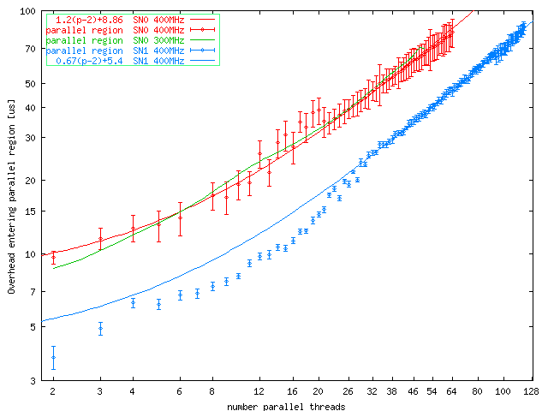
Establishing Parallel Region
Time to user code with established threads
Origin2800
R12K 400MHz
Origin2800
R10K 300MHz
Parallel region overhead time [μs]
Origin3800
R12K 400 MHz
Number parallel threads

Slide 59
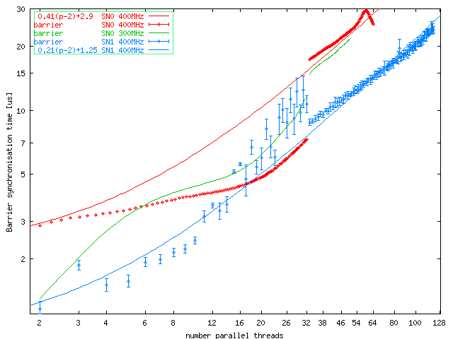
Barrier Overhead
Time to synchronize processors with BARRIER
Origin2800
R12K 400MHz
Origin2800
R10K 300MHz
Barrier synchronization time [μs]
Origin3800
R12K 400 MHz
Number parallel threads

Slide 60
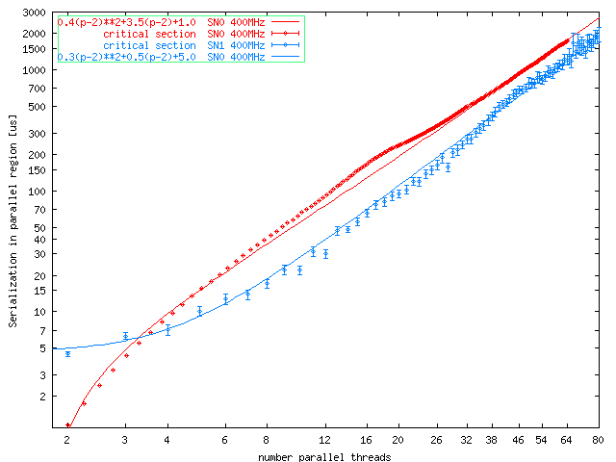
Critical Section Overhead
Time for all threads to pass from critical section
Origin2800
R12K 400MHz
Critical Section time [μs]
Origin3800
R12K 400 MHz
Number parallel threads

Slide 61
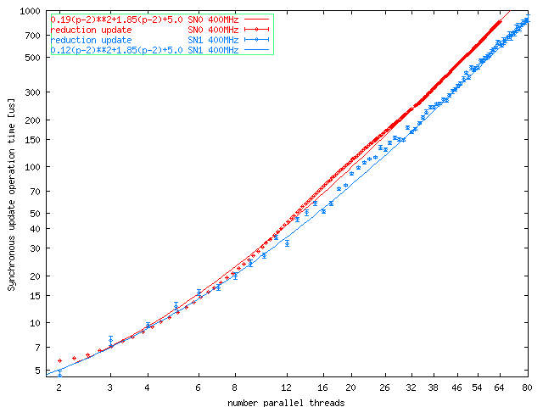
Reduction Operation Overhead
Time for all threads to do shared sum ++x
Reduction Operation time [μs]
Origin2800
R12K 400MHz
Origin3800
R12K 400 MHz
Number parallel threads

Slide 62
OpenMP Measurement Summary
Polynomial fit to data:
  Least Squares fit for the parallel region construct
  “eye” fit for other constructs
OpenMP construct Origin2000 400MHz Origin3000 400MHz
parallel region 1.2(p-2)+8.86 0.67(p-2)+5.4
barrier 0.41(p-2)+2.94 (p>32) 0.21(p-2)+1.25
critical section 0.4(p-2)²+3.5(p-2)+1.0 0.3(p-2)²+0.5(p-2)+5.0
reduction 0.2(p-2)²+1.8(p-2)+0.5 0.1(p-2)²+1.8(p-2)+5.0
Quadratic contributions

Slide 63
Measurements Conclusions
OpenMP performance
  It takes ~50 μs to enter parallel region with 64 proc
    with 800 Mflop/s per processor, it can do 40K flop in that time.
    Parallel loop must contain >2.5Mflop to justify parallel run
  It takes ~500 μs to do reduction with 64 proc
  OpenMP performance depends on architecture, not on processor speed
    compare Origin2800 300MHz, 400MHz and Origin3800 400MHz
  Application speed on parallel machine is determined by the architecture

Slide 64
OpenMP “Danger Zones”
3 major SMP programming errors:
  Race Conditions
    the outcome of the program depends on the detailed timing of the threads in the team
  Deadlock
    threads lock up waiting on a locked resource that will never come free
  Livelock
    multiple threads working individual tasks which the ensemble can not finish
  Death traps:
    thread safe libraries?
    Simultaneous access to shared data
    I/O inside parallel region
    shared memory not coherent (FLUSH)
    implied barriers removed (NOWAIT)

Slide 65
Race Conditions/1
  In the following code the result varies unpredictably based on detailed order of execution of each section
  wrong answers produced without warning
  fixing the example, we choose the assignments to occur in order A, B, C
    icount forces this order
    FLUSH forces the update of the shared variable
C$omp parallel sections
A = B + C
c$omp section
B = A + C
c$omp section
C = B + A
c$omp end parallel sections
icount = 0
C$omp parallel sections
A = B + C
icount = 1
c$omp flush (icount)
c$omp section
1000 continue
if(icount.lt.1) goto 1000
B = A + C
icount = 2
c$omp flush (icount)
c$omp section
2000 continue
if(icount.lt.2) goto 2000
C = B + A
c$omp end parallel sections

Slide 66
Race Conditions/2
Special attention should be given to the work sharing constructs without synchronization at the end:
  the result varies unpredictably because the value of X is not dependable until the barrier at the end of the do loop
  wrong answers produced without warning
C$omp parallel shared(x,y,A) private(tmp,id)
id = omp_get_thread_num()
c$omp do reduction(+:x)
do 100 I=1,100
tmp = A(I)
x = x + tmp
100 continue
c$omp end do nowait
y(id) = work(x,id)
c$omp end parallel

Slide 67
Deadlock/1
The following code shows a race condition with deadlock:
  if A is locked by one thread and B by another - there is a deadlock
  if the same thread gets both locks, you get a race condition:
    different behaviour depending on detailed timing of the threads
  Avoid nesting different locks
call omp_init_lock(lcka)
call omp_init_lock(lckb)
C$omp parallel sections
c$omp section
call omp_set_lock(lcka)
call omp_set_lock(lckb)
call use_A_and_B(res)
call omp_unset_lock(lckb)
call omp_unset_lock(lcka)
c$omp section
call omp_set_lock(lckb)
call omp_set_lock(lcka)
call use_B_and_A(res)
call omp_unset_lock(lcka)
call omp_unset_lock(lckb)
c$omp end parallel sections

Slide 68
Deadlock/2
Often deadlock condition arises from error processing:
  if lcka is set in the first section and the if statement branches around the unset lock, threads running the other sections will deadlock waiting forever for the lock to be released
  make sure locks are always released
call omp_init_lock(lcka)
C$omp parallel sections
c$omp section
call omp_set_lock(lcka)
ival = dowork()
if(ival.EQ.TOL) then
call omp_unset_lock(lcka)
else
call error(ival)
endif
c$omp section
call omp_set_lock(lcka)
call use_B_and_A(res)
call omp_unset_lock(lcka)
c$omp end parallel sections

Slide 69
Livelock
The following code shows a race condition and a livelock:
  if res is never smaller than TOL, the program spins endlessly in Livelock
  the race may be fixed with a barrier before the single, such that the match function will work better
  also, decide on the maximum number of iterations, rather than an infinite loop
C$omp parallel private(id)
id = omp_get_thread_num()
n = omp_get_num_threads()
10 continue
phases(id) = update(u,id)
c$omp single
res = match(phases,n)
c$omp end single
if(res.lt.TOL) goto 20
goto 10
20 continue
c$omp end parallel
C$omp barrier
c$omp single
res = match(phases,n)
icount = icount + 1
c$omp end single
if(res.lt.TOL.or
icount.gt.MAX)goto 20
goto 10
20 continue
c$omp end parallel

Slide 70
Program of Work
Automatic parallelization + compiler directives:
  Compile with -apo and/or -mp
  Measure performance and speedup for each parallel region
    parallel region level
    subroutine (parallel loop) level
  Where not satisfactory, patch up with compiler directives
  Combine as much code as possible in a single parallel region
  Adjust algorithm to reduce parallel overhead
  Provide data distribution to reduce memory bottle necks

Slide 71
OpenMP Summary
OpenMP parallelization paradigm:
  small number of compiler directives to set up parallel execution of computer code and run time library system for locking functions
  the directives are portable (supported by many different vendors in the same way)
  the parallelization is for SMP programming paradigm, i.e. the machine should have a global address space
  the number of execution threads can be controlled outside of the program
  a correct OpenMP program should not depend on the exact number of execution threads, nor on the scheduling mechanism for work distribution
  more over, a correct OpenMP program should be (weakly) serially equivalent, I.e. the results of the computation should be within rounding accuracy similar to the sequentially executing program
  on SGI, the OpenMP parallel programming can be mixed with the Message Passing Interface (MPI) library, providing for “Hierarchical Parallelism”
    OpenMP parallelism in a single node (Global Address Space)
    MPI parallelism between the nodes in a cluster (Connected by Network)

