Slide 1
ECE 498AL
Lecture 2:
The CUDA Programming Model

Slide 2

What is GPGPU ?
General Purpose computation using GPU
in applications other than 3D graphics
  GPU accelerates critical path of application
Data parallel algorithms leverage GPU attributes
  Large data arrays, streaming throughput
  Fine-grain SIMD parallelism
  Low-latency floating point (FP) computation
Applications – see //GPGPU.org
  Game effects (FX) physics, image processing
  Physical modeling, computational engineering, matrix algebra, convolution, correlation, sorting
Notes:
Mark Harris, of Nvidia, runs the gpgpu.org website

Slide 3
Previous GPGPU Constraints
Dealing with graphics API
  Working with the corner cases of the graphics API
Addressing modes
  Limited texture size/dimension
Shader capabilities
  Limited outputs
Instruction sets
  Lack of Integer & bit ops
Communication limited
  Between pixels
  Scatter a[i] = p
per thread
per Shader
per Context
Input Registers
Fragment Program
Texture
Constants
Temp Registers
Output Registers
FB Memory

Slide 4


CUDA
“Compute Unified Device Architecture”
General purpose programming model
  User kicks off batches of threads on the GPU
  GPU = dedicated super-threaded, massively data parallel co-processor
Targeted software stack
  Compute oriented drivers, language, and tools
Driver for loading computation programs into GPU
  Standalone Driver - Optimized for computation
  Interface designed for compute - graphics free API
  Data sharing with OpenGL buffer objects
  Guaranteed maximum download & readback speeds
  Explicit GPU memory management

Slide 5
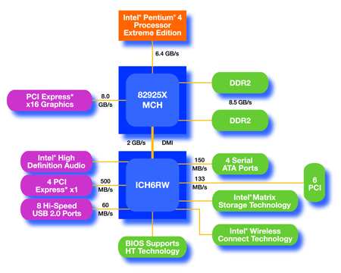
An Example of Physical Reality Behind CUDA
CPU
(host)
GPU w/
local DRAM
(device)

Slide 6
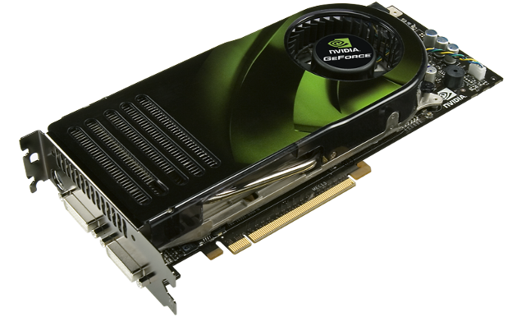
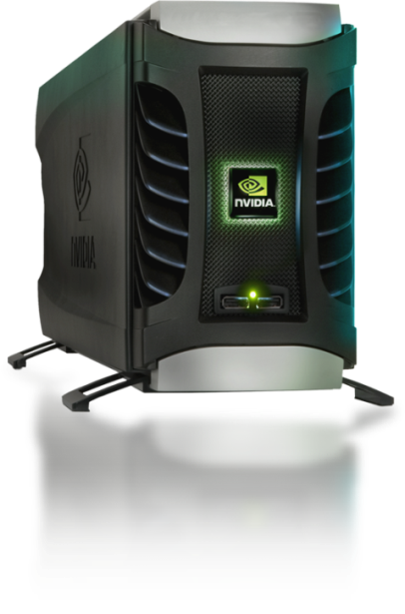
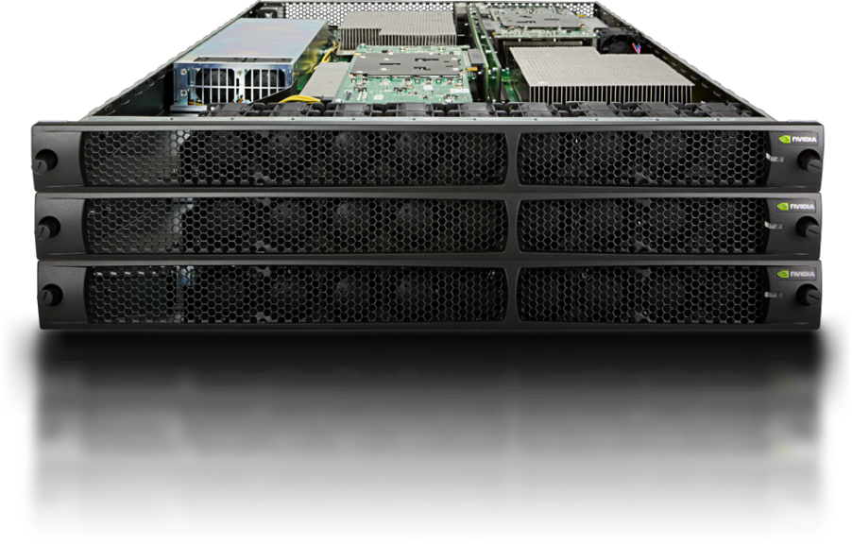
Parallel Computing on a GPU
NVIDIA GPU Computing Architecture
  Via a separate HW interface
  In laptops, desktops, workstations, servers
8-series GPUs deliver 50 to 200 GFLOPS
on compiled parallel C applications
GPU parallelism is doubling every year
Programming model scales transparently
Programmable in C with CUDA tools
Multithreaded SPMD model uses application
data parallelism and thread parallelism
GeForce 8800
Tesla D870
Tesla S870

Slide 7
Extended C
Declspecs
  global, device, shared, local, constant
Keywords
  threadIdx, blockIdx
Intrinsics
  __syncthreads
Runtime API
  Memory, symbol, execution management
Function launch
__device__ float filter[N];
__global__ void convolve (float *image) {
__shared__ float region[M];
...
region[threadIdx] = image[i];
__syncthreads()
...
image[j] = result;
}
// Allocate GPU memory
void *myimage = cudaMalloc(bytes)
// 100 blocks, 10 threads per block
convolve<<<100, 10>>> (myimage);

Slide 8
Extended C
Integrated source
(foo.cu)
cudacc
EDG C/C++ frontend
Open64 Global Optimizer
GPU Assembly
foo.s
CPU Host Code
foo.cpp
OCG
gcc / cl
G80 SASS
foo.sass
Notes:
TBD: Define SASS = SPA Assembly language.

Slide 9
Overview
CUDA programming model – basic concepts and data types
CUDA application programming interface - basic
Simple examples to illustrate basic concepts and functionalities
Performance features will be covered later

Slide 10
CUDA Programming Model:
A Highly Multithreaded Coprocessor
The GPU is viewed as a compute device that:
  Is a coprocessor to the CPU or host
  Has its own DRAM (device memory)
  Runs many threads in parallel
Data-parallel portions of an application are executed on the device as kernels which run in parallel on many threads
Differences between GPU and CPU threads
  GPU threads are extremely lightweight
    Very little creation overhead
  GPU needs 1000s of threads for full efficiency
    Multi-core CPU needs only a few

Slide 11
Thread Batching: Grids and Blocks
A kernel is executed as a grid of thread blocks
  All threads share data memory space
A thread block is a batch of threads that can cooperate with each other by:
  Synchronizing their execution
    For hazard-free shared memory accesses
  Efficiently sharing data through a low latency shared memory
Two threads from two different blocks cannot cooperate
Host
Device
Grid 1
Kernel 1
Block
(0, 0)
Block
(1, 0)
Block
(2, 0)
Block
(0, 1)
Block
(1, 1)
Block
(2, 1)
Grid 2
Kernel 2
Block (1, 1)
Thread
(0, 0)
Thread
(1, 0)
Thread
(2, 0)
Thread
(3, 0)
Thread
(4, 0)
Thread
(0, 1)
Thread
(1, 1)
Thread
(2, 1)
Thread
(3, 1)
Thread
(4, 1)
Thread
(0, 2)
Thread
(1, 2)
Thread
(2, 2)
Thread
(3, 2)
Thread
(4, 2)
Courtesy: NDVIA

Slide 12
Block and Thread IDs
Threads and blocks have IDs
  So each thread can decide what data to work on
  Block ID: 1D or 2D
  Thread ID: 1D, 2D, or 3D
Simplifies memory
addressing when processing
multidimensional data
  Image processing
  Solving PDEs on volumes
  …
Device
Grid 1
Block
(0, 0)
Block
(1, 0)
Block
(2, 0)
Block
(0, 1)
Block
(1, 1)
Block
(2, 1)
Block (1, 1)
Thread
(0, 0)
Thread
(1, 0)
Thread
(2, 0)
Thread
(3, 0)
Thread
(4, 0)
Thread
(0, 1)
Thread
(1, 1)
Thread
(2, 1)
Thread
(3, 1)
Thread
(4, 1)
Thread
(0, 2)
Thread
(1, 2)
Thread
(2, 2)
Thread
(3, 2)
Thread
(4, 2)
Courtesy: NDVIA

Slide 13
CUDA Device Memory Space Overview
Each thread can:
  R/W per-thread registers
  R/W per-thread local memory
  R/W per-block shared memory
  R/W per-grid global memory
  Read only per-grid constant memory
  Read only per-grid texture memory
(Device) Grid
Block (0, 0)
Block (1, 0)
Shared Memory
Shared Memory
Registers
Registers
Registers
Registers
Thread (0, 0)
Thread (1, 0)
Thread (0, 0)
Thread (1, 0)
Local
Memory
Local
Memory
Local
Memory
Local
Memory
The host can R/W global, constant, and texture memories
Host
Global
Memory
Constant
Memory
Texture
Memory
Notes:
Global, constant, and texture memory spaces are persistent across kernels called by the same application.

Slide 14
Global, Constant, and Texture Memories
(Long Latency Accesses)
Global memory
  Main means of communicating R/W Data between host and device
  Contents visible to all threads
Texture and Constant Memories
  Constants initialized by host
  Contents visible to all threads
(Device) Grid
Block (0, 0)
Block (1, 0)
Shared Memory
Shared Memory
Registers
Registers
Registers
Registers
Thread (0, 0)
Thread (1, 0)
Thread (0, 0)
Thread (1, 0)
Local
Memory
Local
Memory
Local
Memory
Local
Memory
Host
Global
Memory
Constant
Memory
Texture
Memory
Courtesy: NDVIA

Slide 15
CUDA – API

Slide 16
CUDA Highlights:
Easy and Lightweight
The API is an extension to the ANSI C programming language
Low learning curve
The hardware is designed to enable lightweight runtime and driver
High performance

Slide 17
A Small Detour: A Matrix Data Type
NOT part of CUDA
It will be frequently used in many code examples
  2 D matrix
  single precision float elements
  width * height elements
  pitch meaningful when the matrix is actually a sub-matrix of another matrix
  data elements allocated and attached to elements
typedef struct {
int width;
int height;
int pitch;
float* elements;
} Matrix;

Slide 18
CUDA Device Memory Allocation
cudaMalloc()
  Allocates object in the device Global Memory
  Requires two parameters
    Address of a pointer to the allocated object
    Size of of allocated object
cudaFree()
  Frees object from device Global Memory
    Pointer to freed object
(Device) Grid
Block (0, 0)
Block (1, 0)
Shared Memory
Shared Memory
Registers
Registers
Registers
Registers
Thread (0, 0)
Thread (1, 0)
Thread (0, 0)
Thread (1, 0)
Local
Memory
Local
Memory
Local
Memory
Local
Memory
Host
Global
Memory
Constant
Memory
Texture
Memory

Slide 19
CUDA Device Memory Allocation
(cont.)
Code example:
  Allocate a 64 * 64 single precision float array
  Attach the allocated storage to Md.elements
  “d” is often used to indicate a device data structure
BLOCK_SIZE = 64;
Matrix Md
int size = BLOCK_SIZE * BLOCK_SIZE * sizeof(float);
cudaMalloc((void**)&Md.elements, size);
cudaFree(Md.elements);

Slide 20
CUDA Host-Device Data Transfer
cudaMemcpy()
  memory data transfer
  Requires four parameters
    Pointer to source
    Pointer to destination
    Number of bytes copied
    Type of transfer
      Host to Host
      Host to Device
      Device to Host
      Device to Device
Asynchronous in CUDA 1.0
(Device) Grid
Block (0, 0)
Block (1, 0)
Shared Memory
Shared Memory
Registers
Registers
Registers
Registers
Thread (0, 0)
Thread (1, 0)
Thread (0, 0)
Thread (1, 0)
Local
Memory
Local
Memory
Local
Memory
Local
Memory
Host
Global
Memory
Constant
Memory
Texture
Memory

Slide 21
CUDA Host-Device Data Transfer
(cont.)
Code example:
  Transfer a 64 * 64 single precision float array
  M is in host memory and Md is in device memory
  cudaMemcpyHostToDevice and cudaMemcpyDeviceToHost are symbolic constants
cudaMemcpy(Md.elements, M.elements, size, cudaMemcpyHostToDevice);
cudaMemcpy(M.elements, Md.elements, size, cudaMemcpyDeviceToHost);

Slide 22
CUDA Function Declarations
 | Executed on the: | Only callable from the:
__device__ float DeviceFunc() | device | device
__global__ void KernelFunc() | device | host
__host__ float HostFunc() | host | host
__global__ defines a kernel function
  Must return void
__device__ and __host__ can be used together

Slide 23
CUDA Function Declarations
(cont.)
__device__ functions cannot have their address taken
For functions executed on the device:
  No recursion
  No static variable declarations inside the function
  No variable number of arguments

Slide 24
Calling a Kernel Function – Thread Creation
A kernel function must be called with an execution configuration:
__global__ void KernelFunc(...);
dim3 DimGrid(100, 50); // 5000 thread blocks
dim3 DimBlock(4, 8, 8); // 256 threads per block
size_t SharedMemBytes = 64; // 64 bytes of shared memory
KernelFunc<<< DimGrid, DimBlock, SharedMemBytes >>>(...);
Any call to a kernel function is asynchronous from CUDA 1.0 on, explicit synch needed for blocking

Slide 25
A Simple Running Example
Matrix Multiplication
A straightforward matrix multiplication example that illustrates the basic features of memory and thread management in CUDA programs
  Leave shared memory usage until later
  Local, register usage
  Thread ID usage
  Memory data transfer API between host and device

Slide 26
Programming Model:
Square Matrix Multiplication Example
P = M * N of size WIDTH x WIDTH
Without tiling:
  One thread handles one element of P
  M and N are loaded WIDTH times from global memory
N
WIDTH
M
P
WIDTH
WIDTH
WIDTH

Slide 27
Step 1: Matrix Data Transfers
// Allocate the device memory where we will copy M to
Matrix Md;
Md.width = WIDTH;
Md.height = WIDTH;
Md.pitch = WIDTH;
int size = WIDTH * WIDTH * sizeof(float);
cudaMalloc((void**)&Md.elements, size);
// Copy M from the host to the device
cudaMemcpy(Md.elements, M.elements, size, cudaMemcpyHostToDevice);
// Read M from the device to the host into P
cudaMemcpy(P.elements, Md.elements, size, cudaMemcpyDeviceToHost);
...
// Free device memory
cudaFree(Md.elements);

Slide 28
Step 2: Matrix Multiplication
A Simple Host Code in C
// Matrix multiplication on the (CPU) host in double precision
// for simplicity, we will assume that all dimensions are equal
void MatrixMulOnHost(const Matrix M, const Matrix N, Matrix P)
{
for (int i = 0; i < M.height; ++i)
for (int j = 0; j < N.width; ++j) {
double sum = 0;
for (int k = 0; k < M.width; ++k) {
double a = M.elements[i * M.width + k];
double b = N.elements[k * N.width + j];
sum += a * b;
}
P.elements[i * N.width + j] = sum;
}
}

Slide 29







Multiply Using One Thread Block
N
One Block of threads compute matrix P
  Each thread computes one element of P
Each thread
  Loads a row of matrix M
  Loads a column of matrix N
  Perform one multiply and addition for each pair of M and N elements
  Compute to off-chip memory access ratio close to 1:1 (not very high)
Size of matrix limited by the number of threads allowed in a thread block
Grid 1
Block 1
Thread
(2, 2)
48
BLOCK_SIZE
M
P

Slide 30
Step 3: Matrix Multiplication Host-side Main Program Code
int main(void) {
// Allocate and initialize the matrices
Matrix M = AllocateMatrix(WIDTH, WIDTH, 1);
Matrix N = AllocateMatrix(WIDTH, WIDTH, 1);
Matrix P = AllocateMatrix(WIDTH, WIDTH, 0);
// M * N on the device
MatrixMulOnDevice(M, N, P);
// Free matrices
FreeMatrix(M);
FreeMatrix(N);
FreeMatrix(P);
return 0;
}

Slide 31
Step 3: Matrix Multiplication
Host-side code
// Matrix multiplication on the device
void MatrixMulOnDevice(const Matrix M, const Matrix N, Matrix P)
{
// Load M and N to the device
Matrix Md = AllocateDeviceMatrix(M);
CopyToDeviceMatrix(Md, M);
Matrix Nd = AllocateDeviceMatrix(N);
CopyToDeviceMatrix(Nd, N);
// Allocate P on the device
Matrix Pd = AllocateDeviceMatrix(P);
CopyToDeviceMatrix(Pd, P); // Clear memory

Slide 32
Step 3: Matrix Multiplication
Host-side Code (cont.)
// Setup the execution configuration
dim3 dimBlock(WIDTH, WIDTH);
dim3 dimGrid(1, 1);
// Launch the device computation threads!
MatrixMulKernel<<<dimGrid, dimBlock>>>(Md, Nd, Pd);
// Read P from the device
CopyFromDeviceMatrix(P, Pd);
// Free device matrices
FreeDeviceMatrix(Md);
FreeDeviceMatrix(Nd);
FreeDeviceMatrix(Pd);
}

Slide 33
Step 4: Matrix Multiplication
Device-side Kernel Function
// Matrix multiplication kernel – thread specification
__global__ void MatrixMulKernel(Matrix M, Matrix N, Matrix P)
{
// 2D Thread ID
int tx = threadIdx.x;
int ty = threadIdx.y;
// Pvalue is used to store the element of the matrix
// that is computed by the thread
float Pvalue = 0;

Slide 34
Step 4: Matrix Multiplication
Device-Side Kernel Function (cont.)
for (int k = 0; k < M.width; ++k)
{
float Melement = M.elements[ty * M.pitch + k];
float Nelement = Nd.elements[k * N.pitch + tx];
Pvalue += Melement * Nelement;
}
// Write the matrix to device memory;
// each thread writes one element
P.elements[ty * P.pitch + tx] = Pvalue;
}
N
WIDTH
M
P
ty
WIDTH
tx
WIDTH
WIDTH

Slide 35
Step 5: Some Loose Ends
// Allocate a device matrix of same size as M.
Matrix AllocateDeviceMatrix(const Matrix M)
{
Matrix Mdevice = M;
int size = M.width * M.height * sizeof(float);
cudaMalloc((void**)&Mdevice.elements, size);
return Mdevice;
}
// Free a device matrix.
void FreeDeviceMatrix(Matrix M) {
cudaFree(M.elements);
}
void FreeMatrix(Matrix M) {
free(M.elements);
}

Slide 36
Step 5: Some Loose Ends (cont.)
// Copy a host matrix to a device matrix.
void CopyToDeviceMatrix(Matrix Mdevice, const Matrix Mhost)
{
int size = Mhost.width * Mhost.height * sizeof(float);
cudaMemcpy(Mdevice.elements, Mhost.elements, size,
cudaMemcpyHostToDevice);
}
// Copy a device matrix to a host matrix.
void CopyFromDeviceMatrix(Matrix Mhost, const Matrix Mdevice)
{
int size = Mdevice.width * Mdevice.height * sizeof(float);
cudaMemcpy(Mhost.elements, Mdevice.elements, size,
cudaMemcpyDeviceToHost);
}

Slide 37
Step 6: Handling Arbitrary Sized Square Matrices
Have each 2D thread block to compute a (BLOCK_WIDTH)² sub-matrix (tile) of the result matrix
  Each has (BLOCK_WIDTH)² threads
Generate a 2D Grid of (WIDTH/BLOCK_WIDTH)² blocks
N
WIDTH
M
P
You still need to put a loop around the kernel call for cases where WIDTH is greater than
Max grid size!
by
ty
WIDTH
bx
tx
WIDTH
WIDTH

