Slide 1
软件架构概述
张严辞

Slide 2
软件危机
1968年首次提出，指计算机软件开发和维护过程中所遇到的一系列严重问题
能否满足对软件日益增长的需求？
能否维护数量日益增长的现有软件？
具体表现
对软件开发成本和进度的估计常常不准确
用户对“已完成”的软件系统不满意的现象经常发生
软件产品的质量不高，可靠性差
软件不可维护，不能适应新环境，程序错误不容易纠正
软件成本占总成本的比例逐年上升
……

Slide 3
软件危机的原因
与软件本身特点有关
软件开发过程的进展情况较难衡量
软件开发的质量也较难评价
软件不易维护
意味着修改原有设计，客观上使软件较难维护
大规模软件更难维护
软件开发过程中，或多或少采用了错误的技术
对用户需求没有完整准确认识

Slide 4
简单例子
在屏幕上绘制若干二维图形
二维图形的种类只有两种：圆和正方形

Slide 5
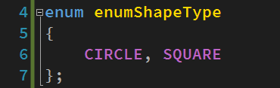
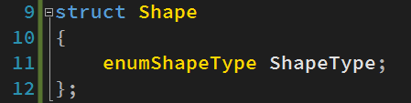
解决方案1 1/6
基于C的解决方案
定义一个枚举类型enumShapeType
定义一个结构体Shape，用于后期的指针强行转换

Slide 6
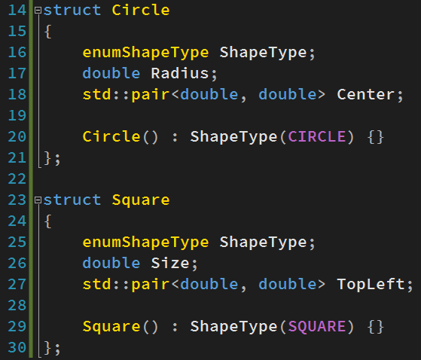
解决方案1 2/6
定义两个结构体，分别表示圆和正方形
第一个分量都是enumShapeType，以便于后期强行指针转换到结构体Shape

Slide 7
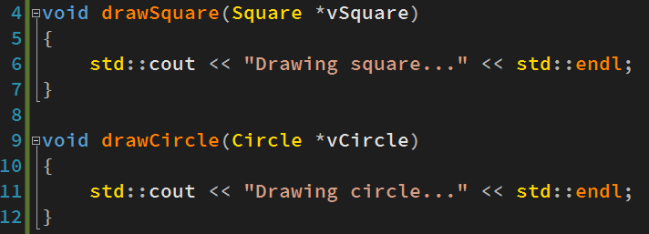
解决方案1 3/6
定义两个函数来分别完成圆和正方形的绘制

Slide 8
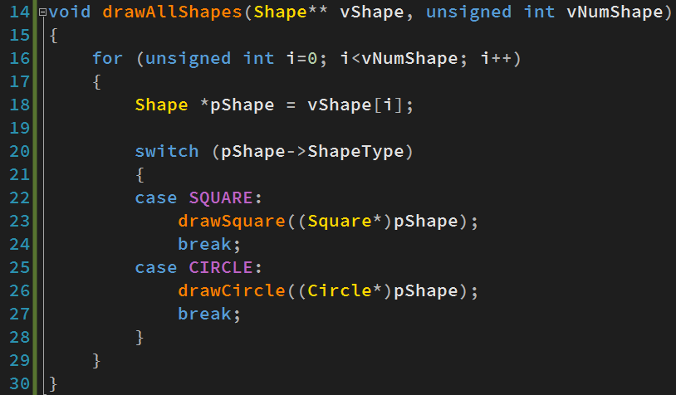
解决方案1 4/6
定义用来绘制所有二维图形的函数
注意这里是指向结构体Shape的指针
通过switch语句来判断形状的类型
将指向Shape的指针强行转换为指向具体形状的指针

Slide 9
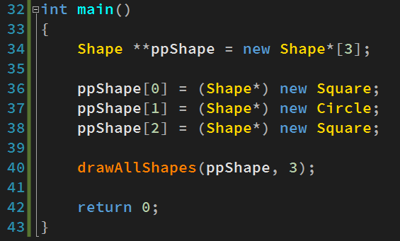
解决方案1 5/6
客户端程序负责创建二维图形，并调用绘制函数
将指向具体形状的指针强行转换为指向Shape的指针

Slide 10
解决方案1 6/6
解决方案1完美满足了用户需求
在需求不发生变化的情况下，没有任何可以指责的地方
但“完美”是建立在用户需求不发生变化的前提下

Slide 11
需求变更
需要增加一种新的二维图形种类：三角形

Slide 12
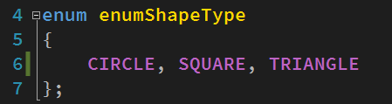
解决方案2 1/5
按照解决方案1的思路来增加新的二维图形种类
修改枚举类型
加入新的枚举

Slide 13
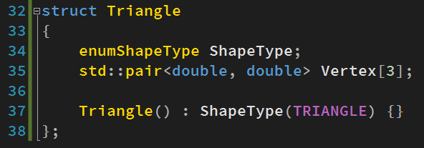
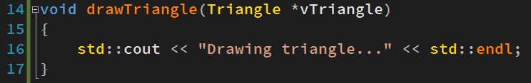
解决方案2 2/5
增加新的结构体
增加新的绘制三角形的函数

Slide 14
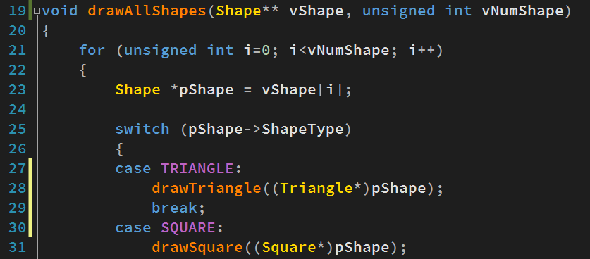
解决方案2 3/5
drawAllShapes()函数也要做相应修改
增加case语句，响应新的图形种类

Slide 15
解决方案2 4/5
当增加新图形种类时，必然会增加新的代码去实现相应功能
但解决方案2中增加的代码是否都是必需？
必需增加的部分
结构体Triangle
新的绘制函数drawTriangle()
值得商榷的部分
为drawAllShapes()增加新的case语句
修改枚举类型enumShapeType

Slide 16
解决方案2 5/5
判断增加代码是否必需的重要标准
防止程序发生连锁反应
是否需要了解原有程序过多的实现细节
按照这个标准，重新审查新增加的代码
结构体和drawTriangle()可以在不知道原有软件细节的情况下完成
枚举类型的使用，使得必须在所有对图形类型进行了判断的部分，增加相应处理来响应新的类型。必须对原有软件非常了解才能完成这个工作！

Slide 17
程序员的分化 1/2
在如何应对需求变化上，程序员发生了分化
差的程序员
按照解决方案2，花大量时间查找原有程序中对类型进行判断的switch/if语句，进行相应修改
运气不好的话，在某几处忘记增加新case语句，导致程序出现bug，花更多的时间去调试
如果增加更多新的类型，重复上述体力活动
如果增加新的图形处理函数，则引入更多switch语句，使得类型的增加更加麻烦
需求虐我千百遍，我待需求如初恋

Slide 18
程序员的分化 2/2
好的程序员
当需求发生变化时，通过软件重构，使得当软件在以后面临类似变化时，修改变得更加容易而不是复杂
当需求发生变化时，永远不假设以后不会发生类似变化
软件不止，重构不息！
需求可以骗我一次，但绝没有第二次

Slide 19
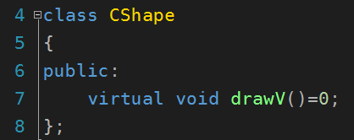
解决方案3 1/4
设计基类CShape，引入纯虚函数drawV()来定义图形绘制的接口
纯虚函数只定义了要做什么，但没有定义怎么做
通过纯虚函数来定义绘制这个动作

Slide 20
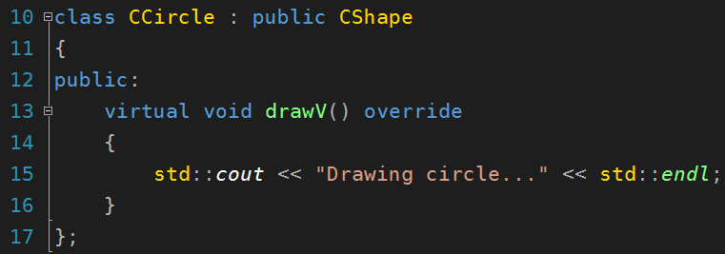
解决方案3 2/4
从基类CShape派生出代表具体形状的类，并重载drawV()来实现绘制功能

Slide 21
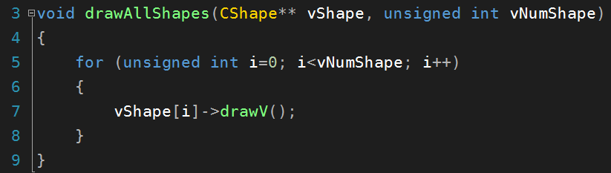
解决方案3 3/4
修改drawAllShapes()函数，使其可以完成任意二维图形的绘制
注意必须传入基类指针
通过调用虚函数drawV()，解除了drawAllShapes()和具体绘制图形功能之间的耦合

Slide 22
解决方案3 4/4
相比于解决方案2
烦人的枚举类型被去掉
drawAllShapes()中的switch语句被去掉
增加新的图形类型，只需从CShape中派生出新的类，而drawAllShapes()不需修改
精髓：功能的扩展通过增加新的代码来实现，但不修改已有代码

Slide 23
目标
解决软件危机
告诉人们如何设计软件、开发软件、管理软件
软件工程方法/软件架构/软件设计模式的合理应用

Slide 24
研究软件架构的目的
弥补软件开发领域“工程上有余而理论上不足”的缺陷
借助计算机科学中其他领域的理论研究方法，试图用模型分析与理论推理的方法解决软件研发中的功能与非功能性问题
将软件工程上总结出来的各类方法论提升为模型与理论，并用于指导软件开发

Slide 25
定义
软件架构(Software Architecture, SA)
提供了对结构、行为和属性的高级抽象
从较高层次来考虑组成系统的构件、构件之间的连接，以及由构件与构件交互形成的拓扑结构
这些要素应该满足一定限制，遵循一定设计规则，能够在一定环境下进行演化
The software architecture of a system is the set of structures needed to reason about the system, which comprise software elements, relations among them, and properties of both.

Slide 26
Architecture Defines Structures 1/3
A structures is simply a set of elements held together by a relation
The most familiar and the most-often mentioned characteristic
Three categories
Model structure
Component-and-connector structure
Allocation structure

Slide 27
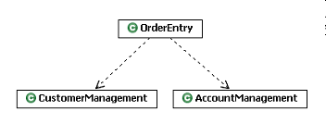
Architecture Defines Structures 2/3
Module structure
Partition systems into implementation units
Module are
Assigned specific computational responsibilities
Basis of work assignment
Static structure

Slide 28
Architecture Defines Structures 3/3
C&C structure
Dynamic structure which focuses on the way elements interact with each other at runtime to carry out system’s functions
Allocation Structures
Map software structures to system’s environment
Modules are assigned to places in a file structure
Components are deployed onto hardware to execute
…

Slide 29
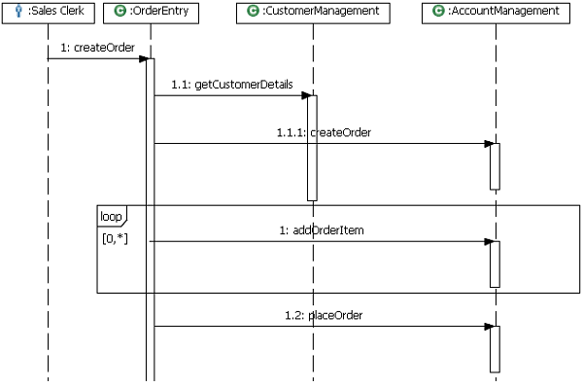
Architecture Defines Behavior
As well as defining structural elements, an architecture defines interactions between these structural elements
These interactions provide desired system behavior

Slide 30
Architecture is Abstraction
An architecture focuses on significant elements
Not concerned with defining all structures and behaviors
Significant elements
Have a long and lasting effect
Associated with essential behavior
Address significant qualities such as reliability and scalability
Can also be phrased as economical significance
Not static and may change over time
The relative stability of architecture in face of change is the sign of a good architecture

Slide 31
Architecture Balances Needs
An architecture is created to ultimately address a set of stakeholder needs
Different stakeholders may express conflicting needs
Making tradeoffs is an essential aspect of architecting process
End user: correct behavior, performance, reliability, usability, availability, and security
Marketer: competitive features, time to market, positioning with other products, and cost
Customer: cost, stability, and schedule
Developer: clear requirements, and a simple and consistent design approach
…

Slide 32
Architecture May Conform to Style
Most architectures share a similar set of concerns. This similarity can be described as architectural style/pattern
Represents a codification of experience
It is good practice for architects to look for opportunities to reuse such experience
Application of an architectural style makes architecting process easier

Slide 33
Architectural Patterns
A coarse grained pattern that provides an abstract framework for a family of systems
Patterns describe different aspects of applications
A typical application will usually use a combination of more than one of these patterns
For example, you might have a SOA design composed of services developed using a layered architecture approach and an object-oriented architecture style

Slide 34
Client/Server Pattern 1/2
Describes distributed systems involving a separate client and server system, and a connecting network
The simplest form: a server application that is accessed directly by multiple clients
Other example: web browser—based programs running on Internet
Suitable for
Server based applications and will support many clients
Centralize data storage, backup, and management

Slide 35
Client/Server Pattern 2/2
Advantages
Higher security
Centralized data access
Ease of maintenance
Disadvantages
Application data and business logic are closely combined on server (negatively impact system extensibility and scalability)
Dependence on a central server (negatively impact system reliability)

Slide 36
Layered Pattern
Grouping of related functionality into distinct layers that are stacked vertically on top of each other
Strict layering: components in one layer can interact only with the same layer or the layer directly below it
Relaxed layering: components in a layer can interact with the same layer or any lower layer
Functionality within each layer is related by a common role or responsibility
Layers may reside on the same physical computer or may be distributed over separate computers

Slide 37
N-Tier / 3-Tier Pattern
Deployment styles describing separation of functionality into segments
Each tier locates on physically separate computers
Example：A typical financial Web application where security is important
Business layer must be deployed behind a firewall
Presentation layer is deployed on a separate tier in perimeter network

Slide 38
Object-Oriented Pattern
Divide responsibilities of an application or system into individual reusable and self-sufficient objects
Each object contains data and behavior relevant to the object
Objects are discrete, independent, and loosely coupled
Objects communicate through interfaces
Calling methods or accessing properties in other objects
Sending and receiving messages

