Slide 1
Quality Attributes
Yanci Zhang

Slide 2
Requirements
All requirements encompass the following categories
Functional requirements
Quality attribute requirements
Constraints

Slide 3
Functional Requirements
State what system must do, and how it must behave or react to runtime stimuli
Functionality does not determine architecture
Achieved by assigning responsibilities to architectural elements
Systems are frequently redesigned not because they are functionally deficient, but because
Difficult to maintain, port or scale
Too slow
Compromised by hackers
…

Slide 4
Quality Attribute Requirements
Measurable or testable property of a system, indicating how well system satisfies needs of stakeholders
Regarded as measuring “goodness” of a product along some dimension of interest to a stakeholder

Slide 5
Quality Attributes
QAs specify how well the system performs its functions
How fast must it respond?
How easy must it be to use?
How secure does it have to be against attacks?
How easy should it be to maintain?
Software qualities are not orthogonal
A change in structure that improves one quality often affects the other qualities

Slide 6
Constraints
A constraint is a design decision with zero degrees of freedom
Use a certain programming language or to reuse a certain existing module

Slide 7
Case Study: ICDE System 1/2
Information Capture and Dissemination Environment (ICDE) is a software system for providing intelligent assistance to professionals
ICDE automatically captures and stores data of actions performed by a user when operating a workstation

Slide 8
Case Study: ICDE System 2/2
Example: When a user performing Google search, ICDE will store in a database:
Search query string
List of returned pages displayed in browser
Data can be later used by 3rd parties
Offer intelligent help
Find potentially useful details overlooked by users

Slide 9
Version 1.0 1/2
Version 1.0
Simple 2 tier, single machine deployment
Java, Perl, SQL,
Programmatic access to data through very complex SQL (38 tables, 46 views)
Only deployed in a small user trial involving a few users
Successfully tests software functionality and demonstrates concepts of data capture and storage

Slide 10
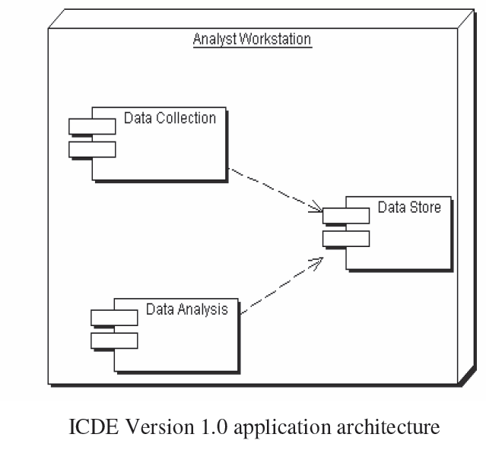
Version 1.0 2/2
transparently track user’s relevant activities and store them in data store
A relational database storing information regarding user activity with timestamps
A GUI based tool supports a set of queries on data store

Slide 11
Version 2.0
Two major business objectives for next version
Encourage 3rd party tool developers to write applications for ICDE
Promote ICDE concept and tools to potential customers, in order to enhance their analytical working environment
Constraints
Scheduled for development in 12 month timeframe
Fixed budget

Slide 12
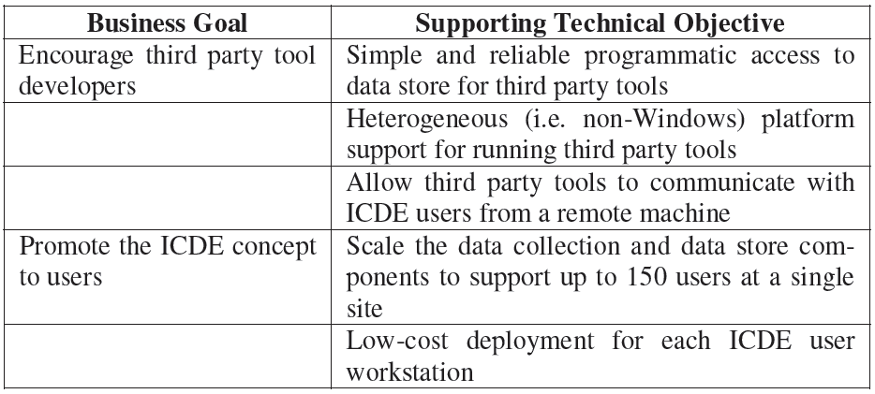
Business Goals

Slide 13
Architecturally Significant Requirements
ICDE project requirements
Heterogeneous platform support for access to ICDE data
Instantaneous event notification (local/distributed)
Secure ICDE data access over internet
Ease of programmatic data access
ICDE project team requirements
Insulate 3rd party projects and ICDE tools from database evolution
Scalable infrastructure to support large, shared deployments
Minimize license costs for a deployment
Unknowns
Minimize dependencies, making unanticipated changes potentially easier

Slide 14
What Are Quality Attributes
Often know as –ilities
Reliability
Availability
Portability
Scalability
Performance

Slide 15
What Are Quality Attributes
Architects are often told:
“My application must be fast/secure/scale”
Far too imprecise to be any use at all
QAs must be made precise/measurable for a given system design, e.g.
“It must be possible to scale the deployment from an initial 100 geographically dispersed user desktops to 10,000 without an increase in effort/cost for installation and configuration.”

Slide 16
QAs of ICDE System
Performance
Scalability
Modifiability
Security
Availability
Integration

Slide 17
Performance
A performance quality requirement defines
metric of amount of work performed in unit time
deadline that must be met
Enterprise applications often have strict performance requirements, e.g.
1000 transactions per second
3 second average latency for a request
Performance is fundamental for software system

Slide 18
Performance: Throughput
Measure of amount of work an application must perform in unit time
Transactions per second
Messages per minute
Is required throughput
Average?
Peak?
Many system have low average but high peak throughput requirements

Slide 19
Performance: Response time
Measure of latency an application exhibits in processing a request
A rapid response time allows users to work more effectively, and consequently is good for business
Often an important metric for users
Two different response time
Guaranteed: all requests to be serviced within a specified time limit
Average: allowing larger latencies when application is extremely busy

Slide 20
Performance: Deadline
Something must be completed before some specified time
Payroll system must complete by 2 am so that electronic transfers can be sent to bank
Weekly accounting run must complete by 6 am Monday so that figures are available to management
Deadlines often associated with batch jobs in IT systems

Slide 21
ICDE Performance Issues
Response time
Overheads of trapping user events must be imperceptible to ICDE users
Solution for ICDE client
Decouple user event capture from storage using an in-memory queue

Slide 22
Scalability
How well a solution to some problem will work when the size of the problem increases
4 common scalability issues in IT systems
Request load
Connections
Data size
Deployments

Slide 23
Scalability: Request Load
How does an 100 tps application behave when simultaneous request load grows?
From 100 to 1000 requests per second?
A scalable solution permits additional processing capacity to be deployed to increase throughput and decrease response time without modifications to architecture
Scale-up: adding more CPUs/memory to machine
Scale-out: distributing application on multiple machines

Slide 24
Scalability in Reality
Reality as always is different!
Applications will exhibit a decrease in throughput and a subsequent exponential increase in response time.
Increased load causes increased contention for resources such as CPU, network and memory
Each request consumes some additional resource (buffer space, locks…), eventually these are exhausted and limits scalability

Slide 25
Scalability: Connections
What happens if number of simultaneous connections to an application increases
If each connection consumes a resource?
Exceed maximum number of connections?
ISP example
Each user connection spawned a new process
Virtual memory on each server exceeded at 2000 users
Needed to support 100Ks of users

Slide 26
Scalability: Data Size
How does an application behave as data it processes increases in size?
Database table size grows from 1 million to 20 billion rows?
Image analysis algorithm processes images of 100MB instead of 1MB?
Can application/algorithms scale to handle increased data requirements?

Slide 27
Scalability: Deployment
How does effort to install/deploy an application increase as installation base grows?
An ideal solution would provide automated mechanisms

Slide 28
Scalability for ICDE
Scalability often overlooked
Major cause of application failure
Hard to predict
Hard to test/validate
Reliance on proven designs and technologies is essential
For ICDE -application should be capable of handling a peak load of 150 concurrent requests from ICDE clients
Relatively easy to simulate user load to validate this

Slide 29
Modifiability
Modifications to a software system during its lifetime are a fact of life
Modifiable systems are easier to change/evolve
Modifiability should be assessed in context of how a system is likely to change
No need to facilitate changes that are highly unlikely to occur
Over-engineering!

Slide 30
Modifiability
Measures how easy it may be to change an application to cater for new (non-)functional requirements
‘may’ –nearly always impossible to be certain
Must estimate cost/effort
Minimizing dependencies increases modifiability
Changes isolated to loosely-coupled components likely to be less expensive than those that cause ripple effects across architecture

Slide 31
Modifiability for ICDE
The range of events trapped and stored by ICDE client to be expanded
3rd party tools to communicate new message types
…

Slide 32
Security
Authentication
Applications can verify identity of their users and other applications with which they communicate
Authorization
Authenticated users and applications have defined access rights to resources of system
Encryption
Messages sent to/from application are encrypted

Slide 33
Security
Integrity
Contents of a message are not altered in transit
Non-repudiation
Sender of a message has proof of delivery and receiver is assured of sender’s identity
Neither can subsequently refute their participation in message exchange

Slide 34
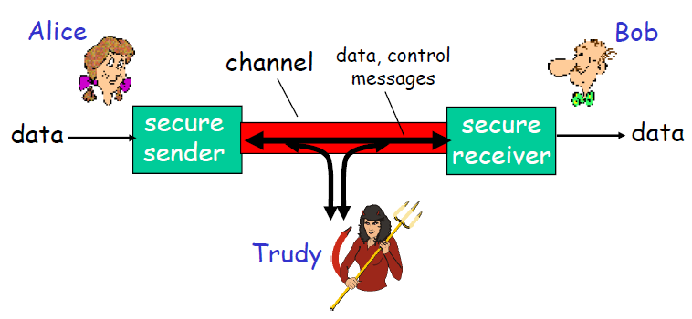
Friends and Enemies: Alice, Bob, Trudy
Well-known in network security world
Bob, Alice want to communicate “securely”
Trudy (intruder) may intercept, delete, add messages

Slide 35
Who Might Alice, Bob Be?
Web browser/server for electronic
Transactions (e.g., on-line purchases)
On-line banking client/server
DNS servers
Routers exchanging routing table updates
……

Slide 36
What Trudy Wants to Do?
Eavesdrop: intercept messages
Actively insert messages into connection
Impersonation: fake source address in packet (or any field in packet)
Hijacking: “take over” ongoing connection by removing sender or receiver, inserting himself in place
Denial of service: prevent service from being used by others (e.g., by overloading resources)
……

Slide 37
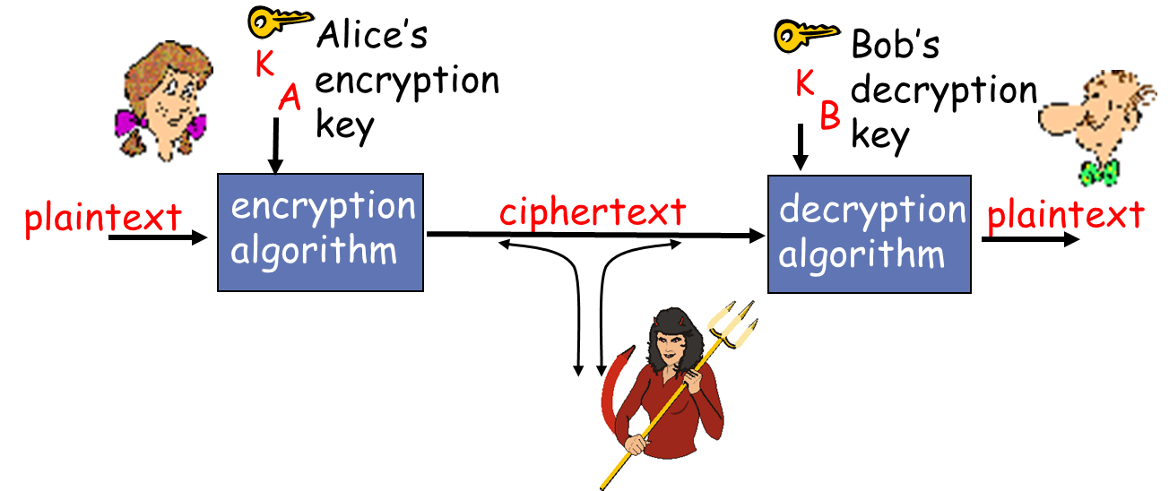
Language of Cryptography
Symmetric key cryptography: sender, receiver keys identical
Public-key cryptography: encryption key public, decryption key private

Slide 38
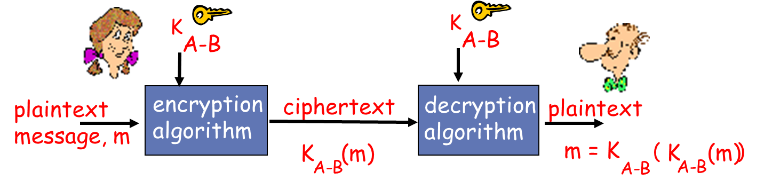
Symmetric Key Cryptography
Bob and Alice share the same (symmetric) key
Simple and fast
How to agree on key in first place (particularly if never “met”)?
Must somehow exchange key in a secure way

Slide 39
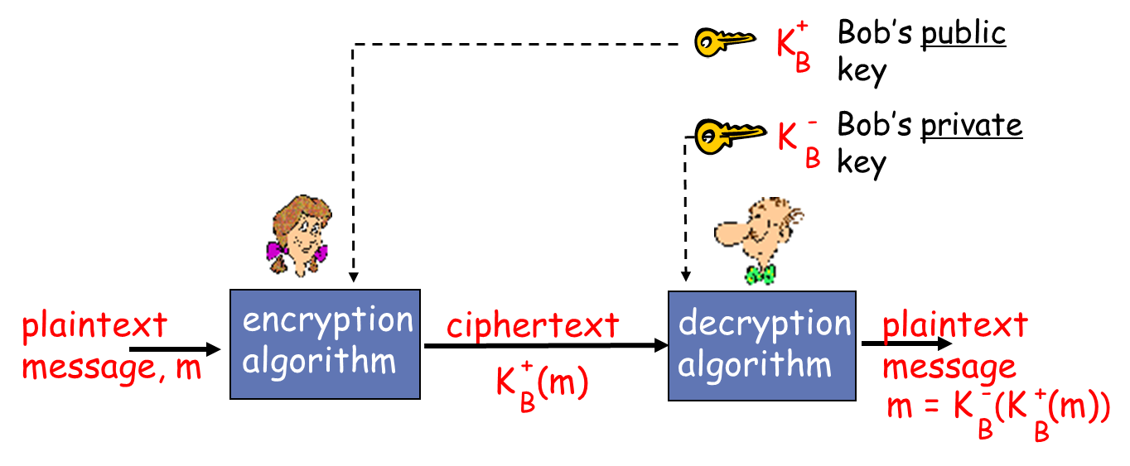
Public Key Cryptography
Sender, receiver do not share secret key
Public encryption key known to all
Can be transmitted, exchanged
Private decryption key known only to receiver, never transmitted

Slide 40
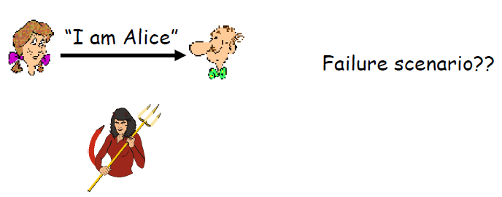
Authentication 1/9
Goal: Bob wants Alice to “prove” her identity to him
Protocol ap1.0: Alice says “I am Alice”

Slide 41
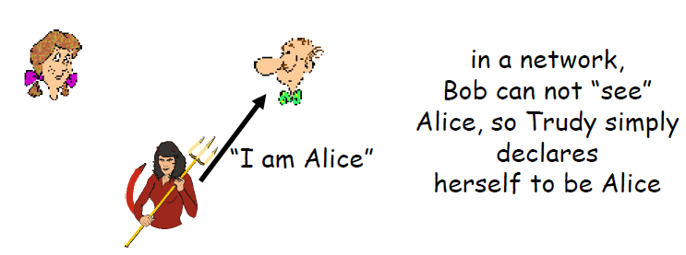
Authentication 2/9
Goal: Bob wants Alice to “prove” her identity to him
Protocol ap1.0: Alice says “I am Alice”

Slide 42
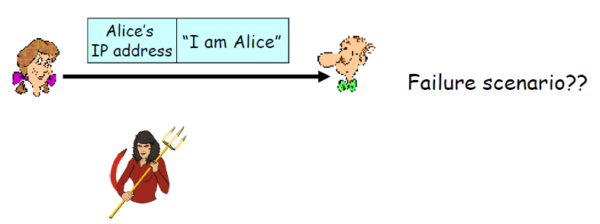
Authentication 3/9
Protocol ap2.0: Alice says “I am Alice” in an IP packet containing her source IP address

Slide 43
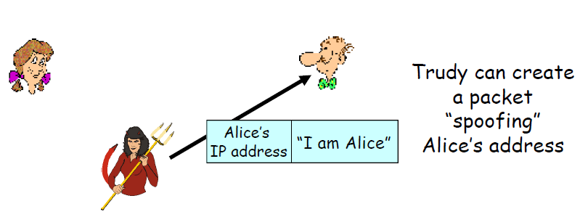
Authentication 4/9
Protocol ap2.0: Alice says “I am Alice” in an IP packet containing her source IP address

Slide 44
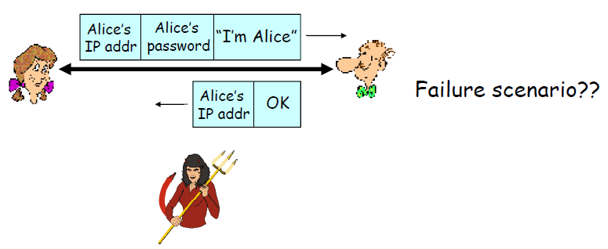
Authentication 5/9
Protocol ap3.0: Alice says “I am Alice” and sends her unencrypted secret password to “prove” it

Slide 45
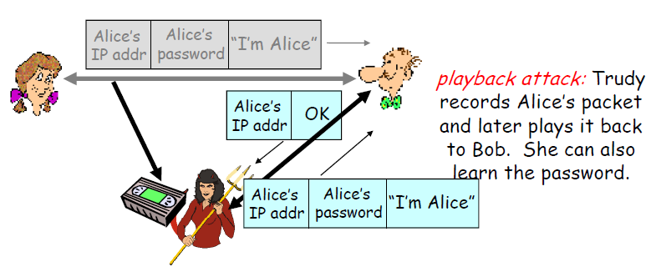
Authentication 6/9
Protocol ap3.0: Alice says “I am Alice” and sends her secret password to “prove” it

Slide 46
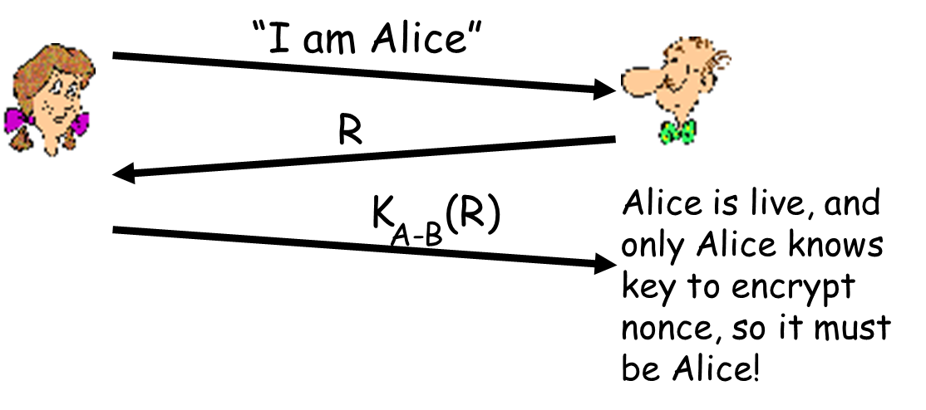
Authentication 7/9
Nonce: number (R) used only once–in-a-lifetime
Protocol ap4.0: to prove Alice “live”, Bob sends Alice nonce R. Alice must return R, encrypted with shared secret key

Slide 47
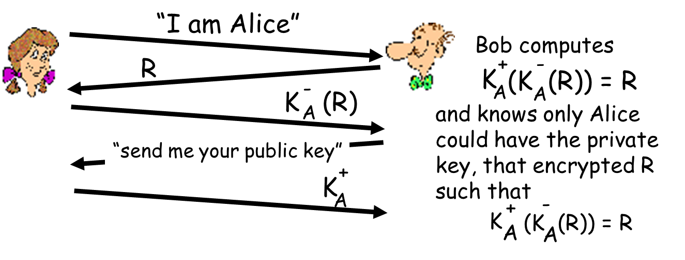
Authentication 8/9
Protocol ap5.0: use nonce, public key cryptography

Slide 48
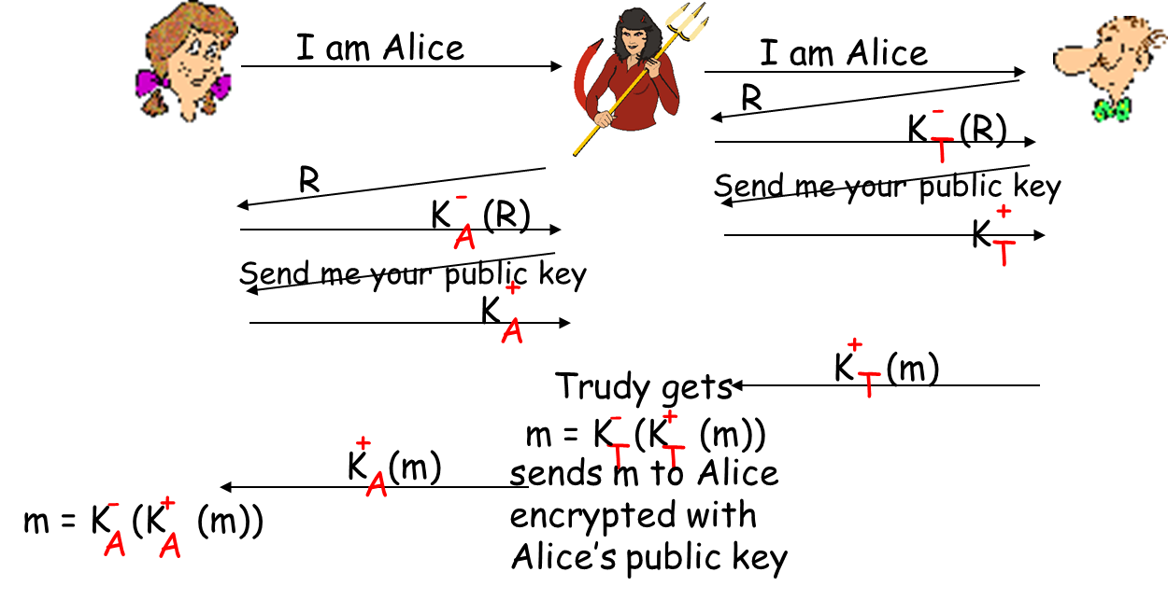
Authentication 9/9
Security hole: Trudy poses as Alice (to Bob) and as Bob (to Alice)

Slide 49
Security for ICDE
Authentication of ICDE users and 3rd party ICDE tools to ICDE server
Encryption of data to ICDE server from 3rd party tools/users executing remotely over an insecure network

Slide 50
Availability
Key requirement for most IT applications
Measured by the proportion of the required time it is usable
100% available during business hours
No more than 2 hours scheduled downtime per week
24*7*52 (100% availability)
Related to an application’s reliability
Unreliable applications suffer poor availability
Related to recoverability

Slide 51
Availability
Period of loss of availability determined by
Time to detect failure
Time to correct failure
Time to restart application

Slide 52
Availability
High availability typically refers to designs targeting availability of 99.999 percent (“5 nines”) or greater
Strategies for high availability
Eliminate single points of failure
Replication and failover
Automatic detection and restart

Slide 53
Availability for ICDE
Achieve 100% availability during business hours
Plenty of scope for downtime for system upgrade, backup and maintenance
Include mechanisms for component replication and failover

Slide 54
Integration
Ease with which an application can be incorporated into a broader application context
Use component in ways that the designer did not originally anticipate
Typically achieved by
Programmatic APIs
Data integration

Slide 55
Integration Strategies
Data –expose application data for access by other components
API –offers services to read/write application data through an abstracted interface
Each has strengths and weaknesses …

Slide 56
Integration for ICDE
Revolve around the need to support third party analysis tools
Well-defined and understood mechanism for third party tools to access data in the ICDE data store

Slide 57
Design Trade-offs
QAs are rarely orthogonal
They interact, affect each other
Highly secure system may be difficult to integrate
Highly available application may trade-off lower performance for greater availability
High performance application may be tied to a given platform, and hence not be easily portable
Architects must create solutions that makes sensible design compromises
Not possible to fully satisfy all competing requirements
Must satisfy all stakeholder needs

Slide 58
Two Categories
QAs can be divided into two categories
Properties of system at runtime: availability, performance, usability…
Properties of development of system: modifiability, testability…

Slide 59
Specify QA Requirements
A quality attribute requirement should be unambiguous and testable
Use quality attribute scenario to specify all quality attribute requirements
Quality attribute scenario emphasizes commonalities among all quality attributes

Slide 60
Quality Attribute Scenario
It contains six part
Source of stimulus
Stimulus
Response
Response measure
Environment
Artifact

Slide 61
Stimulus
Stimulus is a condition that requires a response when it arrives at a system
Stimulus is described by different terms
An event to performance community
A user operation to usability community
An attack to the security community
…

Slide 62
Source of Stimulus
Source of stimulus is some entity that generated stimulus
Entity includes human, computer system or any other actuator
May affect how it is treated by system
For example, differently treat request from a trusted or untrusted user

Slide 63
Response
Response is activity undertaken as result of arrival of stimulus
Consists of responsibilities that system or developer should perform in response to stimulus

Slide 64
Response Measure
Response measure is metric in some fashion so that requirement can be tested
For example
Measure of latency or throughput for performance
Labor or time required to make, test and deploy for modifiability

Slide 65
Environment
Environment is certain condition when stimulus occurs
For example
System may be in an overload condition or in normal operation

Slide 66
Artifact
Artifact is portion of system to which requirement applies
This is can be entire system, or specific portions of system
Modifications to UI may have faster response times than modifications of middleware

Slide 67



Example
Response measure
Artifact
Hand
Stimulus
Response
Ache
Draw back
Source
Environment
Draw back in 0.1s
nettle
Normal

Slide 68
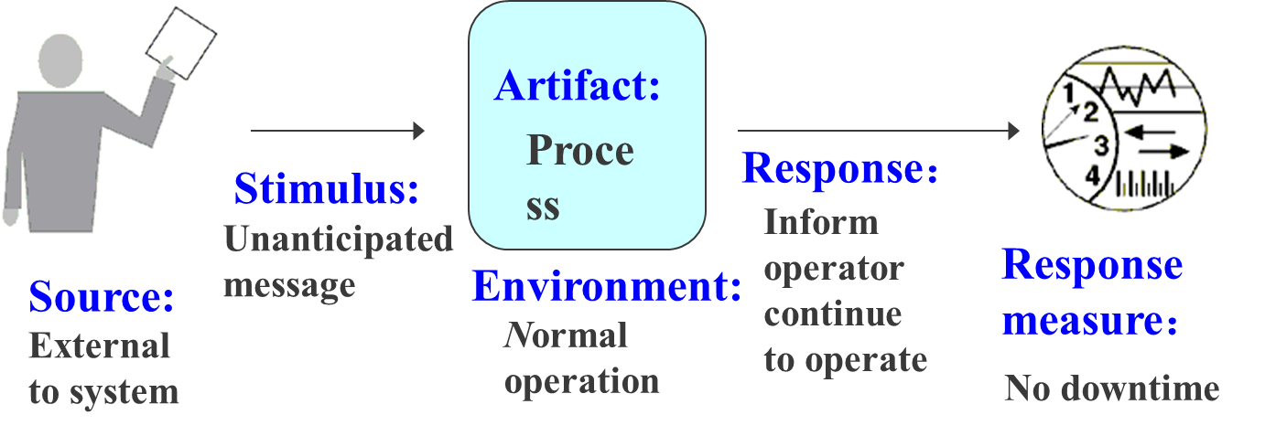
Example
An unanticipated external message is received by a process during normal operation. The process informs the operator of the receipt of the message and continues to operate with no downtime

Slide 69
Tactics
A tactic is a design decision that influences achievement of a QA response
Directly affect system’s response to some stimulus
Focus of a tactic is on a single QA response
No consideration of tradeoff !

Slide 70
Categories of Design Decisions
Seven categories
Allocation of responsibilities
Coordination model
Data model
Management of resources
Mapping among architectural elements
Binding time decisions
Choice of technology

Slide 71
Allocation of Responsibilities
Seven categories
Allocation of responsibilities
Coordination model
Data model
Management of resources
Mapping among architectural elements
Binding time decisions
Choice of technology

