Slide 1
Tactics: Availability
Yanci Zhang

Slide 2
Tactics 1/2
A tactic is a design decision that influences control of a quality attribute response
Focus of a tactic is on a single quality attribute response
Tactics differ from architectural patterns
Tradeoffs are built into architectural patterns

Slide 3
Tactics 2/2
Tactics are techniques that an architect can use to achieve required quality attributes
Qualities are achieved via design decisions/tactics
A system design consists of a collection of decisions
Some help control quality attribute responses
Others ensure achievement of functionality

Slide 4
Review: Availability
Availability: mask or repair faults such that cumulative service outage period does not exceed a required value over a specified time
Similar concepts
Dependability: avoid failures that are more frequent and more severe than is acceptable
Availability: builds upon the concept of reliability by adding notion of recovery, that is, when system break, it repairs itself

Slide 5

Faults & Failure
Failure implies visibility to a system or human observer in environment
A failure’s cause is called fault
A fault can be either internal or external to system

Slide 6
Faults & Availability
Availability is about minimizing service outage time by mitigating faults
Faults can be prevented, tolerated, removed, or forecast
How system failure is detected
How frequently system failure may occur
What happens when a failure occurs
How long a system is allowed to be out of operation
How failures can be prevented
What kinds of notifications are required when a failure occurs

Slide 7
Availability Representation 1/2
Availability can be calculated as probability
Availability = MTBF / ( MTBF + MTTR)
MTBF is mean time between failures
MTTR is mean time to repair
Higher probability indicates higher availability

Slide 8
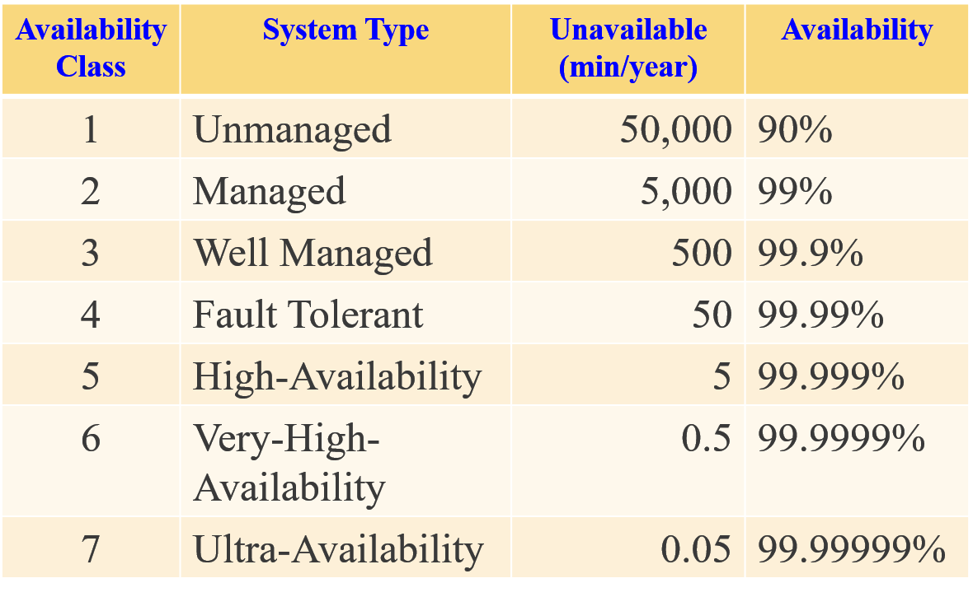
Availability Representation 2/2

Slide 9
Service-Level Agreement
Availability provided by a system is frequently expressed as a Service-Level Agreement ( SLA )
Specifies availability level that is guaranteed and penalties will suffer if SLA is violated
Example: SLA that Amazon provides for its EC2 cloud service:
…to make Amazon EC2 available with an Annual Uptime Percentage of at least 99.95% during the Service Year…

Slide 10
Planning for Failure
For every system, failure is inevitable
Planning for failure is for handling failures with aplomb
Understand what kinds of failures your system is prone to, and what consequences of each will be
“To design systems that work correctly we often need to understand and correct how they can go wrong”
---Dan Goldin, NASA Administrator, 2000

Slide 11
Hazard Analysis
Attempts to catalog hazards that can occur during operation of a system according to severity
Example: DO-178 standard used in aeronautics industry
Catastrophic: failure may cause a crash
Hazardous: failure has large negative impact on safety or performance
Major: failure has a lesser impact
Minor: failure is lesser impact than major
No effect: failure has no impact on safety

Slide 12
Fault Tree Analysis
A top down, deductive failure analysis in which an undesired state of a system is analyzed using Boolean logic to combine a series of lower-level events
Functions
To understand how systems can fail
To identify the best ways to reduce risk
To determine event rates of a safety accident or a particular system level failure

Slide 13
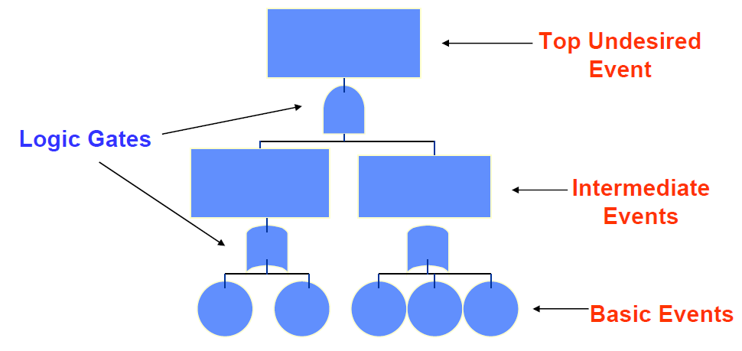
Basic Fault Tree Structure

Slide 14


Logic Gate
OR gate
Union operation of events
Output event occurs if one or more of inputs occur
AND gate
Intersection operation of events
Output event occurs if and only if all inputs occur

Slide 15
Minimal Cut Set
Cut set: A unique set of events that lead to top event
Minimal cut set (MCS): smallest combination of basic events causing top event
Removing any basic event in MCS avoids failure
Complete set of MCS provides complete set of causes of top event
Identify simple point of failure, which is undesirable in any system with a goal of high availability

Slide 16


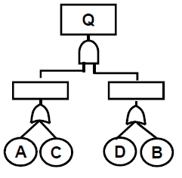
Qualitative Analysis 1/4
Algebraic representation is

Slide 17
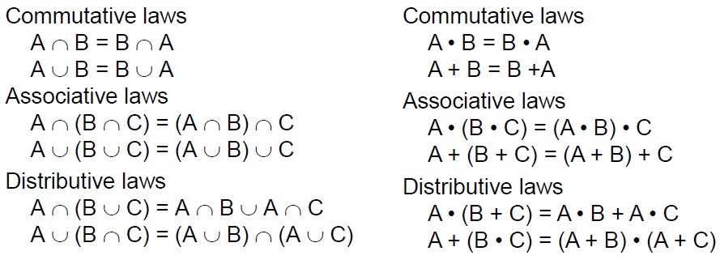
Qualitative Analysis 2/4

Slide 18
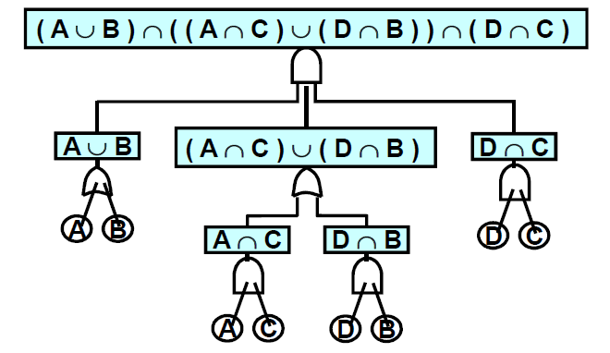
Qualitative Analysis 3/4

Slide 19
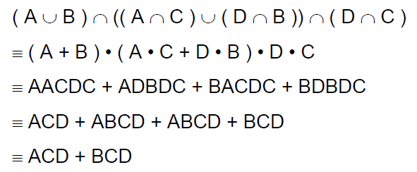
Qualitative Analysis 4/4
cut set
minimum cut set

Slide 20

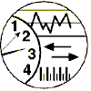
Availability General Scenario
Artifact:
Process, Storage, Processor, Communication
Stimulus:
Response：
(Fault)
Omission, Crash, Timing, Response
Record, Notify, Disable, Continue(Normal/Degraded) Be Unavailable
Response measure：
Source:
Environment:
Internal, External
Normal, Degraded Operation
Repair, Time, Availability, Available Degraded Time Interval

Slide 21
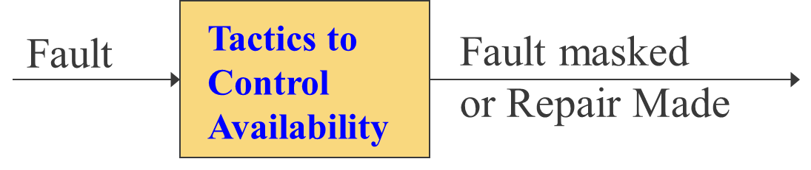
Availability Tactics 1/3
Designed to enable a system to endure faults so that services remain compliant with its specification
Goal of availability tactics
Keep faults from becoming failures or
Bound effects of fault and make repair possible

Slide 22
Availability Tactics 2/3
Availability tactics includes three Categories
Fault Detect——Health monitoring to detect a failure
Fault Recovery——Recover when a failure is detected
Fault Prevention——Prevent fault to become failure

Slide 23
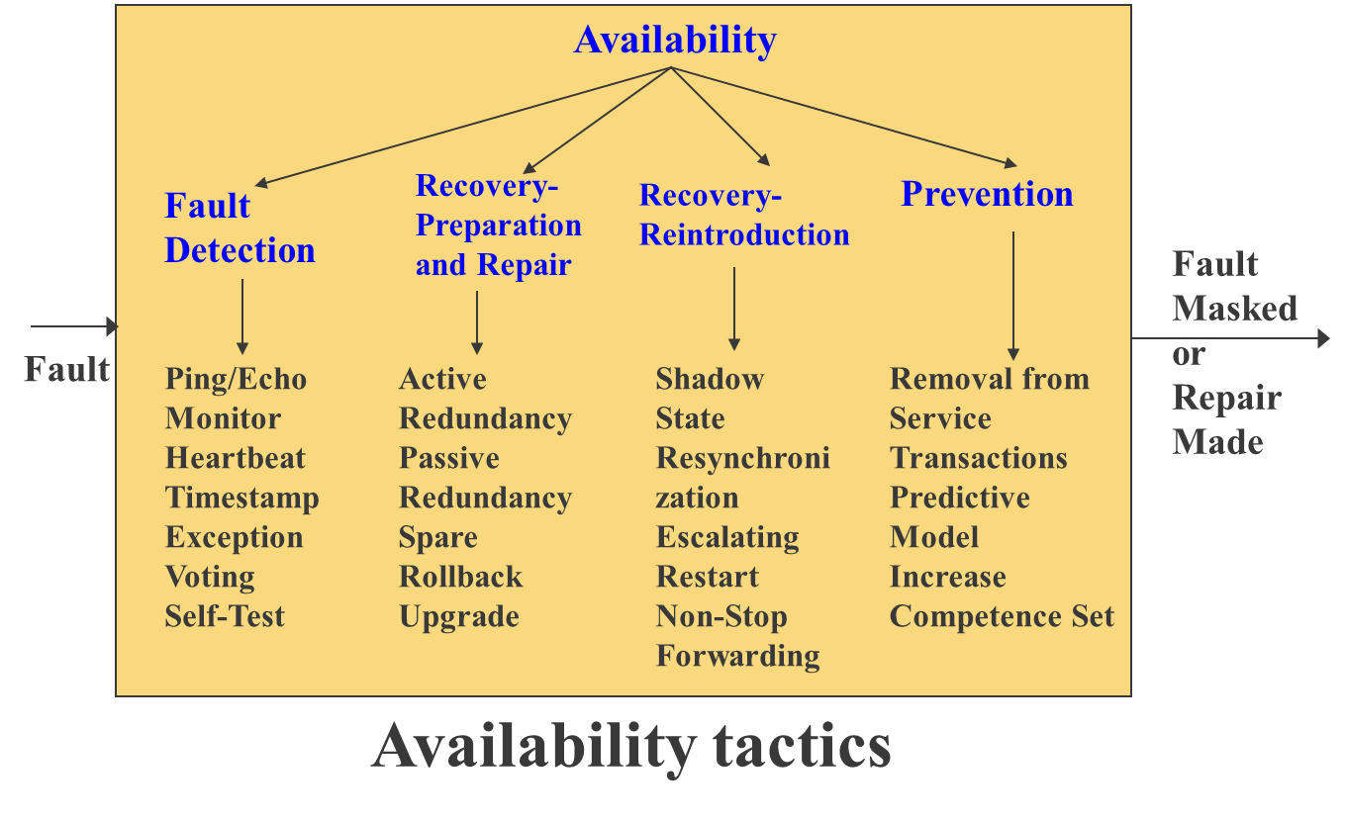
Availability Tactics 3/3

Slide 24
Fault Detection 1/5
Ping/Echo
An asynchronous request/response message pair exchanged between nodes
Comp. 1 issues a “ping” to comp. 2
Comp. 1 expects an “echo” from comp. 2
Answer within predefined time threshold
Active mode
Monitor
A component used to monitor state of health of various other parts of system
Example: Detect failure or congestion in network, such as from a denial-of-service attack

Slide 25
Fault Detection 2/5
Heartbeat
Employs a periodic message exchange between a system monitor and a process being monitored
Comp. 1 emits a “heartbeat” message periodically
Comp. 2 listens for it
If heartbeat fails, Comp. 1 assumed failed and fault correcting comp. 3 is notified
Heartbeat can also carry data
Passive mode
Difference between heartbeat and ping/echo: who holds responsibility for initiating health check

Slide 26
Fault Detection 3/5
Voting
Triple modular redundancy (TMR) employs three components that do the same thing
Each component receives identical inputs, and forwards their output to voting logic
When an inconsistency occurs, the voter reports a fault
It must also decide what output to use (majority voting or average of outputs)

Slide 27
Fault Detection 4/5
Exception Detection
Detection of a system condition that alters normal flow of execution
System exceptions: address faults, divide by zero, …
Parameter fence
Parameter typing
Timeout: some components fail to meet timing constraints

Slide 28
Fault Detection 5/5
Timestamp: used to detect incorrect sequences of events, primarily in distributed message-passing systems
Sanity Checking
Checks validity of a component’s operations or outputs
Typically based on a knowledge of internal design, the state of system, or nature of information under scrutiny
Condition Monitoring: checking conditions in a process or device, or validating assumptions made during design
Self-test: procedure for a component to test itself for correct operation

Slide 29
Fault Recovery
Preparation-and-repair tactics
Based on a variety of combinations of retrying a computation or introducing redundancy
Reintroduction tactic
A failed component is reintroduced after it has been corrected

Slide 30
Preparation-and-Repair 1/3
Active Redundancy
All redundant components respond to events in parallel
All in the same state
Response from only one component is used
Used in client-server configuration
Quick responses are important
Take over from a failed component in a matter of milliseconds

Slide 31
Preparation-and-Repair 2/3
Passive Redundancy
Active component responds to events and periodically informs redundant components to update states
Synchronization is responsibility of active component
State maintained by redundant spares is only loosely couple with active nodes, thus downtime can be seconds
Spare
Redundant spares remain out of service until a fail-over occurs
Downtime for this tactics is usually minutes

Slide 32
Preparation-and-Repair 3/3
Rollback
Permit system to revert to a previous known good state
Depend on a copy of a previous good state updated at regular intervals or significant times in processing
Often combined with active/passive redundancy tactics

Slide 33
Reintroduction
Shadow
A previously failed component runs in “shadow mode” for a short time prior to reverting back to active
During this duration its behavior can be monitored for correctness

Slide 34
Fault Prevention 1/2
Removal from service
Temporarily placing a system component in an out-of-service to mitigate potential system failures
Transaction
Bundling of several sequential steps such that entire bundle can be undone at once

Slide 35
Fault Prevention 2/2
Transaction example: transactional databases
Most modern relational database management systems support transaction
A transaction might consist of one or more data-manipulation statements, each reading and/or writing information in database
Transaction pattern
Begin the transaction
Execute a set of data manipulations and/or queries
If no errors occur then commit the transaction and end it
If errors occur then rollback the transaction and end it

