Slide 1
软件设计: Lock-Free Programming
Yanci Zhang

Slide 2
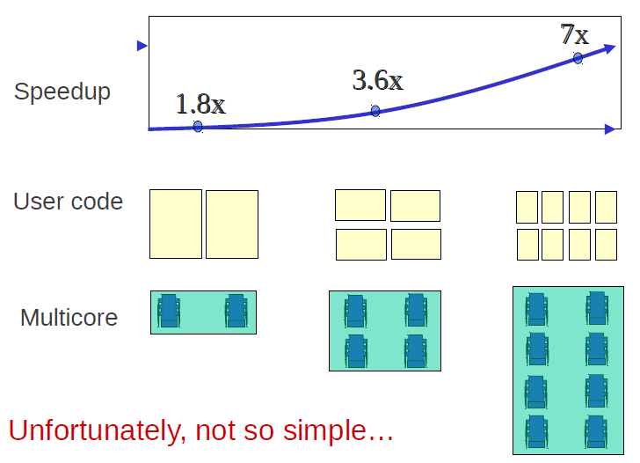
Multicore Scaling Process

Slide 3
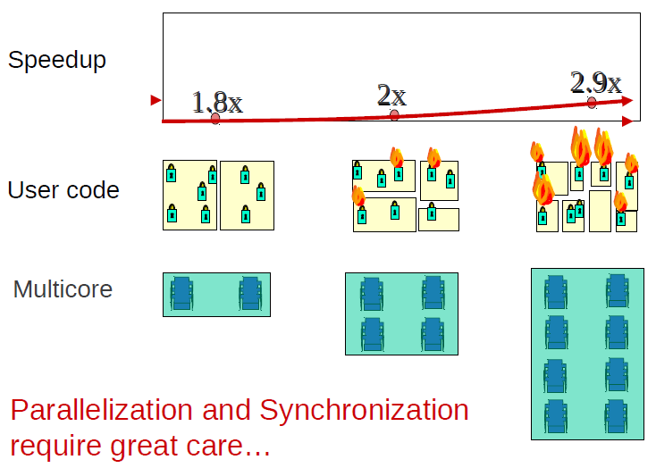
Real-World Scaling Process

Slide 4
Race Condition
A flaw whereby output of process is unexpectedly and critically dependent on sequence of other events
Real world examples
File systems: two or more programs attempt to modify a file

Slide 5
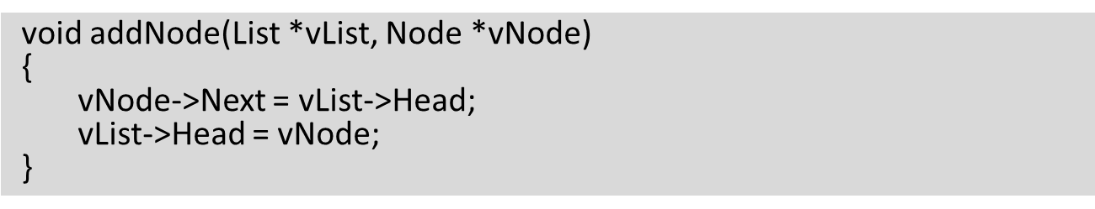
Race Condition: Example
Two threads attempt to insert a node to the same list

Slide 6

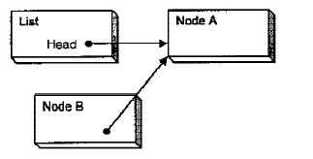
Race Condition: Example
Initial status
Thread #1 attempts to insert node B, but it is suspended by operating system after executing first line

Slide 7
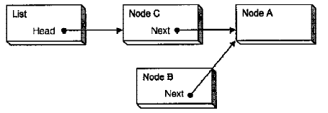
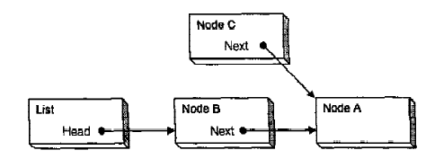
Race Condition: Example
Thread #2 attempts to insert node C and it finishes all work
Thread #1 is resumed to complete the unfinished work

Slide 8
Race Condition: Example
The structure of list is corrupted
Node C is cut off, may result memory leak
Things get even worse because execute order of threads is unpredictable
Above error is unreproducible
Very hard to locate bug

Slide 9
Solution: Mutex
It is critical for multiple threads not to access shared resources at same time
Mutex is the most fundamental method to prevent this from happening
Facilitates protection against data races and allows thread-safe synchronization of data between threads

Slide 10
Solution: Mutex
A mutex allows only a single thread access to a shared resource at one time
When a thread needs to access shared resource, it must first “lock” mutex
“Unlock” mutex after finish accessing shared resource
If any other thread has already locked mutex, “lock” operation waits for other thread to unlock mutex first
Thus ensuring that only a single thread has access to shared resource at a time

Slide 11
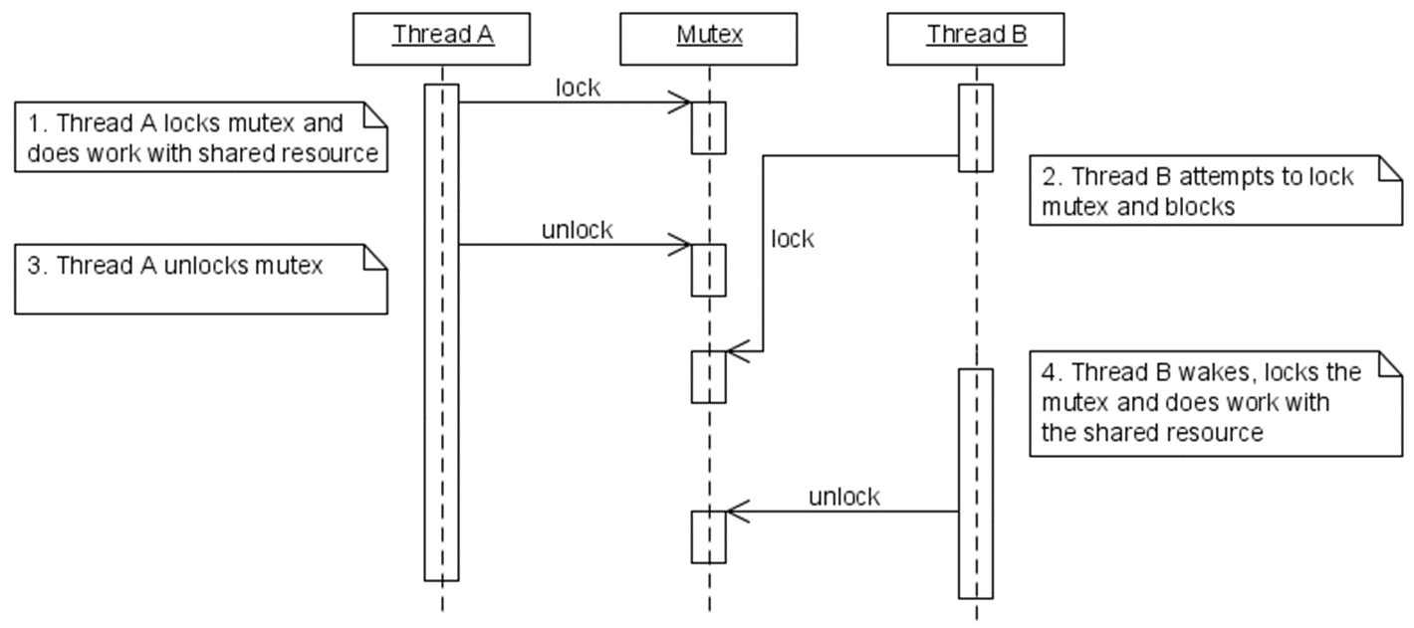
Solution: Mutex

Slide 12
Drawbacks of Locking
Deadlock
Two or more competing actions are each waiting for the other to finish, and thus neither ever does
Example: two transactions try to update two rows of database but in opposite order
Priority inversion
Low-priority processes hold a lock required by a higher priority process

Slide 13
Drawbacks of Locking
Convoying
Several processes need locks in a roughly similar order
One slow process gets in first
All the other processes slow to the speed of first one
Kill-tolerance
If threads are killed/crash while holding locks, what happens?

Slide 14
Drawbacks of Locking
Overall performance
Constant struggle between simplicity and efficiency
Example. thread-safe linked list with lots of nodes
Lock the whole list for every operation?
Reader/writer locks?
Allow locking individual elements of the list?

Slide 15
Lock-free Programming
Thread-safe access to shared data without use of synchronization primitives such as mutex
Not practical without hardware support

Slide 16
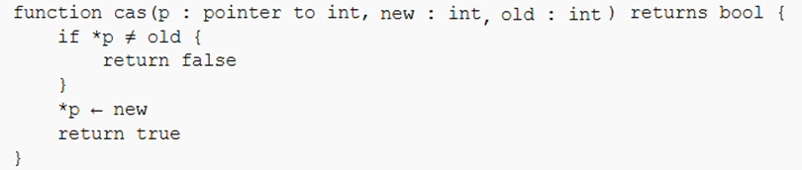
Compare-and-Swap
Compare-and-swap (CAS) is an atomic instruction used in multithreading to achieve synchronization
CAS is an atomic version of the following pseudocode
Atomicity guarantees that new value is calculated based on up-to-date information
If value had been updated by another thread in the meantime, the write would fail.

Slide 17
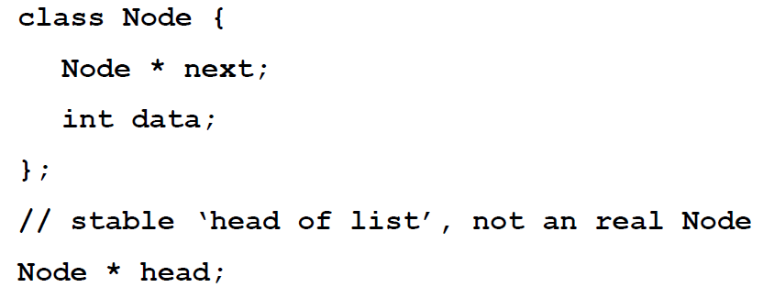
Simple Lock-Free Example
Lock-free stack

Slide 18
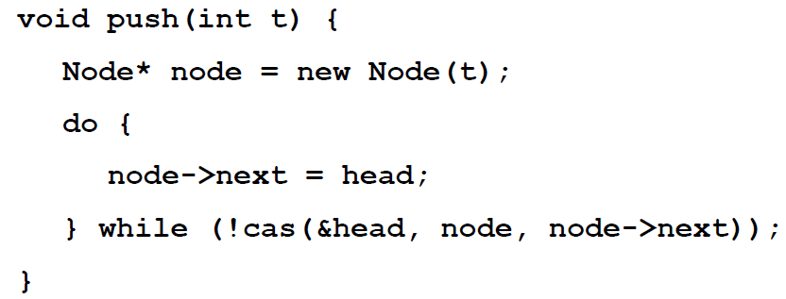
Lock-Free Stack Push
Copy shared variable to a local variable, not yet visible to other threads
Attempt to publish the changes using CAS (if head is not modified by other thread, it will be updated)

Slide 19
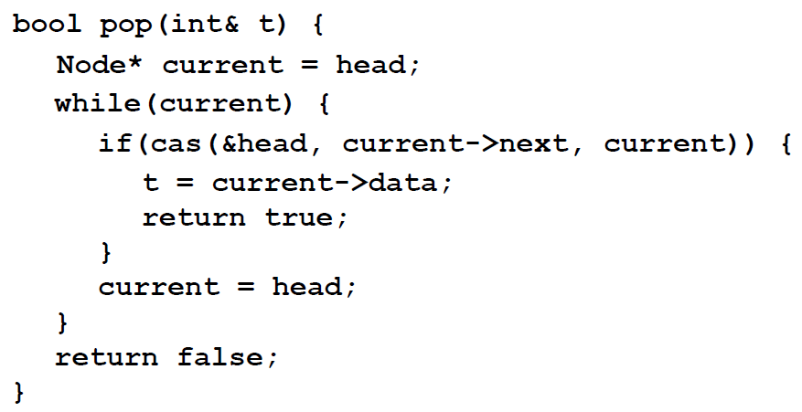
Lock-Free Stack Push

Slide 20
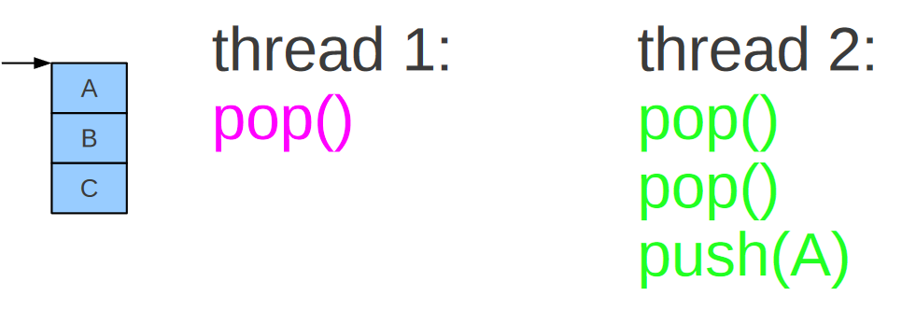
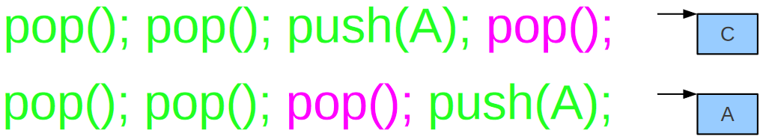
ABA Problem
Correct execution

Slide 21
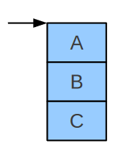
ABA Problem
Thread 1：
For thread 1, current is now points to A
Thread 1 is suspended before execution of cas()

Slide 22
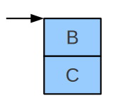

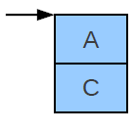
ABA Problem
Thread 2 succeeds to execute pop()
Pops A, discard it
Thread 2 succeeds to execute another pop()
Pops B, discard it
Thread 2 succeeds to execute push()
Memory manager recycles A into new variable, it happens to be the new element added to stack

Slide 23
ABA Problem
Thread 1 is resumed
cas() operation is succeed
current holds a old version of A because it is a local variable of thread 1
current->next is B which has been destroyed !

Slide 24
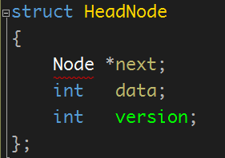
Solution
Design a special data structure for head pointer to stack
Add version number to head

Slide 25
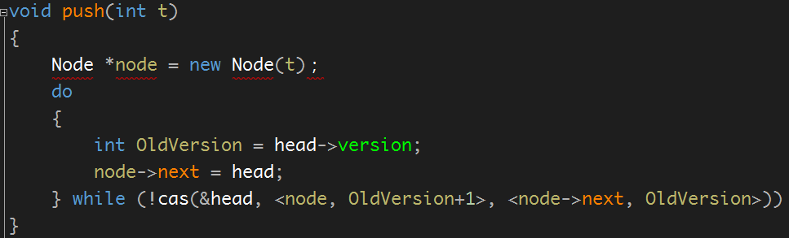
Solution
Check version number when push/pop() is called
Update version number if head is updated

Slide 26
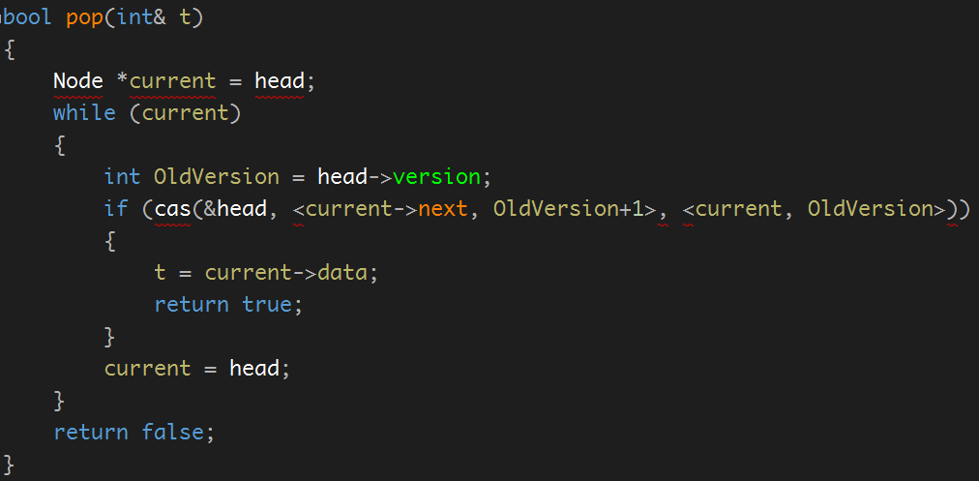
Solution

