Slide 1
Performance
张严辞

Slide 2
Introduction
Performance is about time and the software system’s ability to meet timing requirements
Performance relate to event arriving and response to event
Event property and the system or element’s time-based response to those events is essence of performance

Slide 3
Introduction
Pattern of events arriving and the pattern of response will be characterized
Example: A web-based system, desired response might be expressed by number of transactions processed in a unit time
All systems have performance requirements
It continues to be a fundamentally quality attribute
Example: a word processing tool may not have any explicit performance requirement, but nobody can endure slow response to a operation

Slide 4

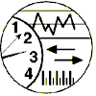
General Scenario
Artifact:
System components
Stimulus:
Response：
Periodic
Sporadic
Stochastic
Process event
Change level of service
Response measure：
Source:
Environment:
Internal, External
Normal
Emergency
Peak load
Overload
Latency
Deadline
Throughput
Jitter
Miss rate

Slide 5
Response of Performance
Latency：The time between the arrival of the stimulus and the system’s response
Deadline in process: The threshold time before it the event must be processed
Throughput：The number of transactions the system can process in a unit of time
The jitter：The allowable variation in latency
Miss rate：The number of events not processed because the system was too busy to respond

Slide 6
A Concrete Scenario
Artifact:
System
Response：
Stimulus:
Initiate Transactions
Transactions Are processed
Response measure：
Source:
Environment:
Users
Normal operation
Average Latency of two seconds
User initiate transactions under normal operations. The system processed the transactions with an average latency of two seconds

Slide 7
Tactics for Performance
Goal of performance tactics is to generate a response to an event arriving at system within some time-based constraint
Response Generated within Time Constraints
Tactics to Control Performance
Event Arrives

Slide 8
Impact Factors of Performance
Two basic contributors to response time
Processing time: time system is working to respond
Blocked time: time system is unable to respond

Slide 9
Processing Time
Processing consumes resources, which takes time
Hardware resources: CPU, data stores, network communication band width, memory
Software resources: entities defined by system under design
Access to critical sections must be made sequential
…

Slide 10
Blocked Time
A computation can be blocked because of contention for some needed resource
Blocked time type
Contention for resources: Multiple streams compete on same resource
Availability of resources: resource is unavailable, may be caused by offline of network or failure of component
Dependency on other computation: A computation may have to wait because it must synchronize with the results of another computation

Slide 11
Categories of Performance Tactics
Control resource demand
Operates on demand side
Produce smaller demand on resources that to service events
Mange resources
Operates on response side
Make resources work more effectively in handling demands

Slide 12
Categories of Performance Tactics
Performance
Control Resource Demand
Prevention
Response Generated within Time Constraints
Manage Sampling Rate
Limit Event Response
Prioritize Events
Reduce Overhead
Bound Execution Times
Increase Resource Efficiency
Increase Resources
Introduce Concurrency
Maintain Multiple Copies of Computations
Maintain Multiple Copies of Data
Bound Queue Sizes
Schedule Resources
Event Arrives
Performance tactics

Slide 13
Control Resource Demand
One way to increase performance is to carefully manage demand for resources
Two categories of tactics to control resource demand
Reduce number of events processed
Limit rate at which system responds to events

Slide 14
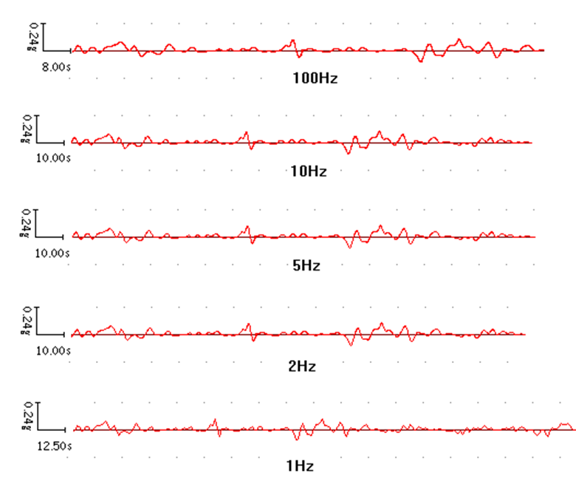
Manage Sampling Rate
Reduce sampling frequency at which a stream of environmental data is captured, demand can be reduced
Typically with some attendant loss of fidelity
Example: voice sample rate at 8K, or 44.1K

Slide 15
Limit Event Response
Limit event response
When discrete events arrive at system too rapidly to be processed, then events must be queued until they can be processed
Triggered by a queue size or processor utilization measure exceeding some warning level

Slide 16
Prioritize Events
If not all events are equally important, a priority scheme can be imposed to rank events to how important it is to service theme
If there are not enough resources available, low-priority events might be ignored
Ignoring events consumes minimal resources, and thus increases performance

Slide 17
Reduce Overhead
A strategy for reducing computational overhead is to co-locate resources
Host cooperating components on same processor to avoid the time delay of network communication
Put resources in the same runtime software component to avoid expense of a subroutine call
Perform a periodic cleanup of resources that have become inefficient
Execute single-threaded servers

Slide 18
Bound Execution Times
Bound execution times: place a limit on how much execution time is used to respond to an event
For iterative, limiting number of iterations is a method for bounding execution times
Bound execution times is usually a less accurate computation
Need to assess its effect on accuracy and see if result is good enough

Slide 19
Increase Resource Efficiency
Improving algorithms used in critical areas will decrease latency
Example: using binary search algorithm is more efficient than other search algorithm

Slide 20
Manage Resources
Usually applied to processor but is also effective when applied to other resources such as a disk
Example: out-of-core problem
Sometimes one resource can be traded for another
Example: intermediate data may be kept in a cache or it may be regenerated depending on time and space resource availability

Slide 21
Increase Resources
Faster processors, additional processors, additional memory, and faster networks all have potential for reducing latency
Increasing resources have some cost. However, in many cases it the cheapest way to get immediate improvement

Slide 22
Introduce Concurrency
If requests can be processed in parallel, blocked time can be reduce
Concurrency can be introduced by processing different streams of events on different threads or by creating additional threads to process different sets of activities
Explain in more detail latter

Slide 23
Maintain Multiple Copies of Computations
Multiple servers in a client-server pattern are replicas of computation
Purpose of replicas is to reduce contention that would occur if all computations took place on a single server
A load balancer is needed to assigns new work to one of available server

Slide 24
Maintain Multiple Copies of Data
Caching is a tactic that involves keeping copies of data on storage with different access speeds
Data replication involves keeping separate copies of data to reduce the contention from multiple simultaneous accesses
Replication usually to predict cache data or users requests
When cache meets concurrency

Slide 25
Bound Queue Sizes
Controls maximum number of queued arrivals and consequently resources used to process arrivals
Need to adopt a policy for what happens when queues overflow and decide if not responding to lost events is acceptable

Slide 26
Schedule Resources
Whenever there is contention for a resource, the resource must be scheduled
Processors, buffers…
Need to understand characteristics of each resources to choose compatible scheduling strategy

Slide 27
Scheduling Policies
A scheduling policy conceptually has two parts
Priority assignment
Dispatching
All scheduling policies assign priorities
A high-priority event stream can be dispatched only if resource to which it is being assigned is available

Slide 28
Scheduling Policies
Typical scheduling policies
First-in-first-out: treats all requests for resources as equals and satisfy them in turn
One request will be stuck behind another one that takes a long time to generate a response
Fixed-priority scheduling: assigns each request a particular priority and assigns resources in that priority order
Ensures better service for higher priority requests
Static scheduling
Dynamic priority scheduling

