Slide 1
Security
—— 2016/4
57

Slide 2
Outline
Introduction
Security and Safety
Security General Scenario
Tactics for Security
A Design Checklist for Security
Summary
57

Slide 3
引言
2015年，全国电信诈骗发案59.9万起，被骗走222亿元，这两个数字触目惊心
上海市反电信网络诈骗中心（以下简称“中心”）自2016年3月21日正式启动试运行以来，截至4月20日共接报电信网络诈骗案件4000余起，涉案资金人民币近亿元，成功劝阻被害人1535人
57

Slide 4
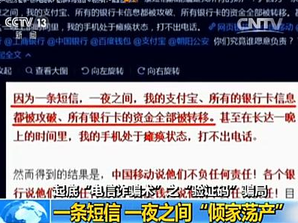
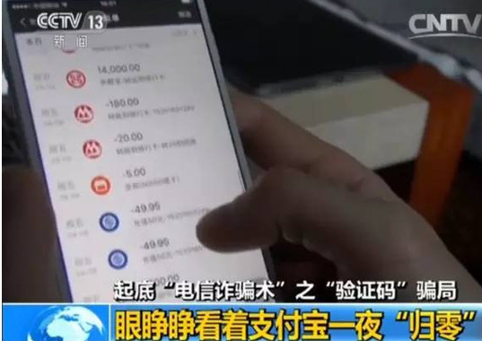
1. Introduction
According to experts who monitor the credit card criminal, the value of stolen credit card data may range from $0.4 to $3. That’s down tenfold from a decade ago(2008)
57

Slide 5
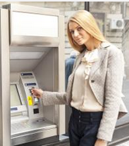
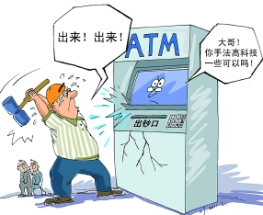
1.1 The concept of Security
Security is a measure of the system’s ability to protect data and information from unauthorized access while still providing access to people and system that are authorized
Authorized
Unauthorized
57

Slide 6
1.2 Attack
Attack is an action taken against a computer system with the intention of doing harm
Attack may be as below
An unauthorized attempt to access data or cervices
An unauthorized attempt to modify data
Intended to deny services to legitimate users
57

Slide 7
1.3 The Characteristics of Security
Security has six characteristics:
Confidentiality( C )
Integrity( I )
Availability( A )
Authentication
Nonrepudiation
Authorization
CIA is the main characteristics of security
57

Slide 8
1.3.1 Confidentiality
Confidentiality (机密性) is the property that data or services are protected from unauthorized access
For example, a hacker cannot access the important national secure information
57

Slide 9
1.3.2 Integrity
Integrity (完整性) is the property that data or services are not subject to unauthorized manipulation
For example, your grade has not been changed since your instructor assigned it
57

Slide 10
1.3.3 Availability
Availability (可用性) is the property that the system will be available for legitimate use
For example, you can withdraw your money from the bank
57

Slide 11
1.3.4 Authentication
Authentication (验证性) verifies the identities of the parties to a transaction and checks if they are truly who they claim to be
For example, when you get an email purporting to come from a bank, authentication guarantees that is true
57

Slide 12
1.3.5 Nonrepudiation
Nonrepudiation (认可性) guarantees that the sender of a message cannot later deny having sent the message, and that the recipient cannot deny having received
For example, you cannot deny ordering something from the Internet, or the merchant cannot disclaim getting the order.
57

Slide 13
1.3.6 Authorization
Authorization (授权) grants a user the privileges to perform a task
For example, an online banking system authorizes a legitimate user to access his accout
57

Slide 14
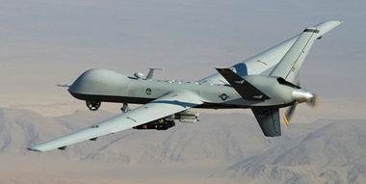
2. Security and Safety
Security refers to data and service(CIA)
Software safety is about the software’s ability to avoid entering states that cause or lead to damage, injury, or loss of life to actors
57

Slide 15


2.1 Safety Concern
Safety is concerned with the prevention of and recovery from hazardous failures
Tactics for safety overlap with those for availability
How do we avoid the unsafety software?
57

Slide 16

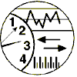
3.Security General Scenario
General scenario of security with parameters
Artifact:
Data
Services
Stimulus:
Response：
Break CIA
Protect CIA
Record Attack
Notify Entities
Response measure：
Source:
Environment:
Human
System
Online or Offline
Behind Firewall
Operational Range
How difficult do the attack break the CIA
57

Slide 17
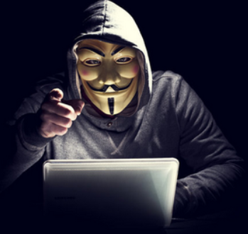
3.1 Source of Stimulus
The source of the attack may be either a human or another system
A human attacker may be from outside the organization or from inside the organization
57

Slide 18
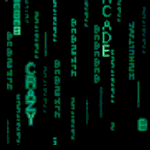
3.2 Stimuli of Security
The stimulus is an attack
An unauthorized attempt to display data, change or delete data, access system services, change the system’s behavior, or reduce availability
57

Slide 19
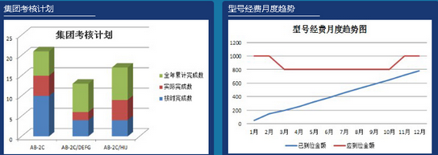
3.3 Artifact of Security
The target of the attack can be either the services of the system, the data within it, or the data produced or consumed by the system
Attack to the vulnerable components
57

Slide 20
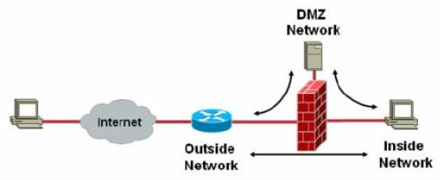
3.4 Environment of Security
The system is either online or offline, either connected to or disconnected from a service, either behind a firewall or open to a network, full operational, partially operational, or not operational
57

Slide 21
3.5 Response of Security
Transactions are carried out in a fashion
Data or services are protected from unauthorized access
Parties to a transaction cannot repudiate
Data or services are available for legitimate use
The system tracks activities within it by
Recording access or modification
Recording attempts to access data, or services
Notifying appropriate entities when attack
57

Slide 22
3.6 Response Measure
How much of a system is compromised when a particular component or data value is compromised
How much time passed before an attack was detected
How many attacks were resisted
How long does it take to recover from a successful attack
How much data is vulnerable to a particular attack
57

Slide 23
3.7 A Concrete Scenario of Security
Artifact:
Data within the System
Stimulus:
Response：
Attempts to Modify Pay Rate Table
System maintains Audit Trail
Response measure：
Source:
Environment:
Correct Data is Restored within a Day and Source Identified
Disgruntled Employee
Normal operations
A disgruntled employee from a remote location attempts to modify the pay rate table during normal operations.
57

Slide 24
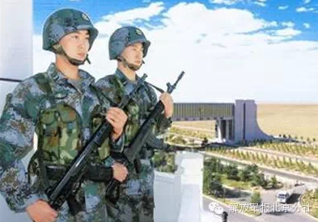
4. Tactics for Security
Secure installations have limited access, have means of detecting intruders, have deterrence mechanisms, have reaction mechanisms
57

Slide 25
4.1 The Graph of Classifying Security Tactics
Security
Detect Attacks
Resist Attacks
React to Attacks
Recover from Attacks
System Detects, Resists, Reacts, or Recovers
Detect Intrusion
Detect Service Denial
Verify Message Integrity
Detect Message Delay
Identify Actors
Authenticate Actors
Authorize Actors
Limit Access
Limit Exposure
Encrypt Data
Separate Entities
Revoke Access
Lock Computer
Inform Actors
Maintain Audit Trail
Restore ( See Availability)
Attack
Security tactics
57

Slide 26
4.2 Detect Attacks
Detect attacks category consists of four tactics:
Detect intrusion
Detect service denial
Verify message integrity
Detect message delay
57

Slide 27
4.2.1 Detect intrusion
Detect intrusion is the comparison of network traffic or service request patterns within a system to a set of signatures or known patterns
The signatures can be based on protocol, TCP flag, payload sizes, applications, source or destination address, or port number
57

Slide 28
4.2.2 Detect Service Denial
Detect service denial is the comparison of the patterns or signature of network traffic coming into a system to historic profiles of known denial-of-service attacks
57

Slide 29
4.2.3 Verify Message Integrity
Verify message integrity employs techniques such as checksums or hash values to verify the integrity of messages and files
Checksum: redundant information to verify the modification
Hash value: a unique string generated by a hashing function. Slight change in the message results in a significant change in the hash value
57

Slide 30
4.2.4 Detect Message delay
Detect message delay is intended to detect potential man-in-the-middle attacks, such as intercepting（拦截）
By checking the time that it takes to deliver a message, it is possible to detect suspicious timing behavior
57

Slide 31
4.3 Resist Attacks
There are a number of well known means of resisting an attack:
Identify actor
Authenticate actor
Authorize actor
Limit access
Limit exposure
Encrypt data
Separate entities
Change default settings
57

Slide 32
4.3.1 Identify Actors
Identify actors is about identifying the source of any external input to the system
Identified proofs:
User IDs
Access code
IP addresses
Protocols
Ports
57

Slide 33
4.3.2 Authenticate actors
Authenticate means ensuring that an actor is actually who or what is purports to be
Means:
Passwords
One-time passwords
Digital certificates
Biometric identification
57

Slide 34
4.3.3 Authorize Actors
Authorization means ensuring that an authenticated actor has the rights to access and modify either data or services
This means provide some access control mechanisms within a system
Access control can be by an actor or by an actor class.
Classes of actors can be defined by actor groups, roles or list of individuals
57

Slide 35
4.3.4 Limit Access
Limit access: Limiting access to computing resources such as memory, network connections, or access points.
Means:
Memory protection
Blocking a host
Closing a port
Rejecting a protocol
For example, the DMZ or firewall
57

Slide 36
4.3.5 Limit exposure
Limit exposure: this tactic minimizes the attack surface of a system
It focuses on reducing the probability of and minimizing the effects of damage caused by a hostile action
Means:
Having the least possible number of access points of resources, data or services
Reducing the number of connectors
57

Slide 37
4.3.6 Encrypt Data
Encrypt data: Confidentiality is usually achieved by applying some form of encryption to data and to communication
Encryption provides extra protection to persistently maintained data
Encryption categories:
Symmetric: Same key
Asymmetric: public and private keys
57

Slide 38
4.3.7 Separate entities
Separate entities: Separating different entities within the system can be done through physical separation
Means:
Virtual machines
Air gap
No connection between different portions
Sensitive data is frequently separated from non-sensitive data
57

Slide 39
4.3.8 Change default settings
Change default settings: Many systems have default settings assigned when the system is delivered
Forcing the user to change those settings will prevent attackers from gaining access to the system
For example, changing your credit card initial password
57

Slide 40
4.4 React to Attacks
There are three categories tactics:
Revoke access
Lock computer
Inform actors
57

Slide 41
4.4.1 Revoke access
Revoke access: If the system administrator believes an attack is underway, then access can be severely limited to sensitive resources, event for normally legitimate users
For example: If your computer has been attacked by a virus, you access to certain resources may be limited until the virus is removed from your system
57

Slide 42
4.4.2 Lock Computer
Lock computer: Repeated failed login attempts may indicate a potential attack. Many systems limit access from a particular computer if there are repeated failed attempts to access an account
Legitimate users may make mistakes in attempting to log in. Therefore, the limited access may only be for a certain time period
57

Slide 43
4.4.3 Inform Actors
Inform Actors: Ongoing attacks may require action by operators, other personnel, or cooperating system
The operators must be notified when the system has detected an attack
57

Slide 44
4.5 Recover from Attacks
Once a system has detected and attempted to resist an attack, it needs to recover
Since a successful attack can be considered a kind of failure, the set of availability tactics can be used
57

Slide 45
4.5.1 Maintain an Audit Trail
Maintain an audit trail: Audit is keep a record of user and system actions and their effects
Audit help trace the actions of, and to identify, an attacker
By analyzing the audit trails we can prosecute attackers, or to create better defenses in the future
57

Slide 46
4.6 Summary Security Tactics
Security
Detect Attacks
Resist Attacks
React to Attacks
Recover from Attacks
System Detects, Resists, Reacts, or Recovers
Detect Intrusion
Detect Service Denial
Verify Message Integrity
Detect Message Delay
Identify Actors
Authenticate Actors
Authorize Actors
Limit Access
Limit Exposure
Encrypt Data
Separate Entities
Revoke Access
Lock Computer
Inform Actors
Maintain Audit Trail
Restore ( See Availability)
Attack
Security tactics
57

Slide 47
5 A Design for Performance
The design for security include:
Allocation of responsibilities
Coordination model
Data model
Mapping among architectural elements
Resource management
Binding time
Choice of technology
57

Slide 48
5.1 Allocation of Responsibilities
Determine which system responsibilities need to be secure
Identify the actor
Authenticate the actor
Authorize actors
Grant or deny access to data or services
Record attempts to access or modify data or services
Encrypt data
57

Slide 49
5.2 Coordination Model
Determine mechanisms required to communicate and coordinate with other systems or individuals:
For communications, Ensure that:
Mechanisms for authenticating and authorizing the actor or system
Mechanisms exist for monitoring and recognizing unexpectedly demands
Mechanisms for restricting or terminating the connection
57

Slide 50
5.3 Data Model
Determine the sensitivity of different data fields
For each data abstraction ensure that:
Data of different sensitivity is separated
Data of different sensitivity has different access rights
Access to sensitivity data is logged
Data is suitable encrypted and that keys are separated from the encrypted data
Data can be restored if it is modified
57

Slide 51
5.4 Mapping among Architectural Elements
Determine how alternative mappings of architectural elements that are under consideration may change
Determine how alternative mappings may affect the recording of access to data, services or resources and the recognition of unexpectedly high demands for resources
57

Slide 52
5.5 Resource Management
Determine the system resources required to identify and monitor
Determine the resources required to authenticate the actor, grant or deny access the data or resource
For resources consider whether an external entity can access a critical resource or exhaust a critical resource, how to monitor the resource, how to mange resource utilization
Ensure contaminated element can be prevented from contaminating other elements
57

Slide 53
5.6 Binding Time
Determine cases where an instance of a late-bound component may be untrusted
There are appropriate mechanisms to manage and validate the late-bound components
Access to late-bound data and services can be managed
57

Slide 54
5.7 Choice of Technology
Determine what technologies are available to help user authentication, data access rights, resource protection, and data encryption
Ensure that your chosen technologies support the tactics relevant for your security needs
57

Slide 55
Summary
Security can be mainly characterized as confidentiality, integrity, and availability(CIA)
Other property include authentication, nonrepudiation and authorization
The tactics of security can be categories: detect attacks, resist attacks, react to attacks, and recover from attacks
No security tactic is foolproof
57

Slide 56
Homework
Write a set of concrete scenarios for security using each of the possible responses in the general scenario
Which of the tactics in our list will protect against an insider threat? Can you think of any that should be added?
57

Slide 57
Discuss
Security and usability are often seen to be at odds with each other. Security often imposes procedures and processes that seem like needless overhead to the casual user. But some say that security and usability go hand in hand and argue that making the system easy to use securely.
How do you coordinate the security and the usability?
57

