Slide 1
Testability
—— 2016/5
44

Slide 2
Outline
Introduction
Netflix’s Simian Army
Testability General Scenario
Tactics for Testability
A Design Checklist for Testability
Summary
44

Slide 3
1. Introduction
Software testability refers to the ease with which software can be made to demonstrate its faults through testing
Testability refers to the probability, assuming that the software has at least one fault, that it will fail on its next execution
44

Slide 4
1.1 A Testing Model
The testing model refers to the input, output and internal state of a process
The oracle is an agent that decides whether the output is correct or not by comparing the output to the program’s specification
input
output
Program
Oracle
Approved
rejected
Internal state
A model of testing
44

Slide 5
1.2 The Strategies of Testing
For a system to be properly testable, it must be possible to control each component’s inputs and then observe its outputs
The internal states are manipulated and observed in the testing
44

Slide 6
1.3 Test harnesses
Test harness, which is specialized software designed to exercise the software under test
Test harnesses come in various forms:
Record-and-playback data
Simulator for an external environment
Assistance in executing the test procedures and recording the output
44

Slide 7

2. Netflix’s Simian Army
Netflix company was establish in 1997 in CA of America
It is a company that provides streaming video to customers by internet
In May 2011 Netflix streaming video accounted for 24 percent of the internet traffic in North America
44

Slide 8

2.1 Netflix’s Auto Testing
Netflix hosts their computer services in the Amazon EC2 cloud
They utilize what they call a “Simian Army” as a portion of their testing process
44

Slide 9
2.2 Netflix’s Simian Army1
There are seven categories of testing
Chaos Monkey: It randomly kills processes in the running system
Latency Monkey: It induces artificial delays to simulate service degradation
Conformity Monkey: It finds instances that don’t adhere to best practices and shuts them down
44

Slide 10
2.3 Netflix’s Simian Army2
Doctor Monkey: It taps into health checks that run on each instance
janitor Monkey: It ensures that the Netflix cloud environment is running free of clutter and waster
Security Monkey: It finds security violations or vulnerabilities
10-18 Monkey: It detects configuration and runtime problems in different languages, (localization and internationalization)
44

Slide 11

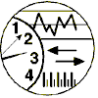
3.Testability General Scenario
General scenario of testability with parameters
Artifact:
Code Subsystem System
Stimulus:
Response：
Completion of a coding increment
The system can be controlled to perform the desired tests and results can be observed
Response measure：
Source:
Environment:
Human
Automated tester
Design time Development Integration Deployment and Run time
How easily a system under test gives up its faults
44

Slide 12
3.1 General Quality-Attribute Table of Performance
Portion of Scenario | Possible Value
Source | Unit testers, integration testers, system testers, acceptance testers, end users
Stimulus | A set of tests is executed due to the completion of a coding increment such as completed integration or whole system
Artifact | The portion of the system being tested
Environment | Design time, development time, compile time, integration time, run time
Response | Execute test suite, capture results, capture activity that resulted in the fault, control and monitor the state
Response Measure | How easily a system under test gives up its faults
44

Slide 13
3.2 Response Measure
One or more of the following
Effort to find a fault or class of faults
Effort to achieve a given percentage of state space test
Time to perform tests
Length of longest dependency chain in test
Length of time to prepare test environment
Reduction in risk exposure
44

Slide 14
3.3 A Concrete Scenario of Testability
Artifact:
Code Unit
Response：
Stimulus:
Code Unit Completed
Results Captured
Response measure：
Source:
Environment:
Unit Tester
Development
85% Path Coverage in Three Hours
The Unit tester completes a code unit during development and performs a test sequence whose results are captured and that gives 85% path coverage within 3 hours
44

Slide 15
4. Tactics for Testability
The goal of testability is to allow for easier testing when an increment of software development is completed
Tactics to Control Testability
Tests Executed
Faults Detected
44

Slide 16
4.1 Two Categories of Tactics
Two categories of tactics for testability:
The first deals with adding controllability and observability to the system
The second deals with limiting complexity in the system’s design
44

Slide 17
4.2 The Graph of Classifying Testability Tactics
Testability
Control and Observe System State
Limit Complexity
Test Executed
Faults Detected
Specialized Interfaces
Record/Playback
Localize State Storage
Abstract Data Sources
Sandbox
Executable Assertions
Limit Structural Complexity
Limit Nondeterminism
Testability tactics
44

Slide 18
4.3 Control and Observe System State
Control and observation are central to testability
The simplest format of control and observation is to provide a set of inputs, let it do its work, and then observe its outputs
These tactics cause a component to maintain some sort of state information, and tester can control and modified the information
44

Slide 19
4.3.1 Specialized Interfaces
Specialized interfaces: Having specialized testing interfaces allows you to control or capture variable values for a component, Example:
A set and get method for important variables, modes, or attributes
A report method that returns full states
A reset method to set the internal state
A method to turn on output, event logging, or resource monitoring
44

Slide 20
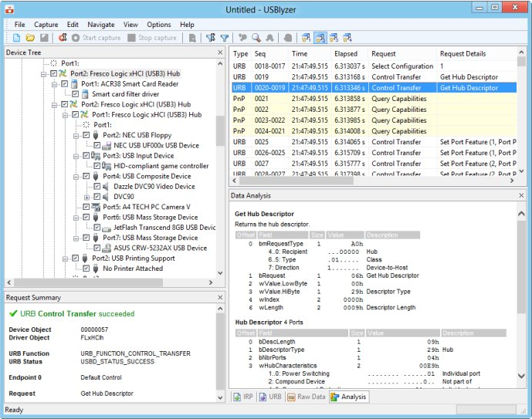
4.3.1.1 The Example of Specialized Interfaces
Display internal states in USB Trace software
44

Slide 21
4.3.2 Record/Playback
Record/Playback: The state that caused a fault is often difficult to re-create
Recording the state when it crosses an interface allows that state to be used to play the system back and to re-create the fault
Record/playback refers to both capturing information and using it as input for further testing
44

Slide 22
4.3.3 Localize State Storage
Localize State Storage：To start a system in an arbitrary state for a test, it is convenient if that state is store in a single place
A convenient way to externalize state storage is to use a state machine as the mechanism to track an report current state
44

Slide 23
4.3.4 Abstract Data Sources
Abstract data Sources: Easily controlling its input data makes it easier to test
Abstracting the interfaces lets you substitute test data more easily
For example, if you have a database of customer transactions, you could design your architecture so that it is easy to point your test system at other test databases without changing your code
44

Slide 24

4.3.5 Sandbox
Sandbox: Sandboxing refers to isolating an instance of the system from the real world to enable experimentation that is unconstrained by the worry about the consequences
Sandbox testing can be used for scenario analysis, training, and simulation
Air traffic Control Simulator
44

Slide 25
4.3.5.1 Sandbox form
A common form of sandboxing is to virtualize resources
Testing a system often involves interacting with resources whose behavior is outside the control of the system
Virtualize resources include: system clock, memory, battery, network and so on
Stubs, mock, and dependency injection are simple but effective forms of virtualization
44

Slide 26
4.3.6 Executable Assertions
Executable: Using this tactic, assertions are hand-coded and placed at desired locations to indicate when and where a program is in a faulty state
The assertions are often designed to check that data values satisfy specified constraints.
The assertions increase the observability
44

Slide 27
4.4 Limit Complexity
Complex software is harder to test because of the large state space
Large state space is more difficult to re-create an exact state
Testing is not just about making the software fail but about finding the fault that caused the failure so that it can be removed, we are often concerned with making behavior repeatable
44

Slide 28
4.4.1 Limit Structural Complexity
Limit structural complexity: This tactic includes avoiding or resolving cyclic dependencies between components
isolating and encapsulating dependencies on the external environment, and reducing dependencies between components in general
44

Slide 29
4.4.1.1 Reduce Structural Complexity in OO system
In object-oriented system, reduce dependency as following:
Limit the number of classes from which a class is derived ( Parent class)
Limit the number of classes derived from a class (Child class)
Limit the depth of the inheritance tree
Limit polymorphism and dynamic calls
44

Slide 30
4.4.1.2 Response of a Class
The response of class C is a count of the number of methods of C plus the number of methods of other classes that are invoked by the methods of C
Keeping the metric low can increase testability
Having high cohesion, loose coupling, and separation of concerns, not only support modifiability, but also support the testability
44

Slide 31
4.4.2 Limit nondeterminism
Limit nondeterminism: This tactic limits the behavioral complexity
Nondeterminism is a very pernicious form of complex behavior
This tactic involves finding all the sources of nondeterminism, such as unconstrained parallelism, in multithreaded systems that respond to unpredictable events
44

Slide 32
4.5 Summary Testability Tactics
Testability
Control and Observe System State
Limit Complexity
Test Executed
Faults Detected
Specialized Interfaces
Record/Playback
Localize State Storage
Abstract Data Sources
Sandbox
Executable Assertions
Limit Structural Complexity
Limit Nondeterminism
Testability tactics
44

Slide 33
5 A Design for Testability
The design for Testability include:
Allocation of responsibilities
Coordination model
Data model
Mapping among architectural elements
Resource management
Binding time
Choice of technology
44

Slide 34
5.1 Allocation of Responsibilities
Determine which system responsibilities are most critical and hence need to be most tested
Ensure that additional system responsibilities have been allocated to do the following:
Execute test suite and capture results
Capture the activity that resulted in a fault
Control and observe relevant system state for testing
44

Slide 35
5.2 Coordination Model
Ensure the system’s coordination and communication mechanisms:
Support the execution of a test suite and capture the results within a system or between system
Support capturing activity that resulted in a fault within a system or between system
Support injection and monitoring of state
Do not introduce needless nondeterminism
44

Slide 36
5.3 Data Model
Determine the major data abstractions that must be tested to ensure the correct operation of the system
Ensure capture the values of data
Ensure the values of data can be set when state is injected, so that the fault may be re-created
Ensure that the creation, initialization, persistence of the data
44

Slide 37
5.4 Mapping among Architectural Elements
Determine how to test the possible mappings of architectural elements so that the desired test response is achieved and potential race conditions identified
Determine whether it is possible to test for illegal mappings of architectural elements
44

Slide 38
5.4 Resource Management
Ensure there are sufficient resources available to execute a test suite and capture the results
Ensure the system provides the means:
Test resource limits
Capture detailed resource usage for analysis in the event of a failure
Inject new resource limits into the system for the purposes of testing
Provide virtualized resources for testing
44

Slide 39
5.6 Binding Time
Ensure that components that are bound later than compile time can be tested in the late-bound context
Ensure that late bindings can be captured in the event of a failure, so that you can re-create the system’s state leading to the failure
Ensure that the full range of binding possibilities can be tested
44

Slide 40
5.7 Choice of Technology
Determine what technologies are available to help achieve the testability scenarios that apply to your architecture
Determine how testable the technologies are that you have chose
Ensure that your chosen technologies support the level of testing appropriate for your system
44

Slide 41
5.8 Two Challenges
Test data
How to create large, consistent and useful set data sets? By computer or by hand
Test automation
It is not possible to test large systems by hand because of the number of tests, their complexity, and the amount of checking of results that’s required
44

Slide 42
Summary
A system is easily testable has payoff cost
Controlling and observing the system state is a major class of testability tactics
Keep the system simple is another class of tactics
44

Slide 43
Homework
Write a set of concrete scenarios for testability using each of the possible responses in the general scenario
Introduce the two categories of testability tactics
44

Slide 44
Discuss
A testable system is one that gives up its faults easily. Fault tolerance is all about designing systems that jealously hide their faults, that is to make fault is difficult to reveal
Is it possible to design a system that is both highly testable and highly fault tolerant, or are these two design goals inherently imcompatible?
44

