Slide 1
Course Outline
MODEL INFORMATION
COMPLETE
INCOMPLETE
Bayes Decision Theory
Supervised Learning
Unsupervised Learning
Parametric Approach
Nonparametric Approach
Parametric Approach
Nonparametric Approach
“Optimal” Rules
Plug-in Rules
Density Estimation
Geometric Rules (K-NN, MLP)
Mixture Resolving
Cluster Analysis (Hard, Fuzzy)

Slide 2
Chapter 2 (Part 1):
Bayesian Decision Theory
(Sections 2.1-2.2)
Decision problem posed in probabilistic terms
Bayesian Decision Theory–Continuous Features
All the relevant probability values are known

Slide 3
Introduction
The sea bass/salmon example
  State of nature, a priori (prior) probability
    State of nature is unpredictable, so it is a random variable
    The catch of salmon and sea bass is equiprobable
      P(ω₁) = P(ω₂) (uniform priors)
      P(ω₁) + P( ω₂) = 1 (exclusivity and exhaustivity)
    Prior prob. reflects our prior knowledge about how likely we are to observe a sea bass or salmon; these probabilities may depend on time of the year or the fishing area!
Pattern Classification, Chapter 2 (Part 1)

Slide 4
Decision rule with only the prior information
  Decide ω₁ if P(ω₁) > P(ω₂), otherwise decide ω₂
Suppose now we have a measurement or feature on the state of nature - say the fish lightness value
Use of the class –conditional probability density
P(x | ω₁) and P(x | ω₂) describe the difference in lightness feature between populations of sea bass and salmon
Pattern Classification, Chapter 2 (Part 1)

Slide 5
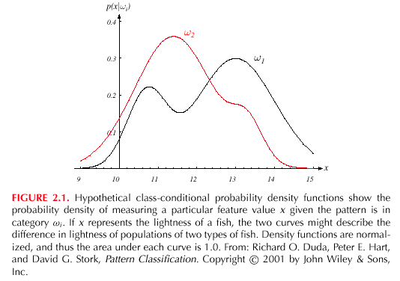
Amount of overlap between the densities determines the “goodness” of feature
Pattern Classification, Chapter 2 (Part 1)

Slide 6
Maximum likelihood decision rule
  Assign input pattern x to class ω₁ if
  P(x | ω₁) > P(x | ω₂), otherwise ω₂
How does the feature x influence our attitude (prior) concerning the true state of nature?
Pattern Classification, Chapter 2 (Part 1)

Slide 7
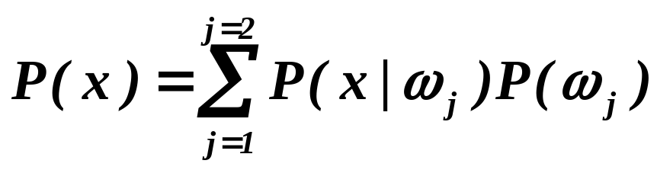
Posterior, likelihood, evidence
  Using Bayes formula
  P(ω_{j} | x) = {P(x | ω_{j}) . P (ω_{j})} / P(x)
  where in case of two categories
  Posterior = (Likelihood. Prior) / Evidence
  Evidence P(x) can be viewed as a scale factor that guarantees that the posterior probabilities sum to 1
  P(x | ω_{j}) is called the likelihood of ω_{j} with respect to x; the category ω_{j} for which P(x | ω_{j}) is large is more likely to be the true category
Pattern Classification, Chapter 2 (Part 1)

Slide 8
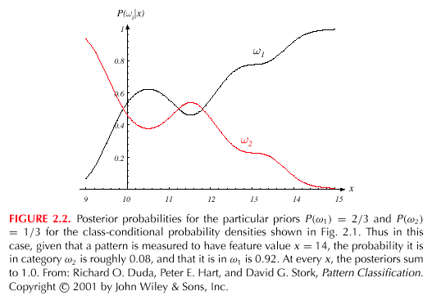
Pattern Classification, Chapter 2 (Part 1)

Slide 9
P(ω₁ | x) is the probability of the state of nature being ω₁ given that feature value x has been observed
Decision given the posterior probabilities, Optimal Bayes Decision rule
X is an observation for which:
if P(ω₁ | x) > P(ω₂ | x) True state of nature = ω₁
if P(ω₁ | x) < P(ω₂ | x) True state of nature = ω₂
Therefore, whenever we observe a particular x, the probability of error is:
P(error | x) = P(ω₁ | x) if we decide ω₂
P(error | x) = P(ω₂ | x) if we decide ω₁
Pattern Classification, Chapter 2 (Part 1)

Slide 10
Bayes decision rule minimizes the probability of error
Decide ω₁ if P(ω₁ | x) > P(ω₂ | x);
otherwise decide ω₂
Therefore:
P(error | x) = min [P(ω₁ | x), P(ω₂ | x)]
Unconditional error, P(error) obtained by integration over all x w.r.t. p(x)
Pattern Classification, Chapter 2 (Part 1)

Slide 11
Optimal Bayes decision rule
Decide ω₁ if P(ω₁ | x) > P(ω₂ | x);
otherwise decide ω₂
Special cases:
  (i) P(ω₁) = P(ω₂); Decide ω₁ if
  P(x | ω₁) > P(x | ω₂), otherwise ω₂
  (ii) P(x | ω₁) = P(x | ω₂); Decide ω₁ if
  P(ω₁) > P(ω₂), otherwise ω₂
Pattern Classification, Chapter 2 (Part 1)

Slide 12
Bayesian Decision Theory – Continuous Features
Generalization of the preceding ideas
  Use of more than one feature (d features)
  Use of more than two states of nature (c classes)
  Allowing other actions besides deciding on the state of nature
  Introduce a loss function which is more general than the probability of error
Pattern Classification, Chapter 2 (Part 1)

Slide 13
Allowing actions other than classification primarily allows the possibility of rejection
Refusing to make a decision in close or noisy cases!
The loss function states how costly each action taken is
Pattern Classification, Chapter 2 (Part 1)

Slide 14
Let {ω₁, ω₂,…, ω_{c}} be the set of c states of nature
(or “categories”)
Let {α₁, α₂,…, α_{a}} be the set of a possible actions
Let λ(α_{i} | ω_{j}) be the loss incurred for taking
action α_{i} when the true state of nature is ω_{j}
_{General decision rule} α(x) specifies which action to take for every possible observation x
Pattern Classification, Chapter 2 (Part 1)

Slide 15
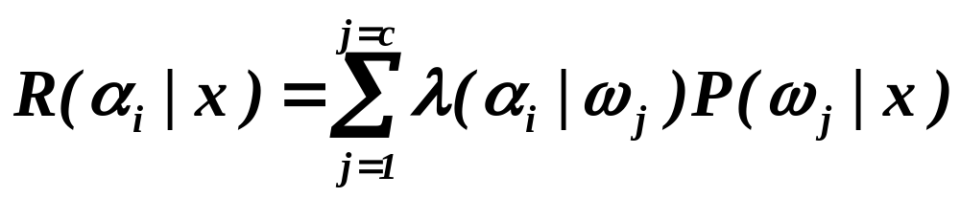
Overall risk
R = Sum of all R(α_{i} | x) for i = 1,…,a
Minimizing R Minimizing R(α_{i} | x) for i = 1,…, a
for i = 1,…,a
Select the action for which the conditional risk R(α_{i} | x) is minimum
Conditional risk
Pattern Classification, Chapter 2 (Part 1)

Slide 16
Select the action α_{i} for which R(α_{i} | x) is minimum
Risk R is minimum and R in this case is called the
Bayes risk = best performance that can be achieved!
Pattern Classification, Chapter 2 (Part 1)

Slide 17
Two-category classification
    α₁ : deciding ω₁
    α₂ : deciding ω₂
    λ_{ij} = λ(α_{i} | ω_{j})
loss incurred for deciding ω_{i} when the true state of nature is ω_{j}
Conditional risk:
R(α₁ | x) = λ₁₁P(ω₁ | x) + λ₁₂P(ω₂ | x)
R(α₂ | x) = λ₂₁P(ω₁ | x) + λ₂₂P(ω₂ | x)
Pattern Classification, Chapter 2 (Part 1)

Slide 18
Bayes rule is the following:
if R(α₁ | x) < R(α₂ | x)
action α₁: “decide ω₁” is taken
This results in the equivalent rule:
decide ω₁ if:
(λ₂₁- λ₁₁) P(x | ω₁) P(ω₁) >
(λ₁₂- λ₂₂) P(x | ω₂) P(ω₂)
and decide ω₂ otherwise
Pattern Classification, Chapter 2 (Part 1)

Slide 19
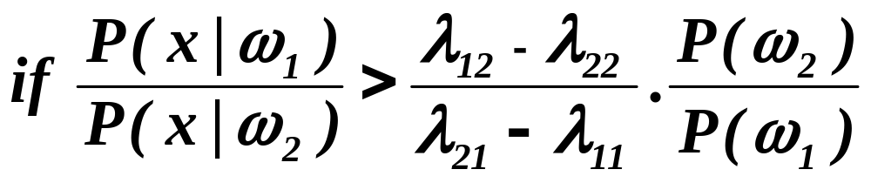
Likelihood ratio:
The preceding rule is equivalent to the following rule:
Then take action α₁ (decide ω₁)
Otherwise take action α₂ (decide ω₂)
Pattern Classification, Chapter 2 (Part 1)

Slide 20
Optimal decision property
“If the likelihood ratio exceeds a threshold value that is independent of the input pattern x, we can take optimal actions”
For the maximum likelihood rule, the threshold value is 1.
Pattern Classification, Chapter 2 (Part 1)

Slide 21
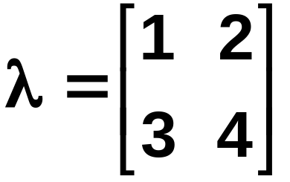
Exercise
Select the optimal decision where:
= {ω₁, ω₂}
P(x | ω₁) N(2, 0.5) (Normal distribution)
P(x | ω₂) N(1.5, 0.2)
P(ω₁) = 2/3
P(ω₂) = 1/3
Pattern Classification, Chapter 2 (Part 1)

