Slide 1
Chapter 2 (Part 2):
Bayesian Decision Theory
(Sections 2.3-2.5)
Minimum-Error-Rate Classification
Classifiers, Discriminant Functions and Decision Surfaces
The Normal Density

Slide 2
Minimum Error Rate Classification
Actions are decisions on classes
If action α_{i} is taken and the true state of nature is ω_{j} then:
the decision is correct if i = j and in error if i ≠ j
Seek a decision rule that minimizes the probability of error or the error rate
Pattern Classification, Chapter 2 (Part 2)

Slide 3
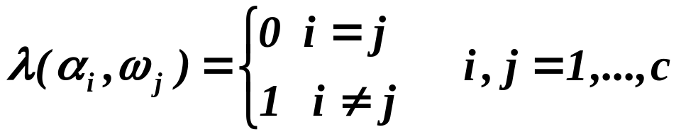
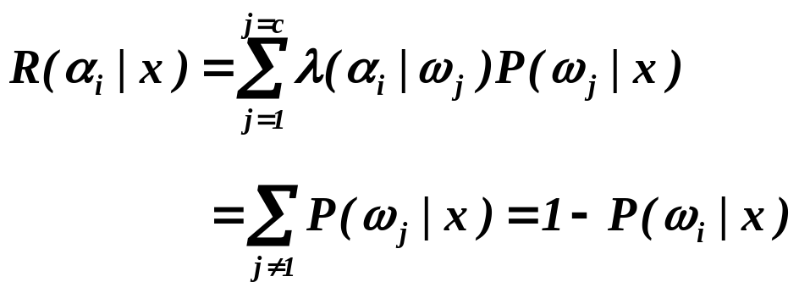
Zero-one (0-1) loss function: no loss for correct decision and a unit loss for any error
Therefore, the conditional risk is:
“The risk corresponding to this loss function is the average probability of error”
Pattern Classification, Chapter 2 (Part 2)

Slide 4
Minimizing the risk requires maximizing the posterior probability P(ω_{i} | x) since
R(α_{i} | x) = 1 – P(ω_{i} | x))
For Minimum error rate
  Decide ω_{i} if P (ω_{i} | x) > P(ω_{j} | x) ∀j ≠ i
Pattern Classification, Chapter 2 (Part 2)

Slide 5
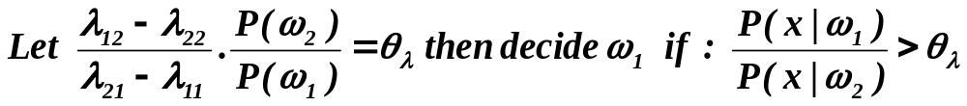
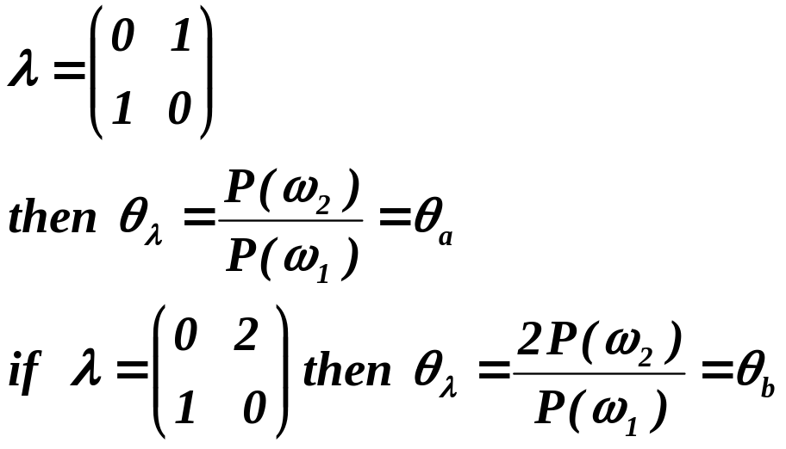
Decision boundaries and decision regions
If λ is the 0-1 loss function then the threshold only involves the priors:
Pattern Classification, Chapter 2 (Part 2)

Slide 6
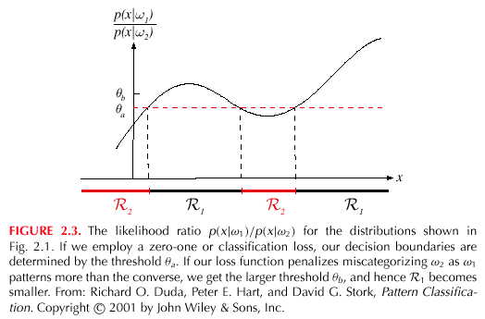
Pattern Classification, Chapter 2 (Part 2)

Slide 7
Classifiers, Discriminant Functions and Decision Surfaces
Many different ways to represent pattern classifiers; one of the most useful is in terms of discriminant functions
The multi-category case
  Set of discriminant functions g_{i}(x), i = 1,…,c
  Classifier assigns a feature vector x to class ω_{i} if:
  g_{i}(x) > g_{j}(x) ∀j ≠ i
Pattern Classification, Chapter 2 (Part 2)

Slide 8
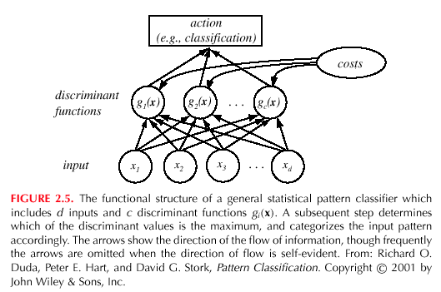
Network Representation of a Classifier
Pattern Classification, Chapter 2 (Part 2)

Slide 9
Bayes classifier can be represented in this way; but the choice of discriminant function is not unique
g_{i}(x) = - R(α_{i} | x)
(max. discriminant corresponds to min. risk!)
For the minimum error rate, we take
  g_{i}(x) = P(ω_{i} | x)
(max. discrimination corresponds to max. posterior!)
g_{i}(x) ≡ P(x | ω_{i}) P(ω_{i})
g_{i}(x) = ln P(x | ω_{i}) + ln P(ω_{i})
(ln: natural logarithm!)
Pattern Classification, Chapter 2 (Part 2)

Slide 10
Effect of any decision rule is to divide the feature space into c decision regions
if g_{i}(x) > g_{j}(x) ∀j ≠ i then x is in R_{i}
(Region R_{i} means assign x to ω_{i})
The two-category case
  Here a classifier is a “dichotomizer” that has two discriminant functions g₁ and g₂
  Let g(x) ≡ g₁(x) – g₂(x)
  Decide ω₁ if g(x) > 0 ; Otherwise decide ω₂
Pattern Classification, Chapter 2 (Part 2)

Slide 11
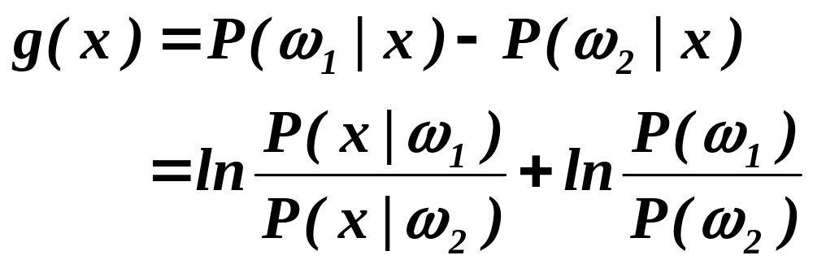
  Computation of g(x)
Pattern Classification, Chapter 2 (Part 2)

Slide 12
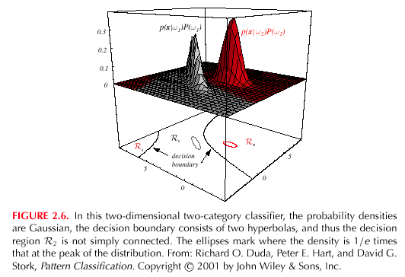
Pattern Classification, Chapter 2 (Part 2)

Slide 13
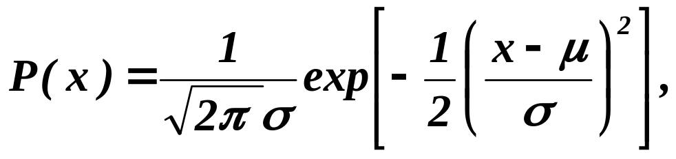
The Normal Density
Univariate density: N (μ , σ²)
  Normal density is analytically tractable
  Continuous density
  A number of processes are asymptotically Gaussian
  Handwritten characters, speech signals and other patterns can be viewed as randomly corrupted versions of a single typical or prototype (Central Limit theorem)
where:
μ = mean (or expected value) of x
σ² = variance (or expected squared deviation) of x
Pattern Classification, Chapter 2 (Part 2)

Slide 14
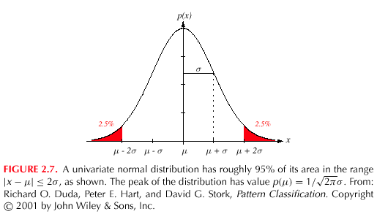
Pattern Classification, Chapter 2 (Part 2)

Slide 15
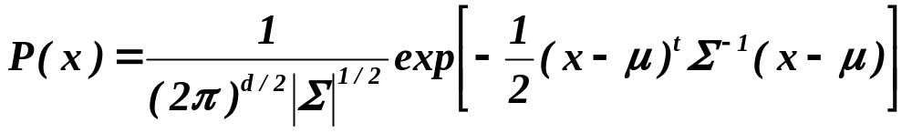
Multivariate density: N (μ , Σ)
  Multivariate normal density in d dimensions:
where:
x = (x₁, x₂, …, x_{d})^{t} (t stands for the transpose of a vector)
μ = (μ₁, μ₂, …, μ_{d})^{t} mean vector
Σ = d*d covariance matrix
|Σ| and Σ⁻¹ are determinant and inverse of Σ, respectively
The covariance matrix is always symmetric and positive semidefinite; we assume Σ is positive definite so the determinant of Σ is strictly positive
The multivariate normal density is completely specified by d + d(d+1)/2 parameters
If x₁ and x₂ are statistically independent then the covariance of x₁ and x₂ is zero.
Pattern Classification, Chapter 2 (Part 2)

Slide 16
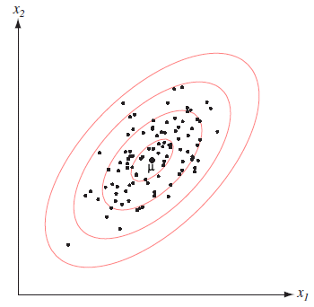

Multivariate Normal density
Samples drawn from a normal population tend to fall in a single cloud or cluster; cluster center is determined by the mean vector and shape by the covariance matrix
The loci of points of constant density are hyperellipsoids whose principal axes are the eigenvectors of Σ

Slide 17
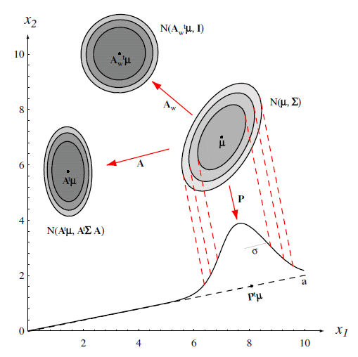
Transformation of Normal Variable
Linear combinations of jointly normally distributed random variables are normally distributed
Coordinate transformation can convert an arbitrary multivariate normal distribution into a spherical one

