Slide 1
Chapter 2 (part 3)
Bayesian Decision Theory (Sections 2-6 to 2-9)
Discriminant Functions for the Normal Density
Bayes Decision Theory – Discrete Features

Slide 2
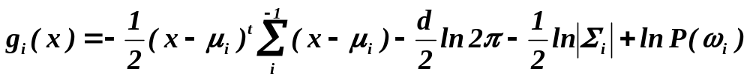
Discriminant Functions for the Normal Density
The minimum error-rate classification can be achieved by the discriminant function
g_{i}(x) = ln P(x | ω_{i}) + ln P(ω_{i})
In case of multivariate normal densities
Pattern Classification, Chapter 2 (Part 3)

Slide 3
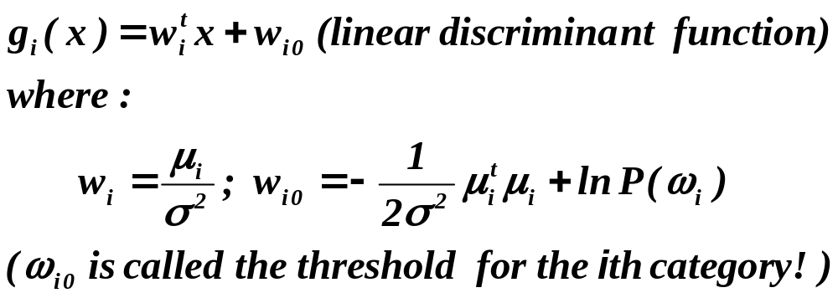
Case Σ_{i} = σ².I (I is the identity matrix)
Features are statistically independent and each feature has the same variance
Pattern Classification, Chapter 2 (Part 3)

Slide 4
  A classifier that uses linear discriminant functions is called “a linear machine”
  The decision surfaces for a linear machine are pieces of hyperplanes defined by the linear equations:
g_{i}(x) = g_{j}(x)
Pattern Classification, Chapter 2 (Part 3)

Slide 5
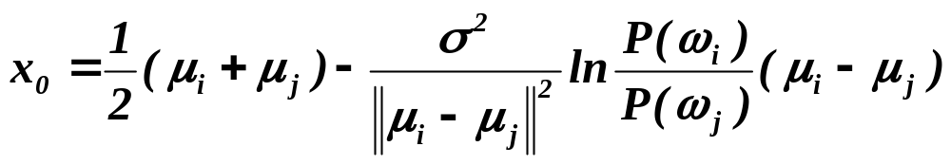
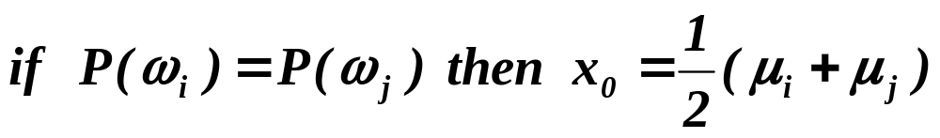
  The hyperplane separating R_{i} and R_{j}
is orthogonal to the line linking the means!
Pattern Classification, Chapter 2 (Part 3)

Slide 6
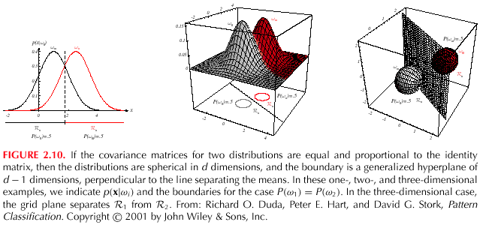
Pattern Classification, Chapter 2 (Part 3)

Slide 7
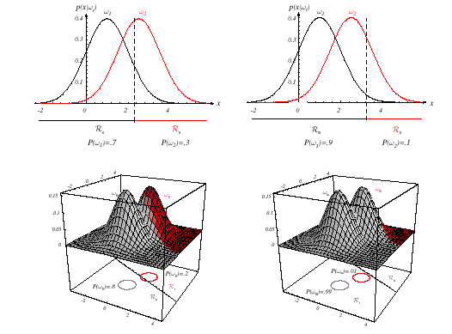
Pattern Classification, Chapter 2 (Part 3)

Slide 8
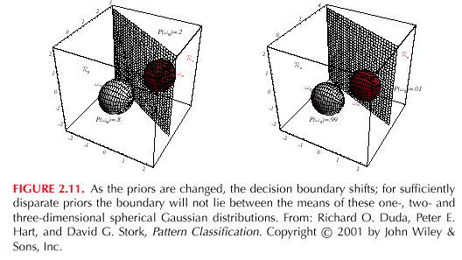
Pattern Classification, Chapter 2 (Part 3)

Slide 9
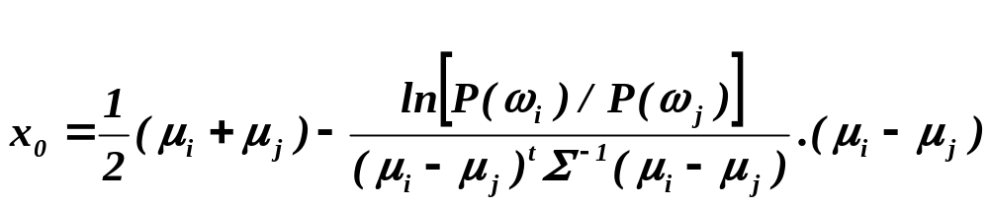
Case 2: Σ_{i} = Σ (covariance matrices of all classes are identical but otherwise arbitrary!)
Hyperplane separating R_{i} and R_{j}
  The hyperplane separating R_{i} and R_{j} is generally not orthogonal to the line between the means!
  To classify a feature vector x, measure the squared Mahalanobis distance from x to each of the c means; assign x to the category of the nearest mean
Pattern Classification, Chapter 2 (Part 3)

Slide 10
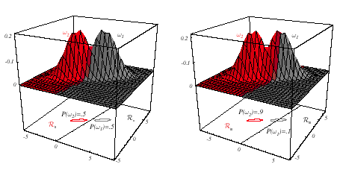
Pattern Classification, Chapter 2 (Part 3)

Slide 11
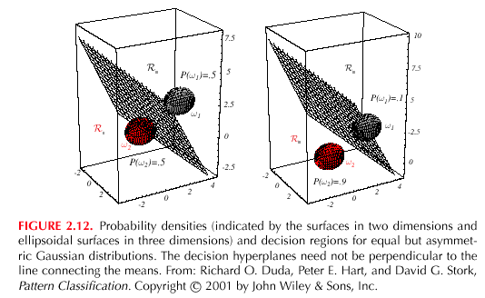
Pattern Classification, Chapter 2 (Part 3)

Slide 12
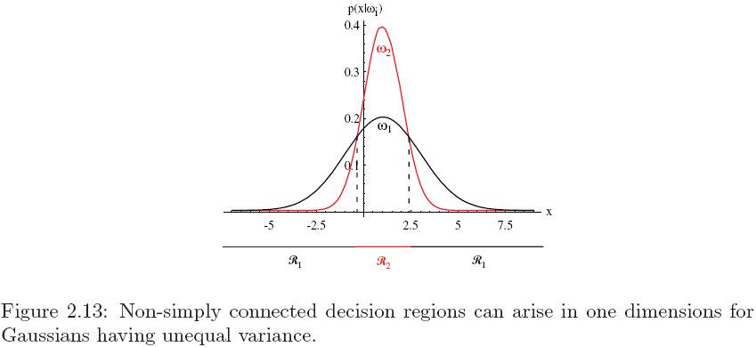
Discriminant Functions for 1D Gaussian

Slide 13
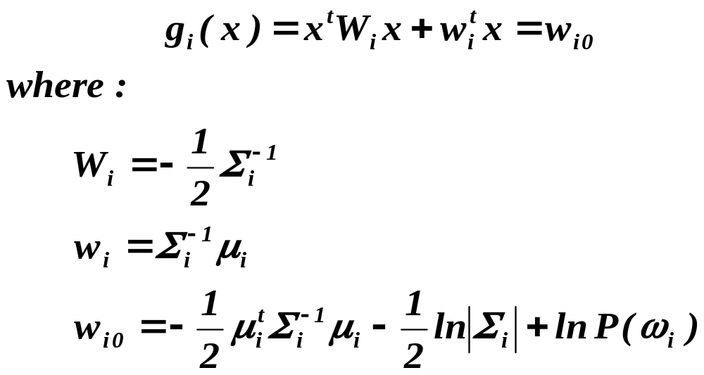
Case 3: Σ_{i} = arbitrary
  The covariance matrices are different for each category
  In the 2-category case, the decision surfaces are hyperquadrics that can assume any of the general forms: hyperplanes, pairs of hyperplanes, hyperspheres, hyperellipsoids, hyperparaboloids, hyperhyperboloids)
Pattern Classification, Chapter 2 (Part 3)

Slide 14
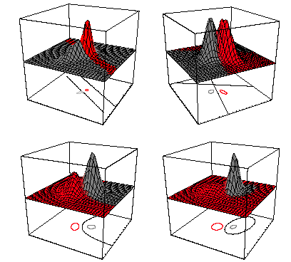
Discriminant Functions for the Normal Density
Pattern Classification, Chapter 2 (Part 3)

Slide 15
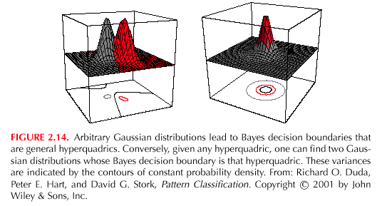
Pattern Classification, Chapter 2 (Part 3)

Slide 16
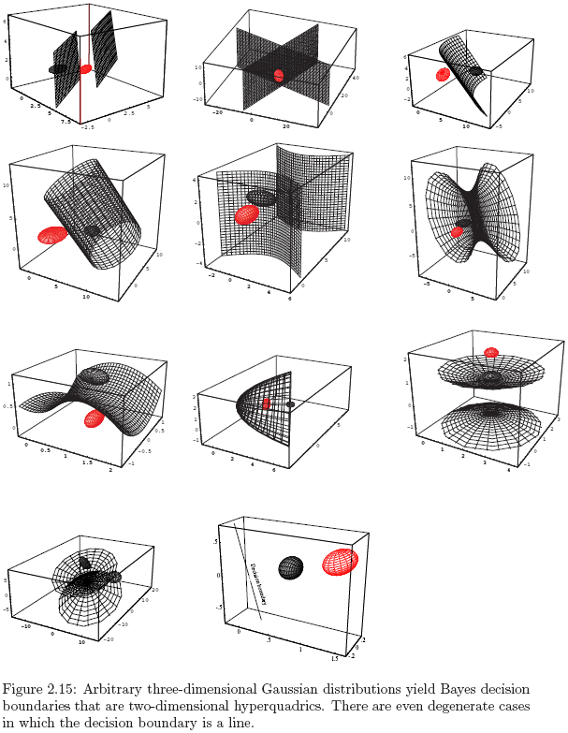
Discriminant Functions for the Normal Density

Slide 17
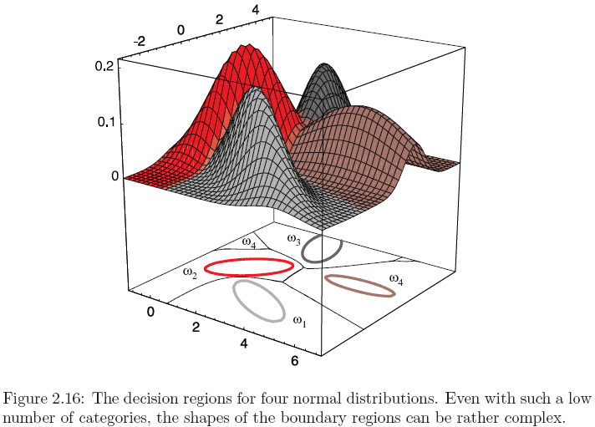
Discriminant Functions for the Normal Density

Slide 18

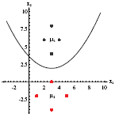


Decision Regions for Two-Dimensional Gaussian Data

Slide 19
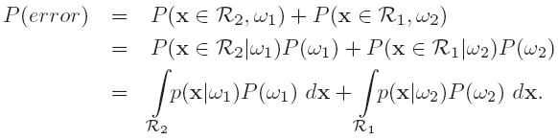

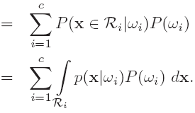
Error Probabilities and Integrals
2-class problem
  There are two types of errors
Multi-class problem
  Simpler to computer the prob. of being correct (more ways to be wrong than to be right)

Slide 20
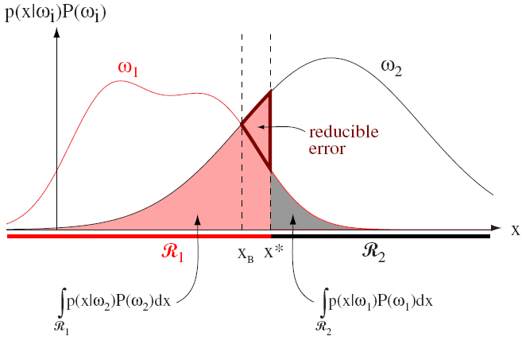
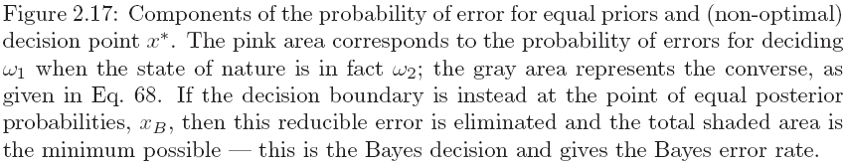
Error Probabilities and Integrals
Bayes optimal decision boundary in 1-D case

Slide 21
Error Bounds for Normal Densities
The exact calculation of the error for the general Guassian case (case 3) is extremely difficult
However, in the 2-category case the general error can be approximated analytically to give us an upper bound on the error

Slide 22


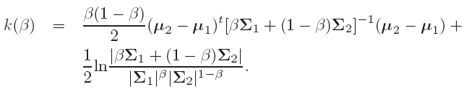
Chernoff Bound
To derive a bound for the error, we need the following inequality
Assume conditional prob. are normal
where

Slide 23
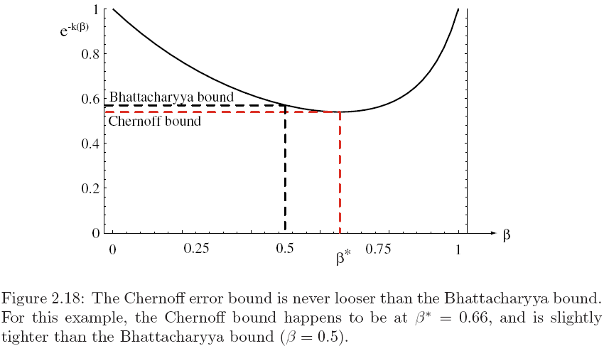
Chernoff Bound
Chernoff bound for P(error) is found by determining the value of β that minimizes exp(-k(β))

Slide 24
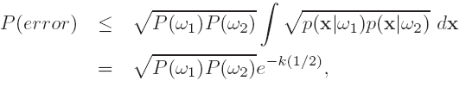
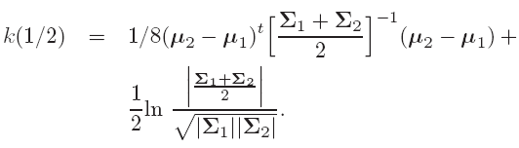
Error Bounds for Normal Densities
Bhattacharyya Bound
  Assume β = 1/2
    computationally simpler
    slightly less tight bound
Now, Eq. (73) has the form

Slide 25
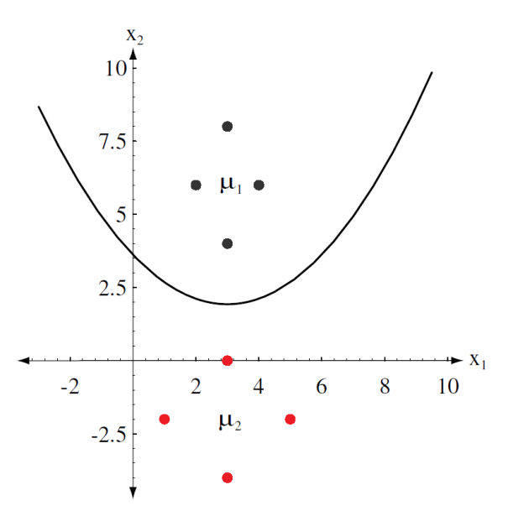

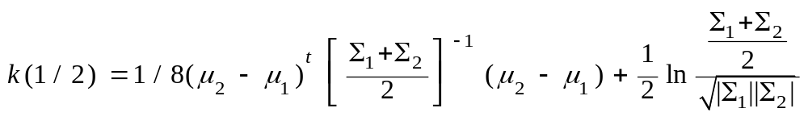
Error Bounds for Gaussian Distributions
Chernoff Bound
Best Chernoff error bound is 0.008190
Bhattacharya Bound (β=1/2)
2–category, 2D data
Bhattacharya error bound is 0.008191
True error using numerical integration = 0.0021

Slide 26



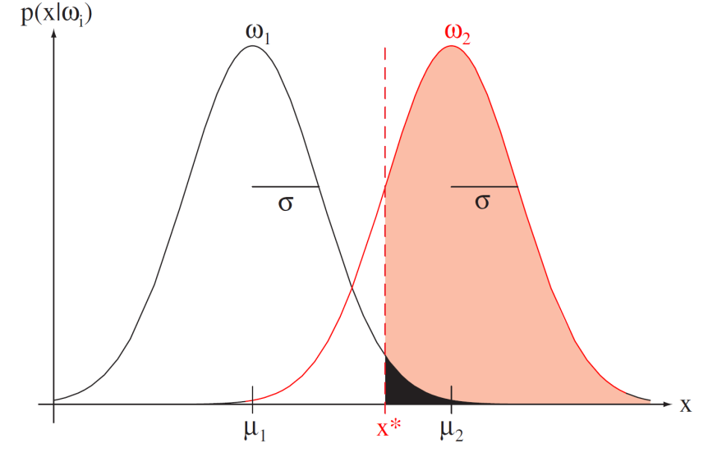

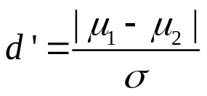




Signal Detection Theory
Check if the pulse is absent (class ) or present (class ) given internal signal x
Actual detector (classifier) employs a threshold value x*
Discriminability: ease of discriminating whether pulse is present
hit
Discriminability can be determined using hit, false alarm, miss and correct rejection
false alarm
miss
correct rejection

Slide 27
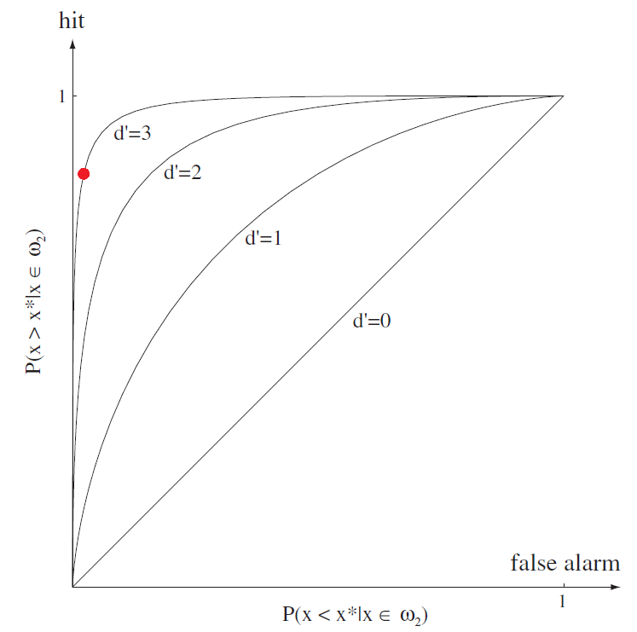
Receiver Operating Characteristic
Experimentally compute hit and false alarm rates for fixed x*
Changing x* will change the hit and false alarm rates
Given discriminability d’, the point will move along a smooth curve
From hit and false alarm rate we can deduce that d’=3
If Gaussian assumption holds, discriminability can be used to compute the Bayes error in one dimension

Slide 28
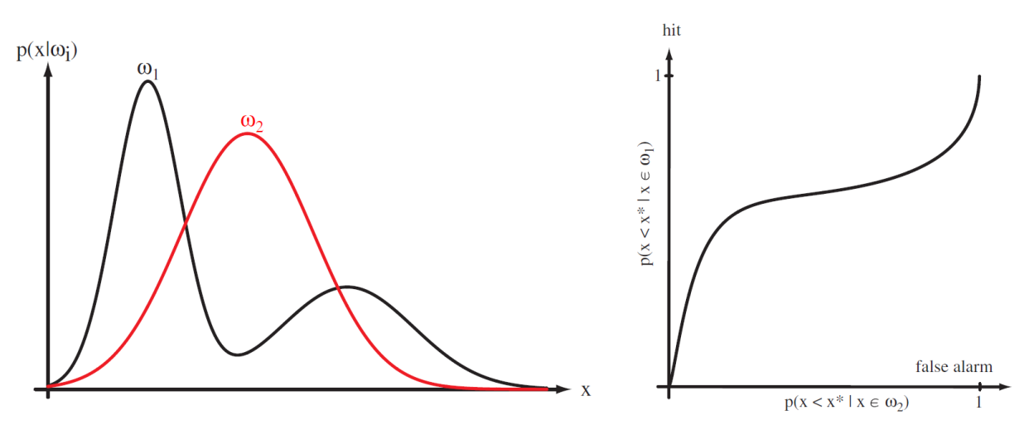
Operating Characteristic
In practice, distributions may not be Gaussian and one dimensional
Vary a single control parameter for the decision rule and plot the resulting hit and false alarm rates
Operating characteristic curves may not be symmetric

Slide 29
Bayes Decision Theory – Discrete Features
Components of x are binary or integer valued; x can take only one of m discrete values
v₁, v₂, …, v_{m}
Case of independent binary features for 2-category problem
Let x = [x₁, x₂, …, x_{d} ]^{t} where each x_{i} is either 0 or 1, with probabilities:
p_{i} = P(x_{i} = 1 | ω₁)
q_{i} = P(x_{i} = 1 | ω₂)
Pattern Classification, Chapter 2 (Part 3)

Slide 30
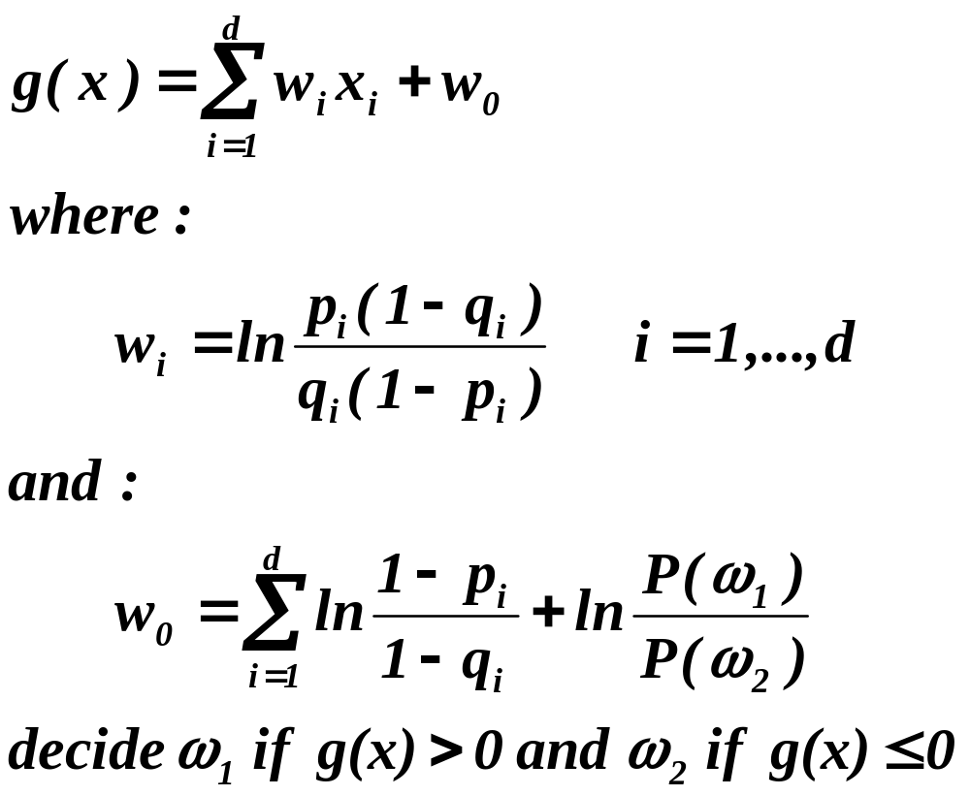
The discriminant function in this case is:
Pattern Classification, Chapter 2 (Part 3)

Slide 31
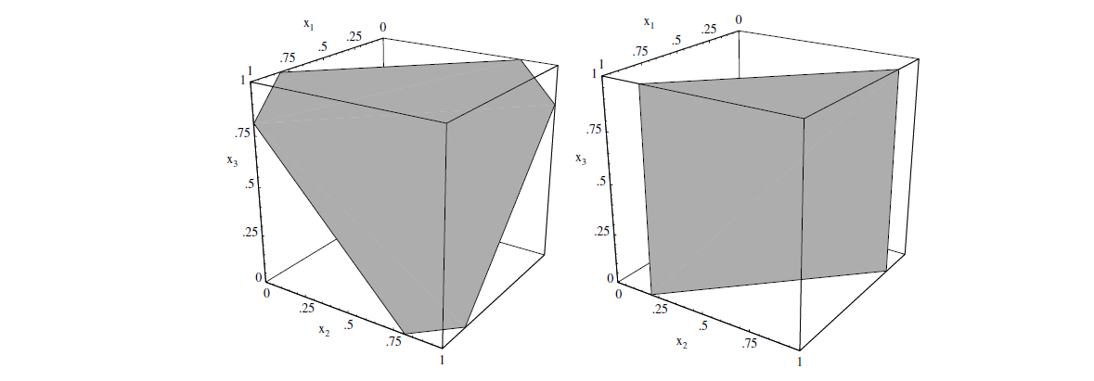
Bayesian Decision for Three-dimensional Binary Data
Consider a 2-class problem with three indepedennt binary features; class priors are equal and pi = 0.8 and qi = 0.5, i = 1,2,3
wi = 1.3863
w0 = 1.2
Decision surface g(x) = 0 is shown below
Decision boundary for 3D binary features. Left figure shows the case when p_{i}=.8 and q_{i}=.5. Right figure shows case when p₃=q₃ so decision surface is parallel to x₃ axis

