Slide 1

Pattern Classification
All materials in these slides were taken from
Pattern Classification (2nd ed) by R. O. Duda, P. E. Hart and D. G. Stork, John Wiley & Sons, 2000
with the permission of the authors and the publisher

Slide 2
Chapter 3:
Maximum-Likelihood & Bayesian Parameter Estimation
Introduction
Maximum-Likelihood Estimation
Bayesian Estimation
Curse of Dimensionality
Component analysis & Discriminants
EM Algorithm

Slide 3
Introduction
  Bayesian framework
    We could design an optimal classifier if we knew:
      P(ω_{i}) : priors
      P(x | ω_{i}) : class-conditional densities
    Unfortunately, we rarely have this complete information!
  Design a classifier based on a set of labeled training samples (supervised learning)
    Assume priors are known
    Need sufficient no. of training samples for estimating class-conditional densities, especially when the dimensionality of the feature space is large
Pattern Classification, Chapter 3
1

Slide 4
  Assumption about the problem: parametric model of P(x | ω_{i}) is available
  Normality of P(x | ω_{i})
    P(x | ω_{i}) ~ N( μ_{i}, Σ_{i})
    Characterized by 2 parameters
  Estimation techniques
    Maximum-Likelihood (ML) and Bayesian estimation
    Results of the two procedures are nearly identical, but the approaches are different
Pattern Classification, Chapter 3
1

Slide 5
    Parameters in ML estimation are fixed but unknown! Bayesian parameter estimation procedure, by its nature, utilizes whatever prior information is available about the unknown parameter
    MLE: Best parameters are obtained by maximizing the probability of obtaining the samples observed
    Bayesian methods view the parameters as random variables having some known prior distribution; How do we know the priors?
    In either approach, we use P(ω_{i} | x) for our classification rule!
Pattern Classification, Chapter 3
1

Slide 6
Maximum-Likelihood Estimation
    Has good convergence properties as the sample size increases; estimated parameter value approaches the true value as n increases
    Simpler than any other alternative technique
  General principle
    Assume we have c classes and
    P(x | ω_{j}) ~ N( μ_{j}, Σ_{j})
    P(x | ω_{j}) ≡ P (x | ω_{j}, θ_{j}), where
Use class ω_{j} samples to estimate class ω_{j} parameters
Pattern Classification, Chapter 3
2

Slide 7
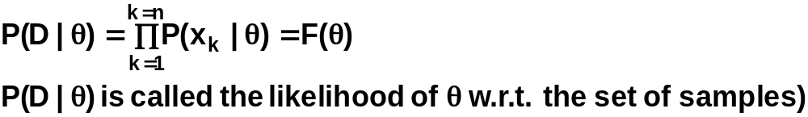

    Use the information in training samples to estimate
    θ = (θ₁, θ₂, …, θ_{c}); θ_{i} (i = 1, 2, …, c) is associated with the ith category
    Suppose sample set D contains n iid samples, x₁, x₂,…, x_{n}
    ML estimate of θ is, by definition, the value that maximizes P(D | θ)
    “It is the value of θ that best agrees with the actually observed training samples”
Pattern Classification, Chapter 3
2

Slide 8
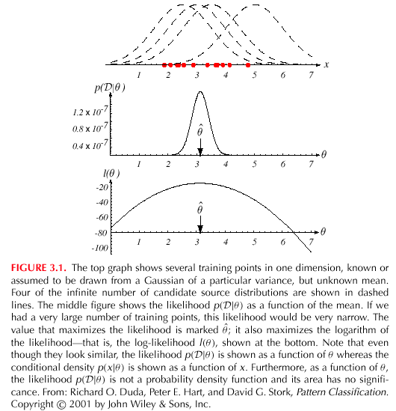
Pattern Classification, Chapter 3
2

Slide 9
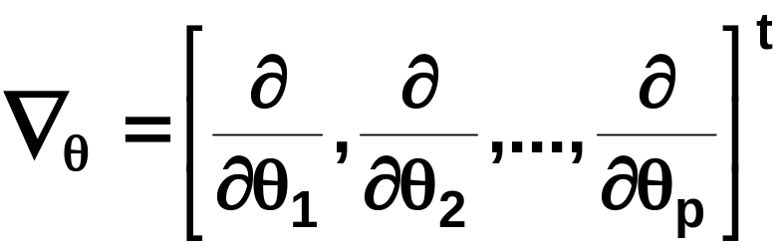
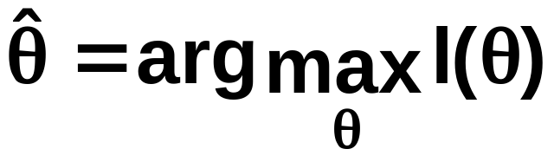
    Optimal estimation
      Let θ = (θ₁, θ₂, …, θ_{p})^{t} and ∇_{θ} be the gradient operator
      We define l(θ) as the log-likelihood function
      l(θ) = ln P(D | θ)
      New problem statement:
      determine θ that maximizes the log-likelihood
Pattern Classification, Chapter 3
2

Slide 10
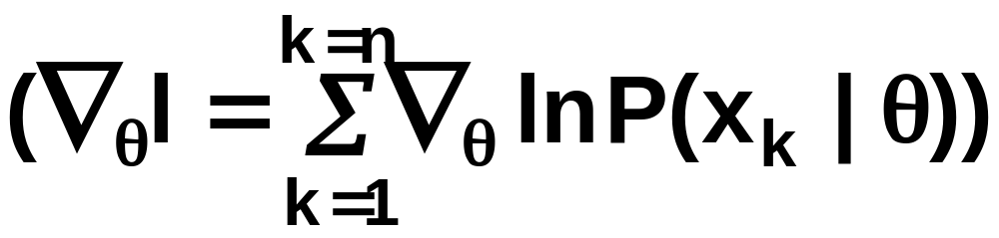
    Set of necessary conditions for an optimum is:
    ∇_{θ}l = 0
Pattern Classification, Chapter 3
2

Slide 11
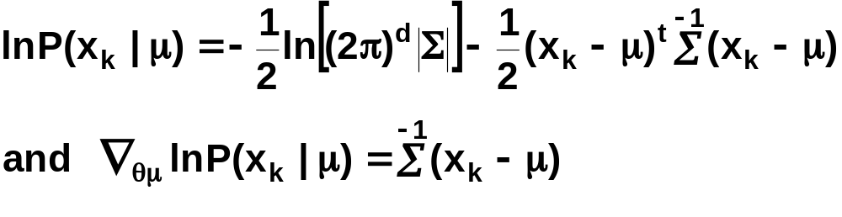
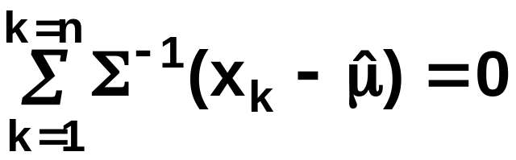
Example of a specific case: unknown μ
  P(x | μ) ~ N(μ, Σ)
  (Samples are drawn from a multivariate normal population)
  θ = μ, therefore the ML estimate for μ must satisfy:
Pattern Classification, Chapter 3
2

Slide 12
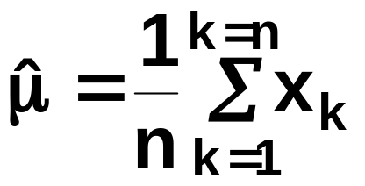
    Multiplying by Σ and rearranging, we obtain:
    which is the arithmetic average or the mean of the samples of the training samples!
Conclusion:
    Given P(x_{k} | ω_{j}), j = 1, 2, …, c to be Gaussian in a d-dimensional feature space, estimate the vector θ = (θ₁, θ₂, …, θ_{c})^{t} and perform a classification using the Bayes decision rule of chapter 2!
Pattern Classification, Chapter 3
2

Slide 13
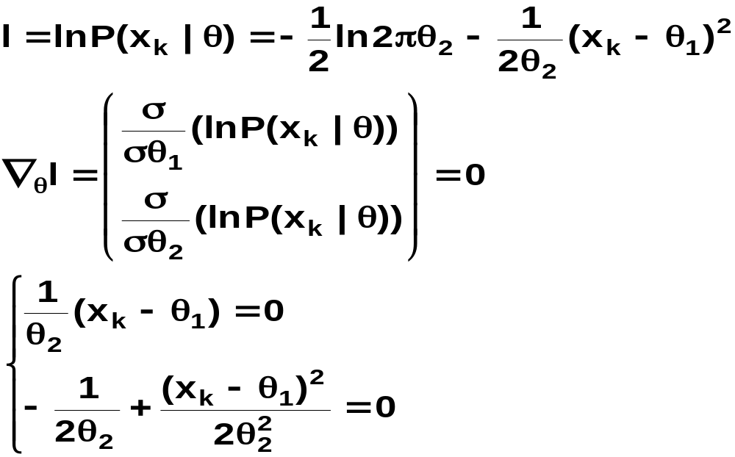
ML Estimation:
  Univariate Gaussian Case: unknown μ & σ
  θ = (θ₁, θ₂) = (μ, σ²)
Pattern Classification, Chapter 3
2

Slide 14
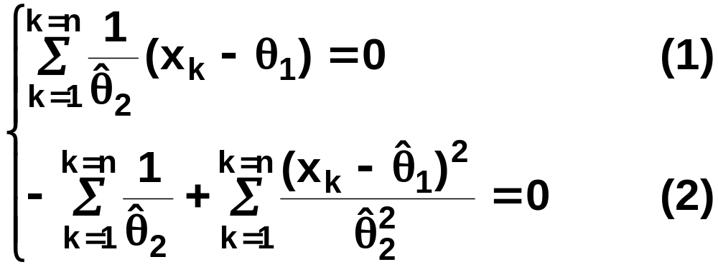
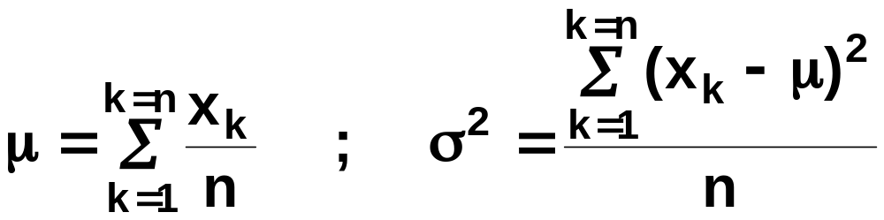
Summation:
Combining (1) and (2), one obtains:
Pattern Classification, Chapter 3
2

Slide 15
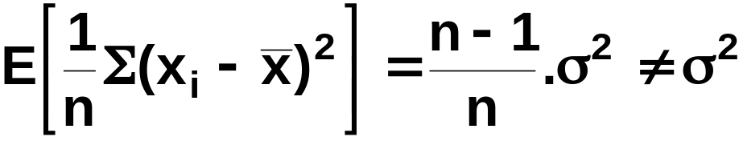
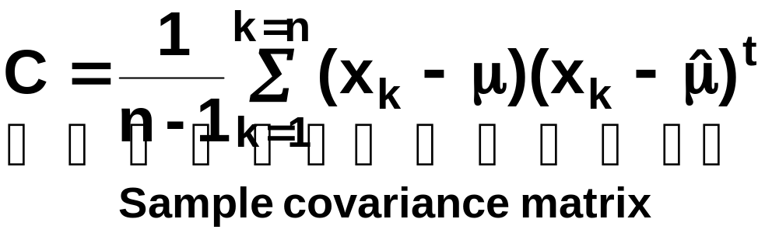
Bias
  ML estimate for σ² is biased
  An unbiased estimator for Σ is:
Pattern Classification, Chapter 3
2

Slide 16
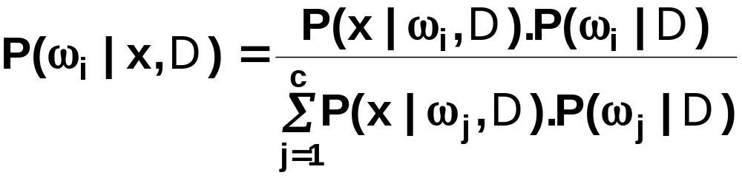
Bayesian Estimation (Bayesian learning approach for pattern classification problems)
  In MLE θ was supposed to have a fixed value
  In BE θ is a random variable
  The computation of posterior probabilities P(ω_{i} | x) lies at the heart of Bayesian classification
  Goal: compute P(ω_{i} | x, D)
  Given the training sample set D, Bayes formula can be written
Pattern Classification, Chapter 1
3

Slide 17
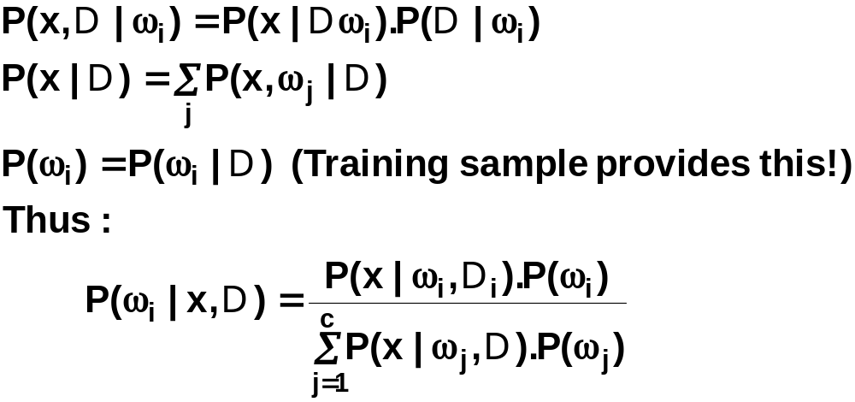
To demonstrate the preceding equation, use:
Pattern Classification, Chapter 1
3

Slide 18
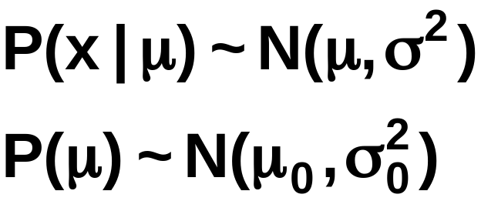
Bayesian Parameter Estimation: Gaussian Case
Goal: Estimate θ using the a-posteriori density P(θ | D)
  The univariate Gaussian case: P(μ | D)
  μ is the only unknown parameter
  μ₀ and σ₀ are known!
Pattern Classification, Chapter 1
4

Slide 19
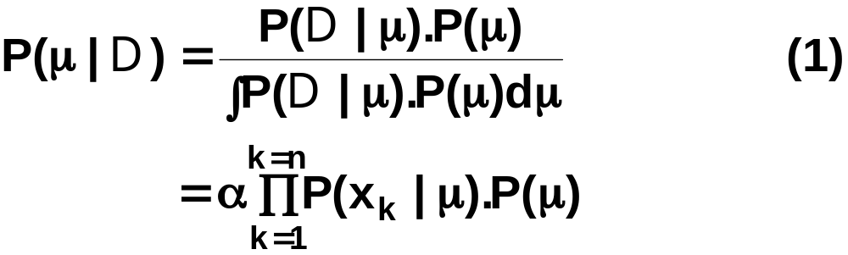
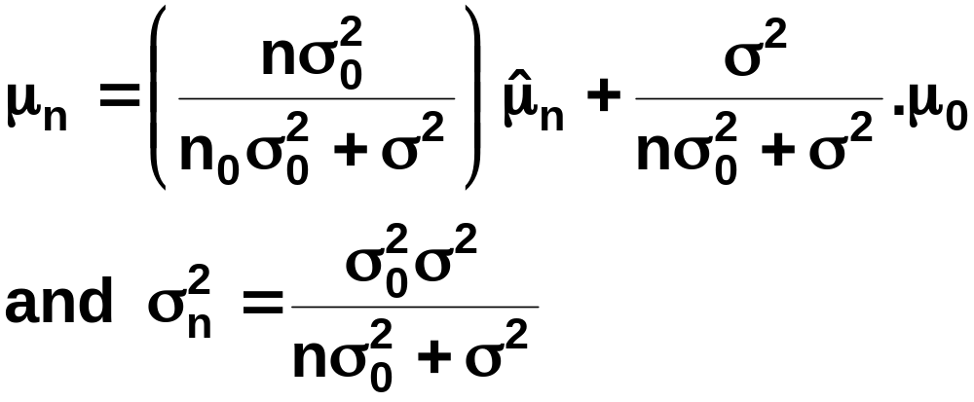
  Reproducing density
  The updated parameters of the prior:
Pattern Classification, Chapter 1
4

Slide 20
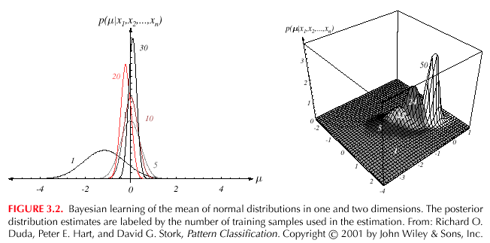
Pattern Classification, Chapter 1
4

Slide 21
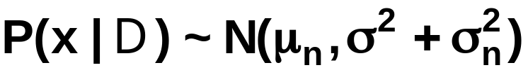
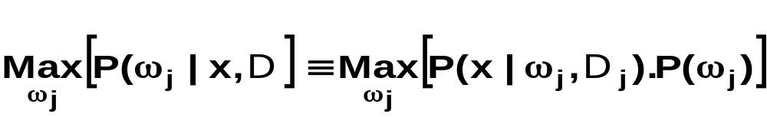
  The univariate case P(x | D)
    P(μ | D) has been computed
    P(x | D) remains to be computed!
    It provides:
    Desired class-conditional density P(x | D_{j}, ω_{j})
    P(x | D_{j}, ω_{j}) together with P(ω_{j}) and using Bayes formula, we obtain the Bayesian classification rule:
Pattern Classification, Chapter 1
4

Slide 22
Bayesian Parameter Estimation: General Theory
  P(x | D) computation can be applied to any situation in which the unknown density can be parametrized: the basic assumptions are:
    The form of P(x | θ) is assumed known, but the value of θ is not known exactly
    Our knowledge about θ is assumed to be contained in a known prior density P(θ)
    The rest of our knowledge about θ is contained in a set D of n random variables x₁, x₂, …, x_{n} that follows P(x)
Pattern Classification, Chapter 1
5

Slide 23
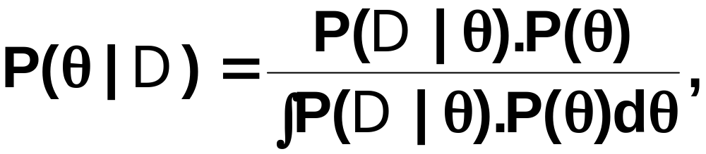
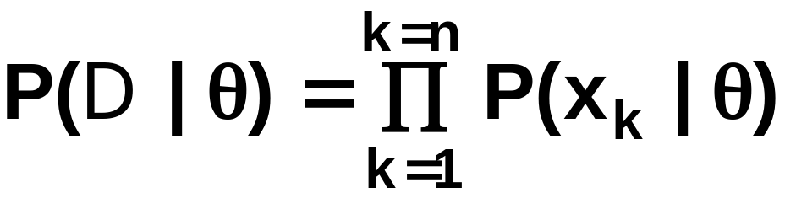
The basic problem is:
“Compute the posterior density P(θ | D)”
then “Derive P(x | D)”
Using Bayes formula, we have:
And by independence assumption:
Pattern Classification, Chapter 1
5

Slide 24
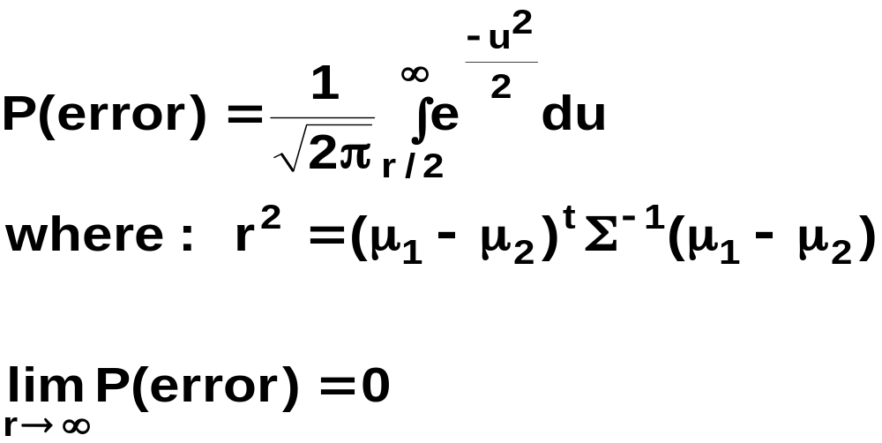
Problem of Dimensionality
  Classification problems with large number of features (hundreds or even thousands) is frequently encountered
    Classification accuracy depends upon the the number of features (dimensionality), their discrimination ability and the amount of training data
    Two-class multivariate normal with the same covariance matrix
Pattern Classification, Chapter 1
7

Slide 25
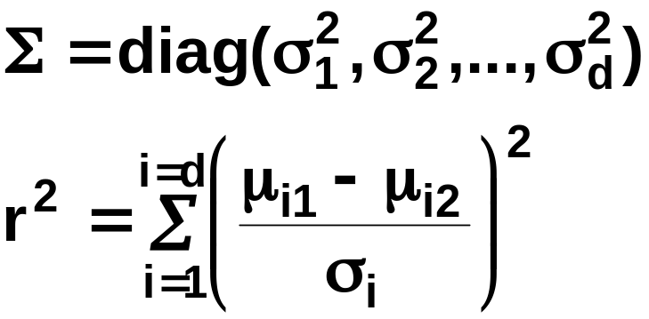
    If features are independent then:
    This shows how each feature contributes to reducing the probability of error. Most useful features are the ones for which the difference between the means is large relative to the standard deviation
    An obvious way to reduce the error further is to introduce new, independent feature.
    It has frequently been observed in practice that, when the number of training samples is small, beyond a certain point, the inclusion of additional features leads to worse rather than better performance: (i) we have the wrong model, (ii) small no. of available training samples to estimate parameters
Pattern Classification, Chapter 1
7

Slide 26
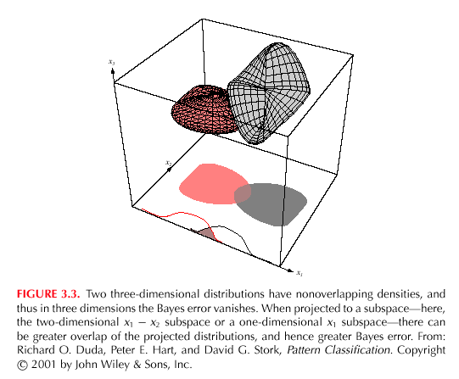
7
7
Pattern Classification, Chapter 1
7

Slide 27
Component Analysis and Discriminants
  Combine features in order to reduce the dimension of the feature space
  Linear combinations are simple to compute and tractable
  Project high dimensional data onto a lower dimensional space
  Two classical approaches for finding “optimal” linear transformation
    PCA (Principal Component Analysis) “Projection that best represents the data in a least- square sense”
    MDA (Multiple Discriminant Analysis) “Projection that best separates the data in a least-squares sense”
Pattern Classification, Chapter 1
8

