Slide 1
3. Bayes Decision Theory: Part II.
Prof. A.L. Yuille
Stat 231. Fall 2004.

Slide 2
Bayes Decision Theory: Part II
1. Two-state case. Bounds for Risk.
Multiple Samples.
ROC curve and Signal Detection Theory.

Slide 3
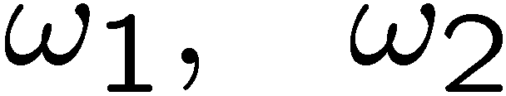
Two-State Case
Detect state
Let loss function pay a penalty of 1 for misclassification, 0 otherwise.
Risk becomes Error.
Bayes Risk becomes Bayes Error.
Want to put bounds on the error.

Slide 4
Error Bounds:
Use bounds to estimate errors. Bayes error:
By
We have:
with

Slide 5
Chernoff and Bhatta
(I) the Bhattarcharyya bound
with Bhattarcharyya coefficient:
(II) the Chernoff bound
With Chernoff Information:

Slide 6
Chernoff and Bhatta
Chernoff bound is tighter than the Bhatta bound.
Both bounds are often good approximations – see Duda, Hart, Stork (pp 44, 48 example 1).
There is also a lower bound:
Bhatta and Chernoff will appear as exact errors rates for many samples.

Slide 7
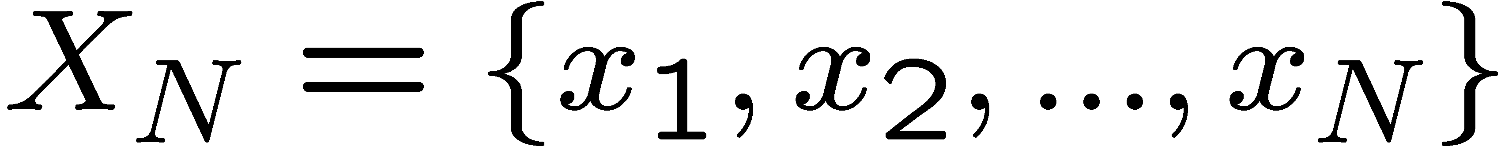
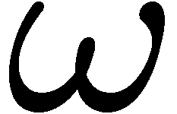
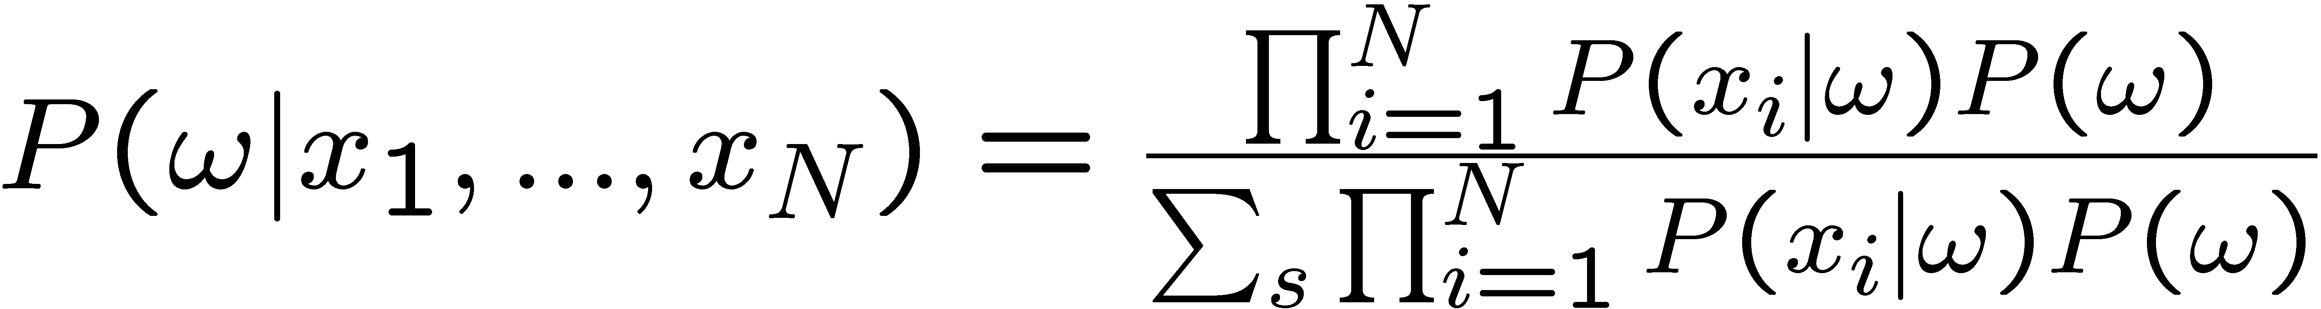
Multiple Samples
N Samples
All from =A, or all from =B. (Bombers or Birds).
Independence Assumption.

Slide 8
Multiple Samples
Prior becomes unimportant for large N.
Task becomes easier.
Gaussian example:
Then
where

Slide 9
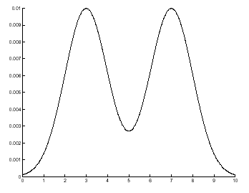
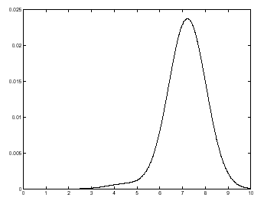
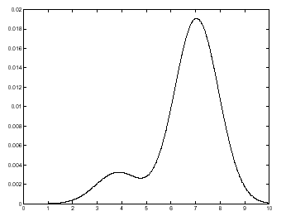
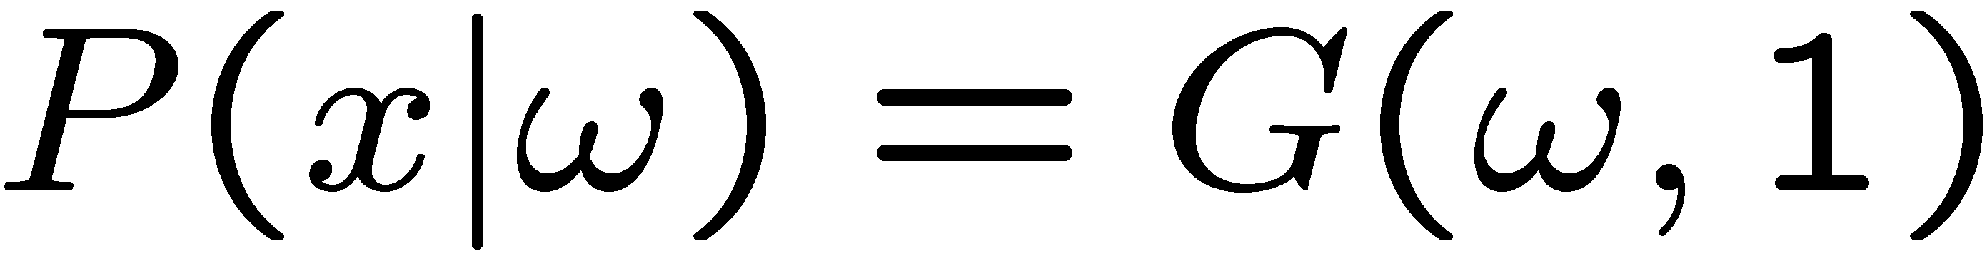
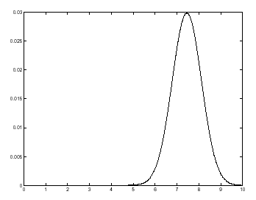
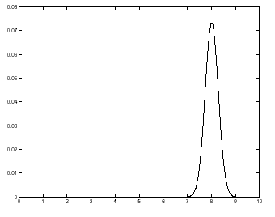
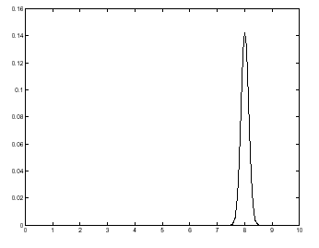
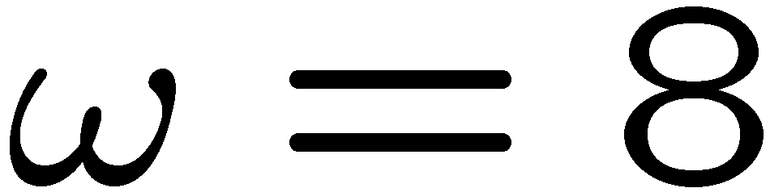
Probabilities of N Samples
Posterior Distributions tend to Gaussians. (Central Limit Theorem). (Assumes independence or semi-independence).
Results for N=0,1,2,3,50,200. (Left to Right, Top to Bottom).

Slide 10
Error Rates for Large N
The error rate E(N) decreases exponentially with the number N of samples.
The Chernoff information:
Recall for a single sample we have:

Slide 11
ROC curves
Receiver Operator Characteristics (ROC) curves are more general than Bayes risk.
Compare the performance of a human observer to Bayesian ideal for bright/dim light test.
Suppose human does worse than Bayes risk--then maybe this is only decision bias.

Slide 12
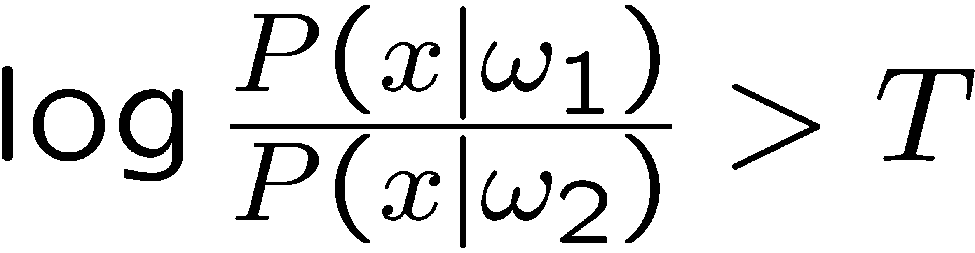
ROC Curves:
For two-state problems, the Bayes decision rule is
where T depends on the priors and the loss function.
The observer may use the correct log-likelihood ratio, but have the wrong threshold.
E.g. the observer’s loss function may penalize false negatives (trigger-shy) or false positives (trigger-happy).

Slide 13
ROC Curves
The ROC curve plots the proportion of correct responses (hits) against the false positives as the threshold T changes.
Requires altering the loss function of observers by rewards (chocolate) and penalties (electric shocks).
The ROC curve gives information which is independent of the observer’s loss function.

Slide 14
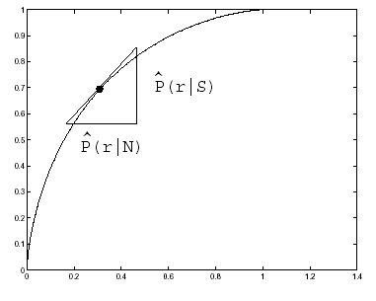
ROC Curves.
Plot hits against false positives. For T large & +ve, bottom left of
curve. T large & -ve, top right of curve. Tangent at 45 deg.s at T=0.

Slide 15
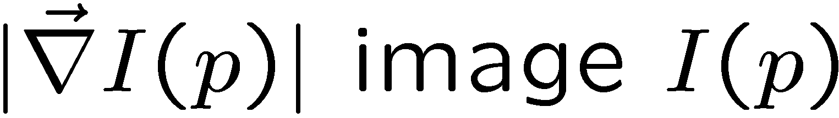
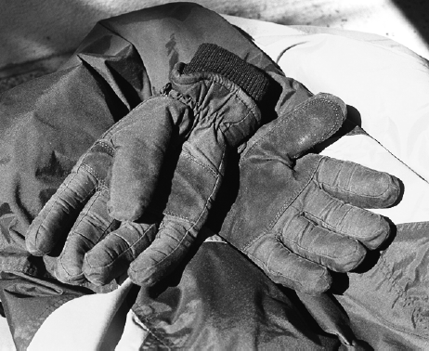
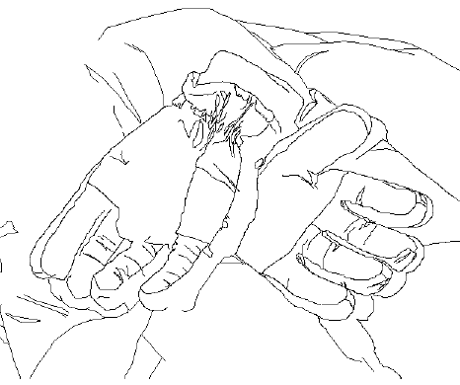
Example: Boundary Detection 1.
The boundaries of objects (right) usually occur where the image intensity gradient is large (left).

Slide 16
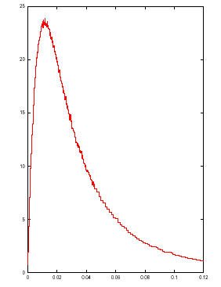
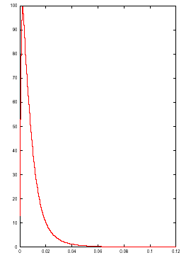
Example: Boundary Detection 2.
Learn the probability distributions for intensity gradient on and off labeled edges.

Slide 17
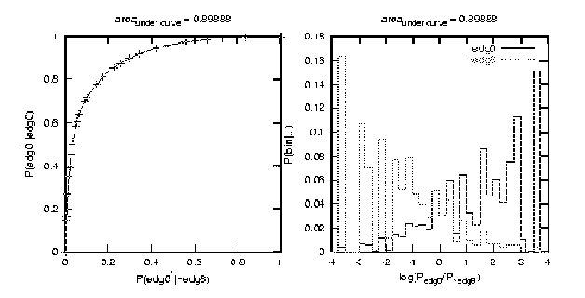
Boundary Detection 3.
Perform edge detection by log-likelihood ratio test.

Slide 18
ROC Curves:
Special case: the likelihood functions are Gaussians with different means but same variance. Important in Psychology. See Duda, Hart, Stork.
The Bayes Error can be computed from ROC curve.
ROC curves distinguish between Discriminability and Decision Bias.

Slide 19
. Summary
Bounds on Error rates for single data. Bhatta and Chernoff Bounds.
Multiple Samples. Error rates fall off exponentially with number of samples. Chernoff coefficient.
ROC curves (Signal Detection Theory).

