Slide 1
Introduction to Bayesian Learning
Ata Kaban
A.Kaban@cs.bham.ac.uk
School of Computer Science
University of Birmingham

Slide 2
Overview
Today we learn:
Bayesian classification
  E.g. How to decide if a patient is ill or healthy, based on
    A probabilistic model of the observed data
    Prior knowledge

Slide 3
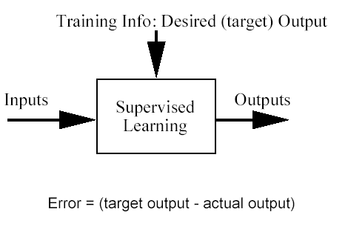
Classification problem
Training data: examples of the form (d,h(d))
  where d are the data objects to classify (inputs)
  and h(d) are the correct class info for d, h(d)∈{1,…K}
Goal: given d_{new}, provide h(d_{new})

Slide 4
Why Bayesian?
Provides practical learning algorithms
  E.g. Naïve Bayes
Prior knowledge and observed data can be combined
It is a generative (model based) approach, which offers a useful conceptual framework
  E.g. sequences could also be classified, based on a probabilistic model specification
  Any kind of objects can be classified, based on a probabilistic model specification

Slide 5
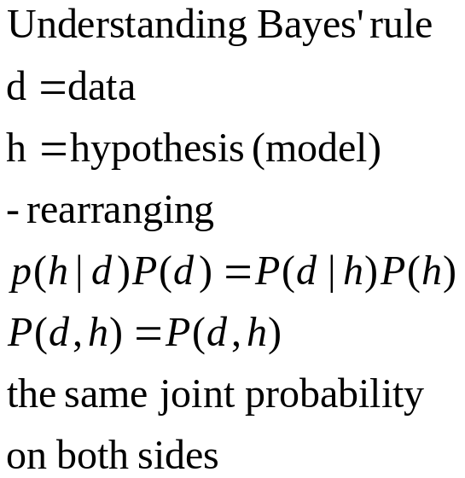
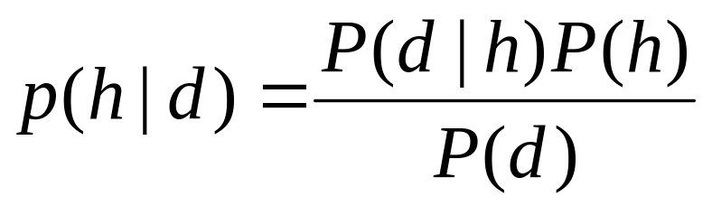
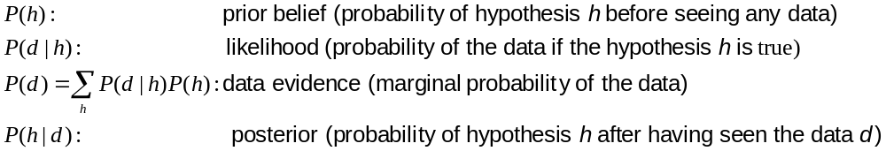
Bayes’ Rule
Who is who in Bayes’ rule

Slide 6
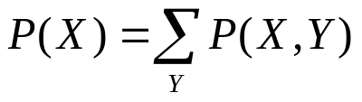
Probabilities – auxiliary slide for memory refreshing
Have two dice h₁ and h₂
The probability of rolling an i given die h₁ is denoted P(i|h₁). This is a conditional probability
Pick a die at random with probability P(h_{j}), j=1 or 2. The probability for picking die h_{j} and rolling an i with it is called joint probability and is P(i, h_{j})=P(h_{j})P(i| h_{j}).
For any events X and Y, P(X,Y)=P(X|Y)P(Y)
If we know P(X,Y), then the so-called marginal probability P(X) can be computed as

Slide 7
Does patient have cancer or not?
A patient takes a lab test and the result comes back positive. It is known that the test returns a correct positive result in only 98% of the cases and a correct negative result in only 97% of the cases. Furthermore, only 0.008 of the entire population has this disease.
  1. What is the probability that this patient has cancer?
  2. What is the probability that he does not have cancer?
  3. What is the diagnosis?

Slide 8
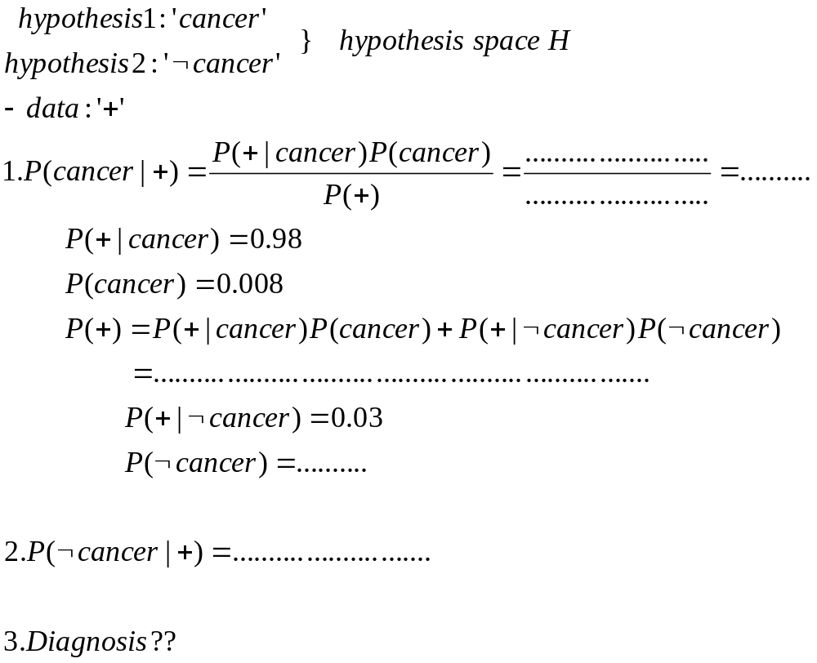

Slide 9
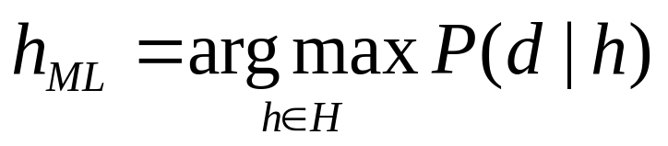
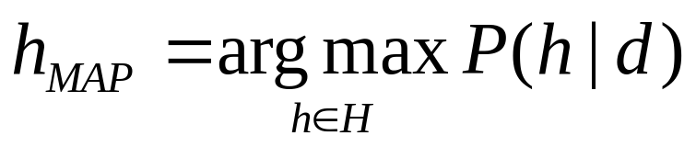
Choosing Hypotheses
Maximum Likelihood hypothesis:
Generally we want the most probable hypothesis given training data.This is the maximum a posteriori hypothesis:
  Useful observation: it does not depend on the denominator P(d)

Slide 10
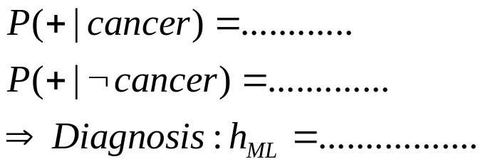
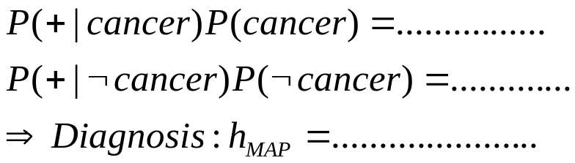
Now we compute the diagnosis
  To find the Maximum Likelihood hypothesis, we evaluate P(d|h) for the data d, which is the positive lab test and chose the hypothesis (diagnosis) that maximises it:
  To find the Maximum A Posteriori hypothesis, we evaluate P(d|h)P(h) for the data d, which is the positive lab test and chose the hypothesis (diagnosis) that maximises it. This is the same as choosing the hypotheses gives the higher posterior probability.

Slide 11
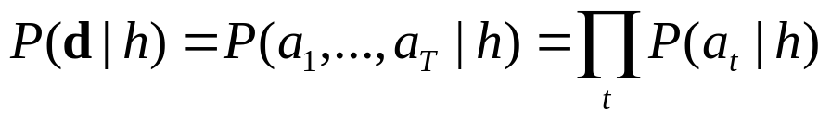
Naïve Bayes Classifier
What can we do if our data d has several attributes?
Naïve Bayes assumption: Attributes that describe data instances are conditionally independent given the classification hypothesis
  it is a simplifying assumption, obviously it may be violated in reality
  in spite of that, it works well in practice
The Bayesian classifier that uses the Naïve Bayes assumption and computes the MAP hypothesis is called Naïve Bayes classifier
One of the most practical learning methods
Successful applications:
  Medical Diagnosis
  Text classification

Slide 12
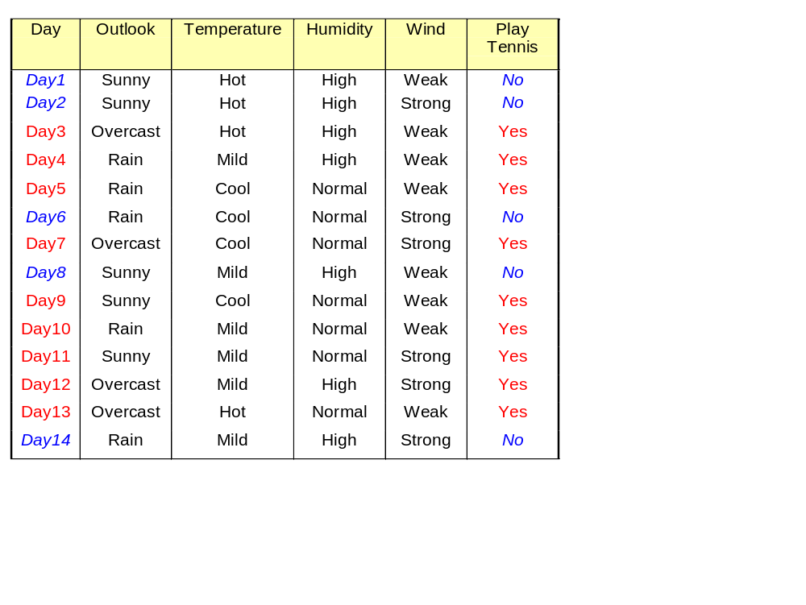
Example. ‘Play Tennis’ data

Slide 13


Naïve Bayes solution
Classify any new datum instance x=(a₁,…a_{T}) as:
To do this based on training examples, we need to estimate the parameters from the training examples:
  For each target value (hypothesis) h
  For each attribute value a_{t} of each datum instance

Slide 14
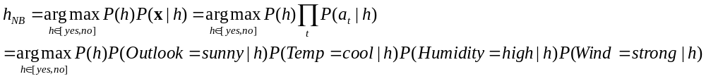
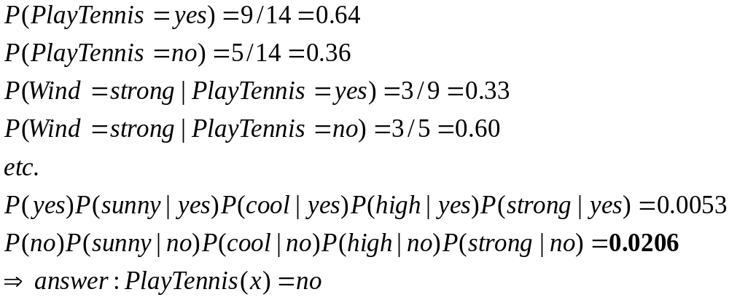
Based on the examples in the table, classify the following datum x:
x=(Outl=Sunny, Temp=Cool, Hum=High, Wind=strong)
That means: Play tennis or not?
Working:

Slide 15
Learning to classify text
Learn from examples which articles are of interest
The attributes are the words
Observe the Naïve Bayes assumption just means that we have a random sequence model within each class!
NB classifiers are one of the most effective for this task
Resources for those interested:
  Tom Mitchell: Machine Learning (book) Chapter 6.

Slide 16
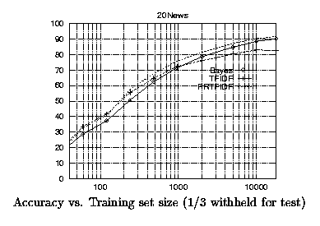
Results on a benchmark text corpus

Slide 17
Remember
Bayes’ rule can be turned into a classifier
Maximum A Posteriori (MAP) hypothesis estimation incorporates prior knowledge; Max Likelihood doesn’t
Naive Bayes Classifier is a simple but effective Bayesian classifier for vector data (i.e. data with several attributes) that assumes that attributes are independent given the class.
Bayesian classification is a generative approach to classification

Slide 18
Resources
Textbook reading (contains details about using Naïve Bayes for text classification):
  Tom Mitchell, Machine Learning (book), Chapter 6.
Software: NB for classifying text:
  http://www-2.cs.cmu.edu/afs/cs/project/theo-11/www/naive-bayes.html
Useful reading for those interested to learn more about NB classification, beyond the scope of this module:
  http://www-2.cs.cmu.edu/~tom/NewChapters.html

