Slide 1
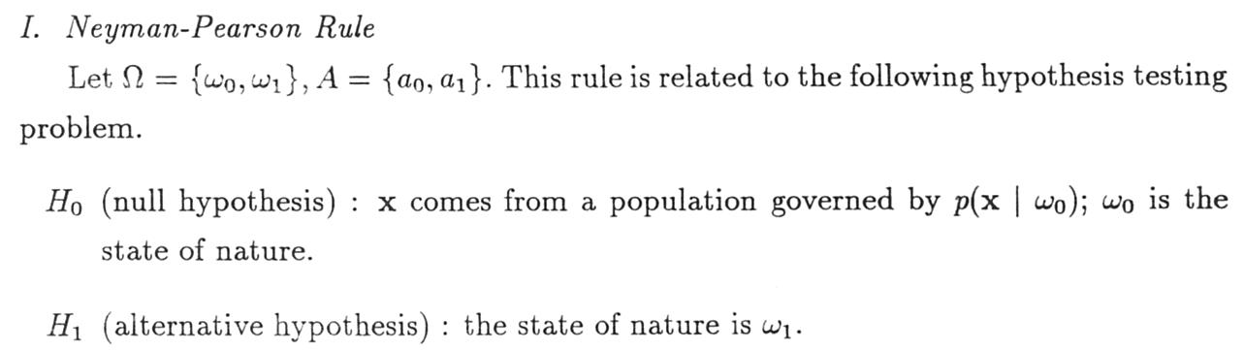
Neyman-Pearson Rule

Slide 2
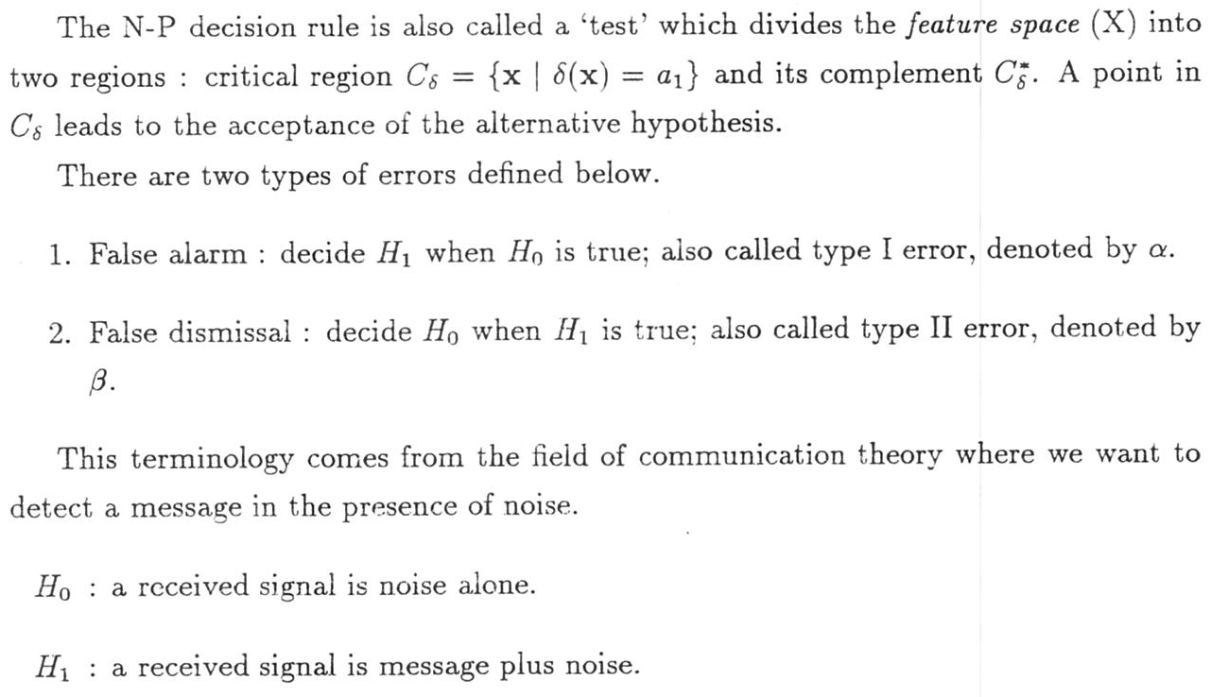
Neyman-Pearson Rule

Slide 3
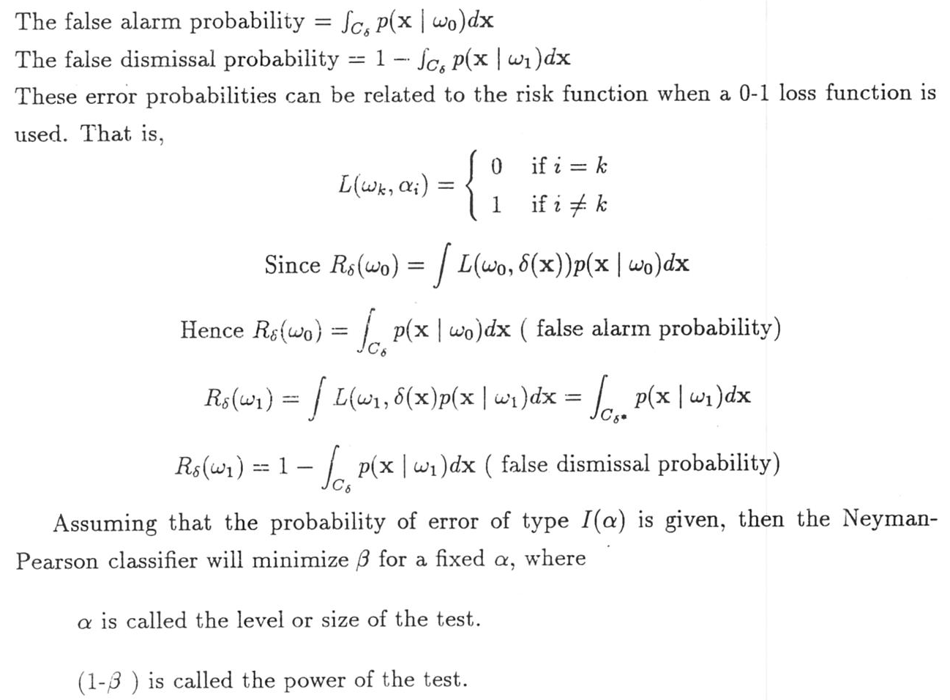
Neyman-Pearson Rule

Slide 4
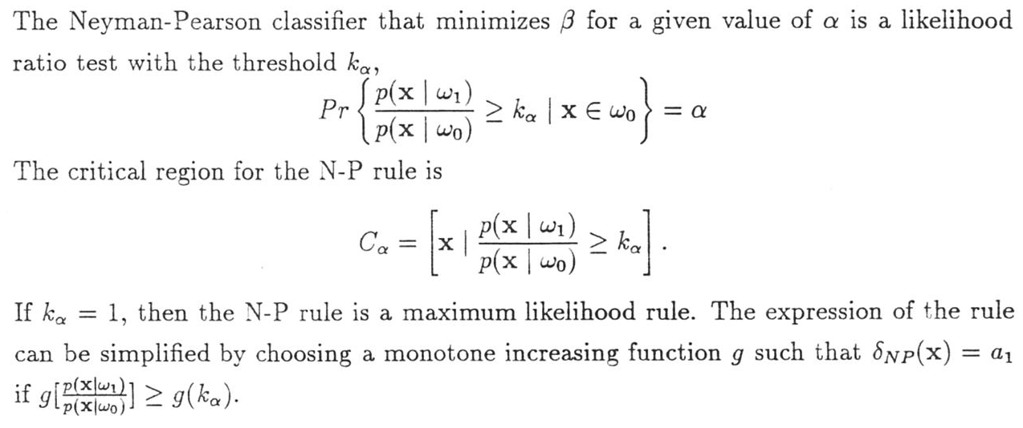
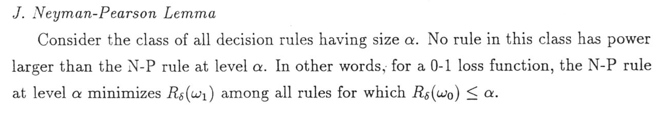
Neyman-Pearson Rule

Slide 5
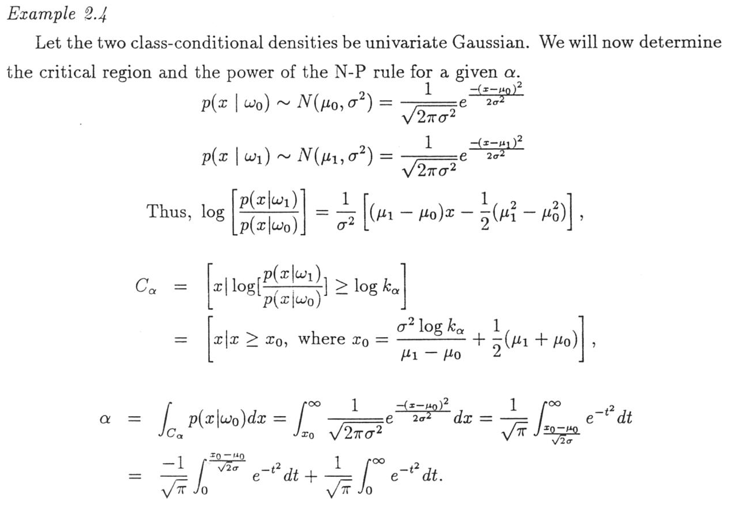
Neyman-Pearson Rule

Slide 6
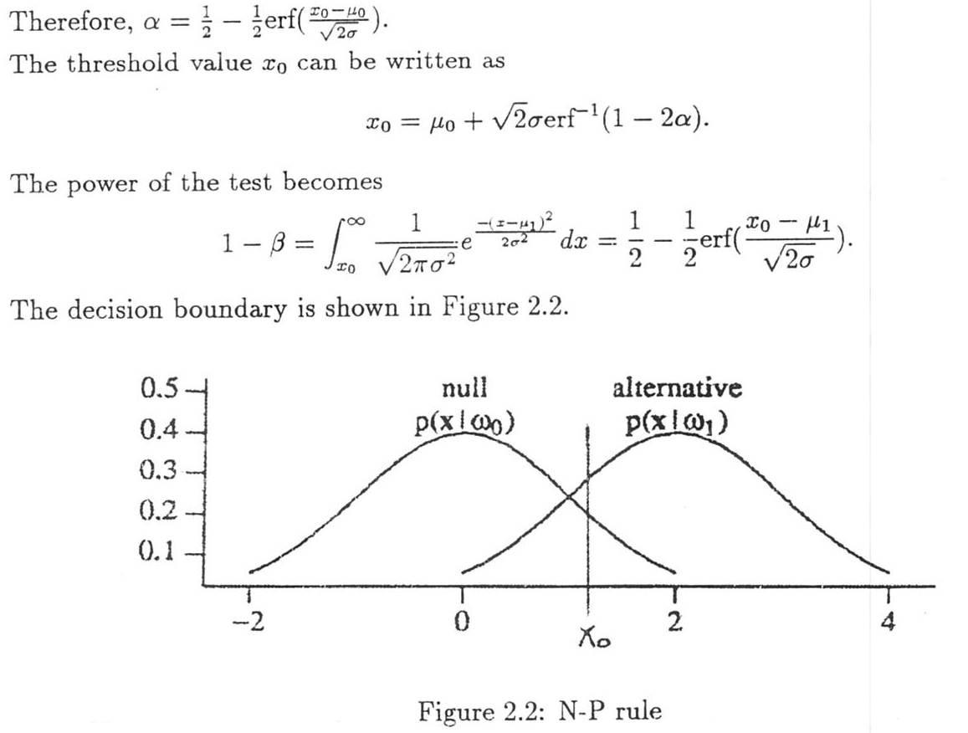
Neyman-Pearson Rule

