Slide 1
An Efficient Representation for Irradiance Environment Maps
Ravi Ramamoorthi
Pat Hanrahan
Stanford University

Slide 2
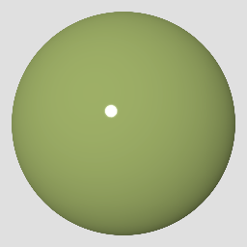
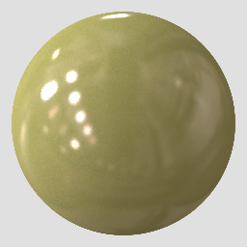
Natural Illumination
People perceive materials more easily under natural illumination than simplified illumination.
Images courtesy Ron Dror and Ted Adelson

Slide 3
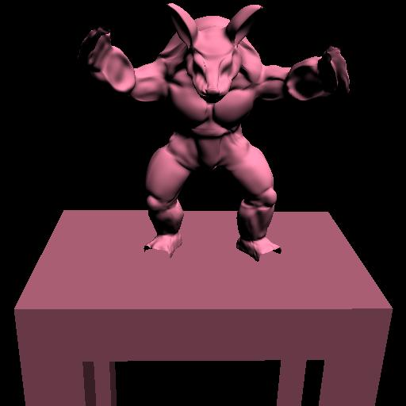
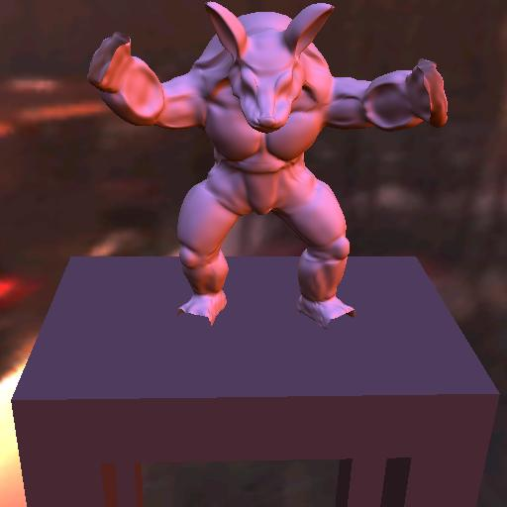
Natural Illumination
Classically, rendering with natural illumination is very expensive compared to using simplified illumination
Directional Source
Natural Illumination

Slide 4

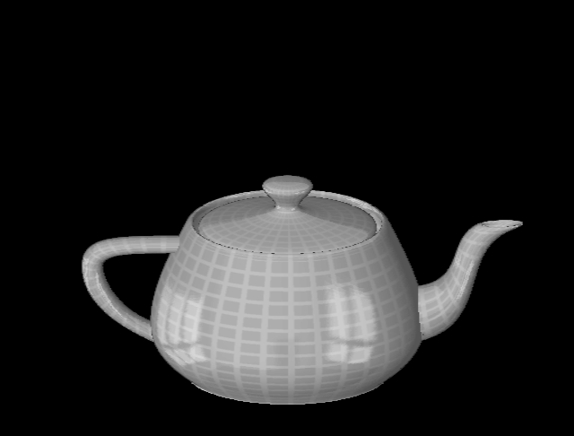
Reflection Maps
Blinn and Newell, 1976

Slide 5
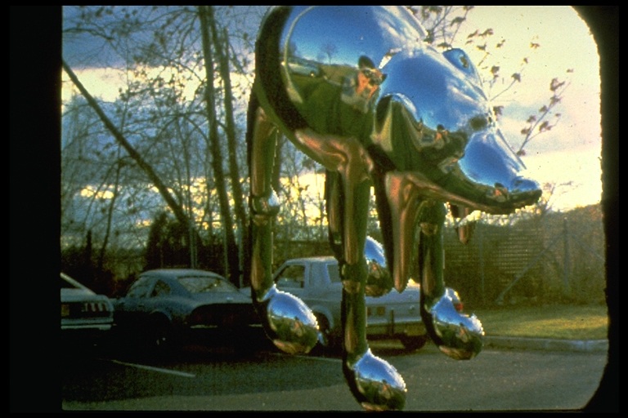
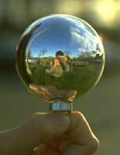
Environment Maps
Miller and Hoffman, 1984

Slide 6
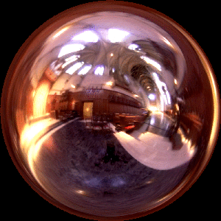
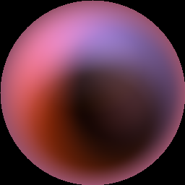
Irradiance Environment Maps
R
N
Incident Radiance
(Illumination Environment Map)
Irradiance Environment Map

Slide 7
Assumptions
Diffuse surfaces
Distant illumination
No shadowing, interreflection
Hence, Irradiance is a function of surface normal

Slide 8
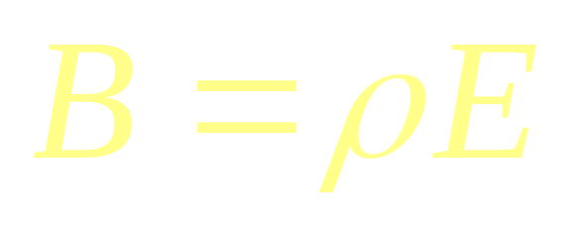
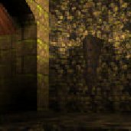
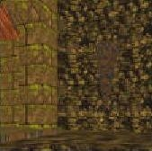
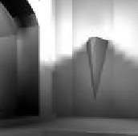
Diffuse Reflection
Radiosity
(image intensity)
Reflectance
(albedo/texture)
Irradiance
(incoming light)
=
×
quake light map

Slide 9
Previous Work
Precomputed (prefiltered) Irradiance maps [Miller and Hoffman 84, Greene 86, Cabral et al 87]
Irradiance volumes [Greger et al 98]
Global illumination [Wilkie et al 00]
Empirical: Irradiance varies slowly with surface normal
  Low resolution Irradiance maps
  Irradiance gradients [Ward 92]

Slide 10
New Theoretical Results
Analytic Irradiance Formula [Ramamoorthi Hanrahan 01, Basri Jacobs 01]
  Expand Radiance, Irradiance in basis functions
  Analytic formula for Irradiance coefficients
Key Results
  Irradiance approx. for all normals using 9 numbers
  Can be computed as quadratic polynomial

Slide 11
Contributions
Theory: frequency domain analysis
Efficient computation of Irradiance
Procedural rendering algorithm (no textures)
New representation: apply to lighting design

Slide 12
Computing Irradiance
Classically, hemispherical integral for each pixel
Lambertian surface is like low pass filter
Frequency-space analysis
Incident
Radiance
Irradiance

Slide 13


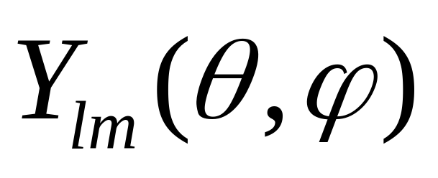


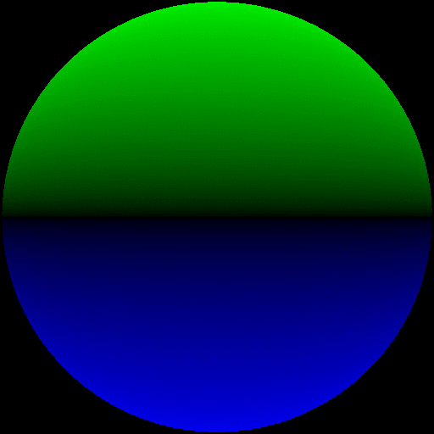
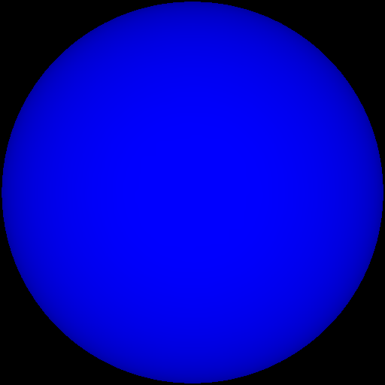

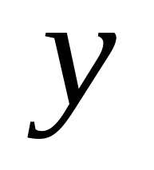


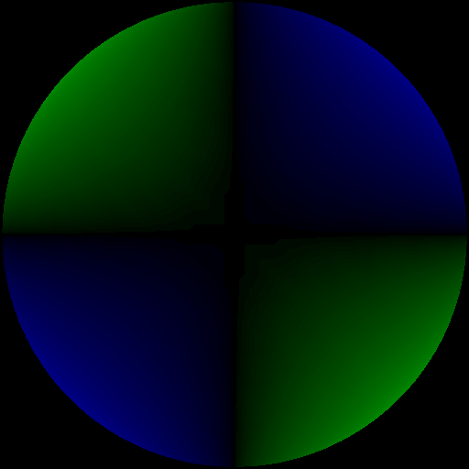
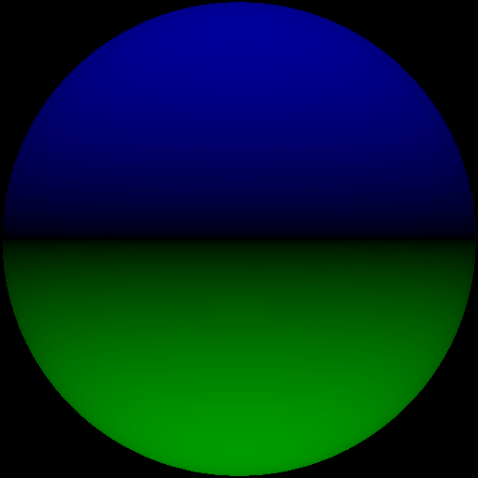
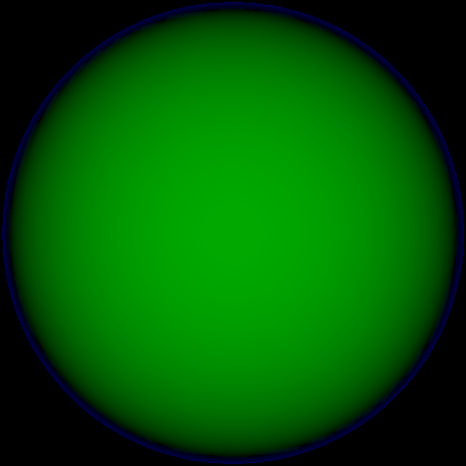

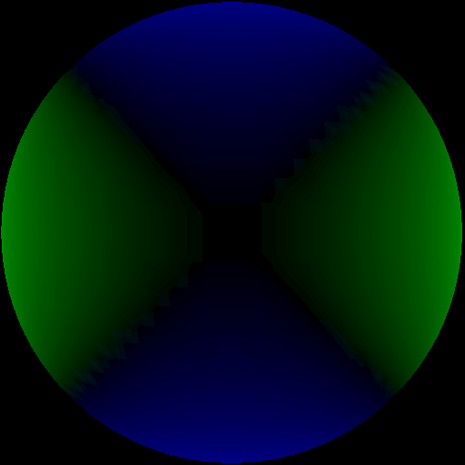
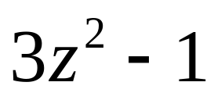
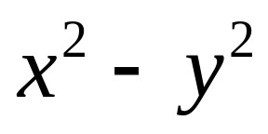
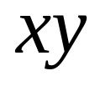
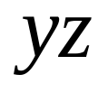

Spherical Harmonics
0
1
2
.
.
.
-2
-1
0
1
2

Slide 14
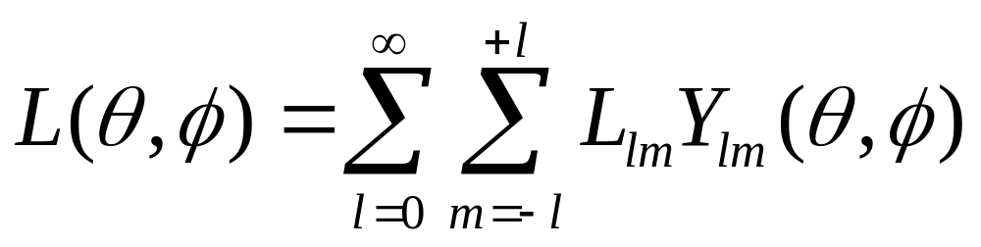
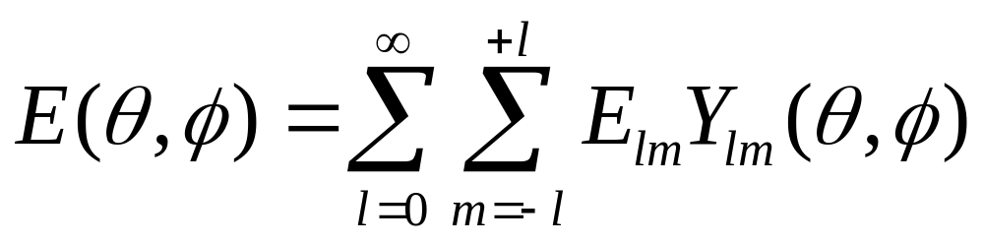
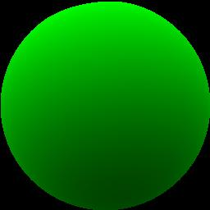
Spherical Harmonic Expansion
Expand lighting (L), irradiance (E) in basis functions
= .67
+ .36
+ …

Slide 15
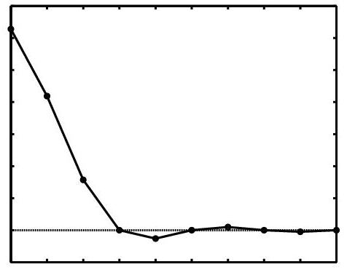



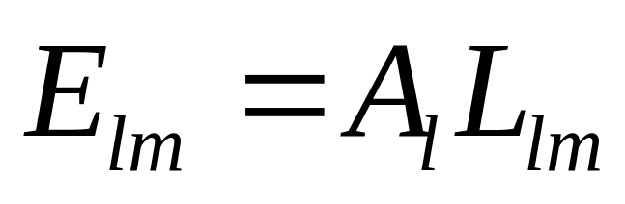


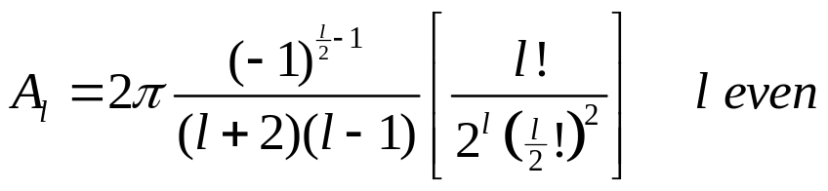
Analytic Irradiance Formula
Lambertian surface acts like low-pass filter
0
0
1
2

Slide 16
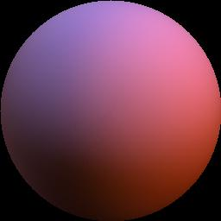

9 Parameter Approximation
Order 0
1 term
Exact image
RMS error = 25 %
0
1
2
-2
-1
0
1
2

Slide 17
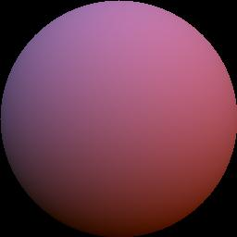
9 Parameter Approximation
Order 1
4 terms
Exact image
RMS Error = 8%
0
1
2
-2
-1
0
1
2

Slide 18
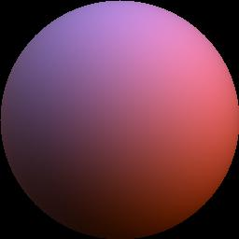
9 Parameter Approximation
Order 2
9 terms
Exact image
RMS Error = 1%
0
For any illumination, average
error < 3% [Basri Jacobs 01]
1
2
-2
-1
0
1
2

Slide 19
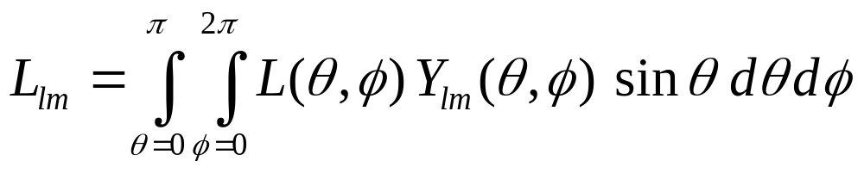
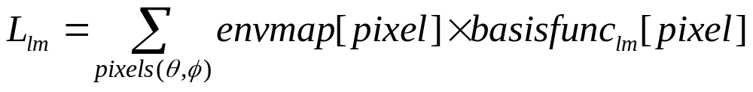
Computing Light Coefficients
Compute 9 lighting coefficients L_{lm}
  9 numbers instead of integrals for every pixel
  Lighting coefficients are moments of lighting
  Weighted sum of pixels in the environment map

Slide 20
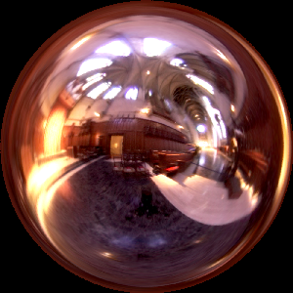
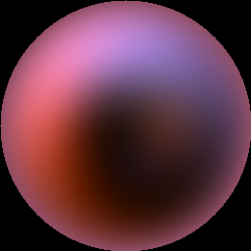


Comparison
Incident
illumination
300x300
Irradiance map
Texture: 256x256
Hemispherical
Integration 2Hrs
Irradiance map
Texture: 256x256
Spherical Harmonic
Coefficients 1sec

Slide 21
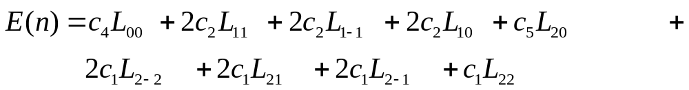
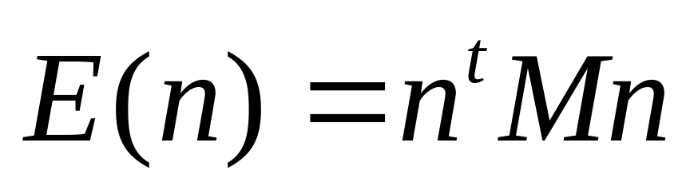
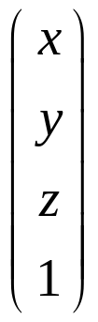
Rendering
Irradiance approximated by quadratic polynomial
4x4 matrix
(depends linearly
on coefficients L_{lm})
Surface Normal vector
column 4-vector

Slide 22
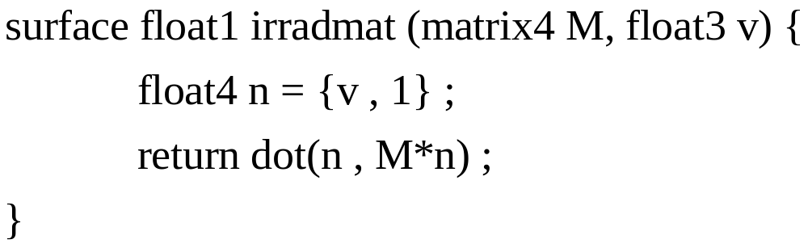
Hardware Implementation
Simple procedural rendering method (no textures)
  Requires only matrix-vector multiply and dot-product
  In software or NVIDIA vertex programming hardware

Slide 23
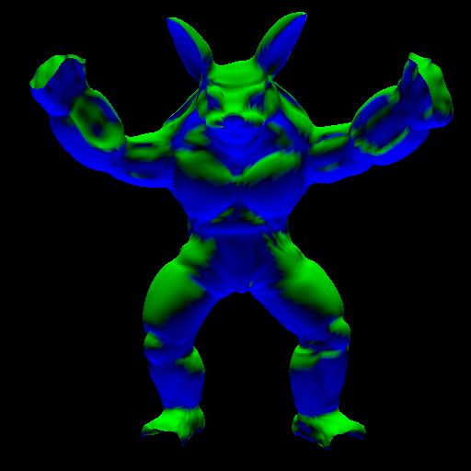
Complex Geometry
Assume no shadowing: Simply use surface normal

Slide 24

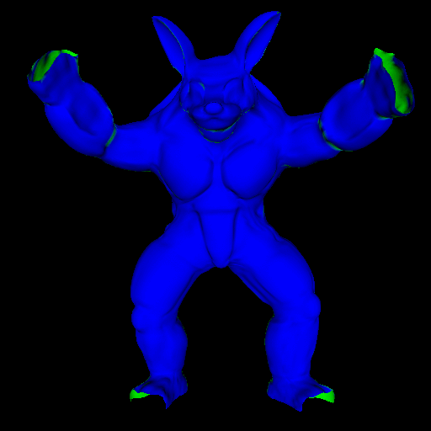
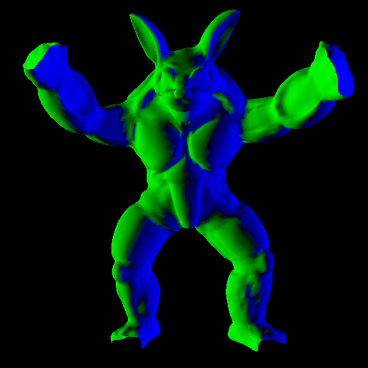
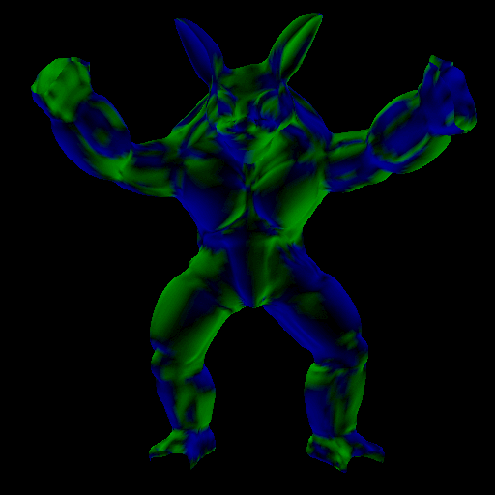
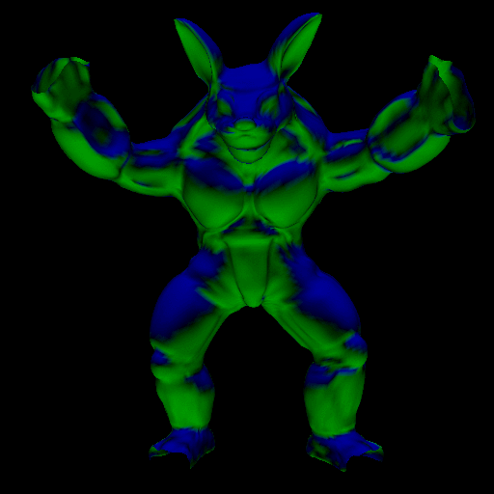
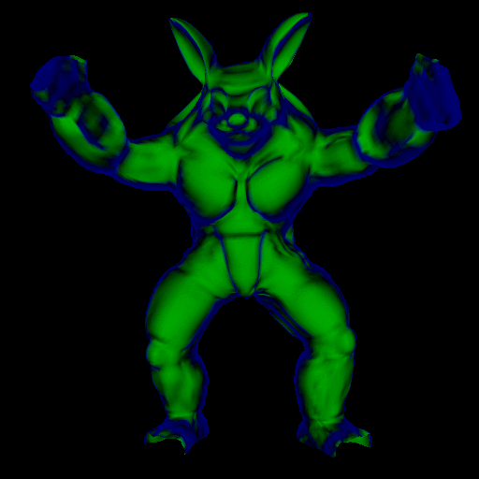
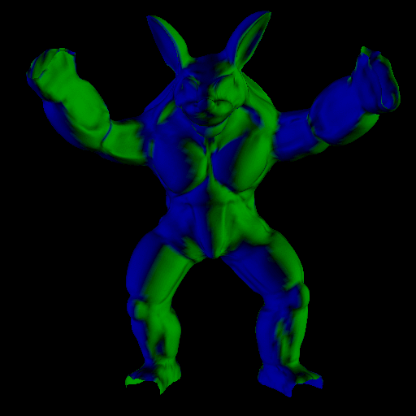
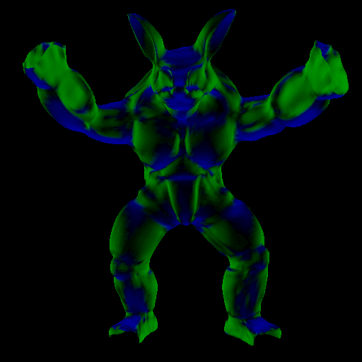
Lighting Design
Final image sum of 3D basis functions scaled by L_{lm}
  Alter appearance by changing weights of basis functions

Slide 25

Demo

Slide 26
Summary
Theory
  Analytic formula for irradiance
  Frequency-space: Spherical Harmonics
  To order 2, constant, linear, quadratic polynomials
  9 coefficients (up to order 2) suffice
Practical Applications
  Efficient computation of irradiance
  Simple procedural rendering
  New representation, many applications

Slide 27
Implications and Future Work
9 parameter model important in other areas
  Inverse Rendering (Wednesday) [SIGGRAPH 01]
  Lighting variability object recognition [CVPR 01]
Frequency space for rendering
  Environment maps with general BRDFs?
  Applications to offline rendering?
http://graphics.stanford.edu/papers/envmap/
  Source code, examples, links to theory paper,…

Slide 28
Acknowledgements
Stanford Real-Time Programmable Shading System
  Kekoa Proudfoot, Bill Mark
Readers of early drafts
  Bill Mark, Kekoa Proudfoot, Sean Anderson, David Koller, Ron Dror, anonymous reviewers
Models
  Armadillo: Venkat Krishnamurthy
  Light probes: Paul Debevec
Funding
  Hodgson-Reed Stanford Graduate Fellowship
  NSF ITR #0085864 “Interacting with the Visual World”

Slide 29
The End

Slide 30


Compare to Point Sources
Irradiance Map Texture
Quadratic Polynomial
6 Directional Light sources
Note Mach Banding

