Slide 1
3D Geometry for
Computer Graphics
Class 5

Slide 2
The plan today
Singular Value Decomposition
  Basic intuition
  Formal definition
  Applications

Slide 3
Geometric analysis of linear transformations
We want to know what a linear transformation A does
Need some simple and “comprehendible” representation of the matrix of A.
Let’s look what A does to some vectors
  Since A(αv) = αA(v), it’s enough to look at vectors v of unit length
A

Slide 4
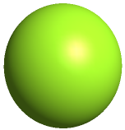
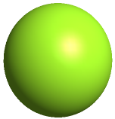
The geometry of linear transformations
A linear (non-singular) transform A always takes hyper-spheres to hyper-ellipses.
A
A

Slide 5
The geometry of linear transformations
Thus, one good way to understand what A does is to find which vectors are mapped to the “main axes” of the ellipsoid.
A
A

Slide 6
Geometric analysis of linear transformations
If we are lucky: A = V Λ V^{T}, V orthogonal (true if A is symmetric)
The eigenvectors of A are the axes of the ellipse
A

Slide 7
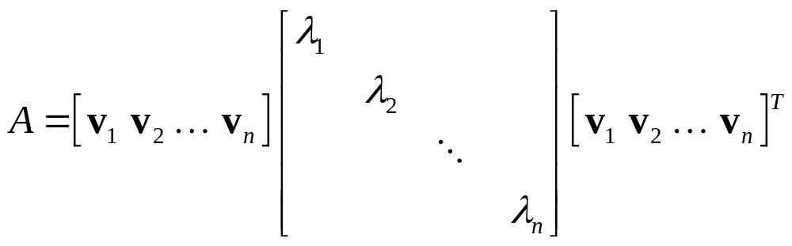
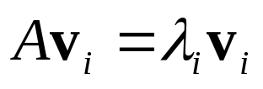
Symmetric matrix: eigen decomposition
In this case A is just a scaling matrix. The eigen decomposition of A tells us which orthogonal axes it scales, and by how much:
1
1
λ₁
A
λ₂

Slide 8
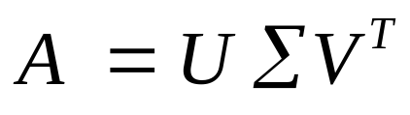
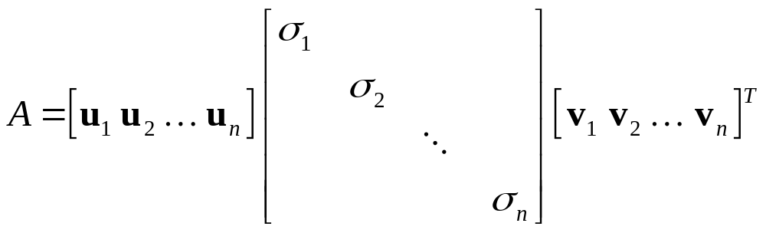
General linear transformations: SVD
In general A will also contain rotations, not just scales:
1
1
σ₂
σ₁
A

Slide 9
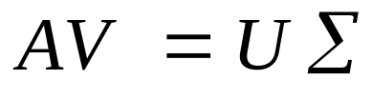
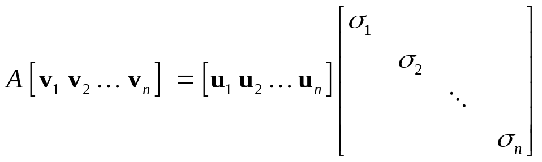
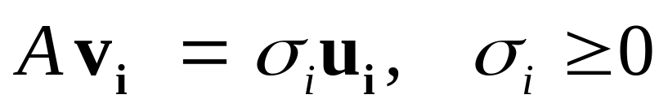
General linear transformations: SVD
1
1
σ₂
σ₁
A
orthonormal
orthonormal

Slide 10
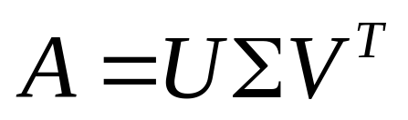



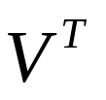
SVD more formally
SVD exists for any matrix
Formal definition:
  For square matrices A ∈ R^{n×n}, there exist orthogonal matrices U, V ∈ R^{n×n} and a diagonal matrix Σ, such that all the diagonal values σ_{i} of Σ are non-negative and
=

Slide 11
SVD more formally
The diagonal values of Σ (σ₁, …, σ_{n}) are called the singular values. It is accustomed to sort them: σ₁ ≥ σ₂≥ … ≥ σ_{n}
The columns of U (u₁, …, u_{n}) are called the left singular vectors. They are the axes of the ellipsoid.
The columns of V (v₁, …, v_{n}) are called the right singular vectors. They are the preimages of the axes of the ellipsoid.
=

Slide 12
Reduced SVD
For rectangular matrices, we have two forms of SVD. The reduced SVD looks like this:
  The columns of U are orthonormal
  Cheaper form for computation and storage
=

Slide 13
Full SVD
We can complete U to a full orthogonal matrix and pad Σ by zeros accordingly
=

Slide 14
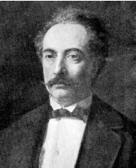
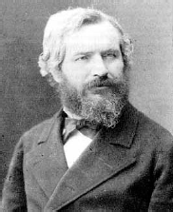
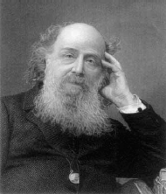
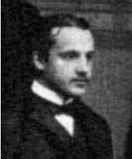
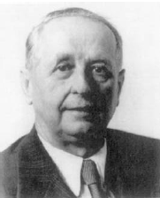
Some history
SVD was discovered by the following people:
E. Beltrami
(1835 − 1900)
M. Jordan
(1838 − 1922)
J. Sylvester
(1814 − 1897)
E. Schmidt
(1876-1959)
H. Weyl
(1885-1955)

Slide 15
SVD is the “working horse” of linear algebra
There are numerical algorithms to compute SVD. Once you have it, you have many things:
  Matrix inverse → can solve square linear systems
  Numerical rank of a matrix
  Can solve least-squares systems
  PCA
  Many more…

Slide 16
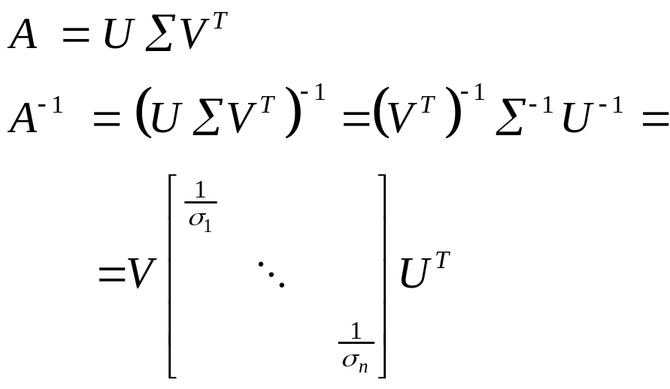
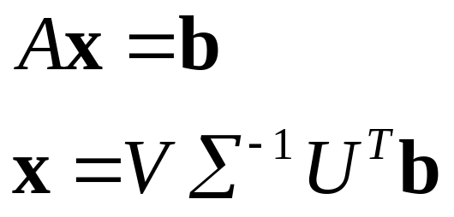
Matrix inverse and solving linear systems
Matrix inverse:
So, to solve

Slide 17
Matrix rank
The rank of A is the number of non-zero singular values
n
σ₁
σ₂
m
=
σ_{n}

Slide 18
Numerical rank
If there are very small singular values, then A is close to being singular. We can set a threshold t, so that numeric_rank(A) = #{σ_{i}| σ_{i} > t}
If rank(A) < n then A is singular. It maps the entire space R^{n} onto some subspace, like a plane (so A is some sort of projection).

Slide 19
PCA
We wanted to find principal components
y
y’
x’
x

Slide 20
PCA
Move the center of mass to the origin
  p_{i}’ = p_{i} − m
y
y’
x’
x

Slide 21
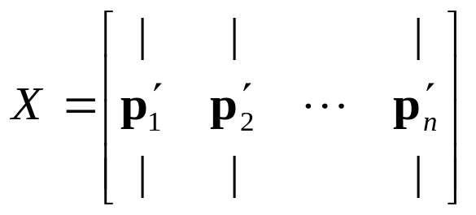
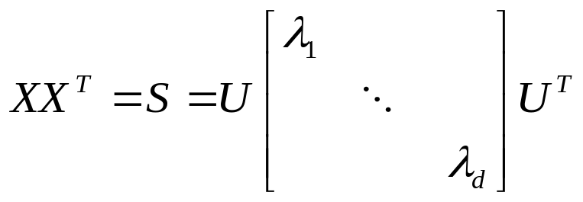
PCA
Constructed the matrix X of the data points.
The principal axes are eigenvectors of S = XX^{T}

Slide 22
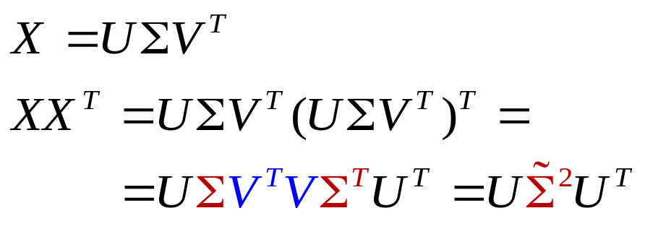
PCA
We can compute the principal components by SVD of X:
Thus, the left singular vectors of X are the principal components! We sort them by the size of the singular values of X.

Slide 23
Shape matching
We have two objects in correspondence
Want to find the rigid transformation that aligns them

Slide 24
Shape matching
When the objects are aligned, the lengths of the connecting lines are small.

Slide 25
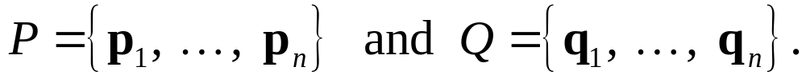
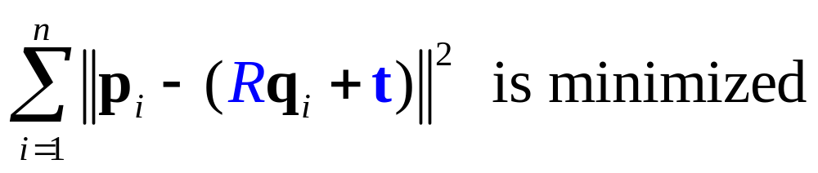
Shape matching – formalization
Align two point sets
Find a translation vector t and rotation matrix R so that:

Slide 26
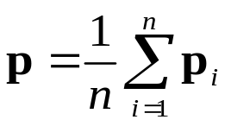
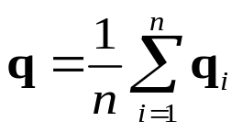
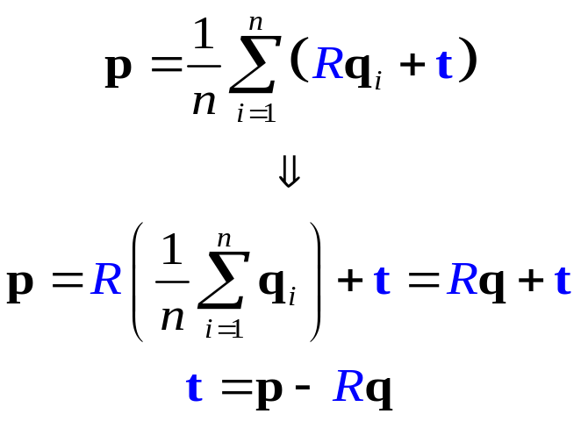
Shape matching – solution
Turns out we can solve the translation and rotation separately.
Theorem: if (R, t) is the optimal transformation, then the points {p_{i}} and {Rq_{i} + t} have the same centers of mass.

Slide 27

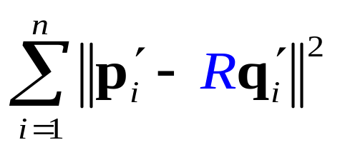
Finding the rotation R
To find the optimal R, we bring the centroids of both point sets to the origin:
We want to find R that minimizes

Slide 28
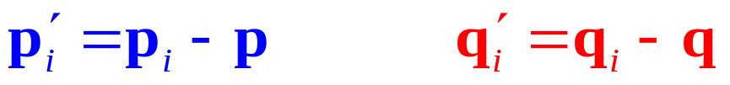
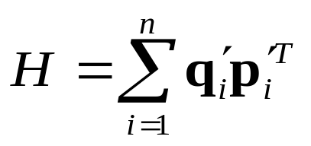
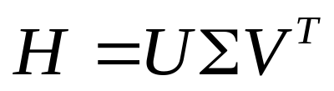
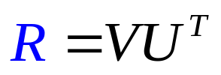

Summary of rigid alignment:
Translate the input points to the centroids:
Compute the “covariance matrix”
Compute the SVD of H:
The optimal rotation is
The translation vector is

Slide 29
Complexity
Numerical SVD is an expensive operation
We always need to pay attention to the dimensions of the matrix we’re applying SVD to.

Slide 30
See you next time

Slide 31
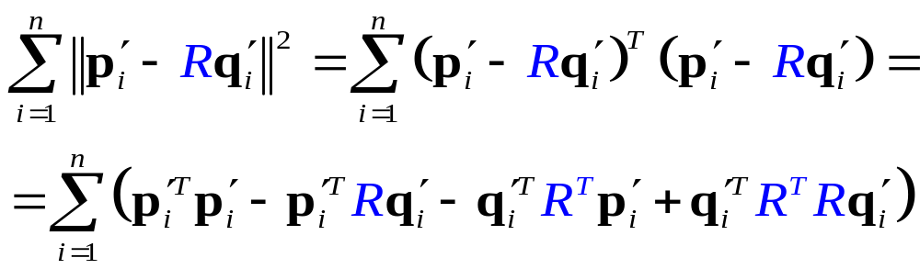
Finding the rotation R
I
These terms do not depend on R,
so we can ignore them in the minimization

Slide 32
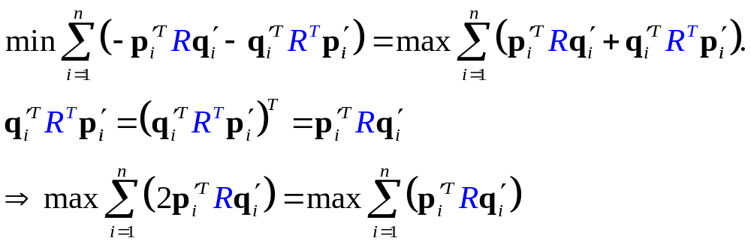
Finding the rotation R
this is a scalar

Slide 33
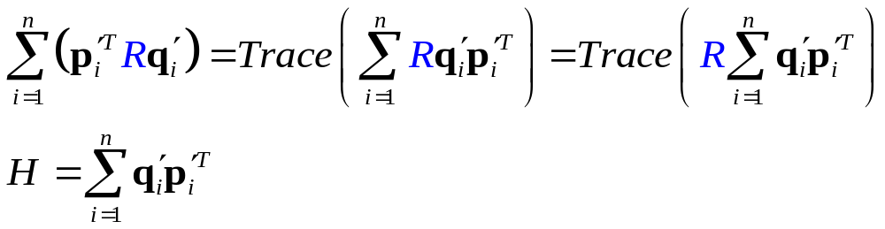
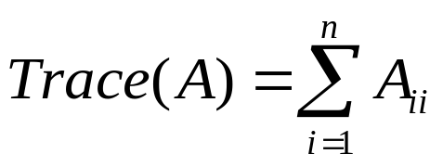
Finding the rotation R
=
3 ×1 1 ×3 = 3 ×3

Slide 34
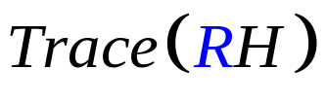
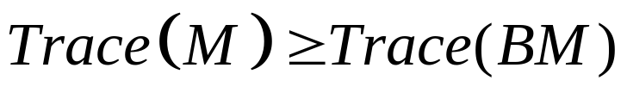
Finding the rotation R
So, we want to find R that maximizes
Theorem: if M is symmetric positive definite (all eigenvalues of M are positive) and B is any orthogonal matrix then
So, let’s find R so that RH is symmetric positive definite. Then we know for sure that Trace(RH) is maximal.

Slide 35
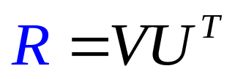
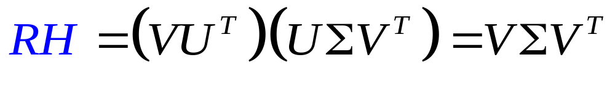
Finding the rotation R
This is easy! Compute SVD of H:
Define R:
Check RH:
This is a symmetric matrix,
Its eigenvalues are σ_{i} ≥ 0
So RH is positive!

