Slide 1
A Voxel Rendering Pipeline in CUDA for Real-time Indirect Illumination
Dave Kotfis
Jiawei Wang

Slide 2
What’s New?
Voxelization Efficiency – 1024^3 Voxels
Texture Mapping in Voxelization
VoxelPipe Shader maps texture color into voxels
Texture Mapping in OpenGL/CUDA Rendering pipelines
Sparse Voxel Octree Construction
Construct Node Pool in GPU memory from VoxelPipe data
In Progress – Mip-Map values from leaves into higher levels

Slide 3
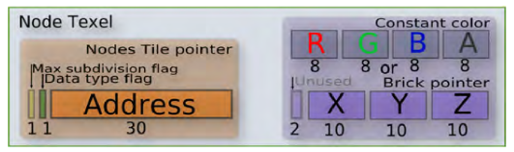
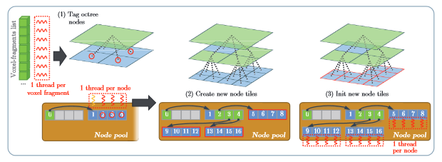
Sparse Voxel Octree Construction
64-bit Nodes for first child address + value or brick pointer
Top-Down construction of node pool in global memory.
Image Credit: GigaVoxels by Cyril Crassin
Taken from OpenGL Insights Chapter 22

Slide 4
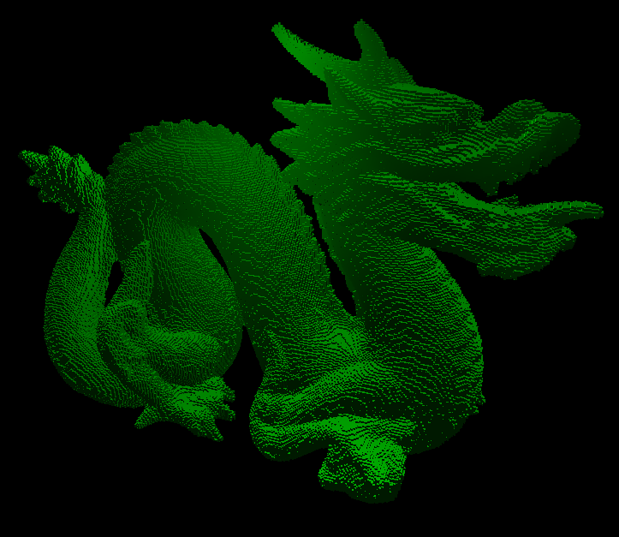
New Results..

