Slide 1
A Voxel Rendering Pipeline in CUDA for Real-time Indirect Illumination - β
Dave Kotfis
Jiawei Wang

Slide 2
What’s New?
Voxelization Efficiency – 1024^3 Voxels
Texture Mapping
Mesh Pipeline
In Progress - OpenGL Shaders use Texture Coordinates
In Test - CUDA Rasterizer does the equivalent
Voxel Pipeline
Complete - New VoxelPipe shader maps texture color directly into voxels
In Test - Additional OpenGL shaders to use CBO created from colored voxels
Sparse Voxel Octree Construction
Complete - Construct Node Pool in GPU memory from VoxelPipe data
In Test – Extraction of cubes from SVO leaves
Just Starting – Mip-Map RGBA values from leaves into higher levels in brick pool

Slide 3
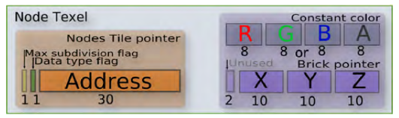
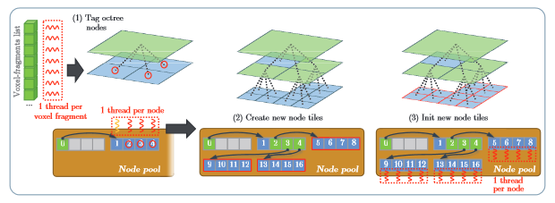
Sparse Voxel Octree Construction
64-bit Nodes for first child address + value or brick pointer
Top-Down construction of node pool in global memory.
Image Credit: GigaVoxels by Cyril Crassin
Taken from OpenGL Insights Chapter 22

Slide 4
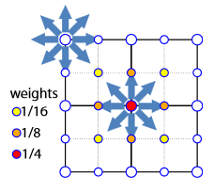
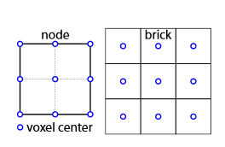
Mip-Mapping the Bricks
Use 3x3x3 bricks in texture memory
Redundant overlapping edges allow for texture interpolation anywhere in the node.
Use appropriate weights when mip-mapping to account for double-counting.

Slide 5
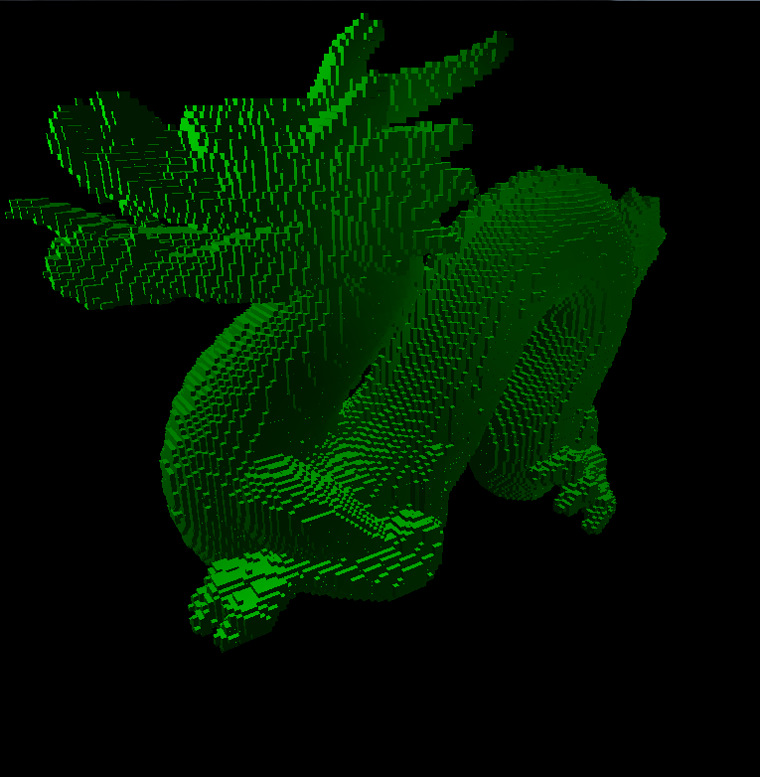
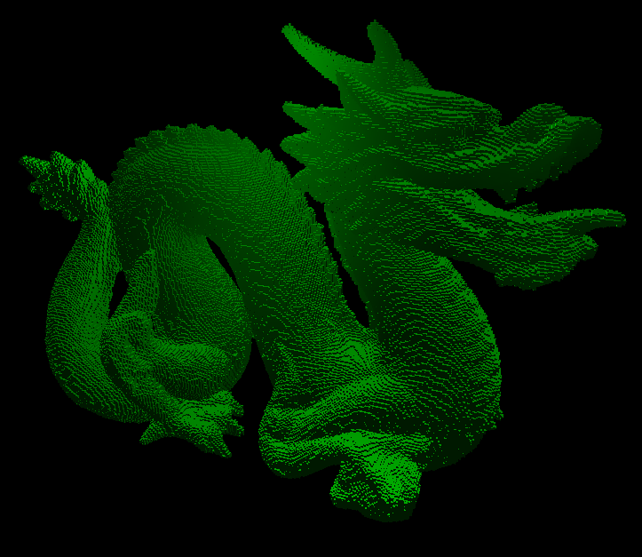
New Results

Slide 6
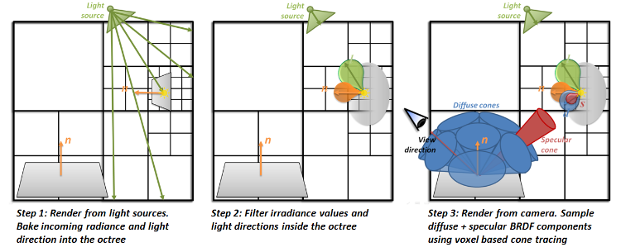
Next Week…
Rendering lighting into the SVO

