Slide 1
A Voxel Rendering Pipeline in CUDA for Real-time Indirect Illumination
Dave Kotfis
Jiawei Wang

Slide 2
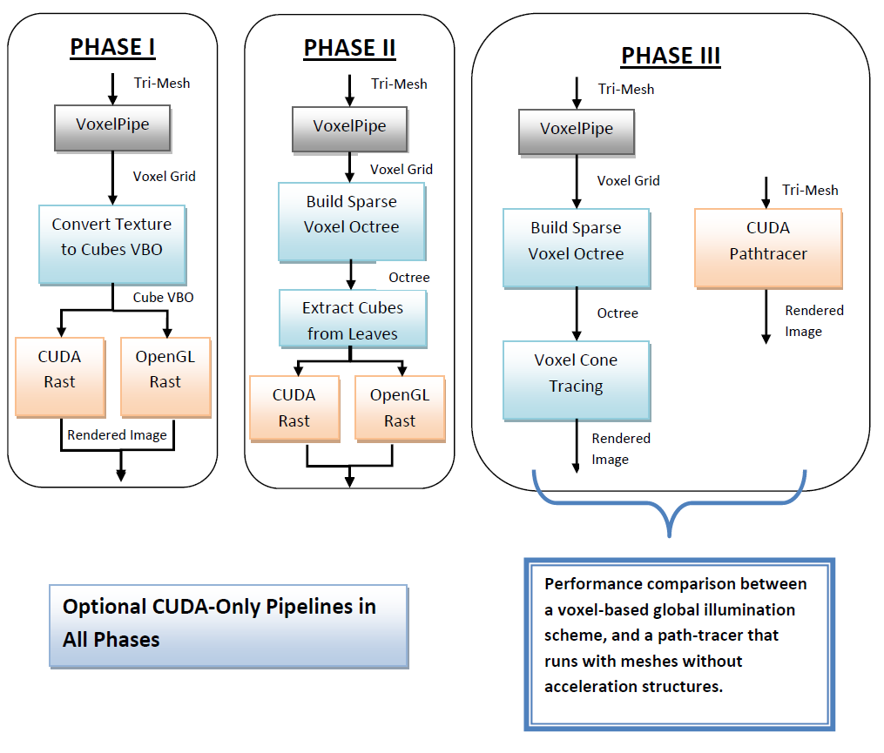
What have we done?
CUDA/OpenGL equivalent rendering pipelines.
Voxelization with texture mapping.
Sparse Voxel Octree Construction (Nodes, but not Bricks)
Cube extraction and rendering.

Slide 3
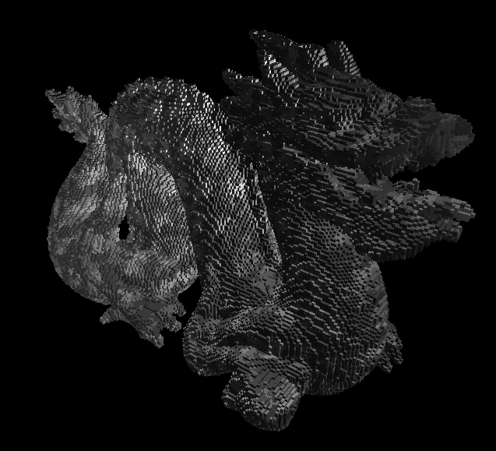
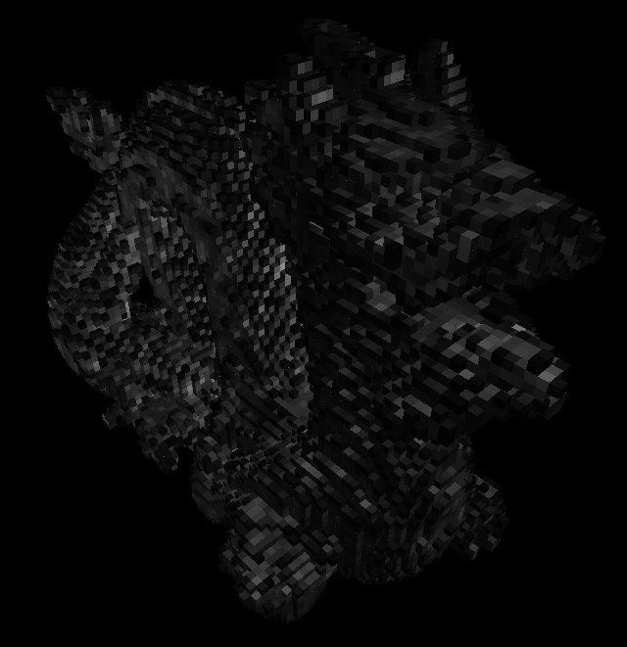
Results
Texture Mapping in VoxelPipe -> Colored Voxels
Extraction of Cubes from Octree at Arbitrary Level of Detail

Slide 4
Performance Analysis
Data Structure Sizes
Model | Res. | # Voxels | # Octree Nodes
Bunny | 128 | 3,234 | 9,656
 | 256 | 11,603 | 38,408
 | 512 | 43,126 | 151,552
Dragon | 128 | 6,327 | 14,696
 | 256 | 20,604 | 58,596
 | 512 | 69,865 | 225,360
Colored voxels are 4 bytes, binary voxels are 1 bit.
Each node is 8 bytes

Slide 5
Performance Analysis (cont)
Voxel Data Structure Timing
Model | Res. | Voxelization | Vox ->Cubes | SVO from Vox | SVO->Cubes
Bunny | 128 | 16.2 ms | 8.46 ms | 1.85 ms | 7.78 ms
 | 256 | 54.2 ms | 19.7 ms | 2.07 ms | 22.6 ms
 | 512 | 203.9 ms | 48.6 ms | 2.3 ms | 39.9 ms
Dragon | 128 | 26.8 ms | 12.1 ms | 1.06 ms | 12.06 ms
 | 256 | 49 ms | 30.5 ms | 2.79 ms | 33.6 ms
 | 512 | 221 ms | 90.9 ms | 2.7 ms | 71.8 ms
The Voxel Grid and SVO structures have comparable runtime to extract cubes for rendering.
SVO Construction is relatively fast, and scales well at ~ log(Res)
Dense voxelization cannot be run at real-time rates. Need a static voxelized background.

Slide 6
Performance Analysis (cont)
Voxelized? | Model | CUDA Render | CUDA FPS | OpenGL Render | OpenGL FPS
No | Dragon | 47 ms | 18 | 15 ms | 60
 | Two Cows | 16 ms | 35 | 0-5 ms | 60
 | Three* | 55 ms | 17 | 15 ms | 58
 | Bunny | 31 ms | 29 | ~0 ms | 60
Yes | Dragon | 156 ms | 5 | 31 ms | 30
 | Two Cows | 23 ms | 27 | 15 ms | 60
 | Three* | 141 ms | 7 | 16 ms | 34
 | Bunny | 109 ms | 10 | 15 ms | 47
*Three is a model scene contains dragon, bunny and buddha objects.

Slide 7
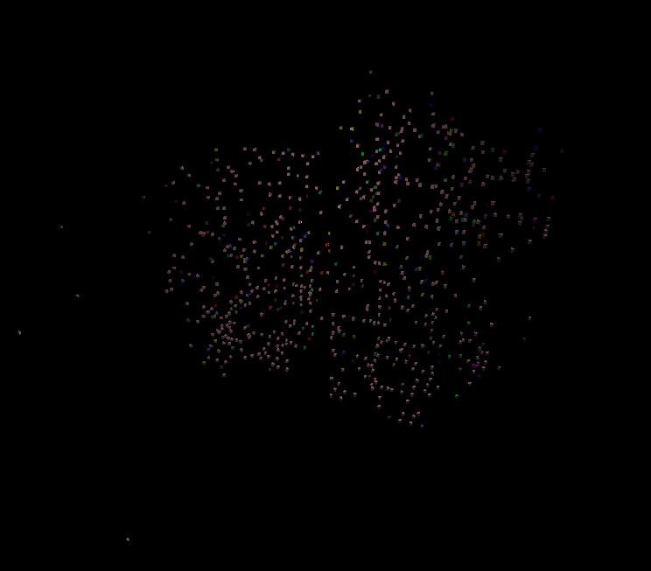
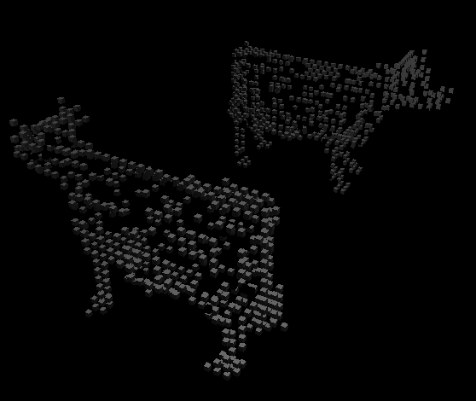
Lessons Learned
Voxel Data Structures on GPU
Memory Hog – Need efficient packing to scale well
SVO lacks convenience functions of a conventional CPU octree
Dynamic Memory Allocation in CUDA Kernels?
We pre-allocate memory -> must be conservative!
Dynamic allocation would conserve memory.

Slide 8
References
“Interactive Indirect Illumination Using Voxel Cone Tracing” – Cyril Crassin
“Octree-Based Sparse Voxelization Using the GPU Hardware Rasterizer.” – Cyril Crassin. OpenGL Insights, Chapter 22.
“GigaVoxels: A Voxel-Based Rendering Pipeline For Efficient Exploration Of Large And Detailed Scenes” – Cyril Crassin
“VoxelPipe: A Programmable Pipeline for 3D Voxelization” - Jacopo Pantaleoni, NVIDIA Research

Slide 9
Thank You!

