Slide 1
A Voxel Rendering Pipeline in CUDA for Real-time Indirect Illumination
Dave Kotfis
Jiawei Wang

Slide 2
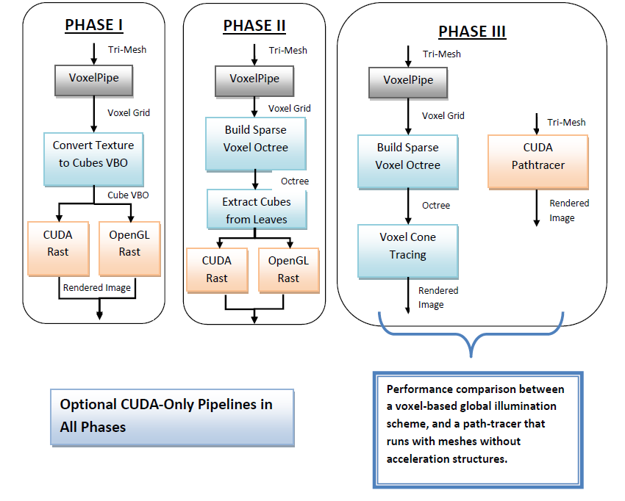
Project Proposal

Slide 3
Tasks
Complete
TO-DO
Project Software Configuration
Literature Review
OpenGL/CUDA Rasterizer Setup
VoxelPipe Software Integration
Cube Extraction from Voxel Grid
Voxelization Improvements
Geometry Shader
Optimizations
Texture Mapping
Sparse Voxel Octree
Voxel Cone Tracing
Performance Evaluation

Slide 4
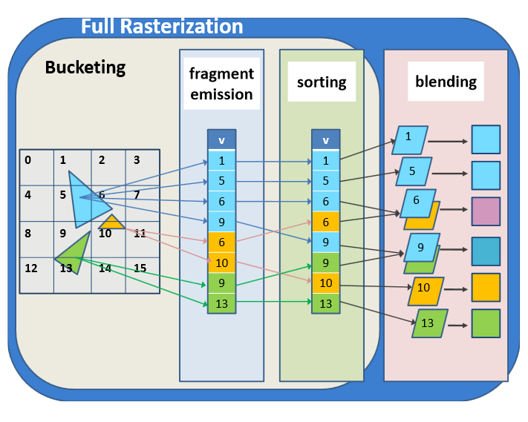
VoxelPipe
Coarse Raster
Parallel on Triangles
Bucket into Tiles
Create fragments (triangle,tile)
Radix Sort On Tiles
Fine Raster
Compute Voxels
Blend Over Triangles
New Steps:
Encode voxel centers (occupied only)
Stream compaction
Copy cube VBO at each center
Image Credit: Jacopo Pantaleoni, NVidia Research

Slide 5
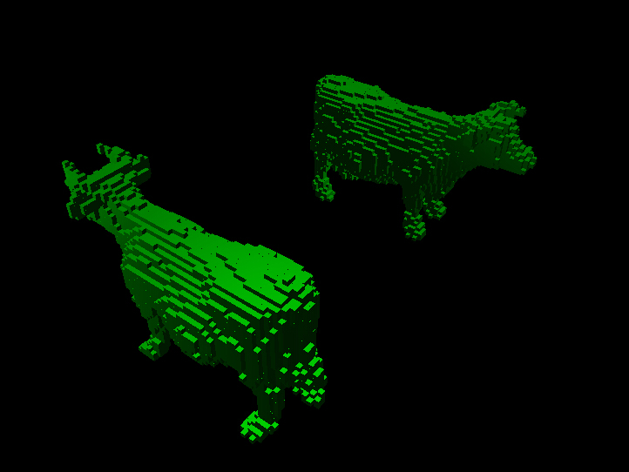
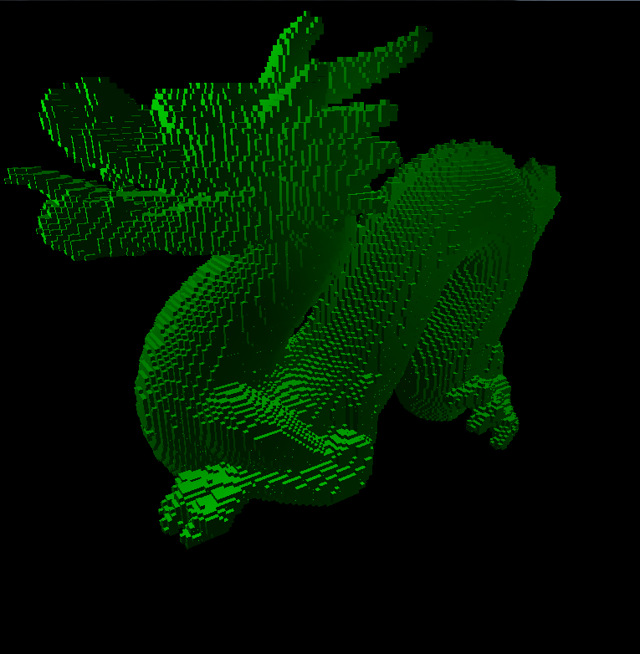
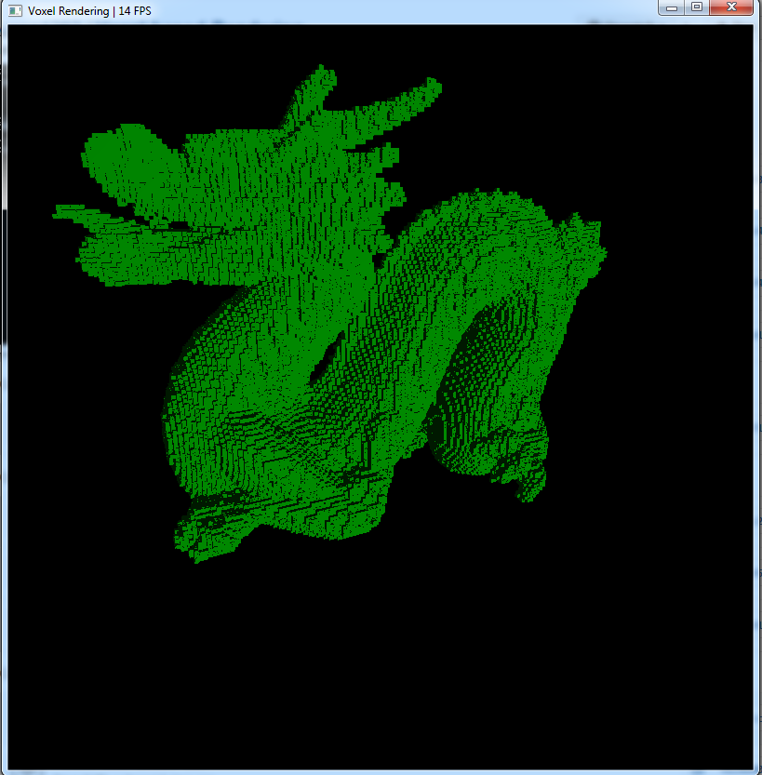
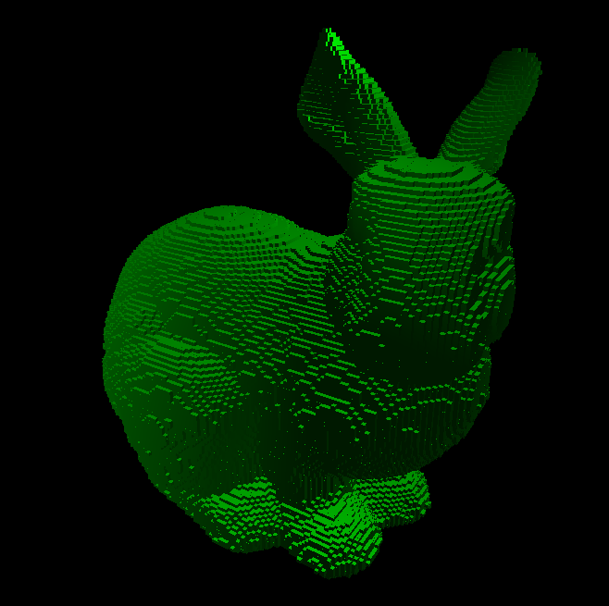
Results So Far..

Slide 6
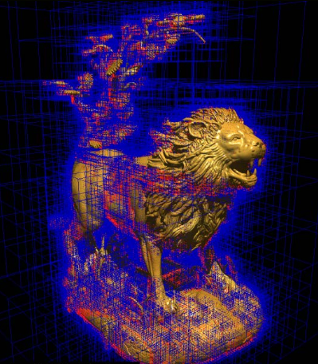
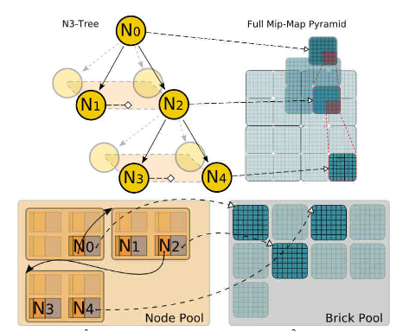
GPU Sparse Voxel Octree
Node pool in GPU memory.
Brick pool in texture memory for interpolation.

Slide 7
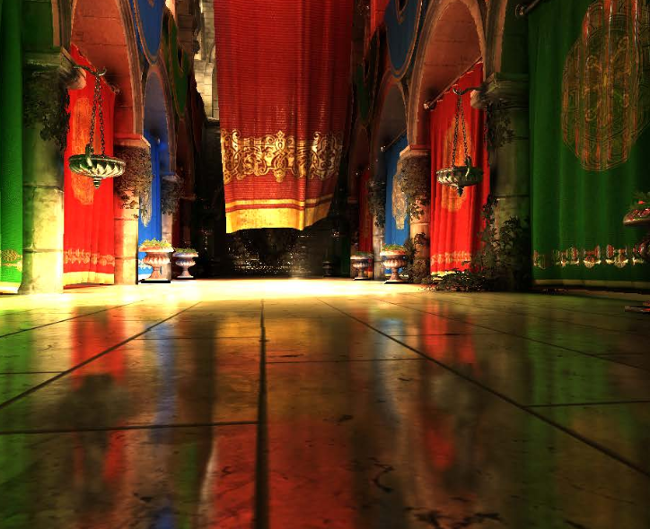
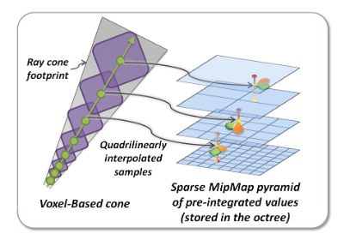
Voxel Cone Tracing
Use Octree LoD for efficient cone integration
Avoid slow Monte Carlo from our CUDA Pathtracer.
Primary Rays -> Normal Rasterization
Image Credit: Cyril Crassin

