Slide 1


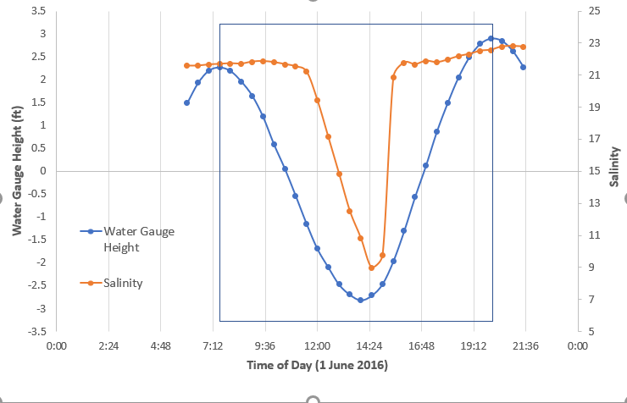
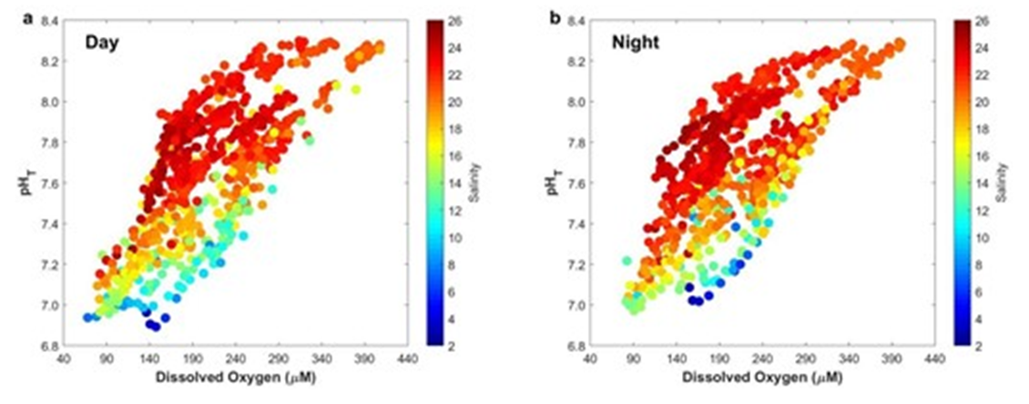
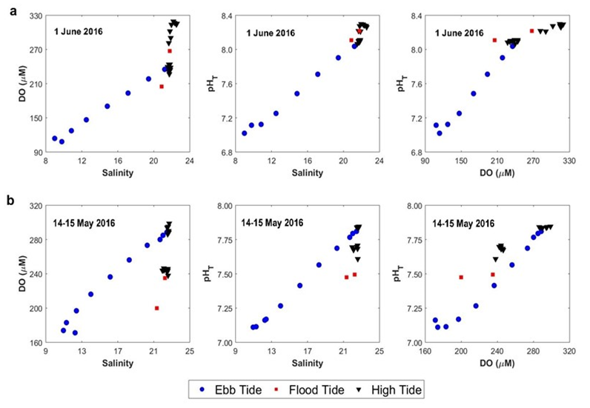
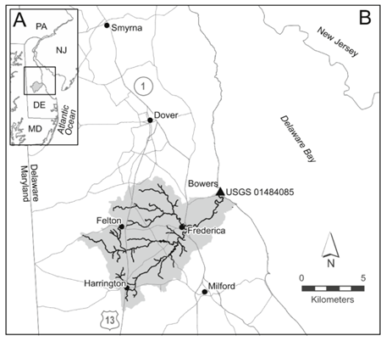
Short-term pH, DO, and salinity variability and their drivers in the Murderkill Estuary-Delaware Bay System (DE, USA)
Jordan A. Watson¹, Stephen F. Gonski², Wei-Jun Cai²
¹East Stroudsburg University, Department of Biological Sciences, East Stroudsburg, PA, USA
²University of Delaware, School of Marine Science and Policy, Newark, DE, USA
Abstract
Results
Figure 2. Tidal time-series of water gauge height (blue) and salinity (orange) on 1 June 2016. The region enclosed in the blue box denotes the 12.5-hour tide period of interest between 0730 and 2000.
Summary statistics for spring daytime and spring nighttime periods (data not shown) did not indicate significant differences and both periods experienced similar ranges of environmental variability (Figure 3). In the spring daytime and spring nighttime, pH, DO, and salinity are all directly related (e.g., pH and DO both increase with increasing salinity) (Figure 3). Spring daytime and spring nighttime pH-Salinity, DO-Salinity, and pH-DO relationships (Figure 3; all figures not shown) developed from all the spring data did not exhibit strong correlations and were not statistically significant.
For the tidal cycle on 1 June 2016 during daytime (Figure 4), Ebb Tide DO-Salinity, pH-Salinity, and pH-DO relationships and High Tide pH-DO relationships all exhibited strong correlation with Pearson Correlation Coefficients (r) > 0.98 while High Tide DO-Salinity and pH-Salinity relationships exhibited weaker correlation lower r of 0.752 and 0.712, respectively. All relationships were significant with P-values < 0.01 (Table 1).
For the tidal cycle on 14-15 May 2016 during nighttime Figure 4), Ebb Tide DO-Salinity, pH-Salinity, and pH-DO relationships and High Tide pH-DO relationships all exhibited strong correlation and significance with Pearson Correlation Coefficients (r) > 0.97 while High Tide DO-Salinity and p-values < 0.01, respectively. Conversely, High Tide DO-Salinity and pH-Salinity relationships were weakly correlated and demonstrated weaker or no significance with substantially lower r of 0.555 and 0.510, respectively, and p-values > 0.01 (Table 1).
The purpose of this study was to examine the short-term temporal variability in and drivers of pH, dissolved oxygen (DO), and salinity in the dynamic Murderkill Estuary-Delaware Bay System. Using data collected between May and August 2016, pH, DO, and salinity were examined on monthly, tidal, and diurnal timescales. Summary statistics were calculated to examine magnitudes of variability on various timescales while Pearson Correlation Coefficients (r) and p-values were used to gauge correlation strength and significance between two parameters, respectively. We determined that there is more significant environmental variability in the spring (May-June) than any other period, and there is no significant difference between environmental variability between spring daytime and nighttime periods. All relationships showed the strongest correlations and significance on tidal timescales when divided into distinct ebb, flood, and high tide components. We found that pH and DO are controlled by tidal mixing during ebb tide periods, while pH and DO are controlled by biological processes such as photosynthesis and respiration during high tides periods when mixing ceases. Consequently, tidal fluctuations are the primary cause of the variability of this system. As such, this phenomenon must be accounted for when carrying out more extensive studies that aim to detect long-term trends amid substantial environmental variability over much shorter timescales in this system.
Objective
The purpose of this study was to explore the different scales of short-term pH, DO, and salinity variability in the Murderkill Estuary-Delaware Bay System and uncover their environmental drivers to inform future detection of long-term trends in pH and DO in this system.
Figure 3. Spring pH-DO relationship as a function of salinity for (a) daytime and (b) nighttime.
Introduction
Discussion
Ranges, dynamics, and environmental drivers of pH and DO variability were best resolved and identified using tidal timescales when tide cycles were divided between distinctive ebb, flood, and high tide periods rather than on monthly or seasonal timescales.
Spring daytime and spring nighttime DO-Salinity, pH-Salinity, and pH-DO relationships were of little use since these relationships simply show tide cycle after tide cycle each with their distinct components simply superimposed on top of one another.
r > 0.98 and p-values < 0.01 for Ebb Tide DO-Salinity and pH-Salinity relationships indicate that tidal mixing between endmembers controls pH and DO variability on the Ebb and likely flood tides.
Lower r values (between 0.510 and 0.752) and higher p-values (between 7.797 x 10⁻⁴ and 0.0749) for high tide DO-Salinity and pH-Salinity suggest tidal mixing exerts less control on pH and DO variability during high tide periods; this makes sense since tidal mixing ceases once Delaware Bay water inundates the site. Divergences between r and p-values of high tide pH-DO relationships between 1 June 2016 and 14-15 May 2016 further suggest differing controlling processes since ranges of pH and DO were larger during daytime (June 1, 2016) such as photosynthesis than nighttime such as respiration (14-15 May, 2016).
r > 0.97 and p-values < 0.01 indicate for high tide pH-DO relationships that biological processes like photosynthesis (increases pH and DO) and respiration (decreases pH and DO) control pH and DO variability once tidal mixing ceases and salinity stabilizes.
pH, DO, and salinity are critical indicators for assessing estuarine ecosystem health. While DO and salinity have been measured in the Murderkill Estuary-Delaware Bay System for several years, pH remains a critical data gap. The Murderkill Estuary-Delaware Bay System is a flood-dominant estuarine system that consists of two dominant endmembers - (1) Delaware Bay water with higher pH, DO, salinity and (2) Murderkill Estuary outflow of lower pH, DO, and salinity. Each endmember dominates at different tide stages. On the ebb or outgoing tide, Delaware Bay water is pushed out of the Murderkill Estuary and its outflowing waters flow downstream to Delaware Bay. On the recharging flood or incoming tide, Delaware Bay water flows upstream and dominates until the next ebb tide period. Higher and increasing DO and pH values of Delaware Bay water occur due to photosynthesis or biological production that produces oxygen and consumes carbon dioxide (CO₂) in the Bay. As Delaware Bay waters flood the watershed, respiration of organic matter has the opposite effects (lower and decreasing) on pH and DO since it consumes oxygen and produces CO₂, respectively. As respiration occurs, waters become more acidic and less habitable on short timescales. Tidal mixing between system endmembers occurs on the flood and ebb tides, but mixing stops once Delaware Bay water inundates the site during extended high tide periods. Because of this, long-term trends in pH and DO are likely masked by substantial short-term variability on tidal cycles and between day and night. Herein, we describe progress made towards identifying dominant scales of short-term variability and environmental drivers of pH and DO that need to be accounted for when characterizing long-term trends in these and other water quality parameters in this system.
Figure 4. Ebb tide (blue circles), flood tide (red squares), and high tide (black triangles) DO-Salinity, pH-Salinity, and pH-DO relationships for tidal cycles on (a) 1 June 2016 and (b) 14-15 May 2016 during daytime and nighttime, respectively.
Methods
pH (on total scale; pH_{T}), DO, and salinity data were collected by a SeapHOx sensor deployed at the confluence of the Murderkill Estuary and Delaware Bay (Figure 1) between May and August 2016 on a 30-minute frequency. Data were divided based on how the pH data has initially been calibrated using discrete water samples (discussed further Gonski et al. (2018).
Spring (May 12 to June 30) data were further divided between day (0800-2000) and night (2030-0730) periods, and summary statistics (mean, standard deviation, minimum, maximum, and range) were then calculated for each period. Preliminary DO-Salinity and pH-Salinity relationships to examine impacts of tidal mixing and pH-DO relationships to examine impacts of biological processes were developed for spring daytime and spring nighttime periods.
12.5-hour tidal cycles scaled to water gauge level data extracted from the United States Geological Survey (USGS) station 01484085 on the Murderkill River co-located with the SeapHOx sensor and filtered to match the 30-minute frequency of the sensor data were selected from spring data (Figure 2) to investigate tidal variability. Tidal cycles were selected based on tidal salinity variability (high or low) and day and night. Only tidal cycles from June 1, 2016, between 0730 and 2000 (High variability during the day) and between May 14, 2016, at 1800, and May 15, 2016, at 0630 will be discussed further. Tidal cycles were defined as the time between successive peak high tide points (or maximums in water gauge level), Ebb (decreasing), Flood (increasing), and High Tide (stable) periods of each tidal cycle were identified based on trends in the rate of change in salinity (Figure 2),
DO-Salinity, pH-Salinity, and pH-DO relationships for each tide period were developed for each tidal cycle. Pearson correlation coefficients (r) and p-values were then calculated to determine the strength of the correlation and significance of the relationship, respectively. P-value < 0.01 indicated a significant relationship between the two parameters..
Table 1. Pearson correlation coefficients and p-values for ebb tide and high tide DO-Salinity, pH-Salinity, and pH-DO relationships for daytime and nighttime tidal cycles on 1 June 2016 and 14-15 May 2016, respectively.
1 June 2016 Tidal Cycle - Spring Daytime
Relationship | Tide Stage | Pearson Correlation Coefficient (r) | P-value
DO-Salinity | Ebb Tide | 0.997 | 8.766 x 10⁻⁸
 | High Tide | 0.752 | 7.797 x 10⁻⁴
pH-Salinity | Ebb Tide | 0.997 | 7.712 x 10⁻⁸
 | High Tide | 0.712 | 1.978 x 10⁻³
pH-DO | Ebb Tide | 0.991 | 1.800 x 10⁻⁶
 | High Tide | 0.983 | 1.022 x 10⁻¹¹
14-15 May 2016 Tidal Cycle - Spring Nighttime
Relationship | Tide Stage | Pearson Correlation Coefficient (r) | P-value
DO-Salinity | Ebb Tide | 0.986 | 2.934 x 10⁻⁸
 | High Tide | 0.555 | 0.0452
pH-Salinity | Ebb Tide | 0.999 | 5.233 x 10⁻¹⁴
 | High Tide | 0.510 | 0.0749
pH-DO | Ebb Tide | 0.985 | 3.571 x 10⁻⁸
 | High Tide | 0.970 | 3.969 x 10⁻⁸
Data density was not sufficient for Flood Tide analyses.
Relationships are significant if p < 0.01.
Conclusions
By scaling variability down from seasonal and monthly to tides, we found that pH and DO variability are controlled by tidal mixing and biological processes and uncovered differences between spring daytime and spring nighttime dynamics that coarser resolutions were unable to resolve. Based on our analyses, long-term trends in pH, DO, and other environmental parameters are masked by substantial short-term variability that must be accounted for in future work looking at long-term trends with tidal timescales being the dominant scale of variability in the Murderkill Estuary-Delaware Bay System.
Figure 1. Map of the Murderkill Watershed and sensor location. Location of the Murderkill Watershed in the Mid-Atlantic and State of Delaware (A, inset). The Murderkill Watershed (grey) and the USGS gauging station (DE01484085) in Bowers, DE (triangle) at the confluence of the Murderkill Estuary and Delaware Bay (B). An autonomous SeapHOx sensor was co-located at the USGS gauging station during the summer of 2016.
Future Directions
For future work, pH, DO, and salinity should be measured every 10 or 15 minutes rather than every 30 minutes to better resolve environmental variability on flood tides that are 1-2 hours long, reduce bias with respect to tide stage, and to gauge whether flood tide and high tide periods can be grouped into the same relationship. Moreover, similar analyses should be carried out using pH-temperature and DO-temperature relationships to examine gas solubility effects and CO₂-DO relationships to gauge any effects of rates of air-water equilibration as additional drivers of pH and DO variability.
References
Baumann, H., Wallace, R. B., Tagliaferri, T., and Gobler, C. J. (2015). Large natural pH, CO₂, and O₂ fluctuations in a temperate tidal salt marsh on diel, seasonal, and
interannual time scales. Estuaries and Coasts, 38(1), 220-231.
Dzwonkowski, B., Wong, K. C., and Ullman, W. J. (2014). Water level and velocity characteristics of a salt marsh channel in the Murderkill Estuary, Delaware. Journal of Coastal Research, 30(1), 63-74.
Gonski, S. F., Cai, W. J., Ullman, W. J., Joesoef, A., Main, C. R., Pettay, D. T., and Martz, T. R. (2018). Assessment of the suitability of Durafet-based sensors for pH measurement in dynamic estuarine environments. Estuarine, Coastal and Shelf Science, 200, 152-168.
Voynova, Y. G., Lebaron, K. C., Barnes, R. T., and Ullman, W. J. (2015). In situ response of bay productivity to nutrient loading from a small tributary: The Delaware Bay-Murderkill Estuary tidally-coupled biogeochemical reactor. Estuarine, Coastal and Shelf Science, 160, 33-48.
Wong, K. C., Dzwonkowski, B., and Ullman, W. J. (2009). Temporal and spatial variability of sea level and volume flux in the Murderkill Estuary. Estuarine, Coastal and Shelf Science, 84(4), 440-446.
Acknowledgements
This project at University of Delaware was made possible by the National Science Foundation EPSCoR Grant No. 1757353 and the State of Delaware. Special thanks to Dr. Najid Hussain, Dr. Elliott Roberts, and Mike Scaboo for their support and feedback throughout the internship period.

