Slide 1

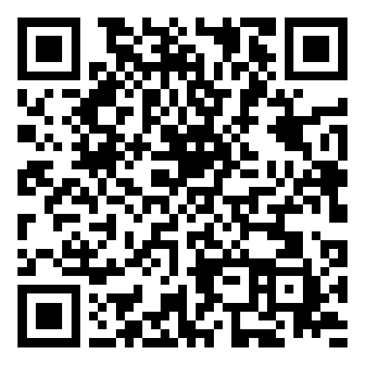
Smart Slides
Make Slides in a flash
How to use Smart Slides

Slide 2
BlockAuth Pay
Revolutionizing Secure Transactions with AI & Blockchain
Team Name & Members

Slide 3
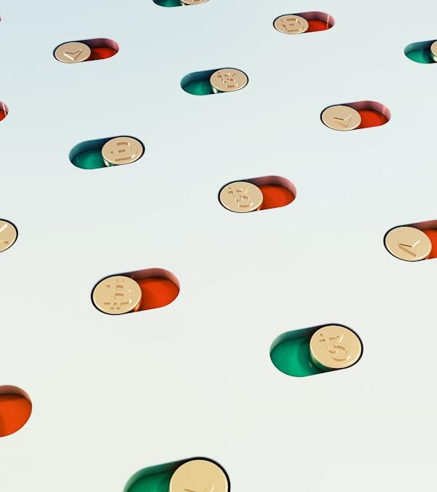
The Problem Statement – Payment Fraud & Security Gaps
Weak authentication methods make transactions vulnerable.
Cyber fraud is rising due to phishing, SIM swapping, and credential leaks.
$32.39 billion lost to online payment fraud in 2024.
SIM swapping attacks increased by 400% in the last 3 years.
80% of hacks involve stolen credentials due to weak authentication.
Photo: a group of pills floating in the air
Photo by Arthur Mazi
Powered by Unsplash

Slide 4
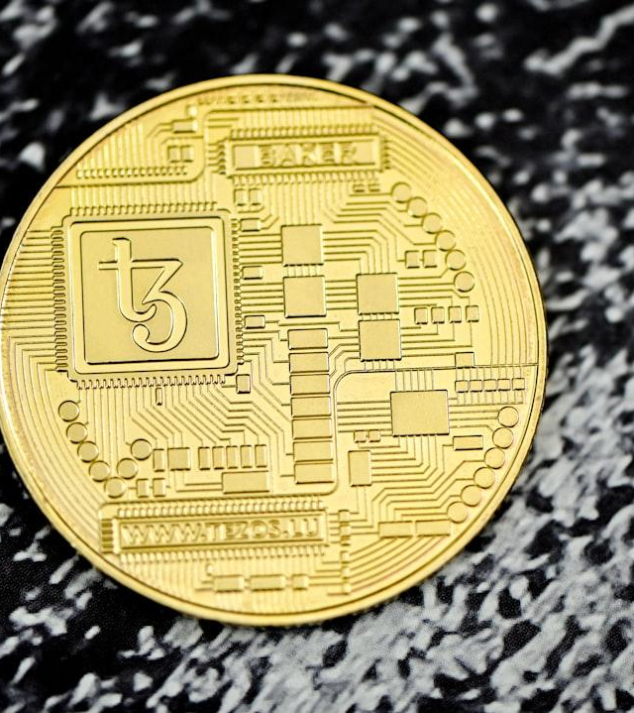
Our Solution – AI & Blockchain-Based Authentication & Payments
Passwordless authentication with biometrics & blockchain identity.
AI-powered fraud detection prevents unauthorized transactions.
Decentralized blockchain-based payments – secure, fast, trustless.
Multi-factor authentication (MFA) without OTPs.
Photo: a close up of a coin on a black surface
Photo by Traxer
Powered by Unsplash

Slide 5
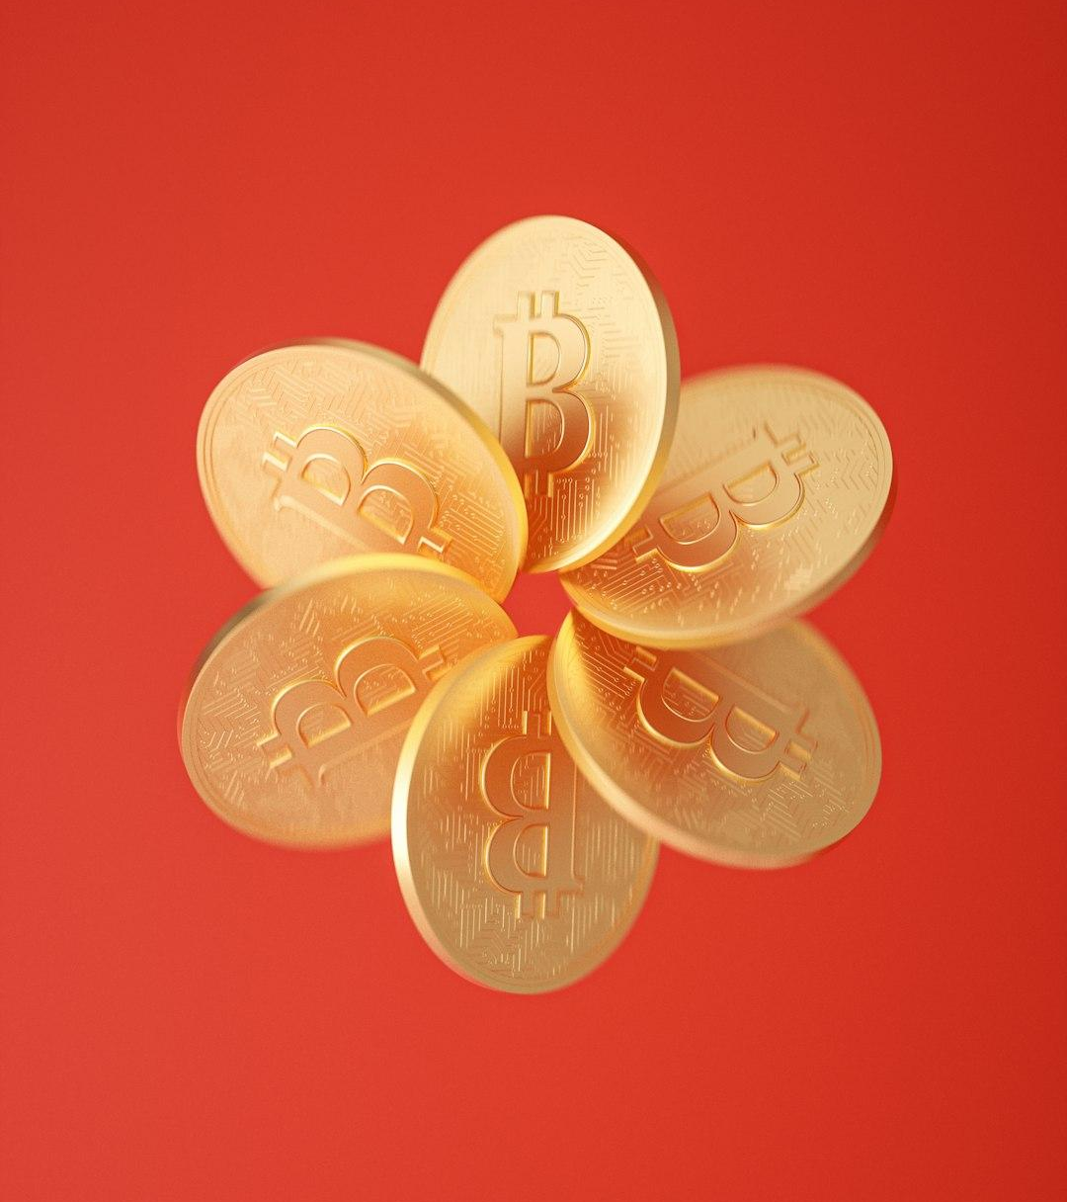
Key Features of Our System
AI monitors typing patterns, swipe behavior, and device interactions.
Face/Fingerprint Scan with liveness detection for primary authentication.
Blockchain-based OTP for secondary authentication.
Smart contract-powered fraud-free transactions.
Decentralized Identity (DID) for seamless authentication.
Photo: a flower made of gold coins on a red background
Photo by 愚木混株 cdd20
Powered by Unsplash

Slide 6
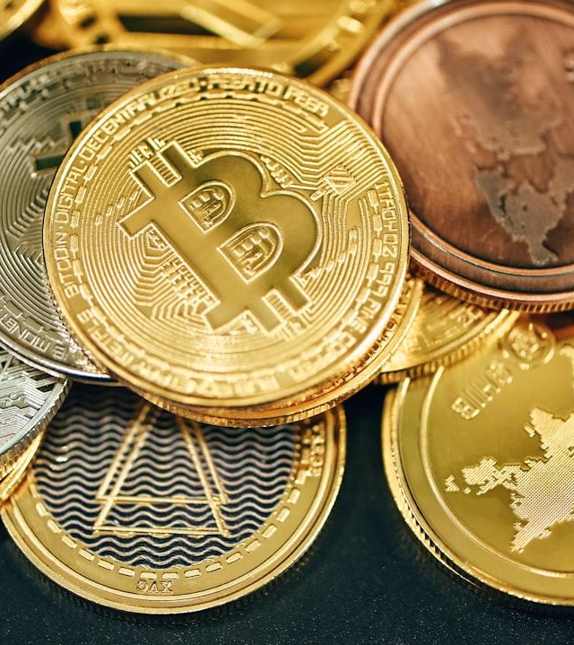
How It Works
Authentication Flow:
1. User logs in with Face/Fingerprint Scan.
2. AI verifies behavior patterns.
3. If suspicious, secondary authentication required.
Payment Flow:
1. User initiates payment via crypto wallet or fiat gateway.
2. Smart contract verifies identity via blockchain ID.
3. Transaction is recorded on-chain for security.
Photo: a pile of gold and silver bitcoins
Photo by Traxer
Powered by Unsplash

Slide 7
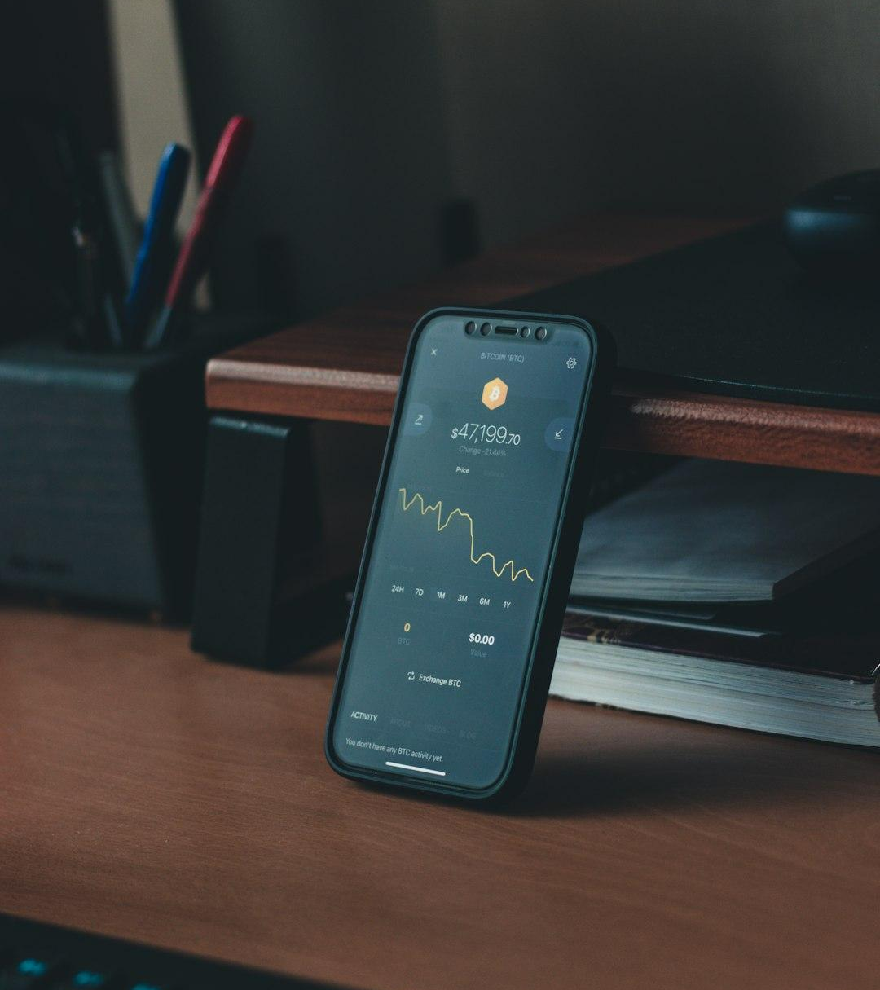
Unique Selling Points (USPs) – Why Our Solution is Better
100% Passwordless & SIM Swap-Proof
AI-Powered Fraud Prevention
Decentralized Payments
Multi-Device Security
No Single Point of Failure
Photo: a cell phone sitting on top of a wooden desk
Photo by Behnam Norouzi
Powered by Unsplash

Slide 8

Why Now? Market & Industry Adoption
Global Blockchain Market: $11B in 2024 → $39B by 2027.
Crypto payments growing by 200% YoY.
Target Audience:
- Banks & Financial Institutions
- E-commerce Platforms
- Government & ID Verification
Photo: a gold coin sitting on top of a pile of pine cones
Photo by Traxer
Powered by Unsplash

Slide 9
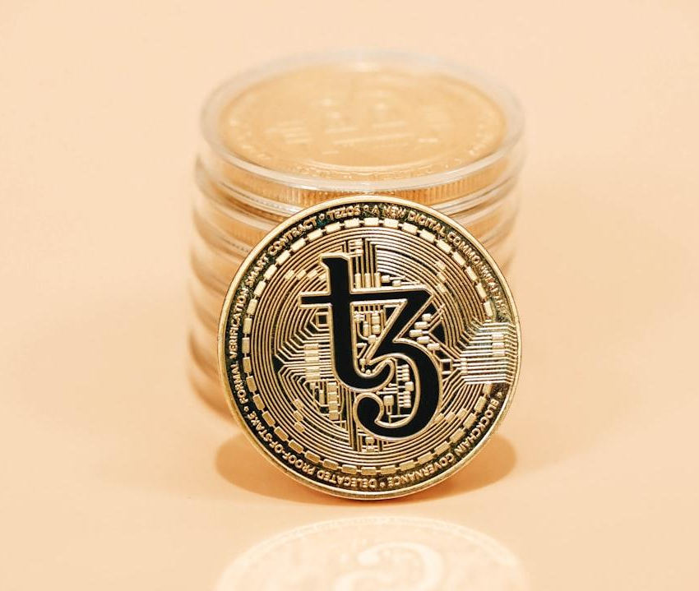
Competitor Analysis & Loopholes in Existing Solutions
Passwords & OTPs – Can be stolen, phished, or SIM swapped.
SMS-based MFA – Vulnerable to interception.
Centralized Payment Gateways – Prone to hacking.
Traditional Crypto Payments – No identity verification, high fraud risk.
Photo: a stack of coins sitting on top of a table
Photo by Traxer
Powered by Unsplash

Slide 10
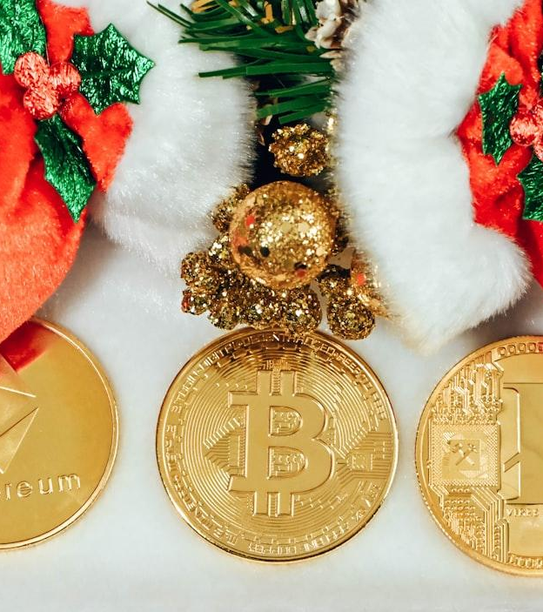
Future Roadmap & Scalability
Phase 1: MVP with AI-based authentication & Web3 payments.
Phase 2: Expand to multi-chain support (Ethereum, Solana, Polygon).
Phase 3: Partner with fintech & e-commerce companies.
Phase 4: Open-source blockchain authentication SDK.
Photo: a bunch of gold coins sitting on top of a white table
Photo by Traxer
Powered by Unsplash

Slide 11
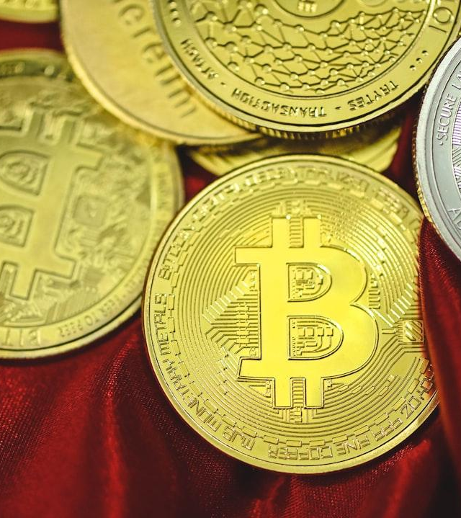
Tech Stack
Frontend: React (Next.js), Tailwind CSS, ethers.js.
Backend: Node.js, Express.js, Fastify.
Blockchain: Solidity (Ethereum), Rust (Solana), Hardhat.
AI: TensorFlow.js / OpenAI API.
Database: PostgreSQL / MongoDB + IPFS.
Photo: a pile of bitcoins sitting on top of a red cloth
Photo by Traxer
Powered by Unsplash

Slide 12
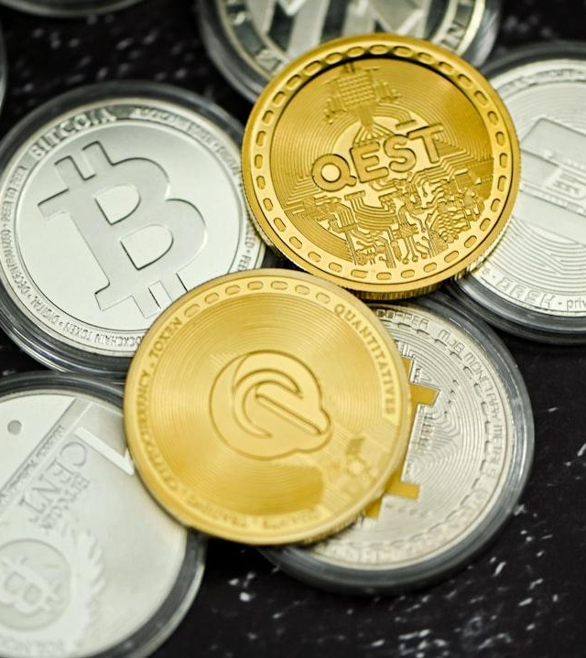
Business Model & Monetization
B2B API Service – Charge fintech & banks for authentication.
Transaction Fee Model – % of each blockchain payment.
Subscription Model – Premium security features for enterprises.
Photo: a pile of coins sitting on top of a table
Photo by Traxer
Powered by Unsplash

Slide 13
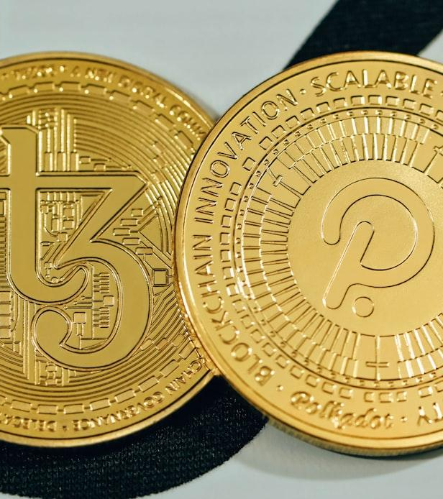
Conclusion & Call to Action
Why Our Solution is the Future of Secure Payments:
- Eliminates passwords & OTP fraud.
- Blockchain-powered transactions = No fraud, no chargebacks.
- AI ensures real-time fraud detection.
- Seamless cross-platform security.
What We Need to Scale:
- Fintech & crypto partnerships.
- Investors to support growth.
🚀 Join us in revolutionizing payment security!
Photo: a close up of two gold coins on a black and white background
Photo by Traxer
Powered by Unsplash

Slide 14
Thanks for using Smart Slides
Learn more about how to use this plugin by visiting https://smartslides.crisp.help/en/article/how-to-use-smart-slides-1w14fiw/
Example Prompts:
Make me a 5 slide presentation about the history of the united states and include charts with images of mountains and rivers
Make me a 5 slide tourist presentation about Norway and lofoten islands with varied layouts and images of the northern lights using
Create a presentation with 5 slides about Sydney with images of Bondi Beach and the Opera House use font size 46 for headings and 36 for content. Use this color #FF5A5F (red) and inlude lots of image slides

