Slide 1
Open vSwitch for Microsoft Hyper-V
Eitan Eliahu, Nithin Raju, Ankur Sharma
Network & Security Business Unit

Slide 2
Agenda
Project Introduction
Hyper-V Switch extensions framework
Introduction to NDIS framework
Internals of OVS for Hyper-V
Fun stuff

Slide 3
OVS on Hyper-V, What is all about?
Develop Open vSwitch on the Hyper-V platform
Shared effort of Cloudbase and VMware
Weekly IRC meeting for discussions
Tuesday 10 AM PST on #openvswitch

Slide 4
Design Objectives ...
Interoperable with other Hypervisors
User cross platform common code
Extensible Netlink protocol for user/kernel interface
Windows specific OS primitives for threads, synchronization, and system IOCTL calls
Leverage Switch Extension Framework for enforcing packet forwarding

Slide 5
Design Objectives
Leverage WFP callout filter driver
Zero copy of packet data in Datapath
Support various tunneling protocols
Asynchronous I/O, NDIS Framework, Event driven notification for Missed packets and port state changes
Use host IP stack for fragment reassembly

Slide 6
High Level Architecture
Root Partition (Host)
Child Partitions (Guest)
ovs-*ctl
ovs-vswitchd
Virtual Machine #1
Virtual Machine #2
dpif-
netlink
netdev-
windows
Physical NIC
Hyper-V Internal NIC
VIF
VIF
User
netlink socket(emulation)
Kernel
OVS Forwarding Extension
I
N
G
R
E
S
S
E
G
R
E
S
S
Interface device
Netlink Message Impl.
Flowtable
vport table
Packet Processing
WFP Callout Driver
Hyper-V extensible switch
NDIS Stack

Slide 7
Hyper-V Extensible Switch - Overview
Layered instances of NDIS filter drivers (“switch extensions”) for monitoring, modifying and forwarding
Each layer has an upper “miniport” interface and a lower “protocol” interface.
Packet (NBLs) are forwarded through modifying or inserting ports in the packet forwarding context (OOB).
Packets are transferred through the filter driver in an asynchronous fashion

Slide 8
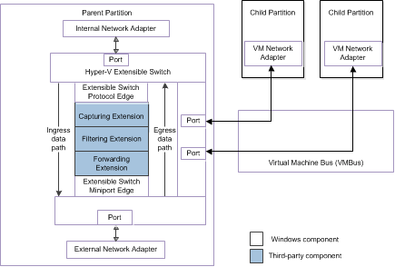
Hyper-V Extensible Switch Architecture
MSDN Documentation

Slide 9
Packet Flow in Hyper-V Virtual Switch
Packet Injected to Ingress path
Packet sent to extension
Packet sent to miniport edge of switch
Packet shows up on Egress path
Packet sent to destination VM or Physical NIC
Child Partitions (Guest)
Virtual Machine #1
Virtual Machine #2
Physical NIC
Hyper-V Internal NIC
VIF
VIF
1
1
5
5
I
N
G
R
E
S
S
E
G
R
E
S
S
2
3
4
Hyper-V extensible switch
NDIS Stack

Slide 10
Typical Ingress Packet Flow with OVS
OVS extension gets packet from Hyper-V Extensible Switch
OVS extracts a “flow key” for that packet and looks up flow
If a match is found (typical case)the flow destination ports are set into the packet “forward context” of the NBL
If no match packet sent to usermode via upcall
In turn, user mode processes the packet and will send it back to the driver as a raw data. (a new flow is installed)
Driver allocates a new packet and injects into ingress path
If the destination port is a Tunnel port the packet is encapsulated and sent to the external port

Slide 11
High Level Architecture
Root Partition (Host)
Child Partitions (Guest)
ovs-*ctl
ovs-vswitchd
Virtual Machine #1
Virtual Machine #2
dpif-
netlink
netdev-
windows
Physical NIC
Hyper-V Internal NIC
VIF
VIF
User
netlink socket(emulation)
Kernel
1
1
4
OVS Forwarding Extension
4
“OpenvSwithDevice” device
I
N
G
R
E
S
S
E
G
R
E
S
S
Netlink Message Impl.
Flowtable
vport table
2
Packet Processing
3
WFP Callout Driver
Hyper-V extensible switch
NDIS Stack

Slide 12
Kernel Datapath - About
OVSEXT - NDIS Filter driver implementing forwarding extensions
Compiled using Visual Studio 2013
Documentation in datapath-windows/DESIGN
Notes:
Filter driver sits in-between the Switch’s protocol edge, and the Switch’s Miniport edge

Slide 13
Kernel Datapath - Components ...
Interfacing with NDIS stack
Registers drivers with NDIS upon load
OVS datapath created/deleted when OVS extension is enabled/disabled on a Hyper-V switch
Supports single OVS datapath
Control path - OID callbacks
Datapath - Ingress, and Ingress completion
Notes:
Creation and Initialization of the datapath ie. Flowtable creation, Enumeration of the ports on the Hyper-V switch etc happen when the OVS extension is enabled on the Hyper-V switch.
Datapath is not created from the userspace unlike on other platforms.

Slide 14
Kernel Datapath - Components ...
Interfacing with OVS Userspace
Control device for Userspace to talk to kernel datapath
Netlink sockets emulated in userspace using handles to control device
Netlink message handling in kernel datapath
Netlink commands in openvswitch.h supported, with extensions defined in OvsDpInterfaceExt.h
Notes:
Netlink PID generated by OVS kernel datapath

Slide 15
Kernel Datapath - Components ...
Port management
OVS-port-name is identity of port in Datapath & OVSDB
Port enumerated on the Hyper-V switch need to be “activated” by adding it from OVS userspace
Hyper-V internal port attached to the Host IP stack
Used as VTEP
Port Event notifications - create/delete/update

Slide 16
Kernel Datapath - Components ...
Optimized Buffer (NBL) management
Avoid deep-copies of NBLs. Works by keeping ref count to parent NBLs, and shallow copying MDLs
Zero copy in the OVS extension
Tunneling
IP Helper for ARP resolution & Route lookup
VXLAN tunnelling supported. Easy to extend
Flowtable/Actions
Supports all basic actions including set L2/L3

Slide 17
Kernel Datapath - Components ...
NIC Offloads completion (VIF NIC)
Checksum and TSO completion in Transmit direction
Checksum verification in Receive direction
Packet send/miss to userspace
Packet notification to avoid busy polling in userspace

Slide 18
Userspace - Components ...
Posix code ported to Windows
Netlink sockets emulated
Unified DPIF provider for Linux & Windows
Uses pool of netlink sockets per handler (thread)
Netdev-Windows implemented using netlink commands in kernel datapath

Slide 19
Userspace - Components
PowerShell cmdlet
Set the “OVS-Port-Name” of a port to name in OVSDB, so datapath can map the Hyper-V port to OVS port
Windows specific command line utility
Eg. Set-VMNetworkAdapterOVSPortDirect
-VMname Ubuntu-VM
-OVSPortName vif-port-1

Slide 20
Open vSwitch for Microsoft Hyper-V
Project Introduction
Hyper-V Switch extensions framework
Introduction into NDIS framework
Internals of OVS for Hyper-V
Fun stuff - Demo
Install the OVS kernel driver
Configuring OVS
Ping between VMs across VXLAN backed tunnel

Slide 21
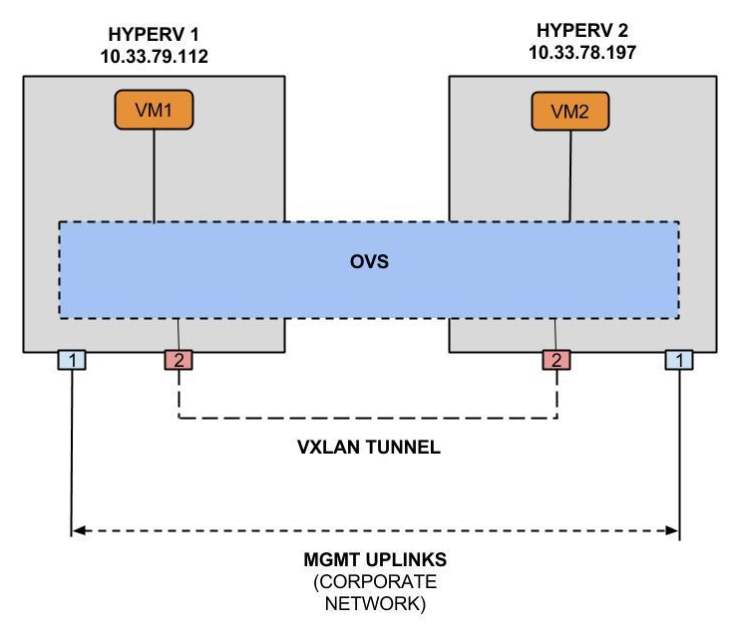
Demo
TOPOLOGY

Slide 22
Developer credits
Ankur Sharma
Ben Pfaff
Eitan Eliahu
Guolin Yang
Gurucharan Shetty
Linda Sun
Nithin Raju
Saurabh Shah
(and more)
Alin Serdean
Lucian Petrut
Samuel Ghinet
Sorin Vinturis
Questions?

Slide 23
Backup Slides

Slide 24
Hyper-V Extensible Switch - Overview
MSDN Documentation

Slide 25
Main Functional Modules
Switch Forwarding Extension
Layered filter driver
WFP Callout driver - used for decapsulation of tunneled packets
Two control paths
Extensible User/Kernel mode interface through exposing a “Netlink” device interface
NDIS/WMI control path through OIDs
Remote VTEP IP address through the use of the host stack (IP Helper)
Network Buffer management (avoids packet data copy)

Slide 26
OVS Switch Forwarding Extension Driver
Registers with NDIS as a filter driver upon loading
Implemented as a set of callback functions adhere to “NDIS Filter Driver” interface
Callback for Egress and Ingress packet processing
Packet processing is done on the egress path
Callback for Port and Nic creation and state change
Callbacks for processing control commands (OIDs)
Acts as a “Miniport” for an upper layer filter driver
Indicates received packets to upper layer
Callback for packet returned from upper layer
Acts as a “Protocol” for lower layered filter driver
Send sdoen packets originated from upper layer
Callback upon packet send completion

Slide 27
OVS Switch Forwarding Extension Driver - cont.
Each Hyper-V Virtual Switch is associated with a Device Object, OVS uses a single Device Object (datapath) for all OVS Virtual Switches
Forwarding is performed on the ingress path on Filter Send NBL callback
Packets can be dropped, offload completed and indicated to usermode, Cloned and forwarded to Vport(s), Encapsulated and sent to a Tunnel port, VLAN tagged
Packet / NBL processing is based on NDIS service function which creates new fragmented NBL based on an original NBL (No data copying rather than buffer control structure manipulation)

Slide 28
WFP Callout Filter Driver - Tunnel Packet Processing
Installed as a filter driver on the Host network stack
Packed into the same binary as the extension driver
Registers a Datagram “callout” with the stack filter engine for processing fragmented packets received on a tunnel UDP port
The filter engine calls the driver ClassifyFn callback function for network packets associated with callout rule
Packet is intercepted and removed from the host stack
The packet is decapsulated and processed and it was received on the egress callback of the Extension driver
Non fragmented tunnel packets are intercepted and processed directly

Slide 29
Userspace - Components [...]
Netdev-windows
No native netdev support
Supports “system” and “internal” ports
Messy to use Windows APIs like GetAdaptersInfo()
Netdev commands implemented in kernel datapath
Get MAC address, MTU, etc
No support for packet send, receive etc (not needed)

Slide 30
High Level Architecture
The built in switch calls the extension Send callback function to process a set of packets originated by a VM
The extension (indirectly) calls the lower driver on its Send callback passing the packets.
The packets are transferred to the destination VM over the VM Bus
The lower layer driver on the destination VM indicates the packet to the Extension.
The Extension (indirectly) calls the upper layer driver with the packet.
Upper layer driver return the packet to the extension
In turn the extension return the packet to the lower driver
Packet return is propagated to the source VM
Send complete callback is called on the extension
Child Partitions (Guest)
Virtual Machine #1
Virtual Machine #2
Physical NIC
Hyper-V Internal NIC
VIF
VIF
1
1
4
4
I
N
G
R
E
S
S
E
G
R
E
S
S
2
3
Hyper-V extensible switch
NDIS Stack

Slide 31
Typical Ingress Packet Flow
An “enlightened” or emulated Virtual NIC driver in a guest transfers a packet originated by the VM to the Virtual Switch over the VM Bus.
The Hyper-V Extensible Switch passes the packet to the Extension with a source port associated with the VM VNIC.
The filter driver generates a “flow key” for that packet.
The flow key is matched to a cached flow table
If a match is found (typical case) the flow destination ports are set into the packet “forward context” of the NBL
If a match is not found the packets is “terminated”, packed in a Netlink format and indicated up to usermode.

Slide 32
Typical Ingress Packet Flow cont.
In turn, user mode (vswitchd.exe) processes the packet and will send it back to the driver as a raw data. (a new flow is installed)
The driver allocates a new packet structure and process it as it was received on its ingress callback
if the destination port is a Tunnel port the packet is encapsulated and sent to the external port

