Slide 1
OVSDB
“use it to configure a switch or track your stamp collection”

Slide 2
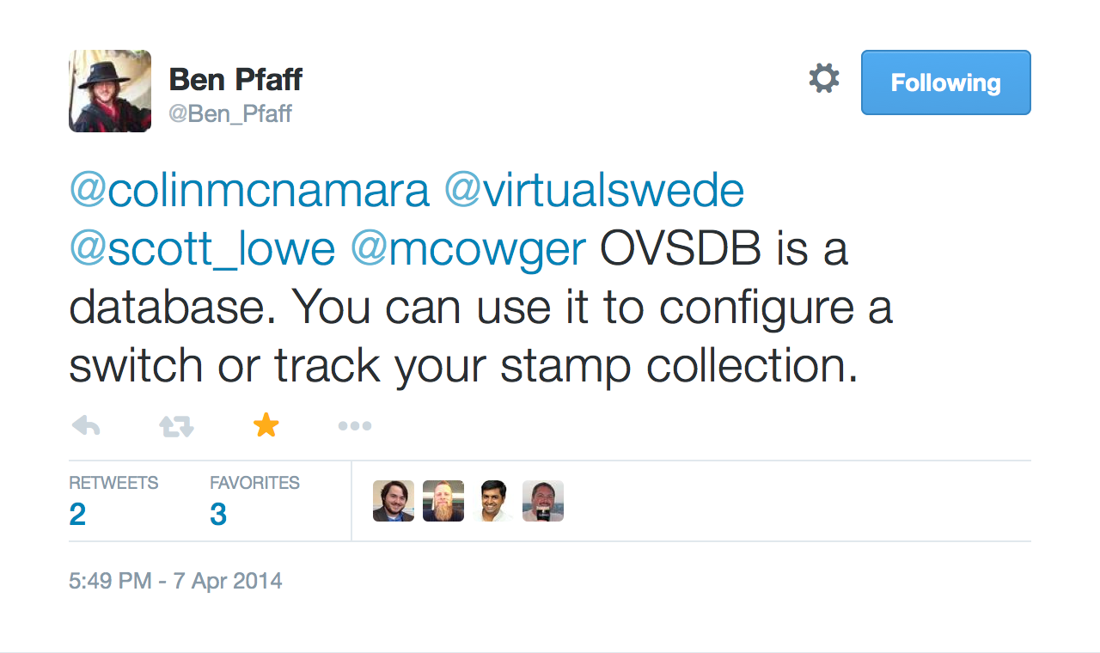

Slide 3
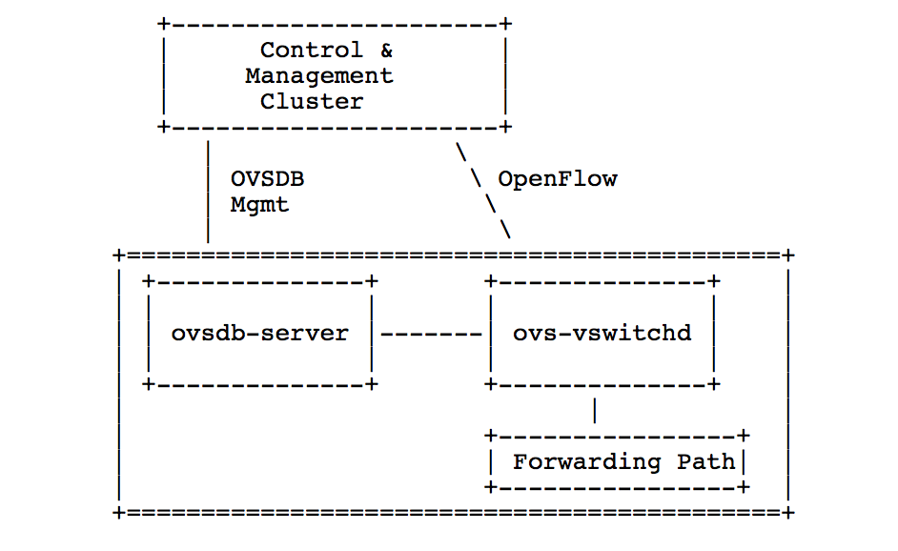

OVSDB - RFC 7047
Open vSwitch Database Management Protocol

Slide 4
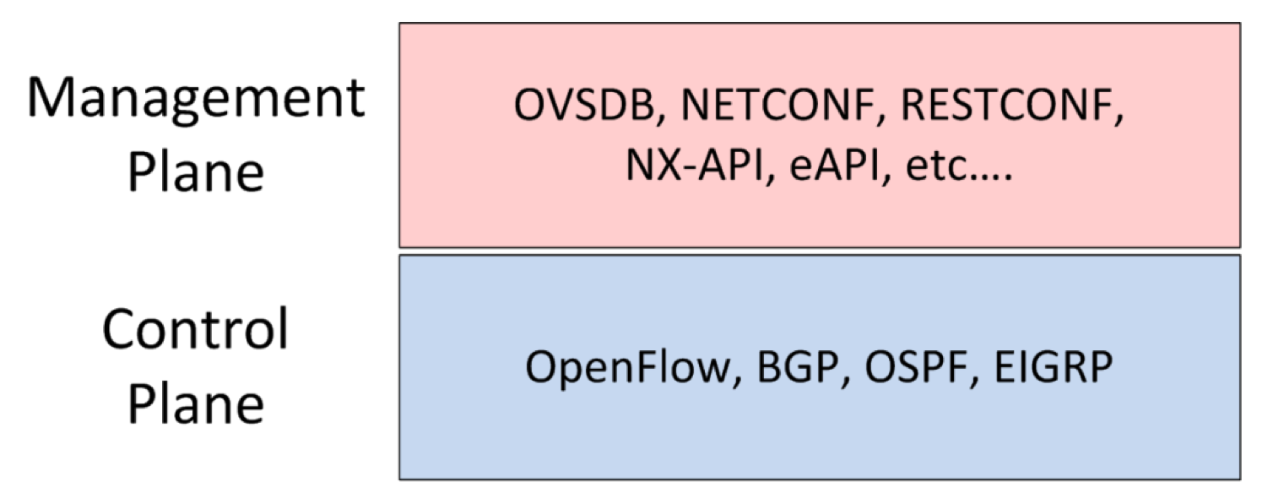
OVSDB vs Openflow

Slide 5
OVSDB
“Beautifully simple”
Bidirectional JSON-RPC
Schema based
Standard Database Operations

Slide 6
1. JSON-RPC 1.0
Request : { “id" : <string> or <integer> “method" : <string>, “params" : [<object>] }
Response : { "id":<string> or <integer> “result" : [<object>], “error" : <error> }
Sample “get_schema” request
{
"id": “cf3f5cd1-0690-40bb-…”
"method": “get_schema",
"params": [
"Open_vSwitch"
]
}

Slide 7
RPC methods
list_dbs
get_schema
transact
cancel
monitor
monitor_cancel
lock
steal
unlock
echo
update
locked
stolen
echo

Slide 8
2. Schema
<database-schema> : { “name”:<id>, "tables": {<id>: <table-schema>, …}, …, }
<table-schema> : { "columns": {<id>: <column-schema>, ...} …, }
<column-schema> : { "type": <type> …, }
Sample (Open_vSwitch Schema) response
{
"id": "cf3f5cd1-0690-40bb-9cfb-1a4e690b6edb",
"result": {
"name": "Open_vSwitch",
"tables": {
"Bridge": {
"columns": {
"controller": {
"type": {
"key": {
"refTable": "Controller",
"type": "uuid"
},
"max": "unlimited",
"min": 0
}
},
"datapath_id": {
"type": {
"key": "string",
}
},
…
…
}

Slide 9
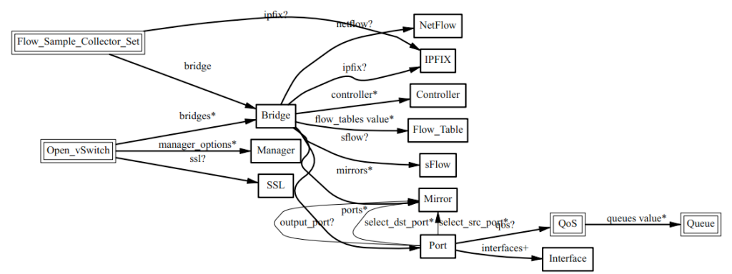
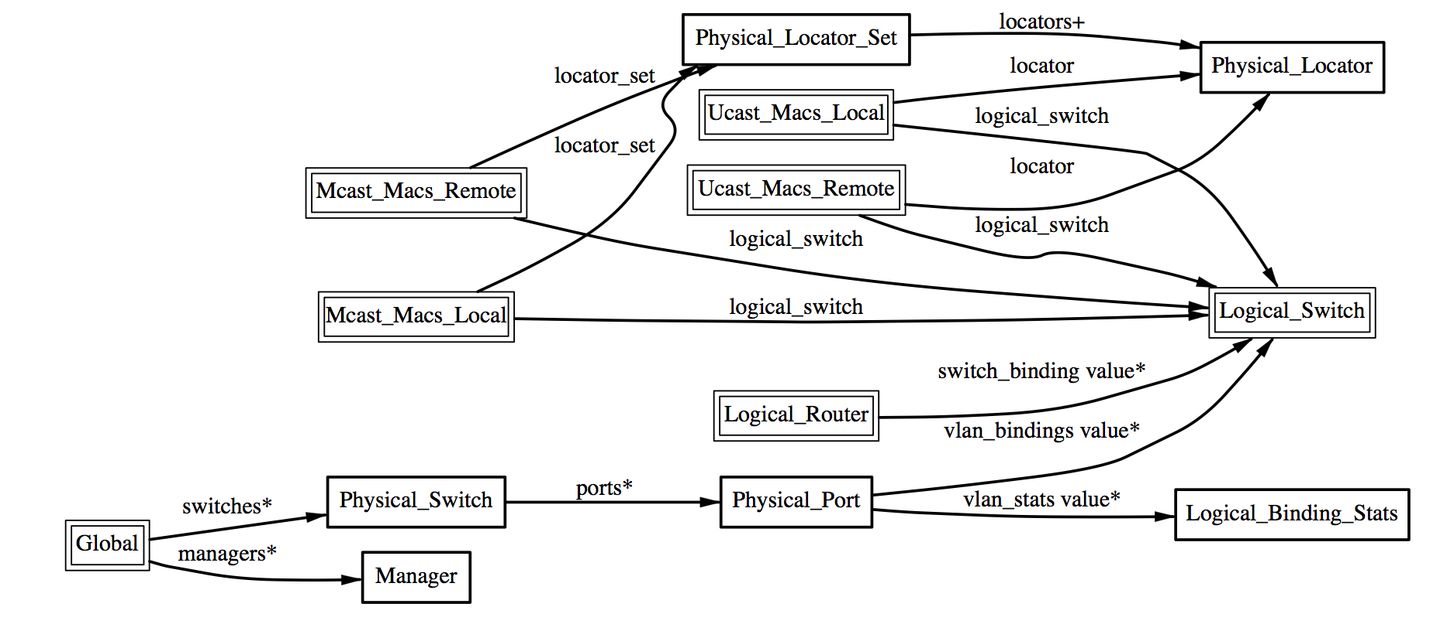
Open_vSwitch
http://openvswitch.org/ovs-vswitchd.conf.db.5.pdf
hardware_vtep
http://openvswitch.org/docs/vtep.5.pdf

Slide 10
3. Database Operations
insert
select
update
mutate
delete
wait
commit
abort
comment
assert
transact method

Slide 11
Sample transact operations
atomic, consistent & isolated
{
"id": "35ed2089-da1e-4898-80a4-b5506ab7f227",
"method": "transact",
"params": [
“Open_vSwitch”,
{
"op": "update",
"row": {
"ports": [
"set",
[
[
"uuid",
"55c2f8c4-257e-4a2b-ac4c-99ddfd77240c"
]
]
},
"table": "Bridge",
"where": [
[
"_uuid",
"==",
[
"uuid",
"f14fb5aa-1578-4ca0-81c3-4bb9c1c2ba5f"
]
]
]
},
{
"mutations": [
[
"next_cfg",
"+=",
1
]
],
"op": "mutate",
"table": "Open_vSwitch",
"where": [
[
"_uuid",
"==",
[
"uuid",
"987c42d0-eab0-43d9-a32b-4246973706c2"
]
]
]
},
{
"comment": “Awesome comment"
"op": "comment"
}
]
}

Slide 12
What next ?
Open-Source OVSDB Client implementations Demo : Java & Go based https://github.com/socketplane/libovsdb
Want to develop your own Stamp collection DB ?
git clone https://github.com/openvswitch/ovs
refer to vswitchd/vswitch.ovsschema & vtep/vtep.ovsschema
Write your own stamp collector schema and start collecting.

