Slide 1
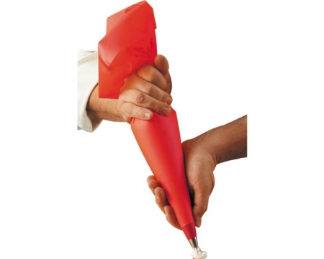

Extending OVN Forwarding Pipeline
for
Topology-based Service Injection
DNS
Liran Schour (IBM)
Gal Sagie (Huawei)
LB
SDN
App 2
Ingress
(Table 0)
L2
(Table 16)
L3
(Table 17)
Egress
(Table 64)
SDN
App
QoS
FW

Slide 2
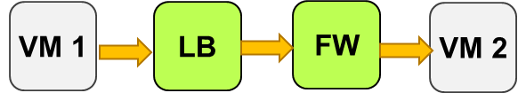
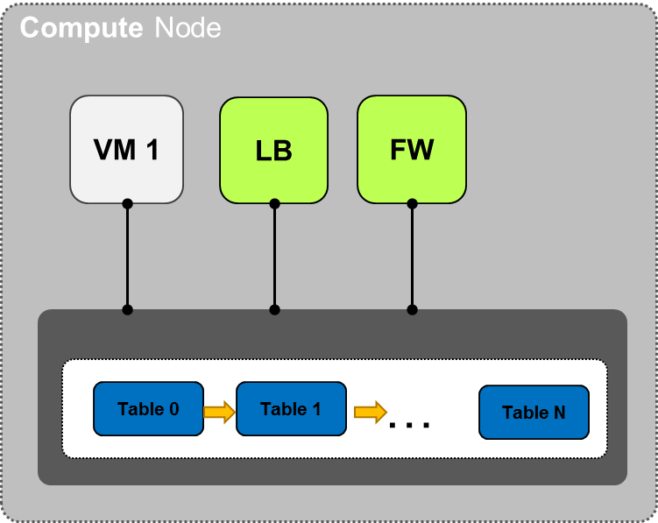
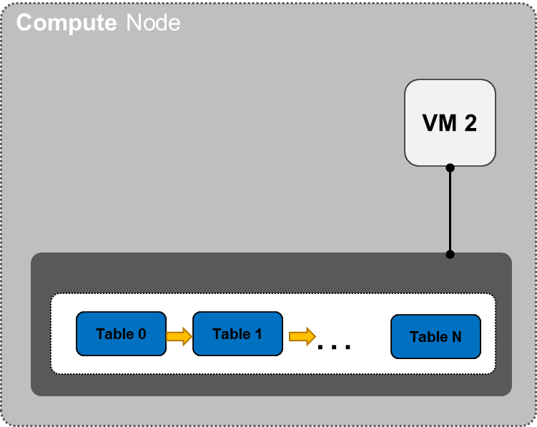
Classic Service Chaining
Traffic Route
Notes:
<voice note: Here we'd explain the part about them being vendor specific makes that each Neutron vendor would have to make its own implementation of libnetwork or cni reinventing the wheel and without the ability to share the common parts./>

Slide 3
Classic Service Chaining
Chain of ports the traffic traverses
Classifier for entry point
Different types of chains
Static or dynamic
Different underlying technologies
NSH
MPLS
App ports
End points of various kinds
VMs
Containers
User space applications
Physical devices
Notes:
<voice note: Here we'd explain the part about them being vendor specific makes that each Neutron vendor would have to make its own implementation of libnetwork or cni reinventing the wheel and without the ability to share the common parts./>

Slide 4
Topology-based Service Injection
External Application
Compute Node
VM 1
VM 2
OpenFlow / Other API
Table 0
Table 1
External
Application
Table
Table N
…
Notes:
<voice note: Here we'd explain the part about them being vendor specific makes that each Neutron vendor would have to make its own implementation of libnetwork or cni reinventing the wheel and without the ability to share the common parts./>

Slide 5

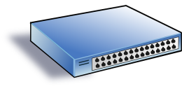
Service Injection Hooks
Logical Router
Distributed
Load
Balancing
DPI
Logical Switch
Logical Switch
DSCP
Marking
VM 1
VM 2
VM 3
Notes:
<voice note: Here we'd explain the part about them being vendor specific makes that each Neutron vendor would have to make its own implementation of libnetwork or cni reinventing the wheel and without the ability to share the common parts./>

Slide 6
Topology Service Injection
Interact with base OpenFlow pipeline
Leverage classification metadata
Distributed network services
Flow based
Compatible with SDN Applications
Can use OpenFlow
Expose virtual topology
Inject services in specific hooks
Easily extendable
No code modifications
Notes:
<voice note: Here we'd explain the part about them being vendor specific makes that each Neutron vendor would have to make its own implementation of libnetwork or cni reinventing the wheel and without the ability to share the common parts./>

Slide 7
Service Injection Example – IPS
IPS Manager
IPS recognizes infected VM
Data Path App
Compute Node
VM 1
IPS
Table 0
…
Table N
Service
Chains
Notes:
<voice note: Here we'd explain the part about them being vendor specific makes that each Neutron vendor would have to make its own implementation of libnetwork or cni reinventing the wheel and without the ability to share the common parts./>

Slide 8
Service Injection Example – IPS
IPS Manager
IPS app manager installs blocking flows for VM1 traffic (Quarantine)
Data Path App
Compute Node
VM 1
IPS
Table 0
…
Table N
Service
Chains
Notes:
<voice note: Here we'd explain the part about them being vendor specific makes that each Neutron vendor would have to make its own implementation of libnetwork or cni reinventing the wheel and without the ability to share the common parts./>

Slide 9

Extending the OVN Logical Pipeline
Today OVN logical forwarding pipeline is fixed
NB DB entries are compiled into logical flows in SB DB by the northd
Logical flows are compiled to OF flows by OVN controllers on compute nodes
Fixed pipeline is not easy to extend
It takes changing the OVN codebase
Extensible logical pipeline
Allows external applications to affect flow routes, e.g. for service injection
High level APIs to dynamically introduce packet processing rules
OVN system compiles these out-of-band abstract rules into the forwarding pipeline
Notes:
This is a summary slide, to have the concise abstract for post-factum readers

Slide 10
OVN today and extending the logical pipeline
Fixed forwarding pipeline
Proactively compiled down to vswitches
Hard to Integrate new functionality
CMS ( Neutron )
Northbound DB
northd
Southbound DB
Compute Node 1
Compute Node 1
OVN-Controller
OVN-Controller
…
OVS
OVS
Notes:
Fixed logical pipeline
CMS/Neutron defines logical network topology
Northd translates logical network topology into logical pipelines stored in SB DB
Each ovn-controller pro-actively compiles logical pipelines into flow tables inside vswitches
Hard to add new functionality – you will need to integrate your code into the OVN code base

Slide 11
Service Injection with the extended OVN logical pipeline
External
Service
1
Northbound DB
Define the service and attach it to a logical topology element (logical router, logical switch, logical port)
2
Topology
Services
Table
Return a token to access service dedicated table
3
4
Add logical flows to the dedicated table
Translate new topology with the service dedicated table
northd
Southbound DB
Push logical flows into OVN controllers
5
Compute Node 1
Compute Node 1
6
Write OF flow entries to vswitch
OVN-Controller
OVN-Controller
6
…
6
Forward traffic based on new flow table
OVS
OVS
7
7
7

Slide 12

Motivational Example: Differentiating Elephant Flows
Where: Hybrid physical network infrastructures
Electro-optical DCN (EU FP7 Project COSIGN )
DCI with differentiated capacities (EU H2020 Project BEACON )
What: Transfer elephant flows over special routes
Optical circuits (also dynamically created)
Low latency DCI paths
How
sFlow collector detects elephant flows on virtual switches
OVN-enabled service introduces DSCP marks for the elephant flows
Notes:
- We had 2 EU projects that we used this method to mark flows using IP DSCP field
Hybrid physical network: Optical and electronic → wanted to route elephant flows over the optical fabric
DCI with differentiated capacities → wanted to route traffic according to tenant affinity
The way that we implemented it was by SFLOW collector that detects elephant flows on the virtual switches and the OVN-enabled service marks these flows by marking the IP DSCP field

Slide 13



Demo …
SouthBound DB
Logical pipeline
Set logical flow:
10.0.0.3→10.0.0.4 TCP port 1234 actions: ip.dscp=64
Push Logical Flow
Apply DSCP marking rule to the Elephant flow
Write flows to table
Host 1
Host 2
Guest 1
10.0.0.3
sFlow collector with Elephant detection
Guest 2
10.0.0.4
Flow Table
Flow Table
0 | 1 | … |  | 64
0 | 1 | … |  | 64
Collect
sFlow
samples
fast path
Detect elephant flow:
10.0.0.3 → 10.0.0.4 TCP port 1234
slow path
Notes:
- SFLOW collector monitors the traffic from OVN vswitches
Detects elephant flow
Write new logical flow to mark DSCP field on the logical flow table
Ovn-controllers compile ne logical flows to flow tables on vswitches
Elephant flow is routed over dedicated fabric ( Optical fabric )

Slide 14
Summary
We’ve demonstrated the value of the extensible forwarding pipeline
Let external, loosely coupled, applications to affect forwarding decisions
For flexible service insertion and service chaining
While leveraging out-of-band information, e.g. flow monitoring by external collectors
Quick PoC – QoS marking of elephant flow packets
Classified by the external tool based on out-of-band statistics collection
So that marked flows can be easily detected and discriminated in the network
The goal is to open a discussion on including this feature in OVN
Generalization – to include a diverse range of use cases
Clean APIs – service definition, high level packet processing rules definition, etc.
Security and correctness – authentication, ordering, conflict resolution, etc.
Notes:
This is a summary slide, to have the concise abstract for post-factum readers
Last bullet is the message to get through

Slide 15
Backup

Slide 16






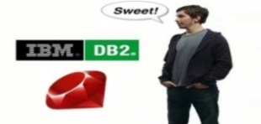




Federated Cloud Tenants Differentiate service between clouds
Application Clients
Application Owner
Application Clients
Tenant B
Tenant A
A
B
B
A
Cloud Mgmt.
Federation Management
Cloud Mgmt.
OVN
Inter cloud diff service
OVN
Private virtual
network
Federation Agent
Federation Agent
Grant agreement no: 644048
ovn-vtep
ovn-vtep
Federation tunnel

Slide 17




Optical DCN Dynamically created circuits to offload heavy flows
Horizon
vApp
vDC
netOps
Orchestration and Management Planes
Heat
vApp
vDC
netOps
Nova
Neutron
OVN
Ext.
Grant agreement no: 619572
Control Plane
Virtual Controller
Physical
Controller
Set logical flows
Elephant detector
Data Plane
Server
Opto-Electronic Switch
Optical Switch
Opto-Electronic Switch
Server
Server
Opto-Electronic Switch
Optical Switch
Opto-Electronic Switch
Server
Server
Opto-Electronic Switch
Optical Switch
Opto-Electronic Switch
Server
Nova Compute
Virtual Switch
Nova Compute
Virtual Switch
Nova Compute
Virtual Switch
Nova Compute
Virtual Switch
Nova Compute
Nova Compute
Packet
Tunnel with DSCP markers

