Slide 1
Measuring OVS Performance
Framework and Methodology
Vasmi Abidi, Ying Chen, Mark Hamilton
vabidi@vmware.com, yingchen@vmware.com

Slide 2
Agenda
Layered performance testing methodology
Bridge
Application
Test framework architecture
Performance tuning
Performance results
Notes:
We address only kernel data path.
No punts to user space

Slide 3
What affects “OVS Performance”?
Unlike a Hardware switch, performance of OVS is dependent on its environment
CPU Speed
Use a fast CPU
Use “Performance Mode” setting in BIOS
NUMA considerations e.g. number of cores per NUMA node
Type of Flows (rules)
Megaflows rules are more efficient
Type of traffic
TCP vs UDP
Total number of flows
Short-lived vs long-lived flows
NIC capabilities
Number of queues
RSS
Offloads – TSO, LRO, cksum, tunnel offloads
vNIC Driver
In application-level tests, vhost may be bottleneck

Slide 4
Performance Test Methodology
Bridge Layer

Slide 5
Bridge Layer: Topologies
Simple loopback
Simple Bridge
Linux Host
Host0
Host1
OVS
OVS
OVS
L2 Switch Fabric
L2 Switch Fabric
Port1
Tx
Port2
Rx
Port1
Tx
Port2
Rx
Spirent Test Center
Spirent Test Center
Topology1
Topology2
Topology1 is a simple loop through hypervisor OVS
Topology2 includes tunnel between Host0 and Host1
No VMs in these topologies
Can simulate VM endpoints with physical NICs
Notes:
Audience Q: What does bullet#3 mean?

Slide 6
Bridge Layer: OVS Configuration for RFC2544 tests
Test Generator wizards typically use configurations (e.g. ‘learning phase’) which are more appropriate for hardware switches
For Spirent, there is an non-configurable delay between learning phase and test phase
Default flow max-idle is shorter than the above delay
Flows will be evicted from kernel cache
Flow miss in kernel cache affects measured performance
Increase the max-idle on OVS
ovs-vsctl set Open_Vswitch . Other_config:max-idle=50000
Note: this is not performance tuning. It is to accommodate the test equipment’s artificial delay after the learning phase

Slide 7
Performance Test Methodology
Application Layer

Slide 8
Application-based Tests Using netperf
Host0
Host1
VM1
VM1
VM8
VM8
OVS1
KVM
OVS2
KVM
L2 Switch Fabric
netperf in VM1 on Host0 connects to netserver on VM1 on Host1
Test traffic is VM-to-VM, upto 8 pairs concurrently, uni and bidirectional
Run different testsuites: TCP_STREAM, UDP_STREAM, TCP_RR, TCP_CRR, ping

Slide 9
Logical Topologies
Bridge – no tunnel encapsulation
STT tunnel
VXLAN tunnel

Slide 10
Performance Metrics

Slide 11
Performance Metrics
Throughput
Stateful traffic is measured in Gbps
Stateless traffic is measured in Frames per Second (FPS)
Maximum Loss Free Frame Rate as defined in RFC2544 (MLFFR)
Alternatively, Tolerate Frame Loss Threshold, e.g. 0.01%
Connections Per Second
Using netperf –t TCP_CRR
Latency
Application level round-trip latency in usec using netperf –t TCP_RR
Ping round-trip latency in usec using ping
CPU Utilization
Aggregate CPU Utilizations on both hosts
Normalized by Gbps

Slide 12
Measuring CPU Utilization
Tools like top under-report for interrupt-intensive workloads
We use perf stat to count cycles & instructions
Run perf stat during test
perf stat -a -A -o results.csv -x, -e cycles:k,cycles:u,instructions sleep <seconds>
Use nominal clock speed to calculate CPU % from cycle count
Record cycles/instruction

Slide 13
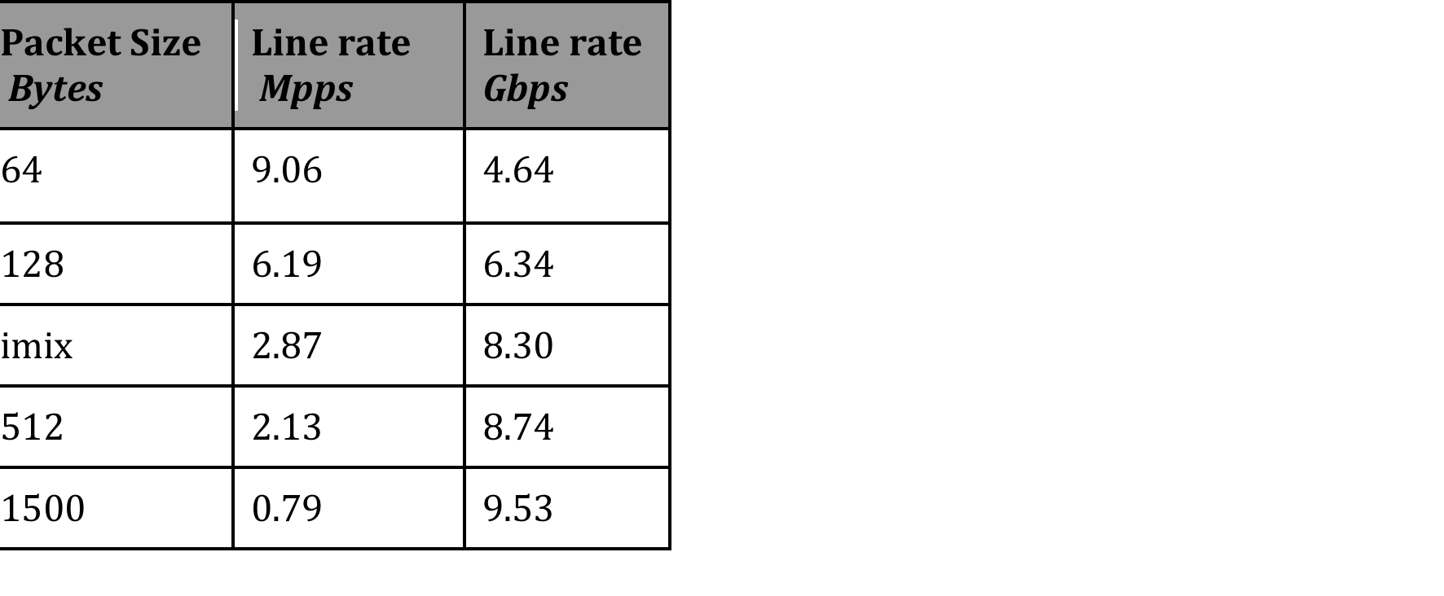
What is “Line rate”?
Maximum rate at which user data can be transferred
Usually less than raw link speed
because of protocol overheads
Example: VXLAN-encapsulated packets

Slide 14
Performance Metrics: variance
Determine variation from run to run
Choose acceptable tolerance

Slide 15
Testing Architecture

Slide 16
Automation Framework Goals & Requirements
Provide independent solutions to do:
System setup and baseline
Upgrade test components
Orchestration of Logical network topology, with and without Controllers
Manage tests and execution
Report generation - processing test data
Provide system setup and baseline to the community
System configuration is a substantial task
Leverage open source community
100% automation

Slide 17
Automation Framework: Solutions
Initial system setup and baseline Ansible
Highly reproducible environment
Install a consistent set of Linux packages
Provide template to the community
Upgrade test components Ansible
Installing daily builds onto our testbed e.g. openvswitch
Logical network topology configuration Ansible
Attaching VMs and NICS, configure bridges, controllers, etc
Test management and execution Ansible, Nose, Fabric
Support hardware generators Testcenter Python libraries
netperf
Extract system metrics
Report generation, validate metrics django-graphos & Highchart
Save results Django

Slide 18
Framework Component: Ansible
Ansible is a pluggable architecture for system configuration
System information is retrieved then used in a playbook to govern changes that are applied to a system
Already addresses major system level configuration
Installing drivers, software packages etc across various Linux Flavors
Agentless – needs only ssh support on SUT (System Under Test)
Tasks can be applied to SUTs in parallel, or forced to be sequential
Rich template support
Supports idempotent behavior
OVS is automation-friendly, because of CRUD behavior
It’s essentially all Python – easier to develop and debug
Our contributions to Ansible: modules openvswitch_port, openvswitch_bridge, openvswitch_db
Ansible website http://www.ansible.com/home

Slide 19
Performance Results

Slide 20
System Under Test
Dell R620 2 sockets, each with 8 cores, Sandy bridge
Intel Xeon E5-2650v2 @ 2.6GHz, L3 Cache 20MB, mem 128GB
Ubuntu 14.04 64-bit with several system level configurations
OVS version 2.3.2
Use kernel OVS
NIC - Intel X540-AT2 ixgbe version 3.15.1-k
16 queues, because there are 16 cores
(Note: # of queues and affinity settings are NIC-dependent)
Notes:
E5-2650 v2
L3 Cache 20MB
“several system level configs” - which ones
Remove NSX version
OVS build is internal. Won’t be understood by external audience.
“stock driver” – give version
16 rx queues and 16 tx qeueues?
mention 1:1 mapping between queues and cores
Irqbalance disabled? Interrupt moderation?
Affinity settings
NIC MTU?
Queue sizes?
remove last bullet

Slide 21
Testbed Tuning
VM Tuning
Set cpu model to match the host
2 MB huge pages, no sharing locked
Use ‘vhost’, a kernel backend driver
2 vCPU, with 2 vnic queues
Host tuning
BIOS is in “Performance” mode
Disable irqbalance
Affinitize NIC queues to cores
Set swappiness to 0
Disable zone reclaim
Disable arp_filter
VM XML
<cpu mode='custom' match='exact'>
<model fallback='allow'>SandyBridge</model>
<vendor>Intel</vendor>
</cpu>
<vcpu placement='static’>2</vcpu>
<memtune>
<hard_limit>2097152</hard_limit>
</memtune>
<memoryBacking>
<hugepages/>
<locked/>
<nosharepages/>
</memoryBacking>
<driver name='vhost' queues='2'/>
Host /etc/sysctl.conf
vm.swappiness=0
vm.zone_reclaim_mode=0
net.ipv4.conf.default.arp_filter=1
Notes:
remove “new” from title.
VM tuning does not apply to hardware tests
Vhost-net multiqueue used in VM?

Slide 22
Bridge Layer: Topologies
Simple loopback
Simple Bridge
Linux Host
Host0
Host1
OVS
OVS
OVS
L2 Switch Fabric
L2 Switch Fabric
Port1
Tx
Port2
Rx
Port1
Tx
Port2
Rx
Spirent Test Center
Spirent Test Center
Topology1
Topology2
Topology1 is a simple loop through hypervisor OVS
Topology2 includes tunnel between Host0 and Host1
No VMs in these topologies
Can simulate VM endpoints with physical NICs
Notes:
Audience Q: What does bullet#3 mean?

Slide 23
Bridge Layer: Simple Loopback Results
1 and 8 cores NUMA results only use cores on the same NUMA node as the NIC
Throughput scales well per core
Your mileage may vary depending on system, NUMA architecture NIC manufacturer etc.

Slide 24
Bridge Layer: Simple Bridge Results
For 1-core and 8-core cases, CPUs are on same NUMA node as NIC
Results are similar to simple loopback
Ymmv. Depends on system architecture, NIC type, …

Slide 25
Application-based Tests
Host0
Host1
VM1
VM1
VM8
VM8
OVS1
KVM
OVS2
KVM
L2 Switch Fabric
netperf in VM1 on Host0 connects to netserver on VM1 on Host1
Test traffic is VM-to-VM, upto 8 pairs concurrently, uni and bidirectional
Run different testsuites: netperf TCP_STREAM, UDP_STREAM, TCP_RR, TCP_CRR, ping

Slide 26
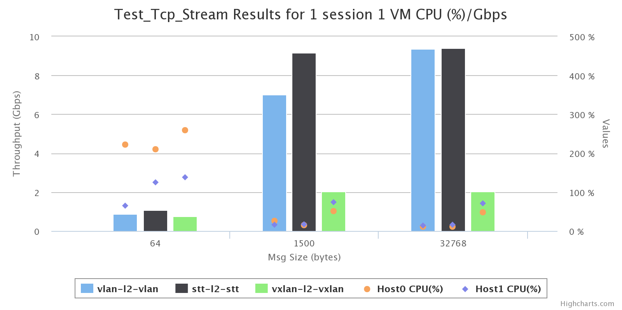
netperf TCP_STREAM with 1 VM pair
 | Throughput
Topology | Msg Size | Gbps
stt | 64 | 1.01
vxlan | 64 | 0.70
vlan | 64 | 0.80
stt | 1500 | 9.17
vlan | 1500 | 7.03
vxlan | 1500 | 2.00
stt | 32768 | 9.36
vlan | 32768 | 9.41
vxlan | 32768 | 2.00
Conclusions
for 64B, sender CPU bound
for 1500B, vlan & stt are sender CPU bound
vxlan throughput is poor. Because no hw offload, CPU cost is high
Notes:
Can remove table, since info is in the chart
With small msg-size, is TCP_NODELAY used (no, for single session)? What’s the pkt size which OVS sees (250B maybe)?
CPU 200%. In host or VM?
Affinity and NUMA considerations

Slide 27
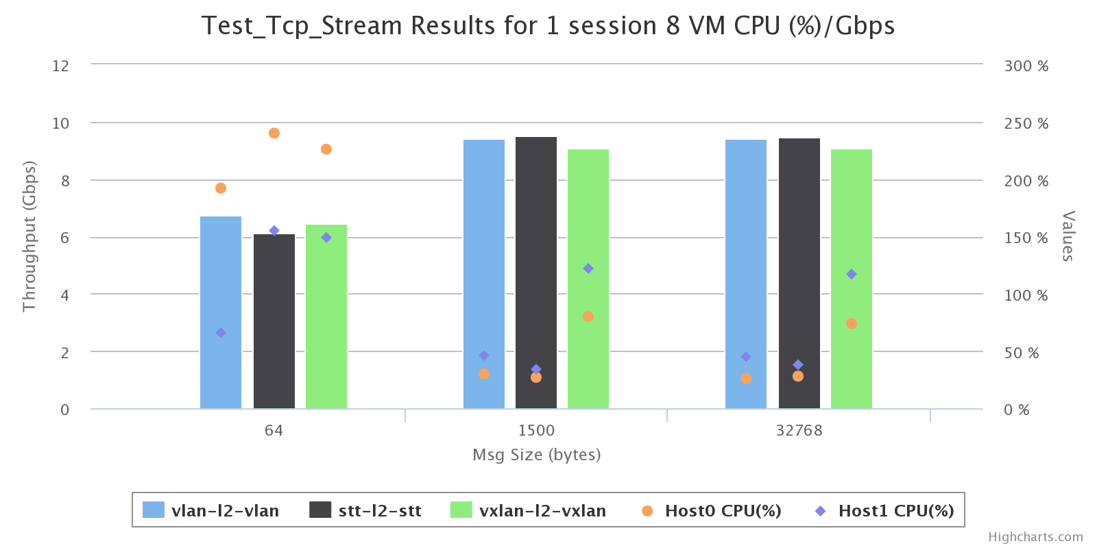
netperf TCP_STREAM with 8 VM pairs
 | Throughput 8 VMs
Topology | Msg Size | Gbps
vlan | 64 | 6.70
stt | 64 | 6.10
vxlan | 64 | 6.48
vlan | 1500 | 9.42
stt | 1500 | 9.48
vxlan | 1500 | 9.07
Conclusions:
For 64B, sender CPU consumption is higher
For large frames, receiver CPU consumption is higher
For given Throughput, compare CPU consumption

Slide 28
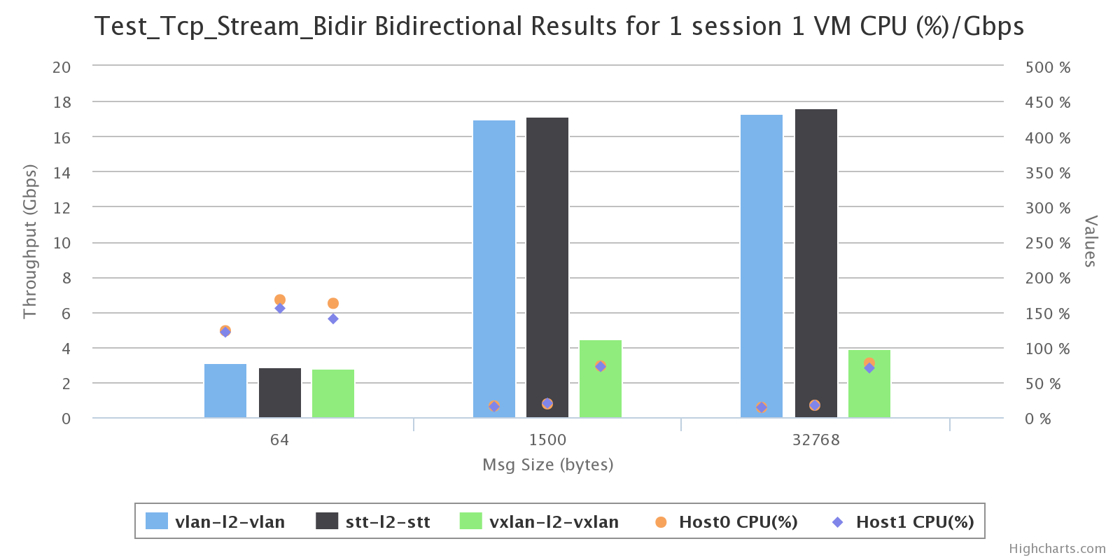
netperf bidirectional TCP_STREAM with 1 VM pair
Bidirectional Throughput 1 VMs
Topology | Msg Size | Gbps
stt | 64 | 2.89
vlan | 64 | 3.10
stt | 1500 | 17.20
 | 1 VM | CPU (%)/Gbps
Topology | Msg Size | Host 0 | Host 1
vlan | 64 | 121 | 121
stt | 64 | 167 | 155
stt | other | 15 | 15
Conclusion:
Throughput is twice unidirectional

Slide 29
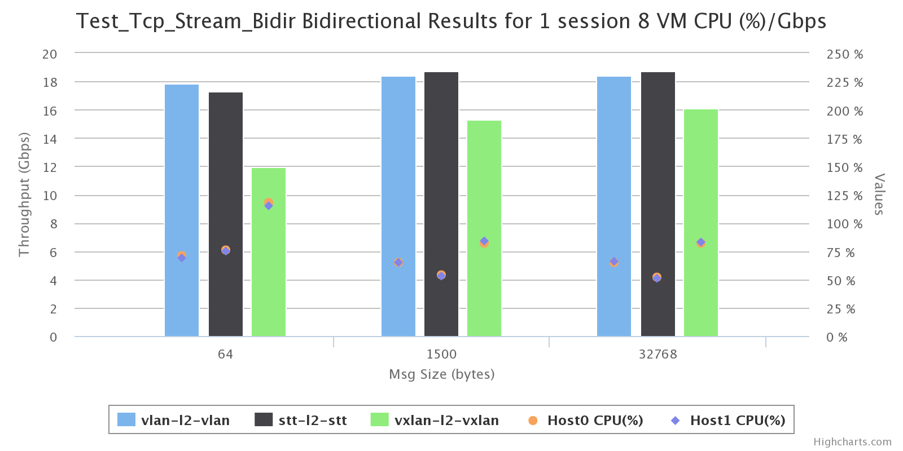
netperf bidirectional TCP_STREAM with 8 VM pairs
Bidirectional Throughput 8 VMs
Topology | Msg Size | Gbps
vlan | 64 | 17.85
stt | 64 | 17.3
vlan | 1500 | 18.4
vlan | 1500 | 18.7
 | 8 VM | CPU (%)/Gbps
Topology | Msg Size | Host 1 | Host 2
vlan | 64 | 69 | 69
stt | 64 | 75 | 75
vxlan | 64 | 118 | 118
vlan | 1500 | 65 | 65
stt | 1500 | 53 | 53
Note:
Symmetric CPU utilization
Large frames, STT utilization is the lowest

Slide 30
Testing with UDP traffic
UDP results provide some useful information
Frame per second
Cycles per frame
Caveat: Can result in significant packet drops if traffic rate is high
Use packet-generator that can control offered load, e.g. ixia/spirent
Avoid fragmentation of large datagrams

Slide 31
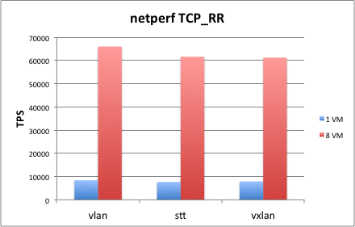
Latency Using netperf TCP_RR
Transactions/sec for 1-byte request-response over persistent connection
Good estimate of end-to-end RTT
Scales with number of VMs

Slide 32
CPS Using netperf TCP_CRR
Multiple concurrent flows
Topology | Session | 1 VM | 8 VMs
vlan | 64 | 26 KCPS | 113 - 118 KCPS
stt | 64 | 25 KCPS | 83 - 115 KCPS
vxlan | 64 | 24 KCPS | 81 - 85 KCPS
Note: results are for the ‘application-layer’ topology

Slide 33
Summary
Have a well-established test framework and methodology
Evaluate performance at different layers
Understand variations
Collect all relevant hw details and configuration settings

Slide 34
Thank You!

