Slide 1



ovn4nfv
Vikram Dham, Dell Research
Russell Bryant, RedHat
Gal Sagie, Huawei European Research Centre
Wenjing Chu, Dell Research

Slide 2
Agenda
The Big Picture
ETSI NV Constructs
ovn4nfv
Thanks

Slide 3

Big picture – what is happening?
OpenStack neutron plugin focus on OpenStack API
Security Groups/Rules for logical networks
Container Integration
DVR/L3
OVN development
Solving the hard networking problems
Simpler API for neutron plugin developers
Functionality of neutron agents moving into OVN
Neutron + OVN => Agentless lean networking
Notes:
Neutron + ovs agents + ovs
Is changing to
Neutron + ovn
It is a ntural recourse for OpenStack to take to maintain highvelocity development of

Slide 4
ovn4nfv – Let’s turn it on in OPNFV
Project name: ovn4nfv (proposal stage)
Category: Collaborative Development
Contribute to upstream projects: openvswitch, networking-ovn, tacker and networking-sfc
Project Goal: This project will enable OVN as another option for network control in OPNFV
Committers: Vikram Dham, Russell Bryant, Lingli Deng, Wenjing Chu, Gal Sagie, Murali Murali Rangachari

Slide 5
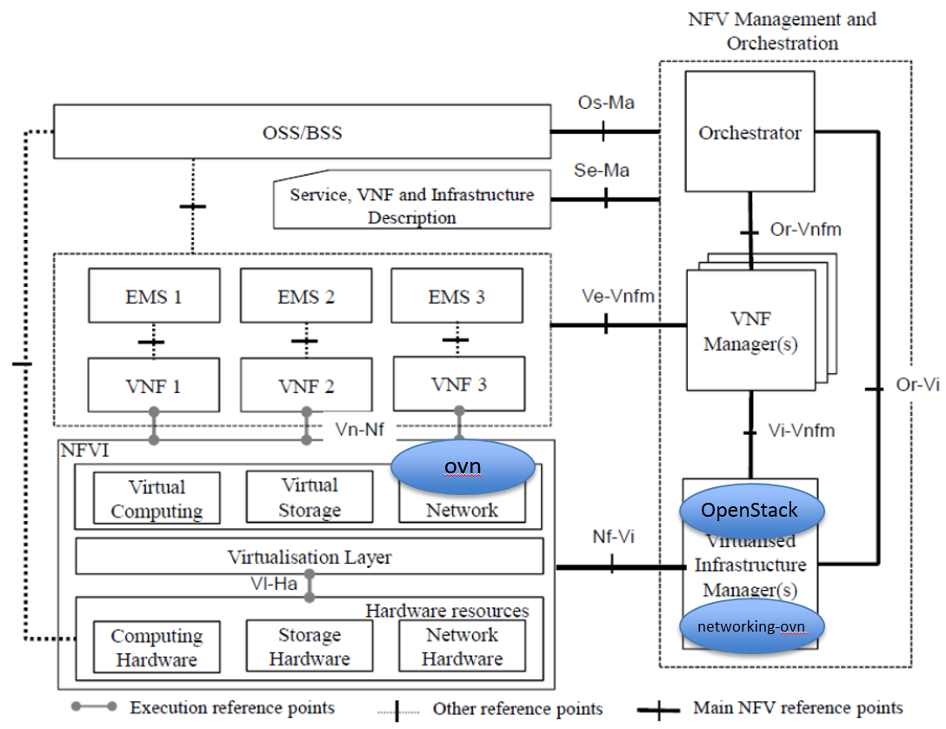
OVN on ETSI NFV Architecture
Notes:
OVN will replace the neutron agents / ovs/dhcp
Networking-ovn is the new plugin

Slide 6
Constructs for ETSI NV
Constructs | ovn | networking-ovn | OpenStack Target Release
Logical L2 | supports | supports | Mitaka (April 7th 2016)
DHCP agent | coming soon | coming soon | Mitaka
L3/DVR | supports | coming soon | Mitaka
ACLs | supports | supports | Mitaka
SFC | needs work | needs work | Mitaka (high risk)
LBaaS | needs work | needs work | TBD
multi-site | needs work | needs work | TBD
HA | needs more work | needs more work | TBD

Slide 7
Participate
Contributors welcome!
Exciting work
Users/ Service Providers/ Telcos welcome!
Option to use a lean network controller
Thanks
Notes:
We will have demo using devstack

