Slide 1

OVS and L7 classification (DPI) Demo part 1: L7 Firewall, L7 QoS Demo part 2: L7 Service Chaining
Open vSwitch conference, November 2015
Franck Baudin

Slide 2
Agenda
OVS & L7 Classification insights
Demo part 1: L7 Firewall and L7 QoS
Demo part 2: L7 Service Chaining
Next steps
Annexes: demos screenshots, collaterals

Slide 3
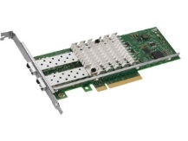
Asynchronous L7 classification: general overview
☹ Delay L7 classification
1st packet already out
☺ Minimum jitter
datapath best/worst case
☺ Garanted latency
datapath worst case
☺ No HEAD of line blocking
by async. design
RX & dispatch
10%
copy
datapath
Flow table
DPI engine
L7, application ID
async.
update
steer, QoS, drop…
100%
TX

Slide 4
Asynchronous L7 classification with OVS via the conntrack table
Linux Kernel
Linux user space
RX & dispatch
OVS kernel
datapath
NL_CT
L7 classifier
(DPI engine)
Flow Table
skbuff->CT->mark
conntrack
table
mark
label
QoS, drop, output …
100%
TX
10%
LOCAL OVS port
(L7PORT)

Slide 5
L7 rule-set hierarchy
L7 matcher
L1-4 matcher
action
Table 0
attach CT
resubmit table 1
Table 1
CLASSIFIED
resubmit table 2
output L7PORT
resubmit table 2
Table 2
SSH
TCP port 22
NORMAL
SSH
DROP
NORMAL

Slide 6
Agenda
OVS & L7 Classification insights
Demo part 1: L7 Firewall and L7 QoS
Demo part 2: L7 Service Chaining
Next steps
Annexes: demos screenshots, collaterals

Slide 7




Demo overview
ssh on port 22 => PASS
ssh on port 5022 => DROP
L7
http server (vmlinuz) => FULL SPEED
bittorrent (vmlinuz) => RATE LIMIT
L7
client
OVS** + L7 classifier
server
** https://github.com/justinpettit/ovs.git, 4a5c0cf

Slide 8
Agenda
OVS & L7 Classification insights
Demo part 1: L7 Firewall and L7 QoS
Demo part 2: L7 Service Chaining
Next steps
Annexes: demos screenshots, collaterals

Slide 9


Dynamic Service Function Chaining: concept overview
Internet
WEB
access
BITTORRENT
L7 Service Classifier
SFF
Service Function Forwarder
FW
RL
LB
PC

Slide 10
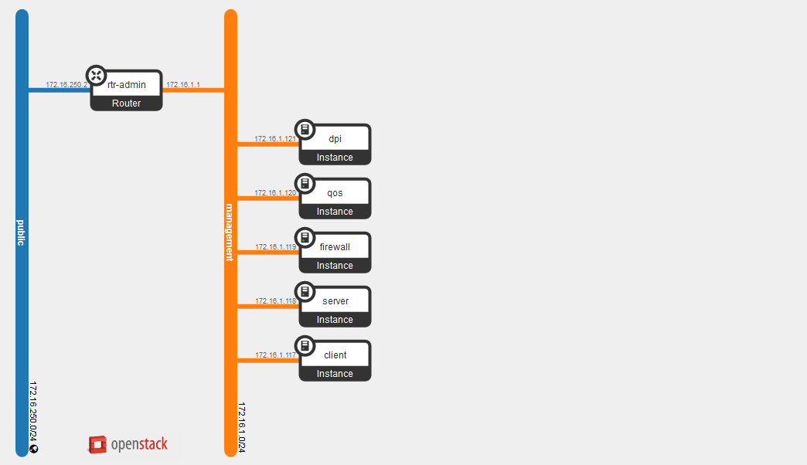
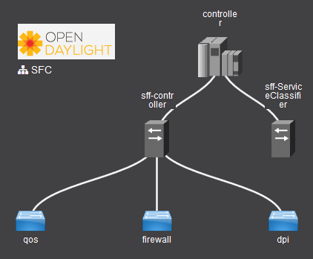

Demo topology
L7 classifier
(DPI engine)
br-sff
br-classifier
br-internet
br-access

Slide 11
br-classifier OVS rules
CHAIN NAME | RSP | TOS | CHAIN
Encrypted | Encrypted-Path-23 | 92 | firewall -> qos
Peer2Peer | Peer2Peer-Path-24 | 96 | qos
# port1: access, port2: internet, port3: SFF
table=0, priority=3,in_port=3 actions=resubmit(,30) # From SFF
table=0, priority=2,ct_state=-trk,ip actions=ct(table=1) # IP traffic: attach CT
table=0, priority=1,in_port=1 actions=output:2 # non IP traffic, bypass
table=0, priority=1,in_port=2 actions=output:1 # non IP traffic, bypass
# Send packet to L7 classifier when required (classif in progress, signaling protocol like SIP or FTP)
table=1, priority=2,ct_state=+new actions=ct(commit),output:4,resubmit(,2)
table=1, priority=1,ct_mark=0x80000000/0x80000000 actions=resubmit(,2) # classif done, offloaded
table=1, actions=output:4,resubmit(,2) # under classif
# Send ssh (0xc6) in Encrypted chain (tos=92), bittorrent (0xf) in Peer2Peer (tos=96)
table=2, priority=11,ct_mark=0xc6/0xffff,in_port=2 actions=mod_nw_tos:92,output:3 # to SFF
table=2, priority=10,ct_mark=0xf/0xffff,in_port=2 actions=mod_nw_tos:96,output:3 # to SFF
table=2, priority=0,in_port=1 actions=output:2 # default policy
table=2, priority=0,in_port=2 actions=output:1 # default policy
# Chains exit, remove the SFC mark (really matters when using NSH, MPLS, VLANs… instead of TOS)
table=30, priority=10,ip,in_port=3,nw_tos=96 actions=mod_nw_tos:0,output:1
table=30, priority=11,ip,in_port=3,nw_tos=92 actions=mod_nw_tos:0,output:1

Slide 12
Br-SFF rules
CHAIN NAME | RSP | TOS | CHAIN
Encrypted | Encrypted-Path-23 | 0x5c | firewall -> qos
Peer2Peer | Peer2Peer-Path-24 | 0x60 | qos
table=0, priority=2,dl_vlan_pcp=1 actions=resubmit(,30)
table=0, priority=1,ip actions=move:NXM_OF_IN_PORT[0..11]->NXM_OF_VLAN_TCI[0..11],mod_vlan_pcp:1,resubmit(,10)
table=10, priority=1000,ip,dl_vlan=9,dl_vlan_pcp=1 actions=move:NXM_OF_IP_TOS[]->NXM_NX_REG0[0..7],load:0xff->NXM_NX_REG1[0..7],resubmit(,20)
table=10, priority=255,ip,dl_vlan=21,dl_vlan_pcp=1,nw_tos=92 actions=load:0x5c->NXM_NX_REG0[0..7],load:0xfe->NXM_NX_REG1[0..7],resubmit(,20)
table=10, priority=254,ip,dl_vlan=23,dl_vlan_pcp=1,nw_tos=92 actions=load:0x5c->NXM_NX_REG0[0..7],load:0xfd->NXM_NX_REG1[0..7],resubmit(,20)
table=10, priority=255,ip,dl_vlan=23,dl_vlan_pcp=1,nw_tos=96 actions=load:0x60->NXM_NX_REG0[0..7],load:0xfe->NXM_NX_REG1[0..7],resubmit(,20)
table=20, priority=255,reg0=0x5c,reg1=0xff actions=mod_vlan_vid:20,mod_vlan_pcp:1,resubmit(,30)
table=20, priority=254,reg0=0x5c,reg1=0xfe actions=mod_vlan_vid:22,mod_vlan_pcp:1,resubmit(,30)
table=20, priority=255,reg0=0x60,reg1=0xff actions=mod_vlan_vid:22,mod_vlan_pcp:1,resubmit(,30)
table=20, priority=0 actions=mod_vlan_vid:9,mod_vlan_pcp:1,resubmit(,30)
table=30, priority=1000,ip,dl_vlan_pcp=1 actions=move:NXM_OF_VLAN_TCI[0..11]->NXM_NX_REG2[0..11],strip_vlan,output:NXM_NX_REG2[0..11]
table=30, priority=1,ip actions=drop
For reference only, too complex for a quick live explanation
Key points
Map NSH NSP/NSI into REG0/REG1 (will ease implementation with NSH)
Multiple SFF support (VNFs distributed among multiples compute nodes)

Slide 13
Agenda
OVS & L7 Classification insights
Demo part 1: L7 Firewall and L7 QoS
Demo part 2: L7 Service Chaining
Next steps
Annexes: demos screenshots, collaterals

Slide 14
Next steps
L7 aware management: OpenStack, OVN, ODL, GBP, FWaaS,…
Optimization: zero copy instead of a copy over a port/tap
Requires a new kernel module, kind of inverted PF_RING
Qosmos developed one, to be open sourced when needed
Porting within DPDK datapath
L7 classifier running as a DPDK secondary process
Interconnected via a DPDK ring
L7 visibility: enriched IPFIX with L7 classification
Exporting ct_mark and ct_label
Exporting associated metadatas (MIME type, SQL request, filename, …)
Need to add a scratchpad in conntrack, with NL_CT accessors…
L7 aware Service Chaining: extend OVS NSH actions (which are under dev.)
NSH type 1 with L7 application ID (aka ct_mark/ct_label)
Metadata extraction and NSH type2

Slide 15
Thanks! Questions?

Slide 16
Annexes
L7 classification insights
Demo part 1: configuration details & step by step screenshots
Demo part 2: screenshots

Slide 17
L7 classification insights: functional
L7 classification is based on network conversations analysis
Conversation: (client -> server) and (server -> client)
2 OpenFlow flows
Direct mapping on Linux: conntrack
L7 classification is based on payload
IP reassembly
TCP segment reordering
Most applications are classified with the first packet of payload
… so right after TCP handshake
some applications requires more packets (skype, bittorrent, …)
Signalization protocols generating RELATED conversations to be analyzed even if classified (ex: ftp & ftpdata)
If the application is not recognized after N packets: classified as “unknown”

Slide 18
DPI engine performances on Intel(R) Xeon(R) E5-2690 v3 @ 2.60GHz
9Gbps/core
Scalable on a socket
Best design: one instance per socket
Realistic traffic profile
real application sessions
HTTP, DNS, Bittorrent, SIP, POP3,…
Average frame size: 799.53 bytes
Breakingpoint traffic generator
North American Wireless Carrier Weekday profile
Notes:
~100k sessions/second per 10 Gbps
~2Mpps per 10 Gbps

Slide 19
Annexes
L7 classification insights
Demo part 1: configuration details & step by step screenshots
Demo part 2: screenshots

Slide 20
Demo part 1, L7 Firewall, L7 QoS: ovs configuration
ovs-ofctl del-flows br0
# table 0: attach a conntrack to all ip packets
# ---------------------------------------------
ovs-ofctl add-flow br0 "priority=40000,table=0,ip,ct_state=-trk,actions=ct(table=1)"
ovs-ofctl add-flow br0 "action=NORMAL"
# table1: send a copy of the packets to the L7 classifier
# -------------------------------------------------------
ovs-ofctl add-flow br0 "table=1,priority=2,ct_state=+new,actions=ct(commit),output:$L7PORT,resubmit(,2)"
ovs-ofctl add-flow br0 "table=1,priority=1,ct_mark=0x80000000/0x80000000 actions=resubmit(,2)"
ovs-ofctl add-flow br0 "table=1,priority=0,actions=output:$L7PORT,resubmit(,2)"
# table2: packet behaviour, depending on ct_mark
# ----------------------------------------------
# offload == ct_mark/0x80000000
# L7 proto == ct_mark/0x7FFF0000 (http, RTP, ... L7 == APP_ID in many cases: ssh, ftp)
# APP_ID == ct_mark/0x0000FFFF (facebook, gmail, bittorrent, SQL, SNMP, CIFS, Exchange, TFTP, …)
# Drop ssh on non regular ports (L7 proto == 0xc6)
ovs-ofctl add-flow br0 "table=2,ct_mark=0x00c60000/0x7FFF0000,ip,tcp,tcp_dst=22,action=NORMAL"
ovs-ofctl add-flow br0 "table=2,ct_mark=0x00c60000/0x7FFF0000,ip,tcp,tcp_src=22,action=NORMAL"
ovs-ofctl add-flow br0 "table=2,priority=1,ct_mark=0x00c60000/0x7FFF0000,ip,action=drop"
# Rate limit bittorrent (L7 proto == 0xf)
ovs-vsctl -- set Port $CLIENTPORT_NAME qos=@newqos -- \
--id=@newqos create QoS type=linux-htb other-config:max-rate=1000000000 queues=0=@q0,1=@q1 -- \
--id=@q0 create Queue other-config:min-rate=1000000000 other-config:max-rate=1000000000 -- \
--id=@q1 create Queue other-config:min-rate=4000000 other-config:max-rate=4000000
ovs-ofctl add-flow br0 "table=2,priority=2,ct_mark=0x000f0000/0x7fff0000,ip,action=set_queue:1,NORMAL"
# Let all other traffic pass
ovs-ofctl add-flow br0 "table=2,priority=0,action=NORMAL"

Slide 21
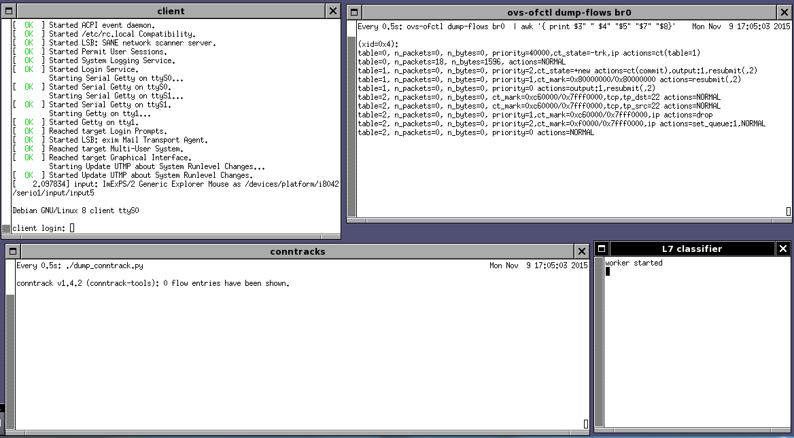
Demo part1: start-up
ICMPv6 (DAD)

Slide 22
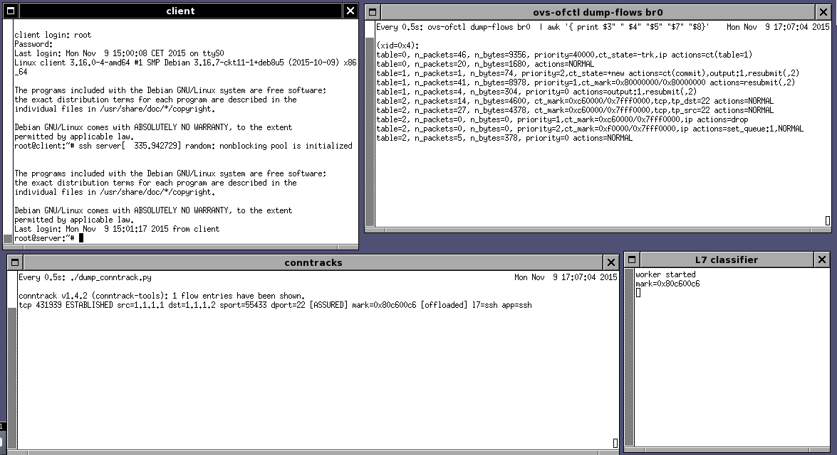
Demo part1: ssh on port 22, pass
ARP
Classification in progress (ct_mark == 0)

Slide 23
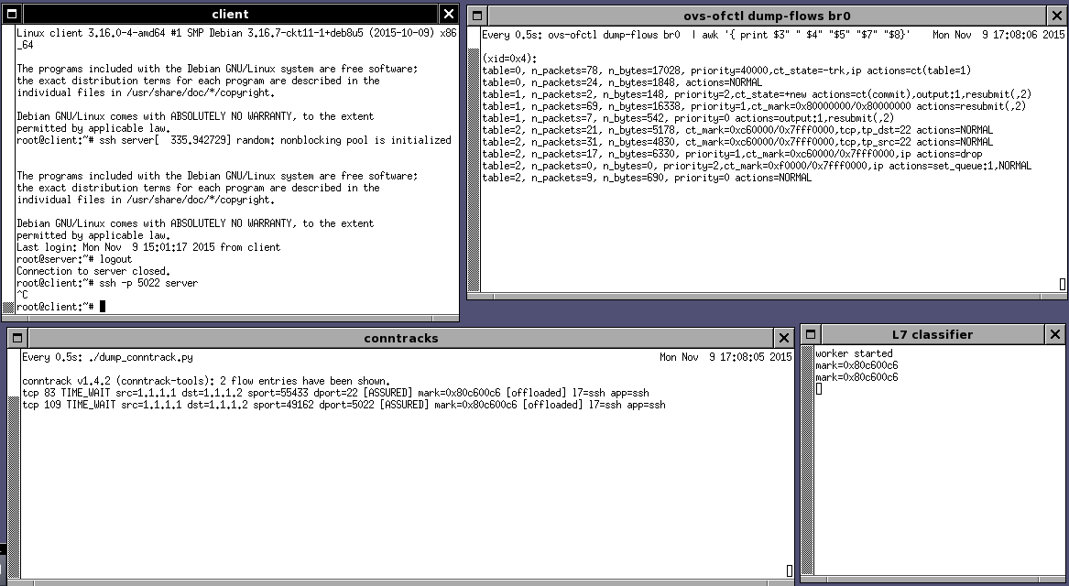
Demo part1: ssh on port 5022, drop
no way to connect…

Slide 24
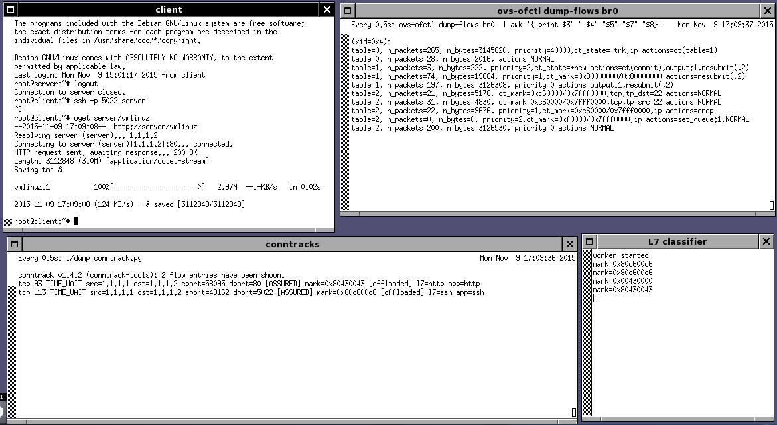
Demo part1: large wget, full speed
Immediate!

Slide 25
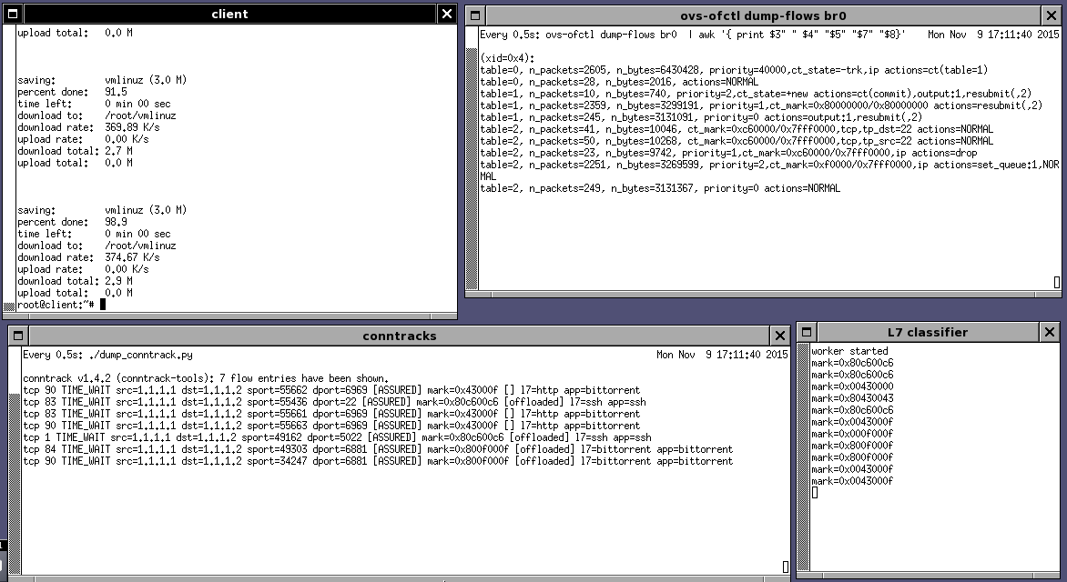
Demo part1: same file, but downloaded via bittorrent
Slow!
Torrent download via scp (ssh)
Tracker: L7=http, app=bittorrent
BITTORRENT file-transfer

Slide 26
Annexes
L7 classification insights
Demo part 1: configuration details & step by step screenshots
Demo part 2: screenshots

Slide 27
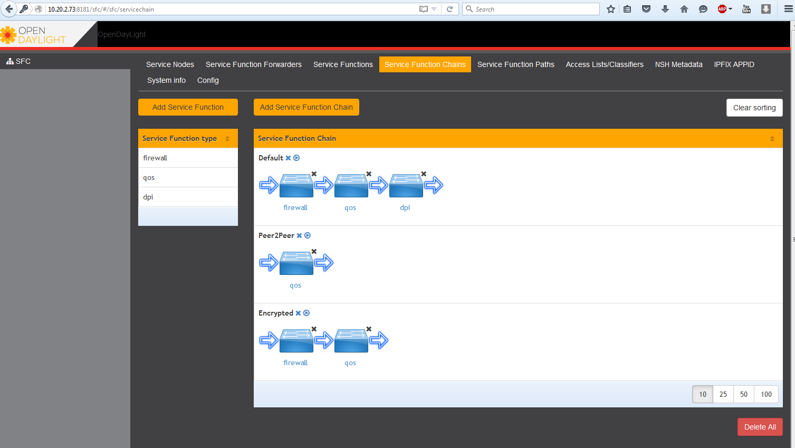
Demo2: initial chains

Slide 28
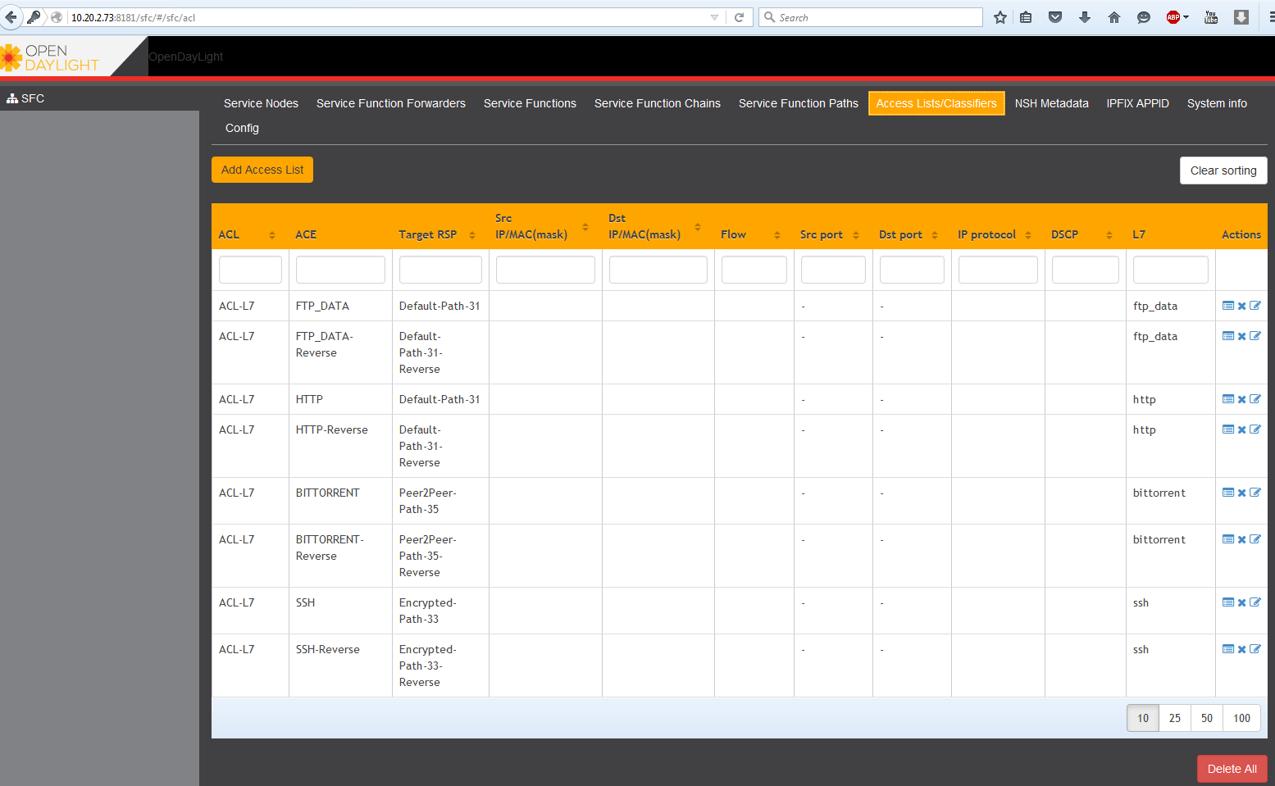
Demo2: initial ACL & ACEs

Slide 29
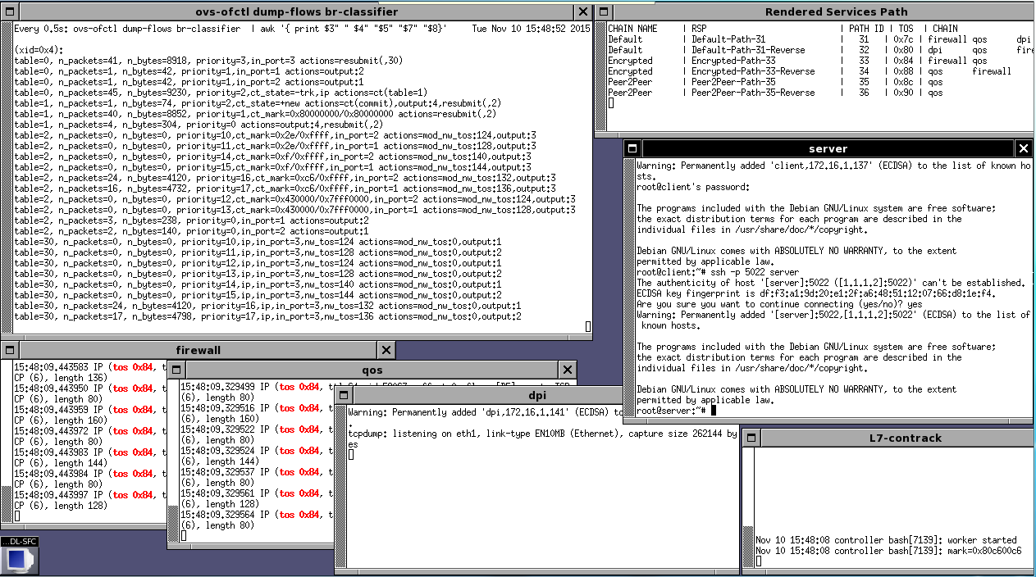
Demo2: ssh on port 5022, Encrypted chain

Slide 30
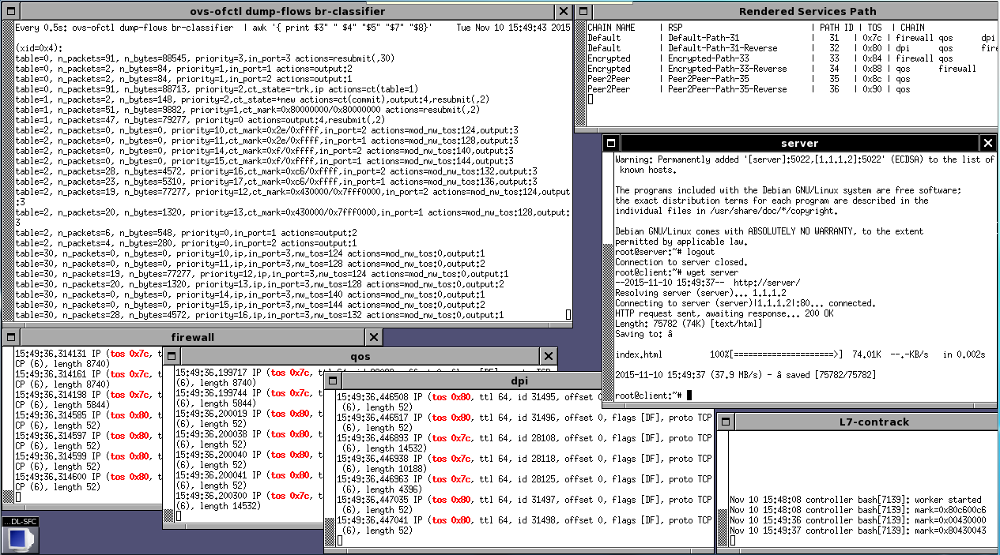
Demo2: HTTP, Default chain

Slide 31
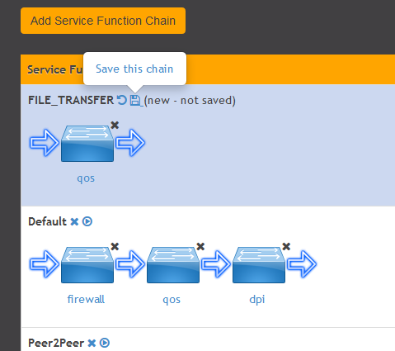
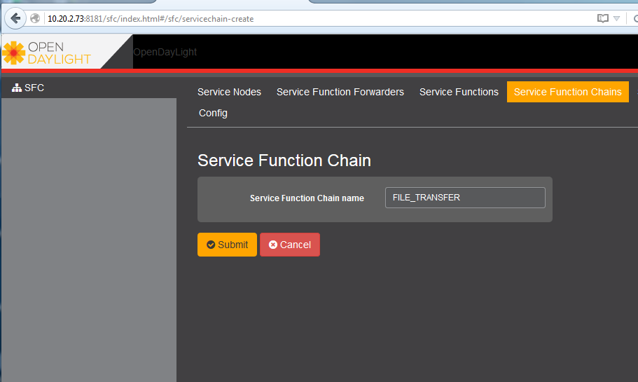
Demo2: add FILE_TRANSFER chain

Slide 32
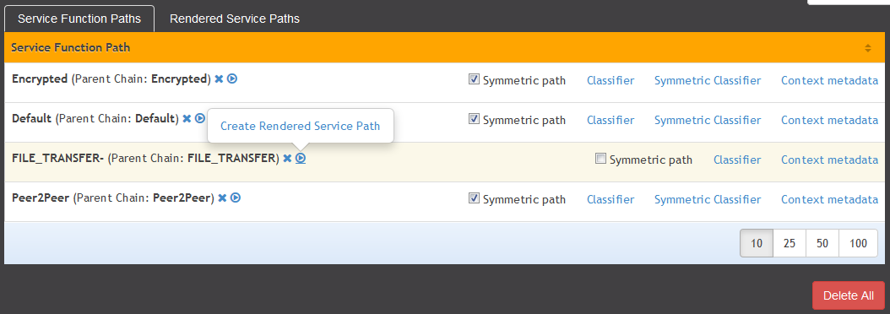
Demo2: create new RSP

Slide 33
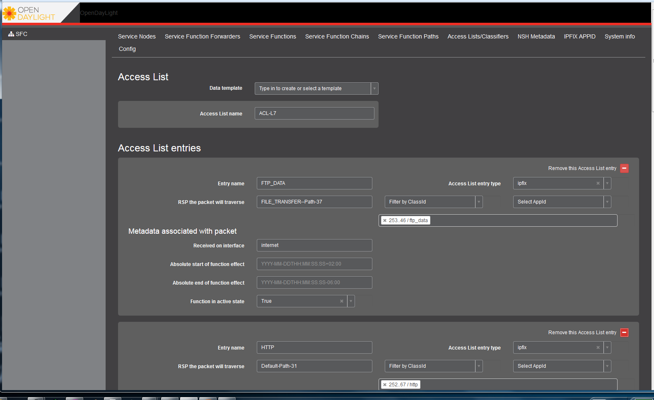
Demo2: update ACEs

Slide 34
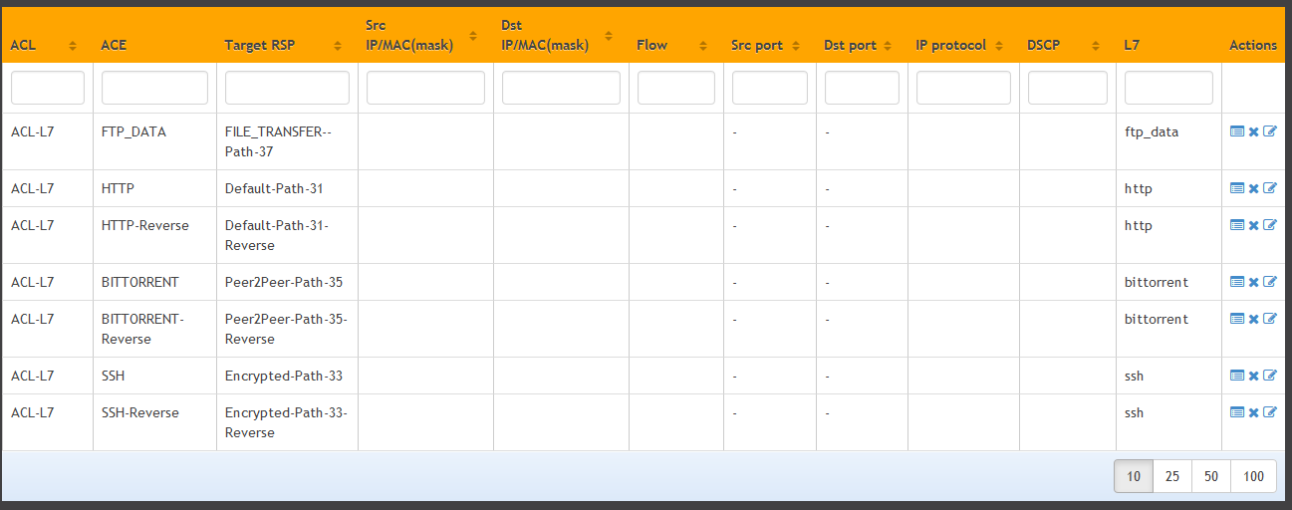
Demo2: Final ACL/ACEs

Slide 35
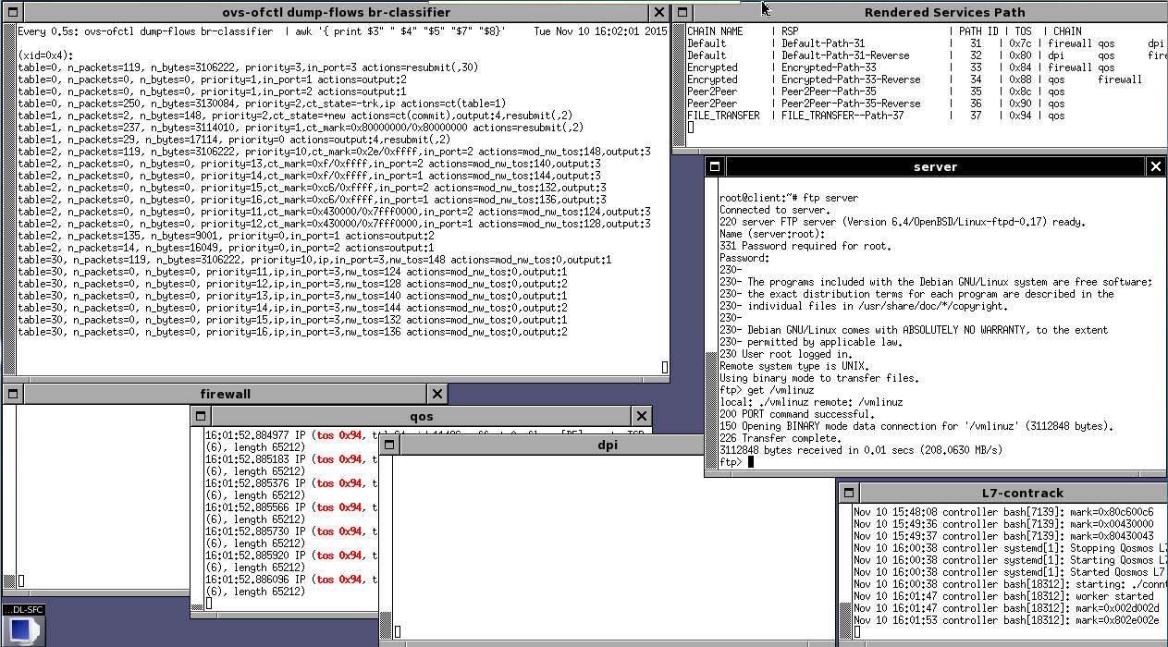
Demo2: go through the new FILE_TRANSFER chain

