Slide 1

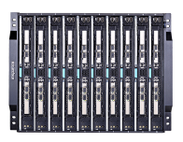
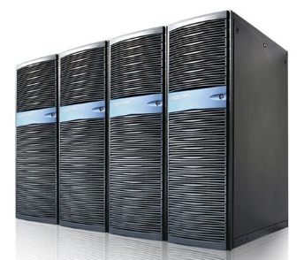
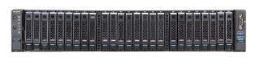
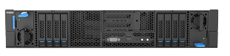

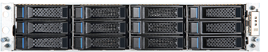




Introduction
Inspur is a China-based leading total solutions provider for datacenter, cloud
computing and big data
Hardware Products
Top #1 in China Top #3 in the world
Server
HPC
Supercomputer
AI
Switch
Storage
Solutions
Enterprise Cloud Solution
Public Cloud Solution
HPC Solution
AI Solution

Slide 2
Comparison between OVS and Tungsten Fabric vRouter Yi Yang @ Inspur

Slide 3
Tungsten Fabric vRouter DPDK
Tungsten Fabric is an open source automated secure multi-cloud multi-stack network virtualization SDN and security solution for providing connectivity and security for virtual, containerized or bare-metal workloads.
Tungsten Fabric vRouter has two implementations: vRouter kernel module and vRouter DPDK, it is equivalent to OVS as far as functionality is concerned.

Slide 4
OVS Architecture TF vRouter Architecture
controller
controller
XMPP
Extensible Messaging and Presence Protocol
openflow
ovsdb
ovs-vswitchd
ovsdb-server
vRouter Agent
UNIX
domain socket
upcall
/dev/flow
netlink
netlink
ovsdb
vRouter DPDK
datapath
VRF
VRF
Megaflow
VRF
flow table
nexthop table
EMC/SMC

Slide 5
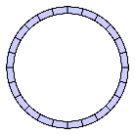
OVS PMD thread TF Forwarding thread
Rx queues
Rx queues
Rx from queues
Rx from queues
Do match and execute actions
Distribute packets to other forwarding threads
Flush Tx queues
Get packets from local Rx ring buffer
Rx ring buffers
Routing
(decap
flow table lookup
nexthop lookup
encap
output)

Slide 6
Flow table
OVS | Tungsten Fabric vRouter
Hierarchical tables: ofproto table, dpcls/Megaflow (subtables), EMC Megaflow used Tuple Space Search (TSS) and many subtables, subtable is also a hash table EMC use hash table per PMD thread A linked entry list for hash collision Ofproto table is slow path dpcls instances per ingress port Subtables are sorted in descending order per hit rate | One table: huge hash table, a single linked list for hash collision All the forwarding threads use a common flow table

Slide 7
Rx & Tx queues assignment
OVS | Tungsten Fabric vRouter
Rx queues assignment is configurable: $ ovs-vsctl set interface dpdk-p0 options:n_rxq=4 \ other_config:pmd-rxq-affinity="0:3,1:7,3:8“ Tx queues are configured automatically | Fixed: A queue is assigned to one recently-least-used forwarding thread. Physical NIC: number of Rx queues and number of Tx queues are equal to number of forwarding threads vNIC: only one Rx queue, one Tx queue per forwarding thread

Slide 8
Rx packets distributing
OVS | Tungsten Fabric vRouter
No Using Intel DDP (Dynamic Device Personalization) or offload features in other NICs can fix it. | Yes
It is very necessary to distribute packets to other PMD/forwarding threads for MPLSoGRE because only one queue can receive packets, RSS hash is almost same for all the flows

Slide 9
Supported Tunnel Types
OVS | Tungsten Fabric vRouter
VXLAN VXLAN-GPE GRE NVGRE GENEVE STT | VXLAN MPLSoGRE MPLSoUDP
Is OVS ready to integrate with existing MPLS backbone?
MPLS/UDP support in OVS: https://bugzilla.redhat.com/show_bug.cgi?id=1403499
spec for MPLS/UDP support in OVS : https://etherpad.openstack.org/p/ovs-mpls-udp

Slide 10
SR-IOV
OVS | Tungsten Fabric vRouter
Host and VM Control plane need to be enhanced for this | VM and vRouter vRouter can use SR-IOV VF or SR-IOV VFs bond as its physical interface vRouter can attach SR-IOV interface to VM Control plane can handle them very well
Issues:
VM live migration
how to communicate between regular VM and SR-IOV VM in the same compute node?
Switch/vRouter can’t control the traffic from and to SR-IOV VM
smartNIC can handle them if VF support virt-io protocol

Slide 11
ARP processing
OVS | Tungsten Fabric vRouter
Just broadcast, vswitch won’t handle it unless openflow table handles it | Doesn’t broadcast, vRouter will use VRRP or host MAC to reply ARP request, but will route the ARP request packets if their target hardware MAC is host MAC vRouter also can handle l2 switch by flooding or forwarding vRouter is default gateway for local VMs vRouter won’t forward ARP packets from fabric to local VMs

Slide 12
Hardware VTEP in ToR switch
OVS | Tungsten Fabric vRouter
OVSDB (configuration and MAC learning) | TSN(ToR service node) + OVSDB + ToR ovsdb agent in 5.0 and before EVPN-VXLAN from 5.0.1 onwards for scalability (BUM flood, VM motion)
Benefits of using EVPNs include:
Ability to have a dual active multihomed edge device.
Provides load balancing across dual-active links.
Provides MAC address mobility.
Provides multi-tenancy.
Provides aliasing.
Enables fast convergence.

Slide 13
EVPN support
OVS | Tungsten Fabric vRouter
No (ODL NetVirt) | EVPN-VXLAN from 5.0.1 onwards for scalability (BUM flood, VM motion) VXLAN and EVPN Integration One instance of the IGP control plane per VXLAN
There is a lot of interest in EVPN today because it addresses many of the challenges faced by network operators that are building data centers to offer cloud and virtualization services. The main application of EVPN is Data Center Interconnect (DCI), the ability to extend Layer 2 connectivity between different data centers which are deployed to improve the performance of delivering application traffic to end users and for disaster recovery.

Slide 14
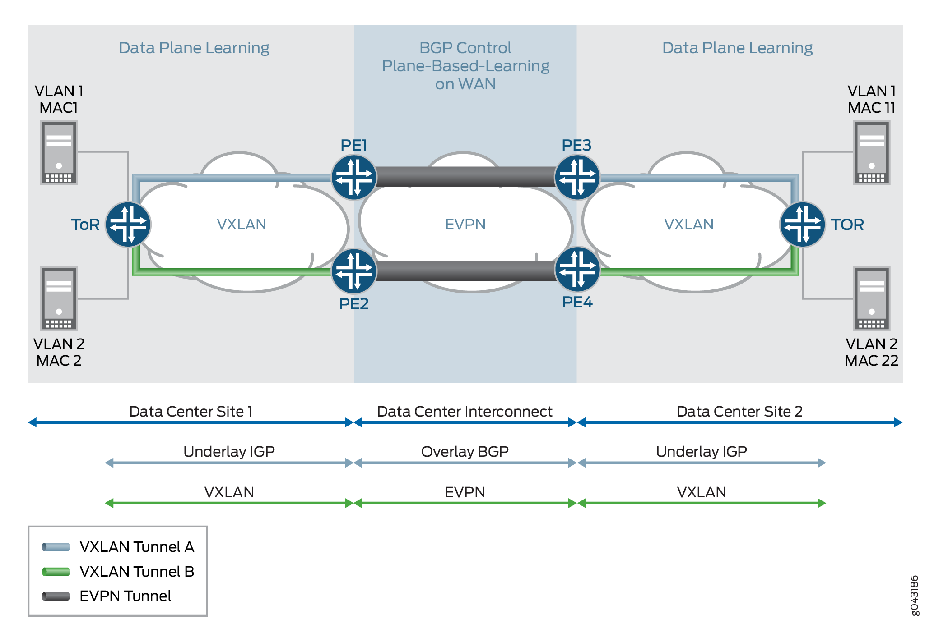

Slide 15
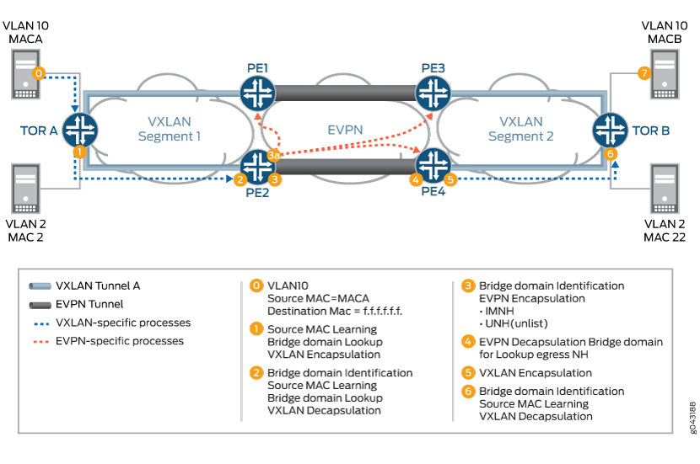

Slide 16
Summary
Features | OVS | TF vRouter
Control plane | Openflow won’t have next version anymore P4 is next one, ready? | XMPP won’t be obsolete
Flow table | Better for performance | Bad for performance
Rx & TX queues assignment | Flexible | Fixed
Rx packets distributing | No (not good for MPLSoGRE) | Yes (better for MPLSoGRE)
Supported Tunnel Types | Many (not good for MPLS backbone) Doesn’t support MPLSoUDP | A few (better for MPLS backbone) Support MPLSoUDP
SR-IOV | NO | Yes and Better
ARP processing | NO | Yes and Better
Hardware VTEP | Yes (OVSDB) | EVPN VXLAN
EVPN | NO | Better

Slide 17



Thank you! Q&A

