Slide 1
Empowering OVS with eBPF
OVSCON 2018
William Tu, Yifeng Sun, Yi-Hung Wei
VMWare Inc.

Slide 2
Agenda
Introduction
Project Updates
Megaflow support
Tunnel support
Experience Sharing on eBPF development
Conclusion and Future works

Slide 3

OVS-eBPF Project Motivation
Goal: Implement datapath functionalities in eBPF
Reduce dependencies on different kernel versions
More opportunities for experiments
Maintenance cost when adding a new datapath feature:
Time to upstream and time to backport to kernel datapath
Maintain ABI compatibility between different kernel version
Backport efforts on various kernels, ex: RHEL, grsecurity patch
Bugs in compat code are easy to introduce and often non-obvious to fix
Notes:
With eBPF,
both userspace version and eBPF programs to be loaded into kernel.
---
How can we leverage eBPF in OVS?
Match the kernel version with features with OVS versions
Add application specific functions without worrying kernel ABI
Extend OVS features more quickly
Reduce maintenance and compatibility issue

Slide 4
What is eBPF (extended Berkeley Packet Filter)?
A way to write a restricted C program and runs in Linux kernel
A virtual machine that runs eBPF bytecode in Linux kernel
Safety guaranteed by BPF verifier
Maps
Efficient key/value store resides in kernel space
Can be shared between eBPF program and user space applications
Ex: Implement flow table
Helper Functions
A core kernel defined set of functions for eBPF program to retrieve/push data from/to the kernel
Ex: BPF_FUNC_map_lookup_elem(), BPF_FUNC_skb_get_tunnel_key()
Notes:
Helper functions are a concept that lets eBPF programs consult a core kernel defined set of function calls in order to retrieve/push data from/to the kernel.
Available helper functions may differ for each eBPF program type,

Slide 5
OVS eBPF Project Updates
This is a continued work based on
Offloading OVS Flow Processing Using eBPF (OVS CON 2016, William Tu, VMware)
New enhancement
Introduce dpif-bpf layer
New supported actions
Megaflow support
Tunnel support
Supported Features
ICMP, TCP and UDP for both IPv4 and IPv6
Bond
Tunnels: VLAN, CVLAN, VXLAN, VXLAN6, GRE, GENEVE, GENEVE6
OVN: Logical Routers and Logical Switches
Supported Actions
output(), userspace(), set_masked(ethernet, ip, tunnel()), push_vlan(), pop_vlan(), recirc(), hash(), truncate()

Slide 6
Flow Lookup with Megaflow Support in eBPF Datapath

Slide 7
Review: Flow Lookup in Kernel Datapath
Slow Path
Ingress: lookup miss and upcall
ovs-vswitchd receives, does flow translation, and programs flow entry into flow table in OVS kernel module
OVS kernel DP installs the flow entry
OVS kernel DP receives and executes actions on the packet
Fast Path
Subsequent packets hit the flow cache
ovs-vswitchd
2. miss upcall
(netlink)
3. flow installation
(netlink)
Flow Table
Parser
1. Ingress
4. actions
Notes:
When a packet arrives on a vport, the kernel module processes it by extracting its flow key and looking it up in the flow table. If there is a matching flow, it executes the associated actions. If there is no match, it queues the packet to userspace for processing (as part of its processing, userspace will likely set up a flow to handle further packets of the same type entirely in-kernel).
Parser will walk through the protocol headers, create hash, and lookup eBPF hash map
eBPF comes with a fast and efficient way of messaing using perf ring buffer

Slide 8
Flow Lookup in eBPF Datapath: 1) Parsing
ovs-vswitchd
Parser
Generate flow key (struct bpf_flow_key)
Packet headers
struct ebpf_headers_t
L2, L3, L4 fields
Metadata
struct ebpf_metadata_t
Packet metadata
Tunnel metadata
Common parser code (bpf/parser_common.h) can be attached to both XDP and TC hook point
Additional metadata are parsed in TC hook point
bpf_skb_get_tunnel_key()
bpf_skb_get_tunnel_opt()
Flow key is stored in a percpu map
percpu_flow_key
2. miss upcall
3. flow installation
Parser
Flow Table
PARSER_CALL
PARSER_DATA
4. actions
1. Parsing in Ingress
BPF map
percpu_flow_key

Slide 9
Flow Lookup in eBPF Datapath: 2) Upcall
Upcall
Packets are forwarded to userspace if it does not match any flows in the flow table
Utilize eBPF helper function to send packets to userspace via perf event
skb_event_output()
OVS userspace handler threads poll the perf event to get flow information and do the flow translation
ovs-vswitchd
2. miss upcall
perf_event
PERF_TYPE_SOFTWARE PERF_COUNT_SW_BPF_OUTPUT
3. flow installation
Flow Table
MATCH_ACTION_ CALL
Parser
UPCALL
1. Parsing in Ingress
4. actions
BPF map
percpu_flow_key
Notes:
https://lkml.org/lkml/2016/4/17/172 event output helper

Slide 10
Flow Lookup in eBPF Datapath: 3-1) Flow Installation
BPF map
Exact Match Cache
flow_table (BPF_HASH)
Flow Key | Action
src=10.1.1.1, dst=10.2.2.2, tp_src=12345, tp_dst=80 | output: 2
flow_table (BPF_HASH)
ovs-vswitchd
megaflow
src=10.1.1.1/255.255.0.0, dst=10.2.2.2/255.255.0.0, tp_src=12345/0, tp_dst=80/0, actions=output:2
3-1. flow installation
Megaflow Cache
2. miss upcall
megaflow_mask_table (BPF_ARRAY)
Index | Flow Mask
0 | src=255.255.0.0, dst= 255.255.0.0, tp_src=0, tp_dst=0
Flow Table
Parser
megaflow_table (BPF_HASH)
1. Parsing in Ingress
Masked Flow Key | Action
src=10.1.0.0, dst=10.2.0.0, tp_src=0, tp_dst=0 | output: 2
4. actions

Slide 11
Flow Lookup in eBPF Datapath: 3-2) Down Call
Down Call
Write actions and metadata to bpf map
execute_actions
downcall_metatdata
Send packet to a tap interface
It is used as an outport for userspace to send packets back to eBPF datapath
Downcall eBPF program is attached to the tap interface
Downcall eBPF program execute the actions in the map
BPF map
ovs-vswitchd
execute_actions
downcall_metadata
3-2. down call
TAP
2. miss upcall
downcall
Flow Table
Parser
1. Parsing in Ingress
4. actions

Slide 12
Flow Lookup in eBPF Datapath: 4) Fast Path Action Execution
Subsequent Packets
Look up EMC cache
EMC flow table
Loop up megaflow cache
Apply megaflow mask to flow key
Look up megaflow table
Store the actions in execute_actions percpu map
Execute the actions in execute_actions percpu map
BPF map
ovs-vswitchd
Exact Match Cache
flow_table
3. flow installation
2. miss upcall
Megaflow Cache
megaflow_mask_table
Flow Table
Parser
megaflow_table
1. Parsing in Ingress
execute_actions
4. actions
percpu_flow_key

Slide 13
A Packet Walk-Through in eBPF-Tunnel
- eBPF tunnel receive and send
- eBPF flow match & actions

Slide 14
Tunnel Setup
VM0
10.1.1.100
VM1
10.1.1.1
tap0
tap1
OVS Bridge
br0 (bpf)
gre0
GRE tunnel
br-underlay
172.13.1.100
Remote: 172.13.1.1
Remote:
172.13.1.100
Local host
eth0
eth1
172.13.1.1
Physical Connection
Notes:
Build a gre tunnel on 172.13.1.x for 10.1.1.x so that two VMs can communicate with other
On local host, let ovs ebpf bridge control three devices: physical device eth0, tunnel device gre0 and tap device for VM
On each device, there are two queues: ingress to receive packet and egress to send packets
We need to attach bpf to either ingress or egress of these devices. For bridge and tap type, we attach bpf to its egress queue; for other device types, we attach bpf to ingress queue.

Slide 15
Ingress and Egress
VM0
10.1.1.100
VM1
10.1.1.1
tap0
BPF
tap1
OVS Bridge
br0 (bpf)
gre0
GRE tunnel
br-underlay
BPF
BPF
172.13.1.100
Remote: 172.13.1.1
Remote:
172.13.1.100
Ingress
eth0
egress
Local host
BPF
eth1
172.13.1.1
Physical Connection
Notes:
Build a gre tunnel on 172.13.1.x for 10.1.1.x so that two VMs can communicate with other
On local host, let ovs ebpf bridge control three devices: physical device eth0, tunnel device gre0 and tap device for VM
On each device, there are two queues: ingress to receive packet and egress to send packets
We need to attach bpf to either ingress or egress of these devices. For bridge and tap type, we attach bpf to its egress queue; for other device types, we attach bpf to ingress queue.

Slide 16
Packet Receive (1)
① # ping 10.1.1.100
VM0
10.1.1.100
VM1
10.1.1.1
tap0
BPF
tap1
② GRE encaps icmp packet
OVS Bridge
br0 (bpf)
gre0
GRE tunnel
br-underlay
BPF
BPF
172.13.1.100
Remote: 172.13.1.1
Remote:
172.13.1.100
③ Linux sends packet through eth1
eth0
Local host
BPF
eth1
172.13.1.1

Slide 17
Packet Receive (2)
① # ping 10.1.1.100
VM0
10.1.1.100
VM1
10.1.1.1
tap0
BPF
tap1
② GRE encaps icmp packet
OVS Bridge
br0 (bpf)
gre0
GRE tunnel
br-underlay
BPF
BPF
172.13.1.100
Remote: 172.13.1.1
Remote:
172.13.1.100
④
③ Linux sends packet through eth1
④ in_port(eth0),ip(src=172.31.1.1,dst=172.31.1.100,proto=GRE),actions=output(br0)
eth0
Local host
BPF
eth1
172.13.1.1

Slide 18
Packet Receive (3)
① # ping 10.1.1.100
VM0
10.1.1.100
VM1
10.1.1.1
tap0
BPF
tap1
⑤ Linux decaps and delivers packets to gre0
② GRE encaps icmp packet
OVS Bridge
br0 (bpf)
gre0
GRE tunnel
br-underlay
⑤
BPF
BPF
172.13.1.100
Remote: 172.13.1.1
Remote:
172.13.1.100
④
③ Linux sends packet through eth1
④ in_port(eth0),ip(src=172.31.1.1,dst=172.31.1.100,proto=GRE),actions=output(br0)
eth0
Local host
BPF
eth1
172.13.1.1

Slide 19
Packet Receive (4)
① # ping 10.1.1.100
VM0
10.1.1.100
⑥ in_port(gre0), tunnel(src=172.31.1.1), icmp(src=10.1.1.1,dst=10.1.1.100),actions=output(tap0)
VM1
10.1.1.1
tap0
BPF
tap1
⑤ Linux decaps and delivers packets to gre0
② GRE encaps icmp packet
OVS Bridge
br0 (bpf)
⑥
gre0
GRE tunnel
br-underlay
⑤
BPF
BPF
172.13.1.100
Remote: 172.13.1.1
Remote:
172.13.1.100
④
③ Linux sends packet through eth
④ in_port(eth0),ip(src=172.31.1.1,dst=172.31.1.100,proto=GRE),actions=output(br0)
eth0
Local host
BPF
eth1
172.13.1.1

Slide 20
Packet Receive (5)
① # ping 10.1.1.100
VM0
10.1.1.100
⑥ in_port(gre0), tunnel(src=172.31.1.1), icmp(src=10.1.1.1,dst=10.1.1.100),actions=output(tap0)
VM1
10.1.1.1
tap0
BPF
tap1
⑤ Linux decaps and delivers packets to gre0
② GRE encaps icmp packet
OVS Bridge
br0 (bpf)
⑥
gre0
GRE tunnel
br-underlay
⑤
BPF
BPF
172.13.1.100
Remote: 172.13.1.1
Remote:
172.13.1.100
④
③ Linux sends packet through eth1
④ in_port(eth0),ip(src=172.31.1.1,dst=172.31.1.100,proto=GRE),actions=output(br0)
eth0
Local host
BPF
eth1
172.13.1.1

Slide 21
Packet Send (1)
① # Send ICMP reply to 10.1.1.1
VM0
VM1
10.1.1.100
10.1.1.1
tap0
BPF
tap1
OVS Bridge
br0 (bpf)
gre0
GRE tunnel
br-underlay
BPF
BPF
172.13.1.100
Remote: 172.13.1.1
Remote:
172.13.1.100
eth0
Local host
BPF
eth1
172.13.1.1

Slide 22
Packet Send (2)
① # Send ICMP reply to 10.1.1.1
② in_port(tap0),icmp(src=10.1.1.100,dst=10.1.1.1),actions= set(tunnel(tun_id=0x0,dst=172.31.1.1,ttl=64,flags(df|key))),output(gre0)
VM0
VM1
10.1.1.100
10.1.1.1
tap0
BPF
tap1
②
OVS Bridge
br0 (bpf)
gre0
GRE tunnel
br-underlay
BPF
BPF
172.13.1.100
Remote: 172.13.1.1
Remote:
172.13.1.100
eth0
Local host
BPF
eth1
172.13.1.1

Slide 23
Packet Send (3)
① # Send ICMP reply to 10.1.1.1
② in_port(tap0),icmp(src=10.1.1.100,dst=10.1.1.1),actions= set(tunnel(tun_id=0x0,dst=172.31.1.1,ttl=64,flags(df|key))),output(gre0)
VM0
VM1
10.1.1.100
10.1.1.1
tap0
BPF
tap1
②
OVS Bridge
br0 (bpf)
③
gre0
GRE tunnel
br-underlay
BPF
BPF
172.13.1.100
Remote: 172.13.1.1
Remote:
172.13.1.100
③ gre0 encaps packet and routes packets to br0 to transfer
eth0
Local host
BPF
eth1
172.13.1.1

Slide 24
Packet Send (4)
① # Send ICMP reply to 10.1.1.1
② in_port(tap0),icmp(src=10.1.1.100,dst=10.1.1.1),actions= set(tunnel(tun_id=0x0,dst=172.31.1.1,ttl=64,flags(df|key))),output(gre0)
VM0
VM1
10.1.1.100
10.1.1.1
tap0
BPF
tap1
②
OVS Bridge
br0 (bpf)
③
gre0
GRE tunnel
br-underlay
BPF
BPF
172.13.1.100
Remote: 172.13.1.1
Remote:
172.13.1.100
④ in_port(br0),ip(src=172.31.1.100, dst=172.31.1.1, proto=GRE), actions=output(eth0)
④
③ gre0 encaps packet and routes packets to br0 to transfer
eth0
Local host
BPF
eth1
172.13.1.1

Slide 25
Packet Send (5)
① # Send ICMP reply to 10.1.1.1
② in_port(tap0),icmp(src=10.1.1.100,dst=10.1.1.1),actions= set(tunnel(tun_id=0x0,dst=172.31.1.1,ttl=64,flags(df|key))),output(gre0)
VM0
VM1
10.1.1.100
10.1.1.1
tap0
BPF
tap1
⑤ Receive packet, decap it and deliver to VM1 by tap1
②
OVS Bridge
br0 (bpf)
③
gre0
GRE tunnel
br-underlay
BPF
BPF
172.13.1.100
Remote: 172.13.1.1
Remote:
172.13.1.100
④ in_port(br0),ip(src=172.31.1.100, dst=172.31.1.1, proto=GRE), actions=output(eth0)
④
③ gre0 encaps packet and routes packets to br0 to transfer
eth0
Local host
BPF
eth1
172.13.1.1

Slide 26
Lesson Learned

Slide 27
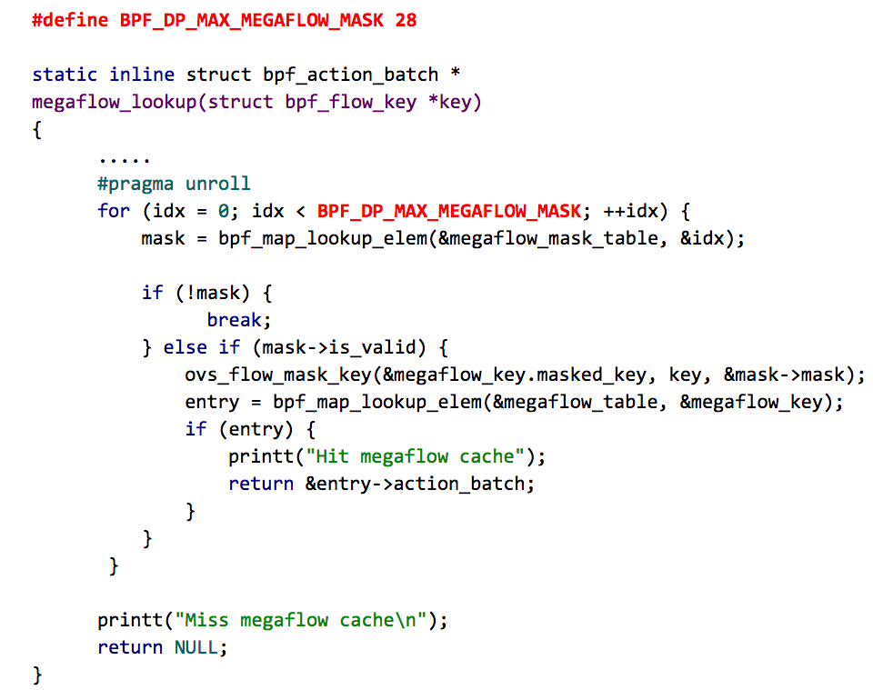
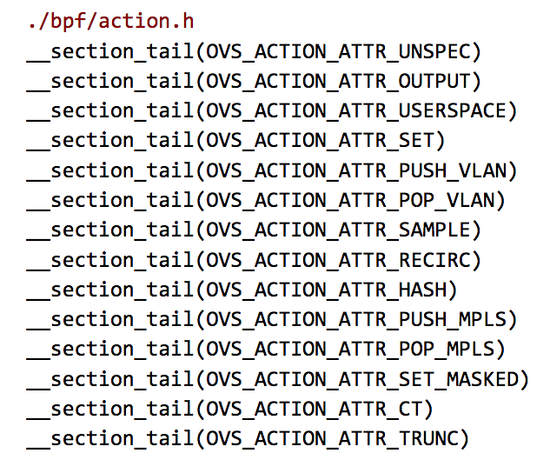
BPF Program Limitation
Instruction limitation
Each BPF program is restricted to have up to 4096 BPF instructions.
Break down large function into tail calls
Limit the number of iterations

Slide 28
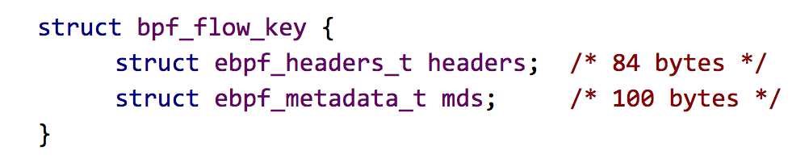
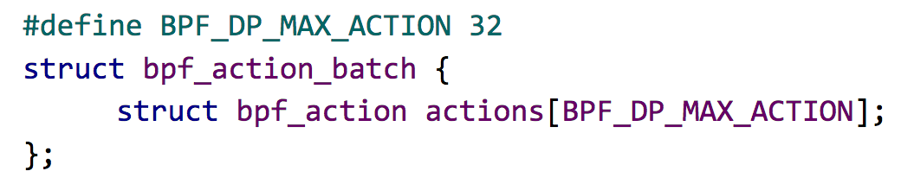
BPF Program Limitation – cont.
Stack size limitation
BPF stack space is limited to 512 bytes
Verifier limitation
Can not verify complex code logics; e.g. too many conditional statements
Can not verify variable size array
Convert TLV into fixed size array
Geneve’s option can support up to only 4 bytes in metadata.
Notes:
Bpf_flow_key 184 bytest
Headers: 84 bytes
Metadata: 100 bytes (does not include all the geneve tunnel metadata)

Slide 29
Conclusion and Future Work
Features
Connection tracking support
Kernel helper support
Implement full suite of conntrack support in eBPF
Pump packets to userspace
Lesson Learned
Writing large eBPF code is still hard for experienced C programmers
Lack of debugging tools
OVS datapath logic is difficult
Notes:
Not clear whether there is performance head
Kernel helper support
nf_conntrack_in()
ip_defrag(), ip_frag()
Implement full suite of conntrack support in eBPF
NAT, ALG, defragmentation
Hard because of limitations mentioned above
Use logging, put lots of logging to trace packets and dump its data.
Logic is difficult, it is quite a challenge to implement whole kernel datapath feature in bpf

Slide 30
Q&A

Slide 31
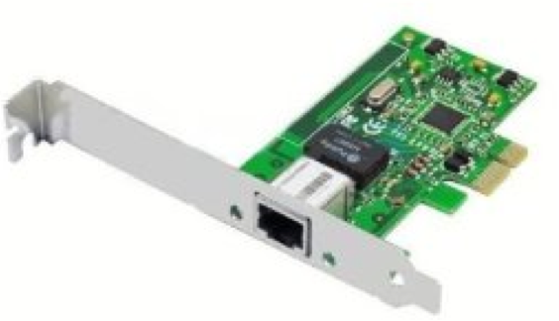
TC Hook Point vs. XDP Hook Point
User space
XDP: eXpress Data path
An eBPF hook point at the network device driver level
A point before SKB is generated
Faster
TC Hook Point
An eBPF hook point at the traffic control subsystem
More kernel helper are available
Slower compared to XDP
Network Stacks (netfilter, IP, TCP…)
Traffic Control (TC)
TC Hook
Kernel
Driver + XDP
XDP Hook
Hardware

