Slide 1
Forwarding Group in OVN
Manoj Sharma
Nutanix Inc.

Slide 2

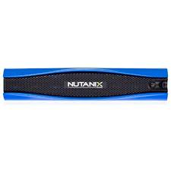
Use case
External Routers
Underlay
Network

Slide 3

OVN Logical Topology
Configure FWD_GROUP
(VIP, VMAC, lsp1..lspn)
Route table
IPv4 Routes
0.0.0.0/0 VIP
Underlay Network
VM1
External Routers
VM2
Logical Router
Logical Switch
table=13 (ls_in_l2_lkup )
match=(eth.dst == VMAC), action=(fwd_group("lsp1".."lspn");)

Slide 4
Datapath
ARP Request (VIP)
ARP Reply (VMAC)
Data Traffic
Underlay Network
VM1
External Routers
VM2
Logical Router
Logical Switch
dl_dst=VMAC actions=group:1
group_id=1, type=select,selection_method=dp_hash, bucket=actions=load:0x2->NXM_NX_REG15, resubmit(,32),
bucket=actions=load:0x3->NXM_NX_REG15, resubmit(,32)

Slide 5
Liveness Detection
BFD
Underlay Network
External Routers
Hypervisor
dl_dst=VMAC actions=group:1
group_id=1, type=select,selection_method=dp_hash,
bucket=watch_port:31, actions=load:0x2->NXM_NX_REG15, resubmit(,32),
bucket=watch_port:32,actions=load:0x3->NXM_NX_REG15, resubmit(,32)

Slide 6
Summary
Convergence time depends on BFD timer settings alone
Repair done locally, without control plane involvement
How to avoid openflow port in the liveness detection?

Slide 7
Thank you!

