Slide 1
OVN Controller
Incremental Processing
Han Zhou
OVSCON 2018
Notes:
1

Slide 2
Distributed Control Plane
CMS
(OpenStack/K8S)
Logical/physical separation
Distributed local controllers
Database Approach (ovsdb)
Central
Virtual Network Abstractions
North-bound ovsdb
North-bound ovsdb
Northd
Northd
South-bound ovsdb
Logical Flows
South-bound ovsdb
HV
HV
…
GW
OVN-Controller
OpenFlows
HV
OVS
OVSDB protocol (RFC7047)
Notes:
OVSDB consistency enables easy separation between control-plane & data-plane.

Slide 3
Scaling Challenge of OVN-Controller
Size of data to be processed by each ovn-controller
Distributed LR requires every HV processes data for all related ports
E.g. 10k logical ports: at least 40k logical flows and 10k port-bindings
Logical flow parsing is CPU intensive
Cloud workload changes frequently

Slide 4
Recomputing
Compute OVS flows by reprocessing all inputs when
Any input changes
Or even when there is no change at all (but just unrelated events)
Benefit
Relatively easy to implement and maintain
Problems
Big waste of CPU resource on all compute nodes
High control plane latency

Slide 5
Incremental Processing Engine
DAG representing dependencies
Each node contains
Data
Links to input nodes
Change-handler for each input
Full recompute handler
Engine
DFS post-order traverse the DAG from the final output node
Invoke change-handlers for inputs that changed
Fall back to recompute if for ANY of its inputs:
Change-handler is not implemented for that input, or
Change-handler cannot handle the particular change (returns false)
input
input
intermediate
input
intermediate
output

Slide 6
Dependency Graph of OVN-Controller
SB port_binding
SB mc_group
SB mac_binding
SB logical_flow
SB addr_set
SB port_group
SB gw_chassis
SB dp_binding
SB chassis
SB dhcpv6
SB dhcp
SB encap
SB dns
OVS port
OVS qos
OVS open_vswitch
OVS bridge
Address Sets (converted)
Port Groups (converted)
Runtime Data
------------------------------
Local_datapath
Local_lports
Local_lport_ids
Active_tunnels
Ct_zone_bitmap
Pending_ct_zones
Ct_zones
MFF OVN Geneve
SB OVSDB input
Local OVSDB input
Input with change handler implemented
Flow Output
---------------------------
Desired_flow_table
Group_table
Meter_table
Conj_id_ofs
Notes:
Note: change handler for Runtime-Data is not implemented for Flow-Output node, so when SB port_binding change causes Runtime-Data change, it is going to trigger recompute in Flow-Output. Fortunately, in most cases port-binding change doesn’t cause Runtime-Data change, except when the port-binding is on local chassis, or it is a special purpose port, e.g. localnet, patch, chassis-redirection, etc. To support incremental processing in those scenarios, the Runtime-Data node needs to be splitted and more change handlers need to be implemented.

Slide 7
Dependency Discovery
The idea of Functional Programming
Engine node output depends only on inputs
Removing global OVSDB IDL handle from engine nodes
Support passing individual table as parameter
Removing global variable access from engine functions
Support OVSDB IDL change tracking for references
Node A depends on Table1 which references Table2.
When a row in Table2 changes, the related rows in Table1 are tracked, which triggers change handling in Node A.
E.g. multicast_group references port_binding: port_binding change triggers multicast_group change handler automatically.
Other Inputs
T1
T2
Output A

Slide 8
Change-handler Implementation
Join with other inputs
Reuse functions for both recompute and change-handlers
E.g. consider_logical_flow()
Build indexes for efficient probing
open flow
open flow
lflow update
open flow
open flow
Hash Index: SB lflow uuid
open flow
open flow
open flow
address-set update
logical flow
logical flow
Hash Index: SB Address Set uuid
logical flow
logical flow
logical flow

Slide 9
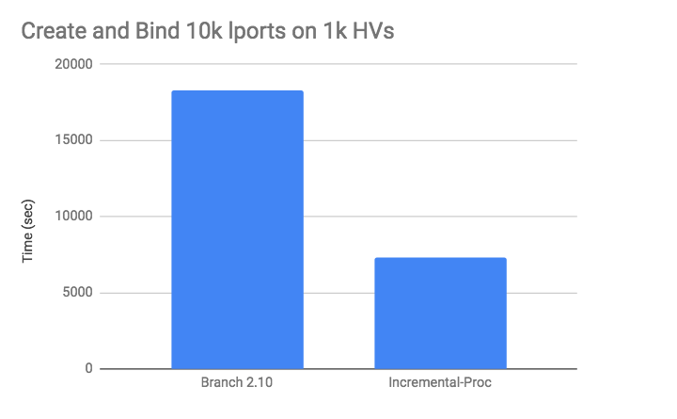
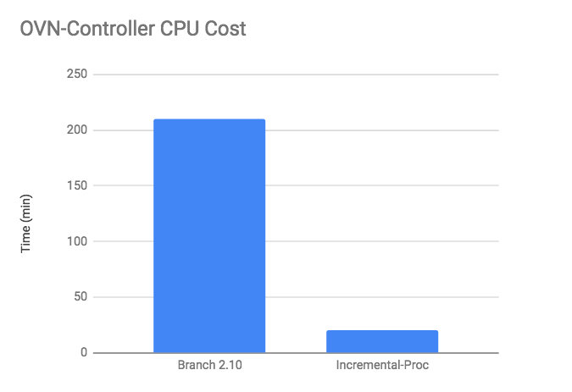
CPU Efficiency Improvement
Create and bind 10k ports on 1k HVs
Simulated 1k HVs on 20 BMs x 40 cores (2.50GHz)
Batch size 100 lports
Bind port one by one for each batch
Wait all ports up before next batch

Slide 10
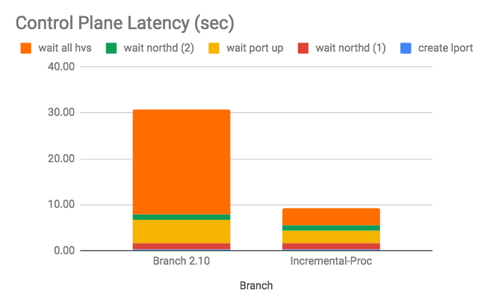
Latency Improvement
End to end latency when 10k port already there
Create one more logical port
Bind the port on HV
Wait until northd generating the lflows and enforcing on all other HVs

Slide 11
Further Improvement
Implement more change handlers as needed
E.g. support incremental processing when port-binding happens locally - further improve end-to-end latency
Incrementally flow installation
Avoid full comparison between desired flows and installed flows in ofctrl_put()

Slide 12
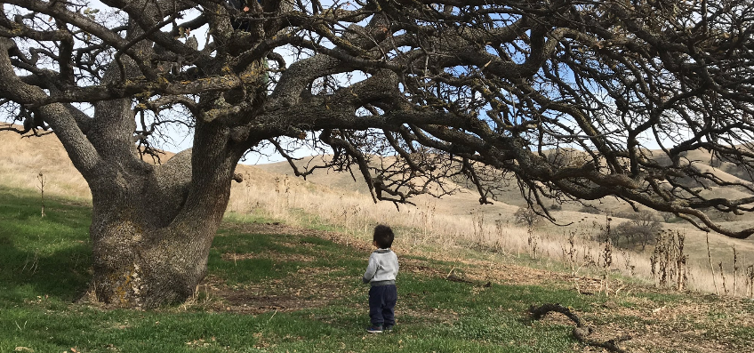
Challenge of Incremental Processing
Complexity of change handler implementation

Slide 13
The Future - Differential Datalog
Differential Datalog (DDlog)
An open-source datalog language for incremental data-flow processing
Defining inputs and outputs as relations
Defining rules to generate outputs from inputs
Benefit
Built-in incremental processing
No need to implement change-handler manually
Easier to maintain and add new features
Effort reused for both OVN-northd and OVN-Controller

Slide 14
DDlog - what’s next
OVSDB wrappers for DDlog input & output
Rewrite the computation logic using DDlog
Regression tests & scalability tests

Slide 15
DDlog Example
Implement the LogicFlow-AddressSet mapping
Input LogicFlow (id: uuid, match: string, action: string, ...)
Input AddressSet (id: uuid, name: string, …)
Output LflowAddrsetMap (lflow: uuid, addrset: uuid)
LflowAddrsetMap (lflow: uuid, addrset: uuid) :-
LogicFlow (lflow, match),
FlatMap (addrset_name = addrset_from_match(match)),
AddressSet (addrset, addrset_name).

Slide 16
References
Incremental Processing on top of branch-2.10
https://github.com/hzhou8/ovs/tree/ip12_rebase_on_2.10
Differential Datalog
https://github.com/ryzhyk/differential-datalog
ovn-scale-test
https://github.com/openvswitch/ovn-scale-test

