Slide 1
OVN DBs HA with scale test
Aliasgar Ginwala (aginwala@ebay.com)
IRC: aginwala

Slide 2
What components can be improved with scale test?
OVN-Controller on computes/GWs – ongoing discussions and WIP upstream
OVS-vSwitchd on computes/GWs – performance improved with help of community.
OVN-Northd on central nodes – ongoing discussions and WIP upstream

Slide 3

Why scale test?
To see how OVN behaves when deployed at scale.
Ensure an entire availability zone is simulated fine in big cloud deployments.
Find out bugs as early as possible to improvise OVN.

Slide 4
What to use for scale test?
OVN Scale test
When something fails, performs slowly or doesn't scale, it's really hard to answer different questions on "what", "why" and "where" without a solid scalability testing framework.
Since OpenStack rally is very convenient benchmarking tool, OVN scale test leverages the same.
It is a plugin of OpenStack Rally.
It’s open sourced and maintained under same base project OpenvSwitch.
Intended to provide the community with a OVN control plane scalability test tool that is capable of performing specific, complicated and reproducible test cases on simulated scenarios.
Need to have a Rally installed, as workflow is also similar to Rally’s.
Upstream scale test repo @ https://github.com/openvswitch/ovn-scale-test
User guide @ http://ovn-scale-test.readthedocs.org/en/latest/

Slide 5
Rally OVS
To run OVN scale test, you don’t need OpenStack installed - instead you just need rally installed.
Main keywords :
Deployment = any cloud deployment consisting of all network and compute components.
Task = Any CRUD operations on compute, farm and network components like lports, lswitches, lrouters, etc.
Farm = collection of sandboxes
Sandbox = a chassis (hypervisor/compute node/ovs sandbox)

Slide 6
Base counters considered for an availability zone
8 lrouters
5 lswitches per router
250 lports per lswitches
Total 10k lports
Total Chassis: 1k
Total BMs that hosts chassis: 20
Total control plane nodes: 3
10 lports(VM) per chassis
OS: Ubuntu 16.04 with 4.4 kernel

Slide 7
OVSdb service models
OVSDB supports three service models for databases:
Standalone
Active-Backup
Clustered
The service models provide different compromises among consistency, availability, and partition tolerance.
They also differ in the number of servers required and in terms of performance.
The standalone and active-backup database service models share one on-disk format, and clustered databases use a different format [1]
1.https://github.com/openvswitch/ovs/blob/80c42f7f218fedd5841aa62d7e9774fc1f9e9b32/Documentation/ref/ovsdb.7.rst

Slide 8
OVN DBs Active-standby using pacemaker
Alternatively, this LB VIP can be replaced by:
Option 2: BGP advertising the VIP on each node
Option 3: put all 3 nodes on same rack and use pacemaker to manage the VIP too.
CMS
Neutron
CMS
Active
LB VIP
Standby
Node1
Node2
Node3
Pacemaker Cluster
NB
NB
NB
Northd
Northd
Northd
SB
SB
SB
LB VIP
HV
HV
...
HV
Notes:
Architecture Diagram credits: Han Zhou <hzhou8@ebay.com>

Slide 9
Start OVN DBs using pacemaker
Let pacemaker manage the VIP resource.
Using LB VIP:
set listen_on_master_ip_only=no
Active node will listen on 0.0.0.0 so that LB VIP IP can connect on respective sb and nb db ports

Slide 10
OVN DBs – Raft Clustering
Cluster Leader
CMS
Neutron
CMS
Active
LB VIP
Standby
Node1
Node2
Node3
NB
NB
NB
Northd uses OVSDB named lock to ensure only one is active
Northd
Northd
Northd
SB
SB
SB
LB VIP
HV
HV
...
HV
Notes:
Architecture Diagram credits: Han Zhou <hzhou8@ebay.com>

Slide 11
Starting OVN DBs using clustering
For LB VIP:
Set connection table to listen on 0.0.0.0 on all nodes
For chassis:
Point it to either VIP IP e.g. tcp:<vip_ip>:6642
Or all central node IPs e.g. “tcp:192.168.220.101:6642,tcp:192.168.220.102:6642,tcp:192.168.220.103:6642”

Slide 12

How to set up scale test env ?
Create deployment which is installing necessary packages/binaries on a BM
rally-ovs deployment create --file ovn-multihost.json --name ovn-overlay
TOR switch
ssh
Rally-ovs
ssh
OVN central node
OVN Farm1
.
.
ssh
OVN Farm20

Slide 13
How to set up scale test env ?
Rally task start create_sandbox is equivalent to convert the BM into a compute node with ovs installed.
rally-ovs task start create_sandbox.farm1.json
TOR switch
ssh
Rally-ovs
ssh
OVN central node
OVN Farm1
HV1
HV2
HV50

Slide 14
How to set up scale test env ?
Finally create lrouters, lswitches and lports and also bind the lports to the chassis
rally-ovs task start create_routers_bind_ports.json
TOR switch
ssh
Rally-ovs
ssh
OVN central node
OVN Farm1
HV1
HV2
..
lport1
lport20
lport500
HV50

Slide 15
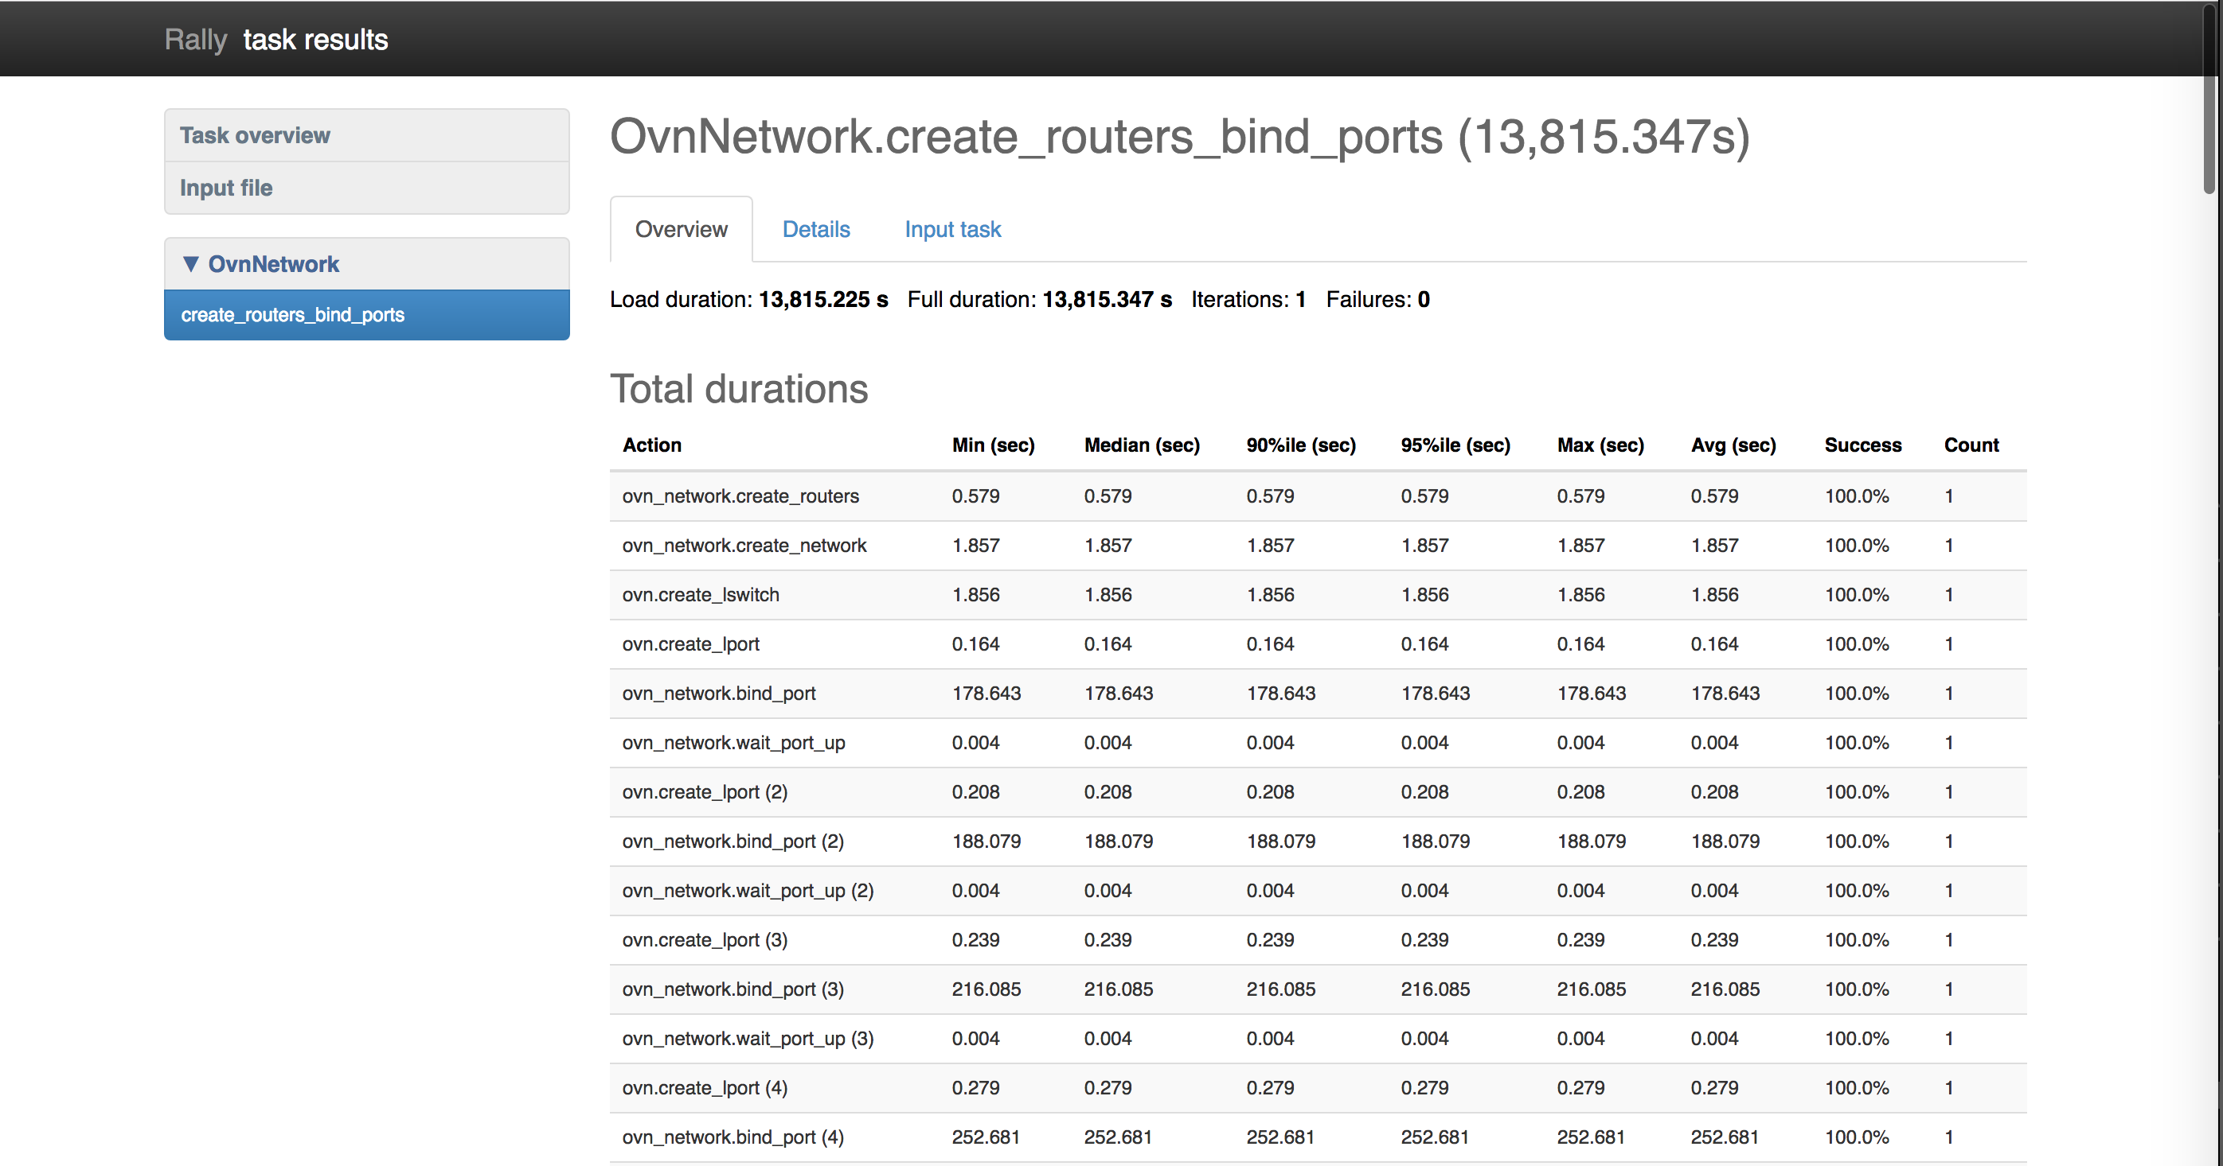
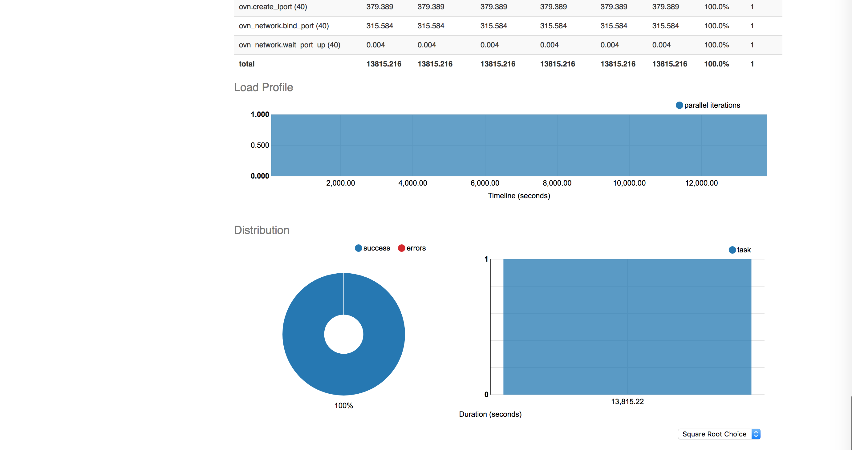

Slide 16
OVN scale test with HA
OVN scale test by default sets up one active standalone OVN DB.
Hence, we need to separately setup an HA cluster
TODO: (support to deploy HA cluster to be added in OVN-scale-test to avoid manual setup)
For testing HA, we need to point the chassis to HA nodes setup which can be set to respective OVN DB HA VIP IP in the create_sandbox.json using below param
"controller_cidr": "192.168.10.10/16",

Slide 17
Scenarios – Active-standby using pacemaker
Scenarios | Impact on Control plane | Impact on Data plane
Standby node reboot | No | No
Active node reboot | Yes (~5+ minutes as SB DB is running super hot resyncing the data) | Only newly created VMs/lports till SB DB cools down.
All active and standby nodes reboot | Yes (few minutes depending on how soon is new node up and data sync is finished) | No*
*Entire NB db data got flushed/lost causing both control and data plane impact
*Discussion @ https://mail.openvswitch.org/pipermail/ovs-discuss/2018-August/047161.html
*Fixed rolled out with help of upstream and no issues reported so far.
*Commit ecf44dd3b26904edf480ada1c72a22fadb6b1825

Slide 18
OVN DBs HA – Active-backup with pacemaker
Current status
Basic functionality tested
Scale testing always ongoing with findings reported and some major issues fixed with help of upstream.
Detailed scale test scenarios reported and also updated on mail chain to the community https://mail.openvswitch.org/pipermail/ovs-discuss/2018-September/047405.html
Consent and improvements asked to upstream folks

Slide 19
Scenarios – Clustered DBs
Scenarios | Impact on Control plane | Impact on Data plane
Any active node reboot | No | No
All active nodes reboot | Yes (few minutes depending on how soon is new node up along with leader selection and data sync completion) | Not fully verified

Slide 20
Raft with scale test summary
Current status
Basic functionality tested.
Scale testing ongoing and problems found when using rally-ovs (ovn scale test) with around 2k+ lports
db=\"tcp:192.168.220.101:6641,tcp:192.168.220.102:6641,tcp:192.168.220.103:6641\" -- wait-until Logical_Switch_Port lport_061655_SKbDHz up=true -- wait-until Logical_Switch_Port lport_061655_zx9LXe up=true -- wait-until Logical_Switch_Port Last stderr data: 'ovn-nbctl: tcp:192.168.220.101:6641,tcp:192.168.220.102:6641,tcp:192.168.220.103:6641: database connection failed (End of file)\n'.", "traceback": "Traceback (most recent call last):\n File \"/ebay/home/aginwala/rally-repo/rally/rally/task/runner.py\", line 66, in _run_scenario_once\n
Following up with community to get it fixed soon with discussions @ https://mail.openvswitch.org/pipermail/ovs-dev/2018-May/347260.html
Upstream also have raft torture test in test cases in ovs repo for testing locally.

Slide 21
Some tunings for both clustered and non clustered setup
Netfilter TCP params on all central nodes:
Since tcp_max_syn_backlog and net.core.somaxconn values are too small, we need to increase the value to avoid getting TCP sync flood messages in syslog:
net.ipv4.tcp_max_syn_backlog = 4096
net.core.somaxconn = 4096
Pacemaker configurations
When the SB DB starts on the new active node, it will be very busy on syncing data to all HVs.
During this time, pacemaker monitoring can get timed out. Because of this, the timeout value for "op monitor" needs to be set big enough to avoid timeout to avoid restart/failover forever.
Hence, configure pacemaker monitor for resource ovndb-servers: op monitor interval=60s timeout=50s
Inactivity probe settings on all chassis
Set inactivity probe to 3min, so that central SB DB won't get overloaded for probe handling and also if failover happens, chassis will be able to notice the changes
Upstart settings on all central nodes when using pacemaker:
Disable ovn-central and openvswitch-switch upstart to avoid confusing pacemaker when node reboots because pacemaker thinks there is already an active pid and all the nodes will act as standalone nodes. Also LB gets confused sending traffic to this standby node.

Slide 22
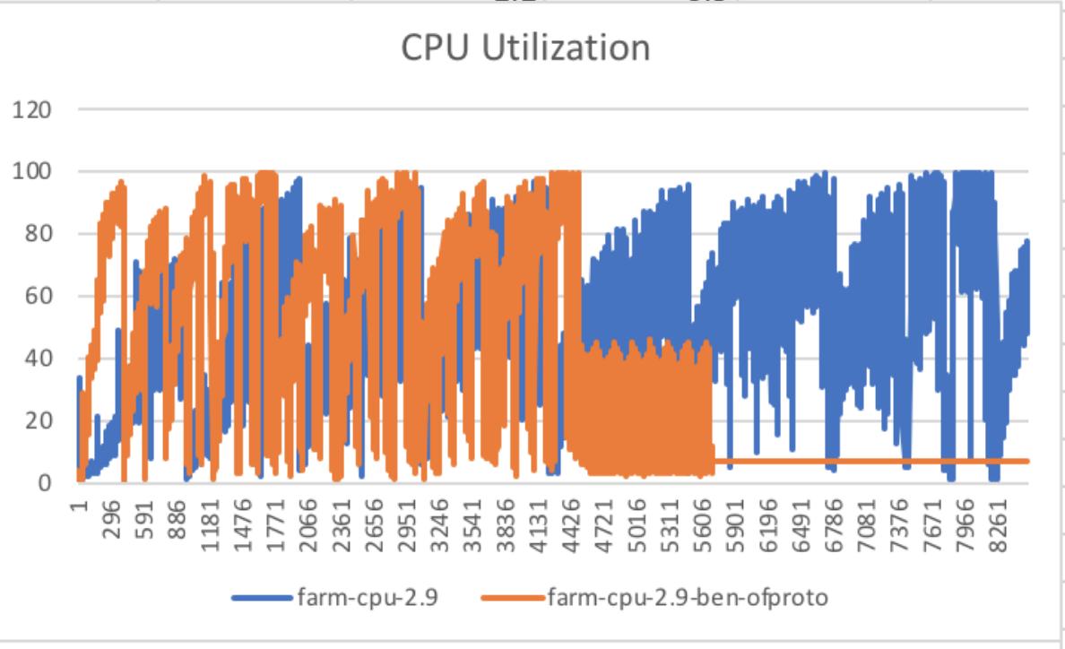
Promising outcome and more to go
OVS-vswitchd CPU utilization was running super high on chassis.
Performance improved by making ofproto faster and results are amazing; test completed in 3+ hours vs 8+ hours:
Discussion @ https://mail.openvswitch.org/pipermail/ovs-discuss/2018-February/046140.html
Commit c381bca52f629f3d35f00471dcd10cba1a9a3d99

Slide 23
CPU/Mem stats for active-standby
Active Central node
Chassis
Components | CPU | Mem
OVN NB DB | 0.12 | 97392000
OVN SB DB | 0.92 | 777028000
OVN Northd | 6.78 | 825836000
Components | CPU | Mem
OVSDB server | 0.02 | 11672000
OVS-vSwitchd | 3.75 | 152812000
OVN-controller | 0.94 | 839188000
Note:
Mem: RES mem in bytes whether its mb, gb or tb.
CPU: total CPU time, the task has used since it started. e.g. if the total cpu time in seconds for a current ovn-controller process is 6:26.90, we convert the same into integer seconds by following time conversion formula: 6 * 6000 + 26 * 100 + 90 = 38690
Converted in Delta (speed per second)

Slide 24

Stuck?
Reach out to OVS community as it’s super interactive and responsive.
For any generic OVS queries/tech discussions use ovs-discuss@openvswitch.org so that wide variety of engineers can respond for the same.

Slide 25
Thank You

