Slide 1

All or Nothing The Challenge of Hardware Offload
__________________________________
December 5, 2018
Dan Daly

Slide 2
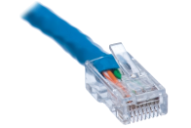
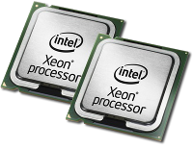
Feature Log
VM,
Container
or Server
Network
Interface
Security
Virtualization
Visibility
Redundancy

Slide 3
HW Offload (First Attempt)
VM,
Container
or Server
Network
Redundancy
Interface
Security
Virtualization
Visibility
Redundancy
Interface
Security
Virtualization
Visibility
HW Interface
Redundancy
Virtualization
Redundancy
How to Fix This?
Rule #1: No Specials
Rule #2: Offload is All or Nothing
Notes:
Rule #1: Some software is more difficult to change than hardware, so adding ‘HW Specials’ isn’t acceptable
Rule #2: Having hand-offs between HW and SW takes away from the value, adds complexity, and special cases. This is challenging as the feature set needed is moving pretty rapidly, usually much faster than a regular hardware cadence

Slide 4
Following the Rules
Virtualized Server
Bare Metal Server
Adopt Existing VM Interfaces (containers & bare metal too)
Adopt Existing OVS Interfaces (use it for connection tracking too)
An Exact Match of the Data Plane (hw stats, mirroring, state tracking)
Requires Re-Programmable, Adaptable Hardware
VM
virtio
Con-
tainer
vSwitch
Slow Path
virtio
virtio
Smart NIC
Smart NIC
vHost + OVS
Fast Path
vHost + OVS
Fast Path
vSwitch
Slow Path

Slide 5
Virtio Host Interface
Server
Server
VM
Seamless VM Migration
VM
virtio-net
virtio-net
Open vSwitch
Open
vSwitch
Redundancy
Benefits:
No change in VM
Increased throughput & frame rate
Reduced latency
Free up cores in server
Hardware isolation between VMs
NIC
SmartNIC
Hardware
Fast Path
Redundancy

Slide 6
Bare Metal Hosting
Server
Server
Disaggregation
of Network Functions
NIC Driver
virtio-net
SmartNIC
Standard NIC
Hardware
Fast Path
ToR Switch
(Tunnel endpoint)
Benefits:
Hardware Agnostic Driver Interface
Brings OVS feature set to bare metal
Avoids network bottlenecks
vSwitch
Slow Path
vRouter Appliance for multiple server racks
Simple ToR Switch

Slide 7
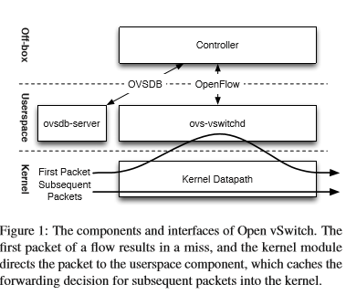
OVS Programming Interface
Virtualized Server
Bare Metal Server
Two Options:
tc-flower
Existing megaflow interface
VM
virtio
Con-
tainer
vSwitch
Slow Path
virtio
virtio
Smart NIC
Smart NIC
vHost + OVS
Fast Path
vHost + OVS
Fast Path
vSwitch
Slow Path
https://www.usenix.org/system/files/conference/nsdi15/nsdi15-paper-pfaff.pdf

Slide 8
Megaflow Based Offload – Architecture
OF Table
OF Table
OF Table
1st - OF Table Lookup
DPIF-NETLINK
OVS slowpath/vswitchd
Userspace
Kernel
megaflows cache
vxlan
sw conntrack
2nd - Megaflow Lookup
hw device
Kernel pipeline
Kernel
HW
Hardware flow cache
hw conntrack
3rd - Hardware Lookup
Kernel pipeline

Slide 9
Megaflow Based Offload - Advantages
Virtualized Server
1. Faster than offloading through tc-flower
TC isn’t required to keep copies of flows
Avoid context switch for tunnels and connection tracking
Fewer CPU cycles in slowpath
2. Simpler to maintain and deploy
No netdev-linux HW offload path in dpif-netlink
Less kernel version dependence
Less kernel modules interactions (vxlan, netfilter)
3. Leverage Adaptable Hardware
Let hardware handle connection tracking
Application Aware Steering
VM
virtio
Con-
tainer
vSwitch
Slow Path
virtio
Smart NIC
vHost + OVS
Fast Path

Slide 10
An Exact Match of the Data Plane
Some Software- Extremely hard to change
Anything in a customer VM
Kernel upgrades are no fun
At the same time, vSwitch requirements are moving extremely fast
Tunneling, connection tracking, telemetry, mirroring, failover
Intel Approach
Build Programmable, Adaptable Hardware (see next session)

