Slide 1

Reprogrammable packet processing pipeline
__________________________________
December 5, 2018
Debashis Chatterjee

Slide 2
Agenda
Intro to Glaciers
A network parse graph
Need for programmable packet processing pipeline
Intel’s reprogrammable parser
Parser tools flow
Intel’s reprogrammable modifier
SDK and SW stack
Q&A

Slide 3
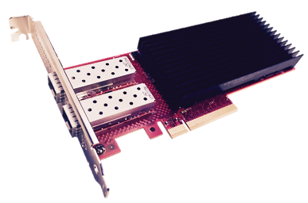
Mt Kiska product family - Cascade Glacier
Programmable vSwitch Offload
Open vSwitch and other vSwitches
High speed Internal Switch Fabric
Millions of flows
Connection tracking & other features
Embedded CPU Cores
vSwitch slow path & NIC management
Virtio-net Hardware Offload
Supports Existing Linux & DPDK VMs
Multiple queues per device
Live migration between HW & SW
Cascade Glacier
FPGA
PCI, SR-IOV
ARM
vNIC
VF
vNIC
VF
DDR4 Memory Controller
Programmable vSwitch Pipeline
25GbE
Ethernet
25GbE
Ethernet

Slide 4
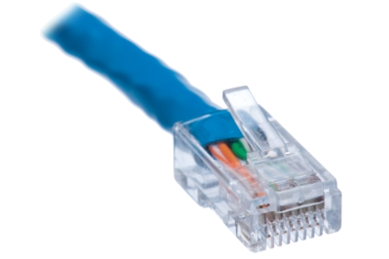
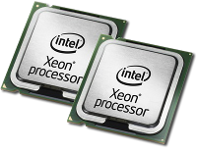
Packet processing parse graph
Packet Parser
Packet Filters
Packet Modifier
Egress
Scheduler
host
wire
What packet is this?
TCP or UDP or TCP in VXLAN?
Table 2
1
Packet type | Header Fields | Actions
P1 | DIP, SIP, DPORT | ENCRYPT, ENCAP
P3 | SIP, DPORT,SPORT | ENCRYPT, ENCAP, NAT
P3 | SIP, DPORT,SPORT | ENCRYPT, ENCAP, NAT
P7 | SIP, DPORT,SPORT , SMAC | ENCAP, SAMPLE
Ethernet
2
VLAN
3
IP
6
IP
4
IPv6
5
IPv4
Forward = To VSI, Mirror
Crypto = IPsec Tunnel mode, Transport, DTLS
Encap = VXLAN, NVGRE, MPLS
Update = IP TTL, Checksum, NAT
Telemetry= packets, bytes
Sample = To PF, remote system
7
IPv6
8
IPv4
Table 1
9
UDP
10
TCP
Packet type | Header Fields | Actions
P1 | VLAN, SIP, DPORT | VF(4), RATE LIMIT
P1 | VLAN, SIP, DPORT | VF(14), RATE LIMIT, SAMPLE
P2 | VLAN, DIP, DPORT, SPORT | DROP, SAMPLE
P3 | VLAN, SIP, DPORT | VF(112), MIRROR
11
UDP
12
TCP
Packet type = 1->2->6->8->11 = Some number ‘P1’
Packet type = 1->2->6->8->12 = Some number ‘P2’

Slide 5
Need for programmable packet processing pipeline
OpenFlow experience
A packet classifier uses values of different header fields for state transitions
A hardened ASIC implementation of an OpenFlow classifier would have to go through anywhere from a multi-layer change to just a metal fix to accommodate these. Cost of even a metal fix at 14 nm could be hundreds of thousands of dollars
CSPs often experiment with pre-RFC protocols
Overriding header fields with new interpretations is also not uncommon
 |  | Header Fields
Version | Date
OF 1.0 | Dec-09 | 12 fields (Ethernet, TCP/IPv4)
OF 1.1 | Feb-11 | 15 fields (MPLS, inter-table metadata)
OF 1.2 | Dec-11 | 36 fields (ARP, ICMP, IPv6, etc.)
OF 1.3 | Jun-12 | 40 fields
OF 1.4 | Oct-13 | 41 fields

Slide 6
Intel’s reprogrammable parser
TCP
Protocol = 0x6?
IPv4
Ethtype = 0x800?
UDP
hdrOffset | cmpFldType | cmpFldEn[0] | cmdFldOffset[0] |  | cmpFldEn[1] | cmdFldOffset[1]
0 | CMP_VLAN | 1 | 36 |  | 0 | 0
cmpFldIdx | cmpFldType | cmpFldEn[0] | cmpFld[0] | cmpFldMask[0] | cmpFldEn[1] | cmpFld[1]
0 | CMP_VLAN | 1 | 0x800(ipv4) | 0xFFFF | 0 | 0
1 | CMP_VLAN | 1 | 0x86dd(ipv6) | 0xFFFF | 0 | 0
2 | CMP_VLAN | 1 | 0x806(arp) | 0xFFFF | 0 | 0
3 | CMP_VLAN | 1 | 0 | 0 | 0 | 0
Eth
Protocol = 0x11?
IPv6
Ethtype = 0x86DD?
@protocol_id("IPV4") @name("parse_ipv4") state parse_ipv4 {
packet.extract(hdr.ipv4[0]);
transition select(hdr.ipv4[0].protocol) {
8w0x11: parse_udp;
8w0x6: parse_tcp;
8w0x1: parse_icmp;
8w0x2f: parse_gre;
default: accept;
}
}

Slide 7
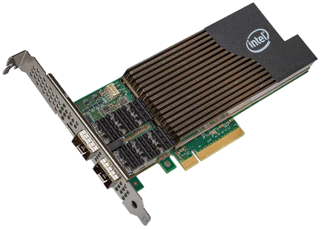
Parser tools flow
Binary Table
Cascade Glacier
Customer
P4 source
Optional Virtual platform to test and debug
P4 to parser binary generator

Slide 8
Intel’s reprogrammable modifier
General
Designed like a programmable CPU, with opcodes representing actions such as DEC_TTL, ENCAP, DECAP, CKSUM etc
A modifier action template has the action to be taken along with associated data
Modifier templates are downloaded to modifier memory by a tool similar to parser tool
Decap
Driven by a ‘template’ provided by the classifier
Removes some number of bytes from header
Mod
Pulls data from DDR4 and small on-die tables
Driven by a ‘template’ provided by the classifier
Updates some number of bytes in the header
Provides checksums, length adjustments for IP/L4
Encap
Pulls data from DDR4 & small on-die tables
Driven by a ‘template’ provided by the classifier
Adds some number of bytes to the header
Provides checksums, length adjustments for new IP/L4
Intel Confidential - Presented Under CNDA

Slide 9
Cascade Glacier SDK and SW stack
CG
SDK
OpenStack
PF driver
Mgmt. driver
Firmware binaries
Open vSwitch or Custom
OpenStack Agent or Custom
API library
Flow APIs
NIC Tools
iproute2 ethtool
SDK APIs
Pipeline reconfigurator
Setup scripts
Mgmt driver
Standard Virtio-net driver
Diagnostic tools
Linux
Sample code

