Slide 1
Encrypting OVN tunnels with IPsec
Qiuyu Xiao
qiuyu.xiao.qyx@gmail.com
The University of North Carolina at Chapel Hill
Notes:
Introduce myself in the talk

Slide 2
Motivations
Why do we need encryption?
VMs compute and communicate sensitive data
Financial data
Health records
Physical network devices (e.g., router, switch) cannot be trusted or might be compromised
Traffic across datacenters
Router misconfiguration
Attackers breaking into internal network
Phishing or social engineering attacks on administrators
Notes:
Give an overview here

Slide 3
Motivations
IPsec configuration is complicated
Many configuration fields
Various cryptographic algorithms and parameters
Different configuration interfaces from different IKE daemons
Verifying security configuration is hard
Notes:
Give an overview here

Slide 4
OVS/OVN IPsec
Offer an easy-to-use interface to configure IPsec encryption for tunnel traffic
Outer
Ethernet
Header
Outer
IP
Header
Tunnel
Header
Inner
Ethernet
Header
Inner
IP
Header
Payload
IPsec Encryption
Outer
Ethernet
Header
Outer
IP
Header
ESP
Header
Confidentiality
Integrity
Authenticity
Notes:
Give an overview here

Slide 5
IPsec in Linux
IKE daemon
IKE protocol
User space
Kernel
security policy
security association
IPsec kernel stack
ESP/AH protocol
Notes:
Give an overview here

Slide 6
IPsec in Linux
IKE daemon
Authentication
Negotiates cryptographic algorithms
Generates keying material
IKE daemon
IKE protocol
User space
Kernel
security policy
security association
IPsec kernel stack
ESP/AH protocol

Slide 7
IPsec in Linux
IKE daemon
Authentication
Negotiates cryptographic algorithms
Generates keying material
Installs security policy and security association
IKE daemon
IKE protocol
User space
Kernel
security policy
security association
IPsec kernel stack
ESP/AH protocol

Slide 8
IPsec in Linux
IKE daemon
Authentication
Negotiates cryptographic algorithms
Generates keying material
Installs security policy and security association
IKE daemon
IKE protocol
User space
Kernel
security policy
security association
Which traffic to protect
IPsec kernel stack
ESP/AH protocol

Slide 9
IPsec in Linux
IKE daemon
Authentication
Negotiates cryptographic algorithms
Generates keying material
Installs security policy and security association
IKE daemon
IKE protocol
User space
Kernel
security policy
security association
IPsec kernel stack
ESP/AH protocol
How to protect the selected traffic

Slide 10
IPsec in Linux
IPsec kernel stack
Encryption and decryption
Checks integrity and authenticity
IKE daemon
IKE protocol
User space
Kernel
security policy
security association
IPsec kernel stack
ESP/AH protocol

Slide 11
OVS IPsec Tunnel
ovsdb
OVS IPsec daemon
IKE daemon
User space
Kernel
ovs datapath
IPsec kernel stack

Slide 12
OVS IPsec Tunnel
Configuring IPsec tunnel via ovsdb
Using pre-shared key
ovsdb
OVS IPsec daemon
IKE daemon
User space
Kernel
For example:
$ ovs-vsctl set interface tun type=geneve \
options:remote_ip=10.33.79.149 \
options:psk=swordfish
ovs datapath
IPsec kernel stack

Slide 13
OVS IPsec Tunnel
Configuring IPsec tunnel via ovsdb
Using self-signed certificate
ovsdb
OVS IPsec daemon
IKE daemon
User space
Kernel
For example:
ovs datapath
IPsec kernel stack
$ ovs-vsctl set Open_vSwitch . \
other_config:certificate=/etc/ipsec.d/certs/vm1-cert.pem
other_config:private_key=/etc/ipsec.d/certs/vm1-privkey.pem
$ ovs-vsctl set interface tun type=geneve \
options:remote_ip=10.33.79.149 \
options:remote_cert=/etc/ipsec.d/certs/vm2-cert.pem

Slide 14
OVS IPsec Tunnel
Configuring IPsec tunnel via ovsdb
Using CA-signed certificate
ovsdb
OVS IPsec daemon
IKE daemon
User space
Kernel
For example:
ovs datapath
IPsec kernel stack
$ ovs-vsctl set Open_vSwitch . \
other_config:certificate=/etc/ipsec.d/certs/vm1-cert.pem
other_config:private_key=/etc/ipsec.d/certs/vm1-privkey.pem
other_config:ca_cert=/etc/ipsec.d/cacerts/cacert.pem
$ ovs-vsctl set interface tun type=geneve \
options:remote_ip=10.33.79.149 \
options:remote_name=vm2

Slide 15
OVS IPsec Tunnel
Establishing IPsec tunnel
OVS IPsec daemon configures IKE daemon
ovsdb
OVS IPsec daemon
IKE daemon
User space
Kernel
ovs datapath
IPsec kernel stack

Slide 16
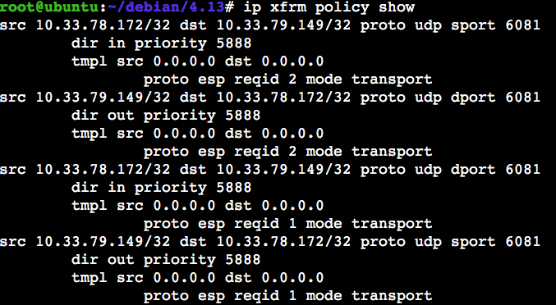
OVS IPsec Tunnel
Establishing IPsec tunnel
OVS IPsec daemon configures IKE daemon
IKE daemon sets up security policy and security association
ovsdb
OVS IPsec daemon
IKE daemon
User space
Kernel
security policy
security association
For example (geneve tunnel):
ovs datapath
IPsec kernel stack

Slide 17
OVS IPsec Tunnel
IPsec kernel stack
Encryption and decryption
Checks integrity and authenticity
ovsdb
OVS IPsec daemon
IKE daemon
User space
Kernel
unencrypted
packet
ovs datapath
IPsec kernel stack
encrypted
packet

Slide 18
OVN IPsec
northbound db
ovn-northd
southbound db
ovn-controller
…
ovn-controller
ovsdb
vswitchd
ovsdb
vswitchd
Hypervisor 1
Hypervisor n

Slide 19
OVN IPsec
northbound db
In each hypervisor, configure ovsdb to use CA-signed certificate for authentication
Enable IPsec by configuring northbound database
ovn-northd
southbound db
For example:
$ ovn-nbctl set nb_global . ipsec=true
ovn-controller
…
ovn-controller
ovsdb
vswitchd
ovsdb
vswitchd
Hypervisor 1
Hypervisor n

Slide 20
IPsec Evaluation
Environment: StrongSwan 5.3.5, Linux 4.4.0, Intel Xeon 2 GHz, 10 Gbps NIC
iperf generates TCP stream (window size: 85KB), which is encrypted in a single core
Notes:
Use a Ipsec

Slide 21
Current Status
Compatible with StrongSwan and LibreSwan IKE daemon
Packages for Ubuntu and Fedora
Tutorials on using OVS/OVN IPsec
Need to use OVS out-of-tree kernel module
Notes:
Status of the current project.
Both works on LibreSwan and StrongSwan.
Fedora and ubuntu packages.

Slide 22
Possible Extensions
More flexible tunnel encryption policies:
Only encrypting tunnel traffic between certain hypervisors
Only encrypting tunnel traffic from certain logical network

Slide 23

Q&A

