Slide 1

Offloading Linux LAG devices Via Open vSwitch and TC
John Hurley
Open vSwitch 2018 Fall Conference

Slide 2
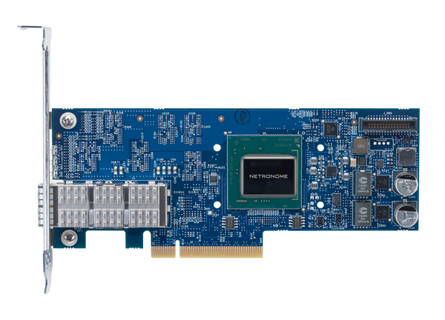
Offloading Flows With TC Flower
ovs-vswitchd
VM 1
VM 2
TC Flower
OVS Datapath
ovs-dpctl dump-flows
in_port(2),eth_type(0x0800),ipv4(proto=6,frag=no), packets:98, bytes:14316, used:5.351s, actions:3
tc -s filter show dev nfp_v0.0 ingress
filter protocol ip pref 1 flower chain 0
filter protocol ip pref 1 flower chain 0 handle 0x1
eth_type ipv4
ip_proto tcp
ip_flags nofrag
in_hw
action order 1: mirred (Egress Redirect to device nfp_p0) stolen
index 1 ref 1 bind 1 installed 12 sec used 11 sec
Action statistics:
Sent 14316 bytes 98 pkt (dropped 0, overlimits 0 requeues 0)
backlog 0b 0p requeues 0
Nic Driver (NFP)
(nfp_p0) (nfp_p1) (nfp_v0.0)

Slide 3
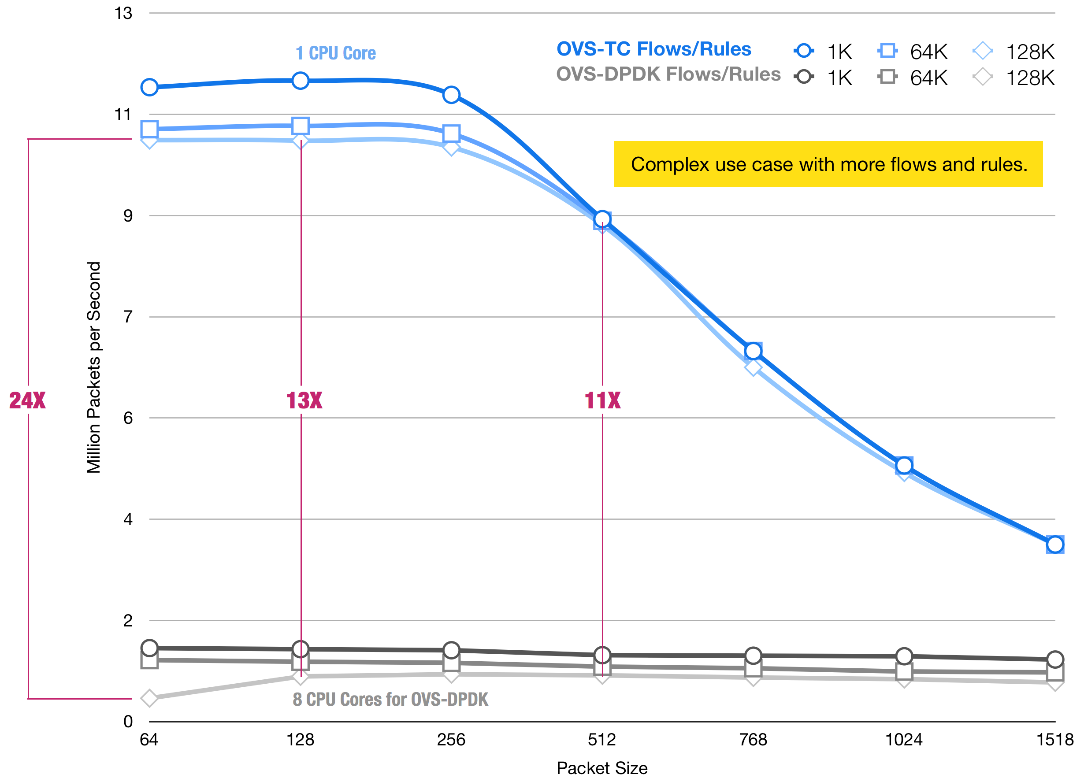
Offload Performance on SmartNIC
VXLAN encapsulated traffic
Open vSwitch rules offloaded to SmartNIC via TC
Traffic sent in physical port
Forwarded to VM and bounced back on different port

Slide 4
LAG Devices and Representors
Link Aggregation (LAG) - combine multiple ports to act as single
Load balance to increase bandwidth
Active/backup failover
Open vSwitch bonds
Combination of OvS kernel, OvS bond, LACP, high throughput - link flapping
Linux LAG devices
Linux bond, Team
Deployed in OpenStack environments
What if a Linux LAG upper device has ‘offloadable’ lower devices and is added to an OVS bridge?
ip link show
35: bond0: <BROADCAST,MULTICAST,MASTER,UP,LOWER_UP> mtu 1500 qdisc noqueue state UP
37: nfp_p0: <BROADCAST,MULTICAST,SLAVE,UP,LOWER_UP> mtu 1500 qdisc pfifo_fast master bond0 state UP
38: nfp_p1: <BROADCAST,MULTICAST,SLAVE,UP,LOWER_UP> mtu 1500 qdisc pfifo_fast master bond0 state UP

Slide 5
Egress Offload
tc -s filter show dev nfp_v0.0 ingress
filter protocol ip pref 49152 flower chain 0 handle 0x1
eth_type ipv4
in_hw
action order 1: mirred (Egress Redirect to device bond0) stolen
Kernel
TC
Bond
Team
NFP
NETDEV_CHANGELOWERSTATE
Record active/backup port states
NETDEV_CHANGEUPPER
Track new LAG upper and lower devs
Packet hash on NIC gets egress port
SmartNIC
Group 1: nfp_p0 nfp_p1
_______
Group 2:
…...
match: nfp_v0.0, ipv4, action: Group 1

Slide 6
Ingress Offload
SmartNIC is not aware of LAG devices (in-kernel representation)
If ‘bond0’ contains offloadable ports there is a need to:
Distribute filters to all lower devices
Combine stats from all lower device offload to LAG upper device/flower rule
No offload callback in the LAG drivers
Difficult for SmartNIC driver to track changes
Are there any TC features we can make use of to solve this?
tc -s filter show dev bond0 ingress
filter protocol ip pref 49152 flower chain 0 handle 0x1
eth_type ipv4
not_in_hw
action order 1: mirred (Egress Redirect to device nfp_v0.0) stolen

Slide 7
TC Shared Blocks
Introduced in Kernel 4.16
Each ingress qdisc has its own set of chains and filters called ‘blocks’
Shared blocks allow multiple qdiscs/netdevs to use the same chains/filters
Prevent duplicating rules which may not scale on, say, TCAM device offload
Each qdisc/netdev on block reports same filters and stats
Block X
tc qdisc add dev nfp_p0 ingress_block 22 ingress
tc qdisc add dev nfp_p1 ingress_block 22 ingress
tc filter add block 22 protocol ip parent ffff: flower ip_proto tcp skip_sw action drop
nfp_p0 ingress qdisc
nfp_p1 ingress qdisc

Slide 8
TC Shared Block as LAG Representations
Grouping LAG lower devices in shared blocks along with their upper device
LAG netdev hierarchy not influenced outside the TC layer
All lower devices receive same filters applied to master
Effective distribution of offloaded filters - all offload ports get callback
Stats correctly handled by default
Block X
bond0 upper netdev
bond0 upper netdev
nfp_p0 lower netdev
nfp_p1 lower netdev
nfp_p0 lower netdev
nfp_p1 lower netdev

Slide 9
TC Shared Block Offload and Re-offload
TC shared blocks call offload hook for each netdev per filter
Cannot (in 4.16 - 4.18) add new qdiscs/netdevs to block if it has offloaded rules
Filter deletion offload hooks are only triggered on block deletion
Removing a netdev from a shared block may still leave offloaded rules
LAG devices by their nature require flexible addition/removal of netdevs
[PATCH 0/7] net: sched: support replay of filter offload when binding to block (kernel 4.19)
Add the ability to replay offloaded filters when a new callback is registered
Replay ‘delete’ filter messages for each netdev on block withdrawal

Slide 10
Working with Open vSwitch
Open vSwitch 2.10
[Patch 0/6] offload Linux LAG devices to the TC datapath
Add shared block ID support to OVS-TC API
Track Linux kernel netdevs and record LAG info
If a LAG upper dev is added to the OVS bridge, assign its qdisc a unique block ID
If a lower dev’s related upper dev is on the OVS bridge then associate it with the upper devices block
ovs-vswitchd
User Space
Kernel
TC Datapath
Block X
Upper Dev Qdisc
Lower Dev 1 Qdisc
Lower Dev 2 Qdisc
NFP Driver
SmartNIC
NFP SmartNIC
Lower Device 1 filters/stats
Lower Device 2 filters/stats

Slide 11
Thank You

